Slide 1
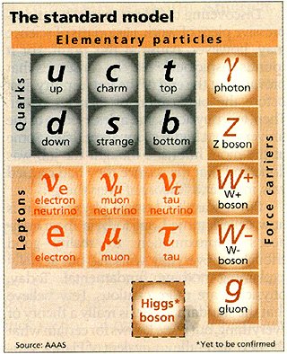
Higgs Boson
Elizabeth R McMahon
14 April 2017

Slide 2
Table of Contents
Introduction
Discovery of the Higgs Boson
Importance of Higgs
ML Challenge
Data Description
Introduction to Variables
Important Ideas
Data Exploration
Models
Decision Tree
Conditional Inference Decision Tree
Random Forest
Logistic Regression
Naïve Bayes
Results/Discussion
Conclusions
References

Slide 3
Introduction

Slide 4
Discovery of the Higgs Boson
Announced July 4th, 2012
LHC-CERN, Switzerland
ATLAS and CMS Experiments

Slide 5
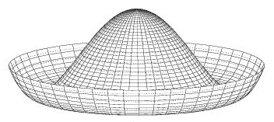
Importance of Higgs
Interactions with Higgs field gives other particles mass

Slide 6
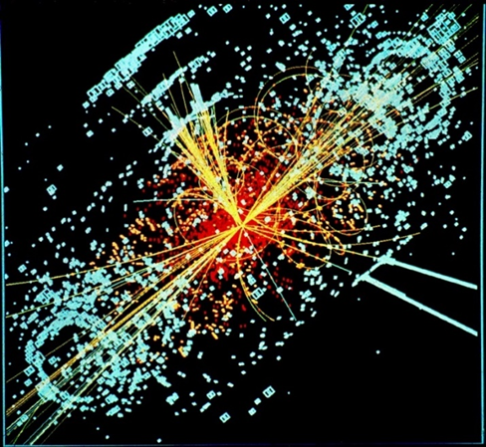
Method of Discovery

Slide 7
CERN physicists & data scientists simulated data set mimicking ATLAS results
GOAL: optimize classification and characterization of Higgs Events using ML techniques

Slide 8
Data Description

Slide 9
Training Set: 250,000 collisions
Test Set: 500,000 collisions
Computational Problems!
Reduced data set to 5000 collisions
(Random sample)

Slide 10
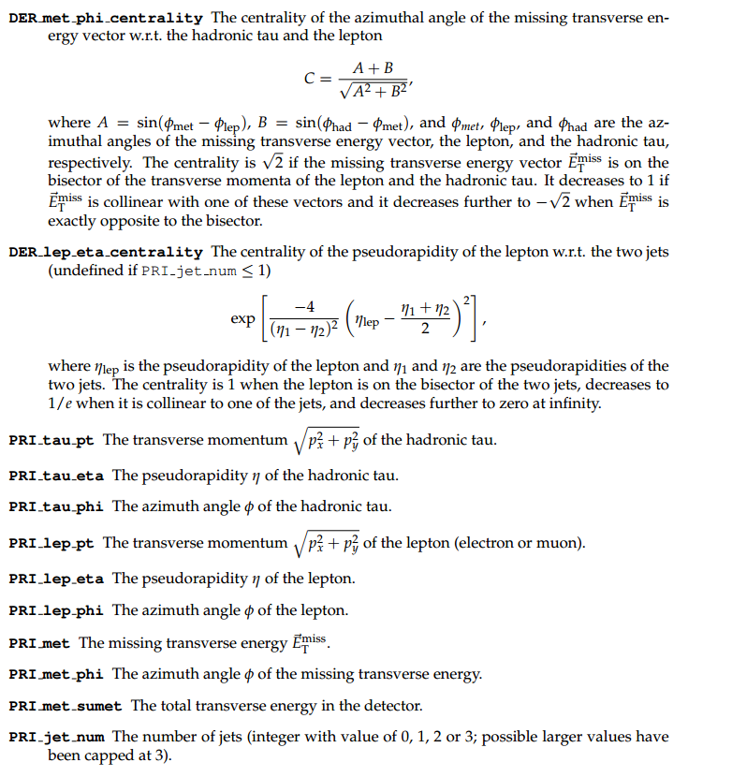
Variables I

Slide 11
Variables II
Feature Engineering is difficult for this data without having a particle physics background!
So the CERN physicists did the engineering for us → DER variables
*DER: derived value
PRI: primitive (raw)

Slide 12
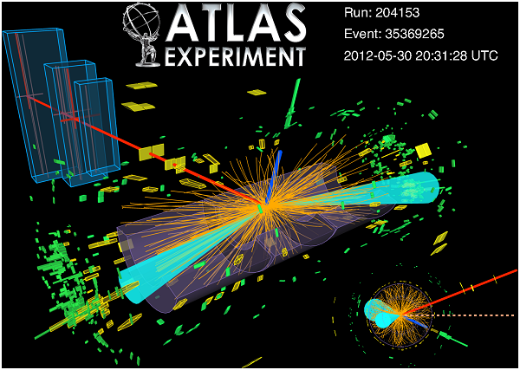
Important Ideas
Measuring
Angles
Velocities
Masses
Energies
Momentum
Number of jets
Distances

Slide 13
Data Exploration

Slide 14
Analysis of Raw Data
Simple functions run to find ratio of signal vs. background on training set

Slide 15
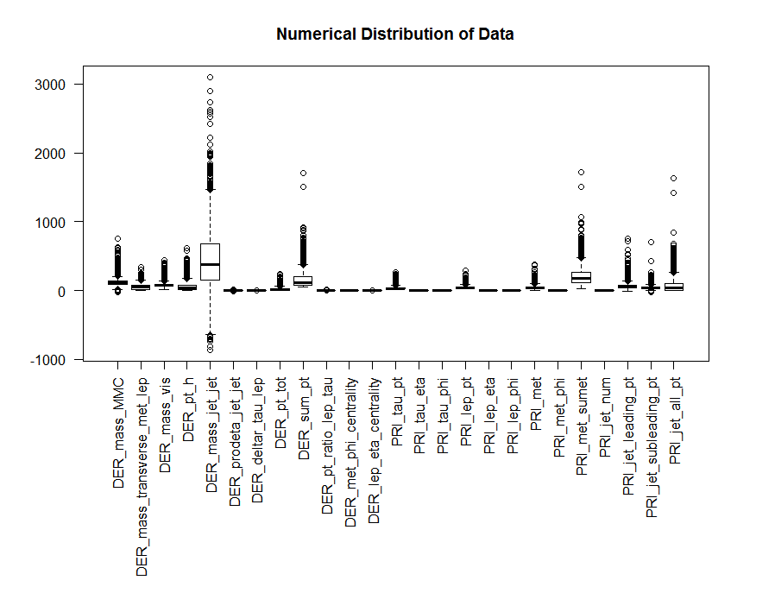
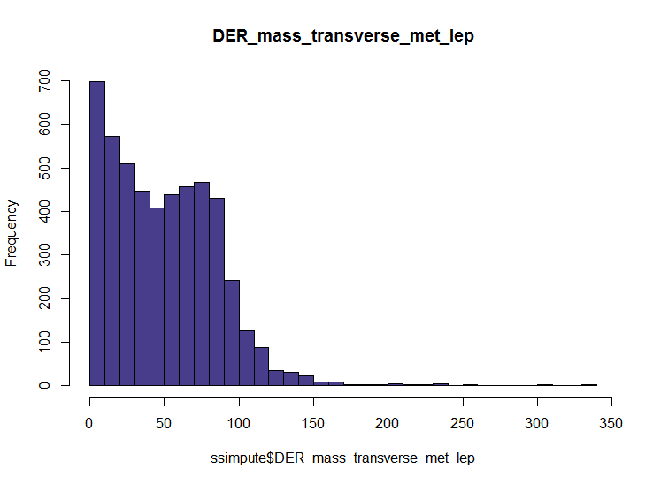
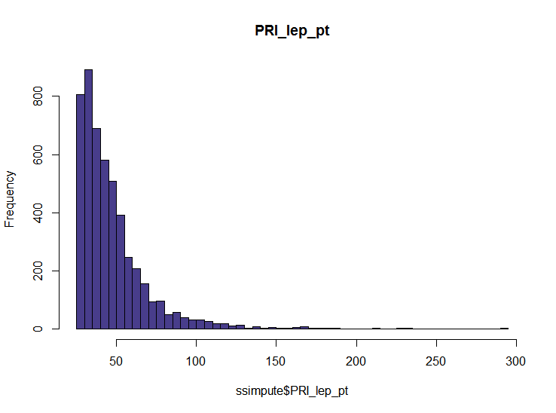

Slide 16
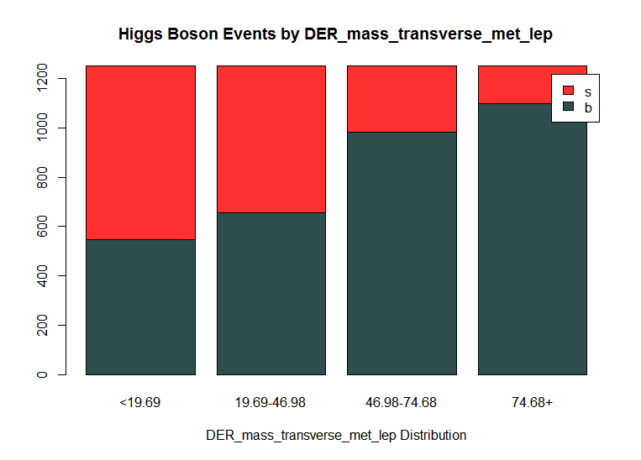
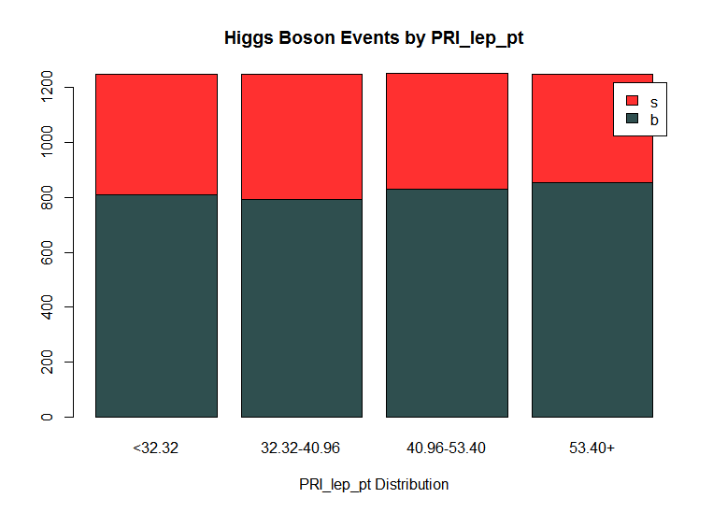

Slide 17
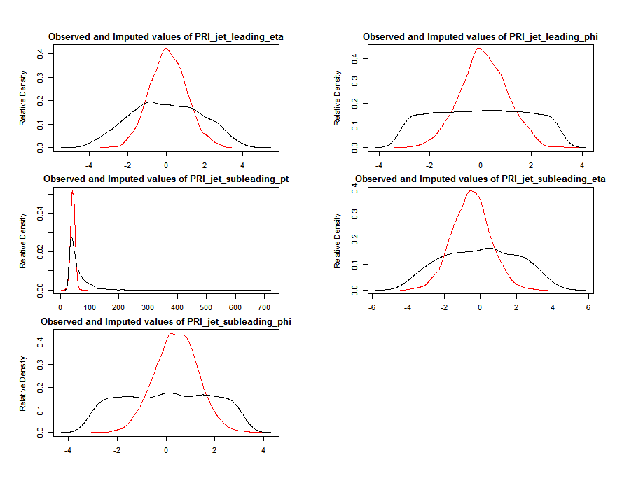
Missing Data

Slide 18
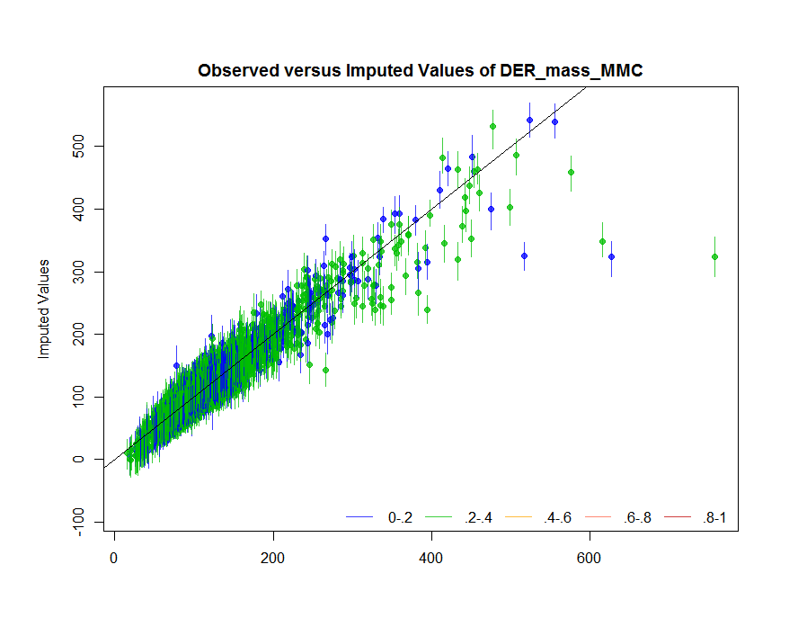
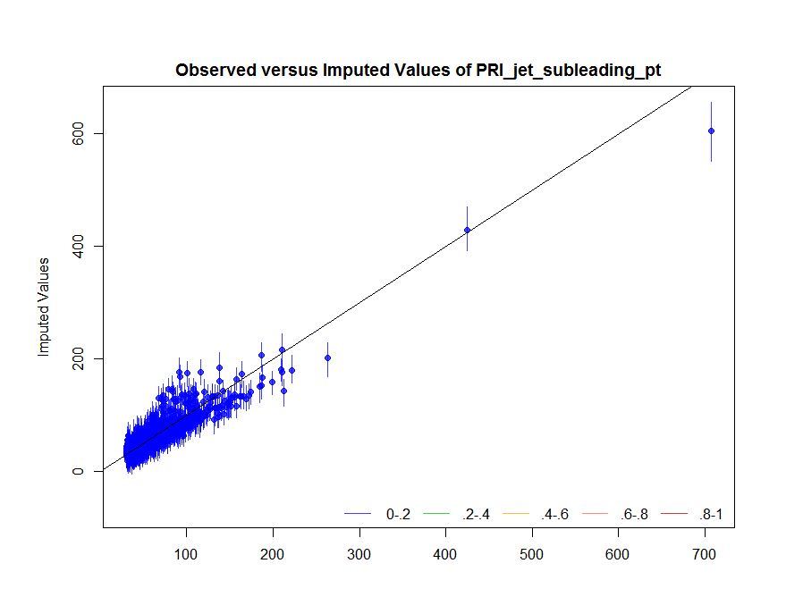
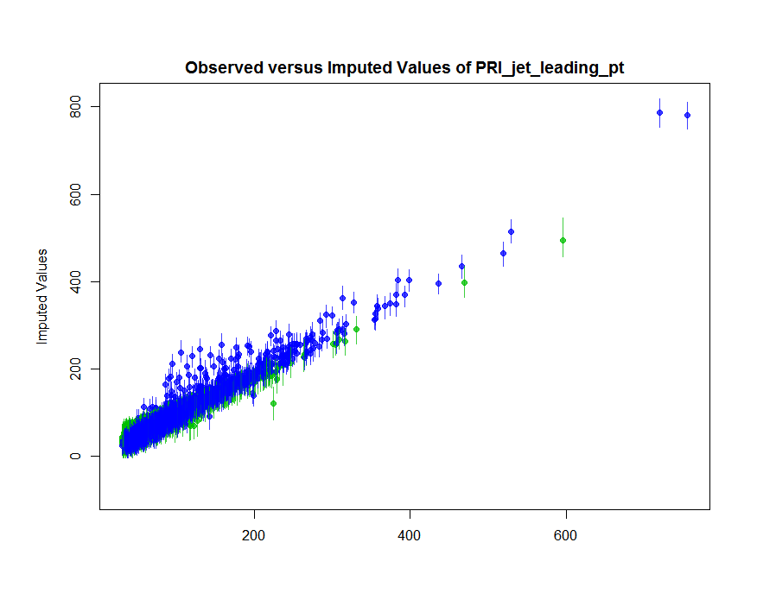
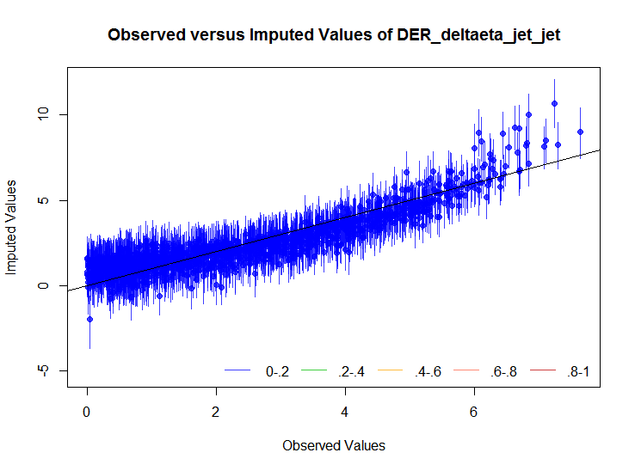
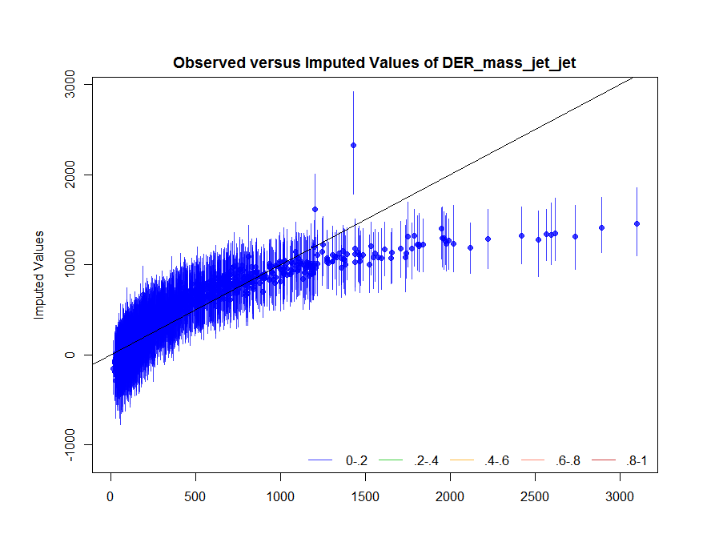
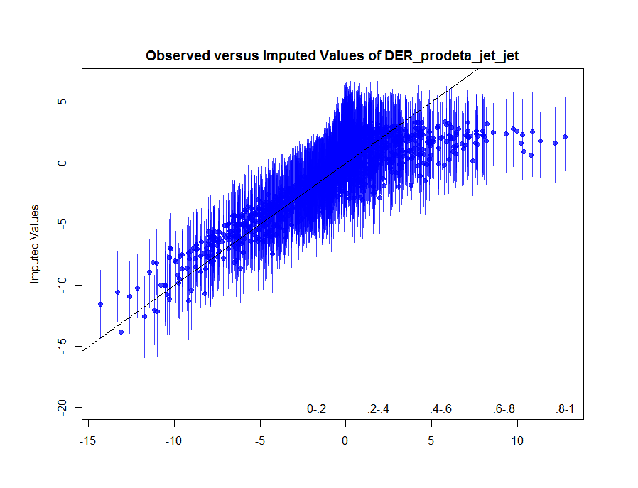
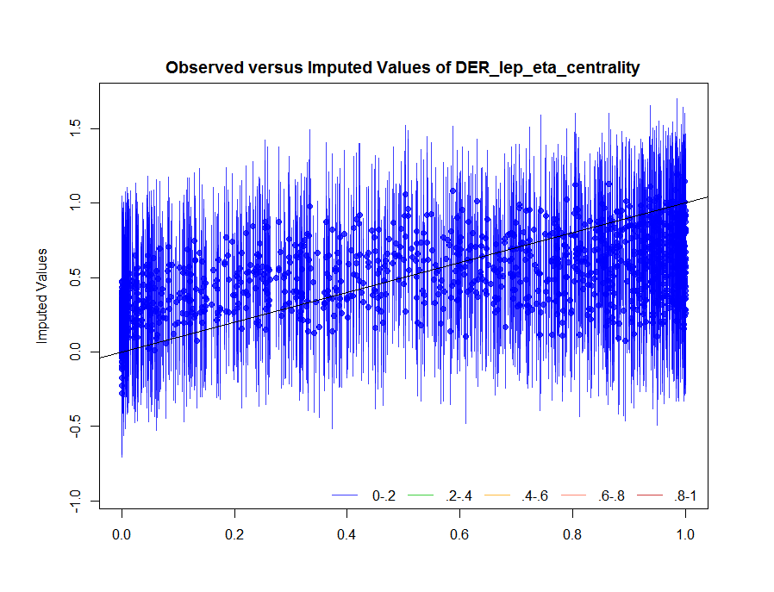
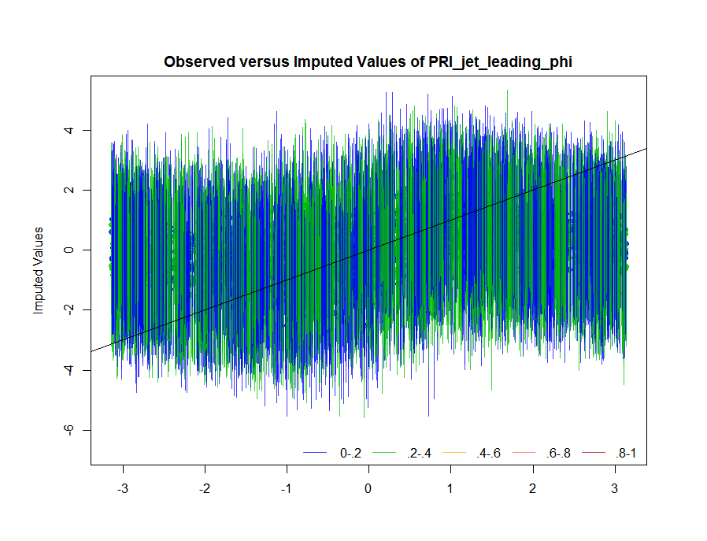
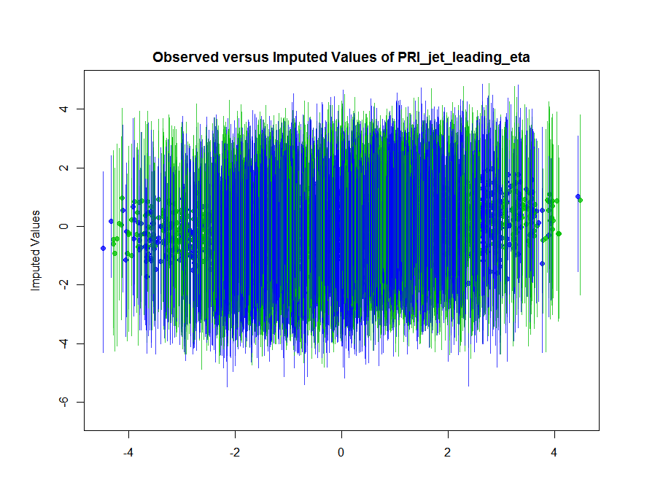
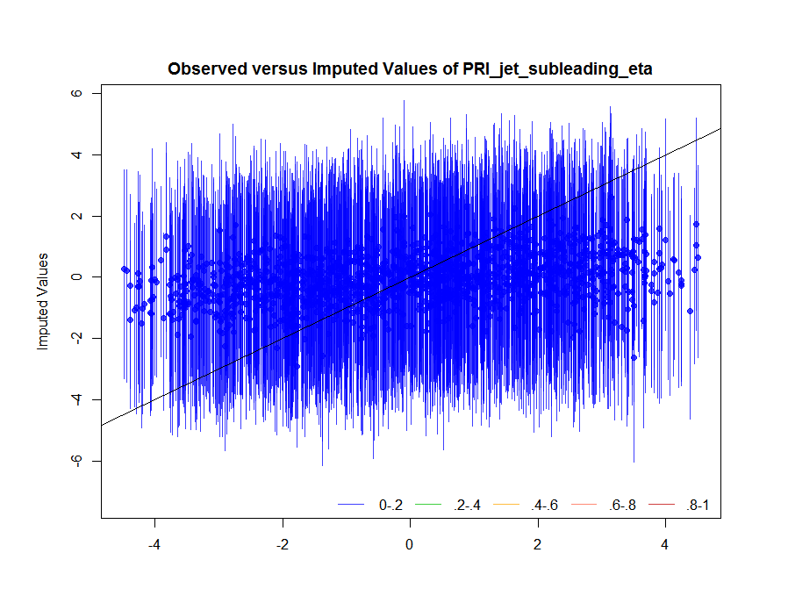
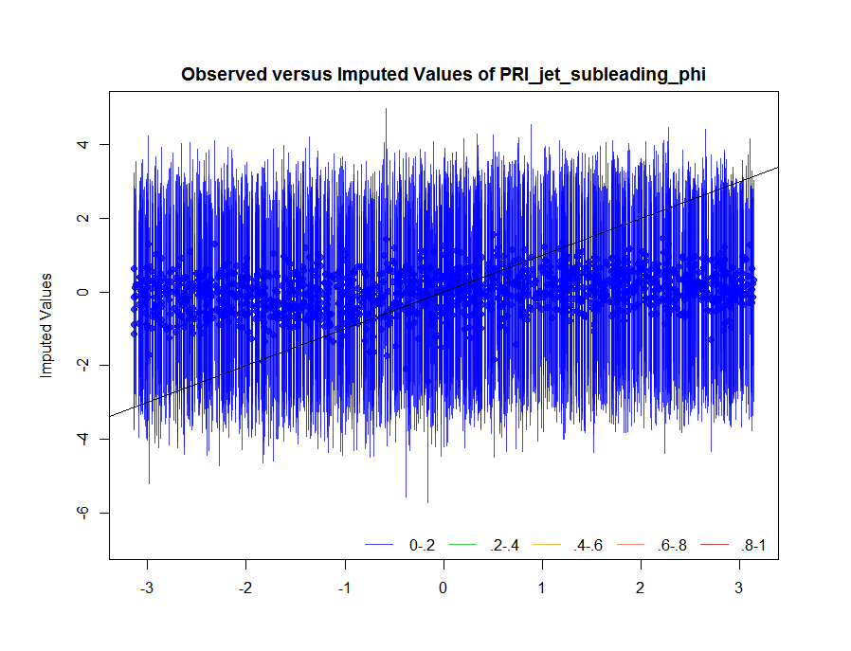

Slide 19
Models

Slide 20
Decision Tree
Every variable checked at every level
Biggest split
Tell tree when to stop growing (vary complexity parameter)

Slide 21
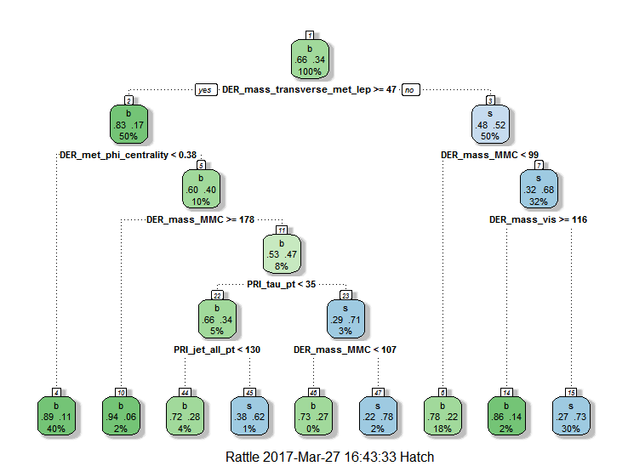
Example of Decision Tree in Use
Event 290849
DER_mass_MMC | DER_mass_transverse_met_lep | DER_mass_vis | DER_pt_h
124.586 | 0.010 | 49.545 | 200.535
DER_mass_jet_jet | DER_prodeta_jet_jet | DER_deltar_tau_lep | DER_pt_tot | DER_sum_pt
70.110000 | 0.96100000 | 1.849 | 59.745 | 200.867
DER_pt_ratio_lep_tau | DER_met_phi_centrality | DER_lep_eta_centrality | PRI_tau_pt | PRI_tau_eta
1.815 | 1.000 | 0.99900000 | 20.984 | 0.097
PRI_tau_phi | PRI_lep_pt | PRI_lep_eta | PRI_lep_phi | PRI_met | PRI_met_phi | PRI_met_sumet
-0.127 | 38.088 | 1.109 | -1.674 | 160.847 | -1.674 | 256.460
PRI_jet_num | PRI_jet_leading_pt | PRI_jet_subleading_pt | PRI_jet_all_pt | Label
2 | 94.69500 | 47.100000 | 141.795 | s

Slide 22
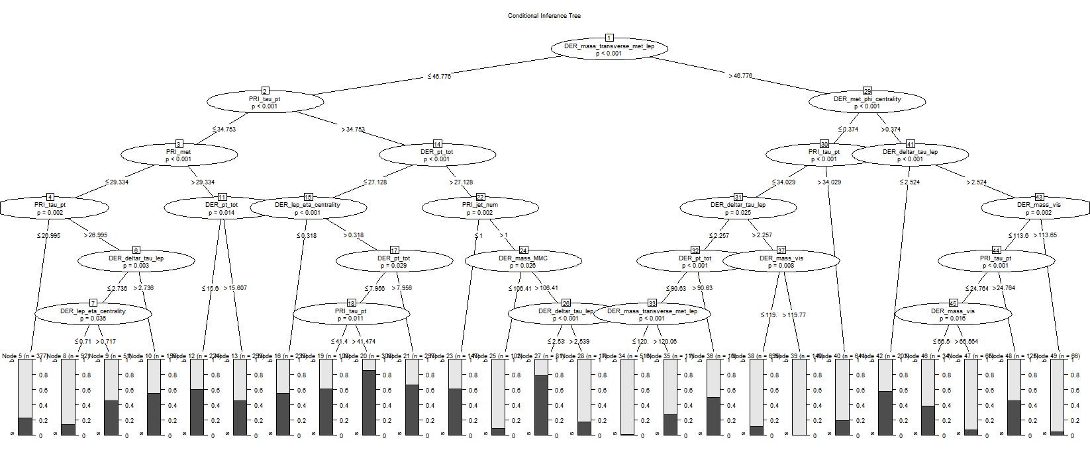
Conditional Inference Tree
Statistical significance

Slide 23
Random Forest
Array of decision trees
Reduces error

Slide 24
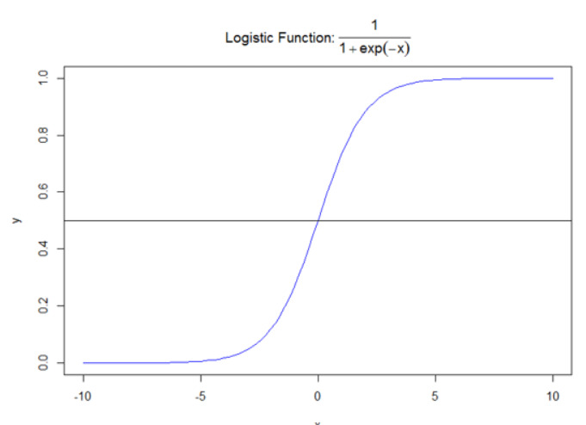
Logistic Regression
Discrete classification

Slide 25
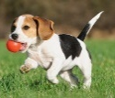
Naïve Bayes
Properties of an unknown:
Barks? NO
Fluffy? YES Energetic? YES
$$\text{P}\text{(}\text{dog}\text{|}\text{fluffy}\text{, }\text{energetic}\text{)}$$
$\text{=}\text{P}\text{(}\text{dog}\text{)∗}\text{P}\text{(}\text{fluffy}\text{|}\text{dog}\text{)∗}\text{P}\text{(}\text{energetic}\text{|}\text{dog}\text{)}$*P(no bark|dog)
$\text{P}\text{(}\text{fluffy}\text{)∗}\text{P}\text{(}\text{energetic}\text{)}$*P(no bark)
=(0.44)(0.61)(0.60)(0.07)
(0.59)(0.72)(0.52)
=0.05
P(cat…)=0.11
P(fish…)=0
PET | Barks |  | Fluffy |  | Energetic
 | Yes | No | Yes | No | Yes | No
Cat | 1 | 39 | 35 | 5 | 25 | 15
Dog | 50 | 5 | 55 | 0 | 40 | 15
Fish | 0 | 30 | 0 | 30 | 3 | 27
Prior Probabilities (Base Rates)
$P\left(cat\right)=\frac{40}{125}=0.32$
$P\left(dog\right)=\frac{55}{125}=0.44$
$P\left(fish\right)=\frac{30}{125}=0.24$
Evidence Probabilities
$P\left(barks\right)=\frac{51}{125}=0.41$
$P\left(fluffy\right)=\frac{90}{125}=0.72$
$P\left(energetic\right)=\frac{65}{125}=0.52$
Likeliihood Probabilities
$P\left(barks|cat\right)=\frac{1}{51}=0.0$2
$P\left(fluffy|cat\right)=\frac{35}{90}=0.39$
…
$P\left(energetic|fish\right)=\frac{3}{67}=0.045$

Slide 26
Assumes variables are independent and normalized

Slide 27
Results/Discussion

Slide 28
Accuracies
Rank | Model | Accuracy
1 | Logistic Regression | 82.27
2 | Random Forest | 81.88
3 | Decision Tree | 80.40
4 | CI Decision Tree | 76.20
5 | Naïve Bayes | 74.90

Slide 29
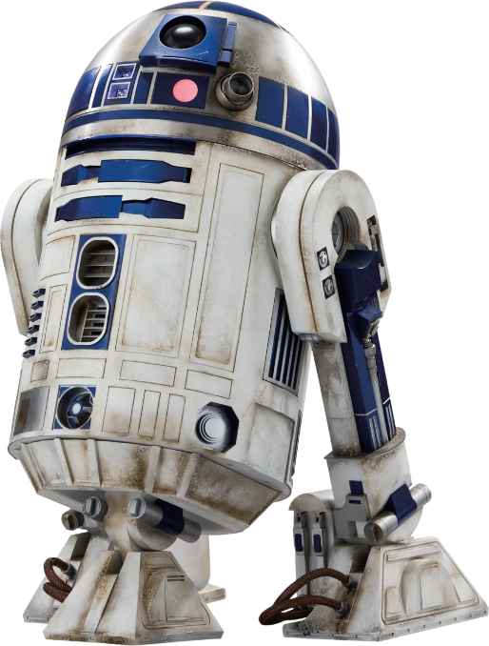
% ‘right’ answers
PROS: simple calculation
CONS: not good judgement
Ex. FIREFIGHTING-Robots
Good at predicting true negatives (TN)→ house not on fire
Bad at predicting true positives (TP) → house on fire
98% of houses are not on fire → by not acting 100% of the time, they are 98% accurate. But 2% of houses are on fire.

Slide 30
Confusion matrices
Precision and Recall [0,1]
Precision: $\frac{\# true positives}{\#predicted positives}$
Recall: $\frac{\# true positives}{\# actual positives}$
F₁Score=$2\frac{PR}{P+R}$

Slide 31
Robot Firefighter Example
Accuracy$=\frac{25+75}{125}=0.80$
Precision$=\frac{25}{25+15}=0.63$
Recall$=\frac{25}{25+10}=$0.71
F₁ Score$=\frac{2\left(0.63∗0.71\right)}{0.63+0.71}$=0.67
 |  | 1 | 0
 | 1 | 25 | 15
 | 0 | 10 | 75
actual
Predicted

Slide 32
F₁ Scores
Model | Precision | Recall | F₁Score
Logistic Regression | 0.975136 | 0.664725 | 0.790551
Random Forest | 0.775886 | 0.663753 | 0.715452
Decision Tree | 0.692308 | 0.72439 | 0.707986
CI Decision Tree | 0.65037 | 0.666667 | 0.658417
Naïve Bayes | 0.639612 | 0.615385 | 0.627265

Slide 33
Variable Importance
1
2
3
Most model packages had a built-in “variable importance” functions
Able to determine how each model ranked the influence/importance of variables
4
*CI Decision Tree excluded as variable importance not built-in

Slide 34
Variable Importance
Variable | Decision Tree | Random Forest | Logistic Regression | Naïve Bayes | Mean | Median
DER_mass_transverse_met_lep | 2 | 2 | 1 | x | 1.67 | 2
DER_mass_MMC | 1 | 1 | 19 | 4 | 6.25 | 2.5
DER_met_phi_centrality | 3 | 4 | 5 | 2 | 3.50 | 3.5
DER_mass_vis | 4 | 3 | 4 | 10 | 5.25 | 4
DER_pt_ratio_lep_tau | 5 | 8 | 3 | x | 5.33 | 5
PRI_tau_pt | x | 6 | 21 | 1 | 9.33 | 6
DER_deltar_tau_lep | 7 | 5 | 2 | 17 | 7.75 | 6
DER_pt_h | 8 | 9 | 16 | 5 | 9.50 | 8.5
DER_sum_pt | 6 | 11 | 22 | 3 | 10.50 | 8.5
PRI_jet_num | 11 | 20 | 6 | 9 | 11.50 | 10
PRI_met_sumet | x | 10 | 14 | 7 | 10.33 | 10
DER_mass_jet_jet | 10 | 17 | 11 | 12 | 12.50 | 11.5
PRI_jet_leading_pt | 15 | 13 | 10 | 8 | 11.50 | 11.5
PRI_jet_all_pt | 12 | 12 | x | 6 | 10.00 | 12
DER_lep_eta_centrality | 13 | 15 | 8 | 11 | 11.75 | 12
PRI_met | 21 | 7 | 7 | 20 | 13.75 | 13.5
PRI_lep_eta | 9 | 19 | 15 | 15 | 14.50 | 15

Slide 35
Conclusion/Future Work

Slide 36
Predict phenomena in my field, use it as a tool to better understand chemistry
Talk to Dr. Chen/Dr. Vidden!
ML is cool!

Slide 37
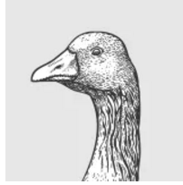
References
Thank you to:
Dr. Vidden
Dr. Ragan
Dr. Lesher
Dr. Chen

Slide 38
Questions?

Slide 39
CI Tree
DER_mass_transverse_met_lep
p<0.001
≤46.776
>46.776
PRI_tau_pt
p<0.001
DER_met_phi_centrality
p<0.001
≤34.753
≤0.374
>0.374
>34.753

Slide 40
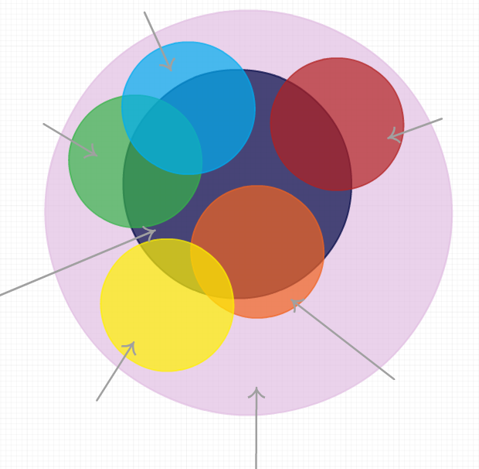
V₅<X₅
V₄<X₄
V₁<X₁
Higgs (s)
V₂<X₂
V₃<X₃
Collisions

