Slide 1

A Systematic Approach to Appointing Patients to Providers
Team #4
Megan Dehn
Kathryn Swiecichowski
Simon Ulik
Notes:
Hi everyone, I’m Megan, Kathryn, Simon…we have just passed out some brochures you can look at throughout our presentation, just note that the figures are not in sequential order. We have been working with LHI over the course of this semester and we are really excited to show you our systematic approach to appointing service members to providers.

Slide 2
Introduction
Problem Statement
Provider Scoring Algorithm
Maximum Range
Results
Conclusions
Notes:
We will first discuss our problem statement, which we have solved with our provider scoring algorithm. One key feature we have implemented into our algorithm is the maximum range, and the results we have found. Lastly, we will discuss our conclusions we can draw from these results.

Slide 3

Problem Statement
Notes:
This is our problem statement

Slide 4
Problem Statement
LHI assigns the cheapest provider within a 60 mile radius
Increase in Reschedules
Far distance
Notes:
When LHI is appointing patients to the cheapest providers, the company usually stays within a 60 mile radius. Because this radius is so big, this causes an increase in reschedules.

Slide 5
Amount of Reschedules
An average of 15% of appointments are being rescheduled each year
Notes:
Seen here, there is an average of 15% of appointments being rescheduled each year after the duplicated rescheduled data is deleted. This is why it’s a problem.

Slide 6
Problem Statement
Patients reschedule
Cost is higher for LHI
Closest provider is chosen, regardless of cost
Notes:
Our second problem that we found is when a patient If a patient calls LHI to reschedule, the customer service representative assigns the patient to the closest Provider regardless of price, so this makes the cost higher for LHI.

Slide 7
Rescheduled Cost
T-test Between Mean Price of Original and Final Appointments
Rescheduled Appointment Year | Mean Price of Original Appointment | Mean Price of Final Appointment | T-test (If P < 0.001, the change is significant)
2017 | 3.46 | 3.92 | <0.001
2016 | 3.84 | 4.39 | <0.001
2015 | 2.77 | 2.79 | 0.06
2014 | 3.70 | 4.06 | <0.001
2013 | 6.11 | 6.99 | <0.001
2012 | 5.48 | 5.51 | 0.05
After rescheduling an appointment, the cost will increase while the distance decreases
Notes:
In this figure, we see
The original appointment
The appointment after LHI rescheduled
5/6
Small t score = groups are similar
Large t score = groups are different

Slide 8
Problem Statement
Minimizing reschedules while keeping cost low
LHI assigns the cheapest provider within a 60 mile radius
Increase in Reschedules
Increases distance
Patients reschedule
Cost is higher for LHI
closest provider is chosen, regardless of cost
Provider Scoring Algorithm
Notes:
We have two problems, and in to solve both of these problems, we were able to take both of them and solve them at once with our provider scoring algorithm.

Slide 9
Problem Statement
How we reduce distance at a reasonable cost
 | Cost | Distance
Initial Appointments | Low | Far
Our Algorithm | Middle | Middle
Final Rescheduled Appointments | High | Close
In Wisconsin, we reduced cost by 7.6%
In Wisconsin, we reduced distance by 34%
Notes:
Successfully, our algorithm shows that we reduced….

Slide 10
Provider Scoring Algorithm

Slide 11
Process
Notes:
Be much more brief with this slide
Katie- Explain this slide

Slide 12
Calculating the Provider Score
Patient and Service
Patient_Addresses
Provider_Addresses
Data Sets:
Provider_Costs
Provider Scoring Merged Set
Patient ID
Service ID
City
State
Latitude
Longitude
Latitude
Longitude
Provider Cost
Distance
Provider Score

Slide 13
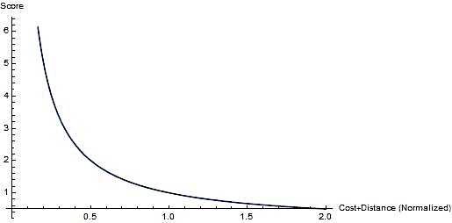
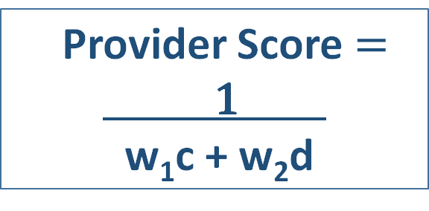
Calculating the Provider Score
Provider Score$=$
1
w₁c + w₂d
w₁ = distance weight
w₂ = cost weight
c = cost​ (normalized)
d = distance​ (normalized)
Notes:
Simon- discuss how LHI can weight the cost and distance values.

Slide 14
Service 10500
 | Patient ID | Provider ID | Service ID | Provider Cost | Distance | Provider Score
1 | x | a | 10500 | 1.2 | 6.088 | 1.257
2 | x | b | 10500 | 1.3 | 5.747 | 1.181
3 | x | c | 10500 | 1.3 | 6.434 | 1.164
4 | x | d | 10500 | 1.594 | 6.173 | 0.978
5 | x | e | 10500 | 0.9 | 48.226 | 0.722
6 | x | f | 10500 | 0.9 | 55.335 | 0.66
7 | x | g | 10500 | 1.75 | 36.247 | 0.604
8 | x | h | 10500 | 1.658 | 40.898 | 0.593
Notes:
This is the foundation of our code and what our algorithm currently does. You can see that it does output this list of provider score, but we want to make it better by implementing a maximum range.

Slide 15
Maximum Range
Notes:
Determine which provider receives a specific provider score when distance and cost are minimized

Slide 16
Maximum Range
60 miles
City
(population)
Maximum Range
More reasonable list of Provider Scores
Service (frequency)
Notes:
Two examples- one for city, one for service
Flu shot, metropolitan area
Heart surgery, rural,
Each patient should be treated with different providers
Inform our choice of maximum range

Slide 17

Notes:
Sally lives in a metropolitan city, We want to create a maximum range she will prefer to travel in.
Jack needs heart transplant. He will consider traveling that maximum 60 miles. (more willing to).
From here, we see that

Slide 18



Maximum Range
Acceptable mileage unique to each city
Acceptable mileage unique to each Service ID
Rho $\text{(}\text{ρ}\text{)}$
Mu$\text{(µ)}$
Maximum Range = $\frac{\text{(}\text{ρ}\text{ + }\text{µ}\text{)}}{2}$
Notes:
Because of these different circumstances, we have considered mu and rho into our algorithm
Average

Slide 19
Determining Rho
 | MEDIAN | Appleton | Green Bay | La Crosse | Madison | Milwaukee | Middleton | Rhinelander | Wautoma | Oshkosh
Appleton | 29 | 1
Green Bay | 9 | * | 1
La Crosse | 40 | * | * | 1
Madison | 12 | * | * | * | 1
Milwaukee | 9 | * | * | * | * | 1
Middleton | 12 | * | * | * | 0.726 | * | 1
Rhinelander | 29 | * | * | * | * | * | * | 1
Wautoma | 74 | * | * | * | * | * | * | * | 1
Oshkosh | 14 | * | * | * | * | * | * | * | * | 1
* = A statistically significant difference in the median distances traveled for a selected sample of cities
Notes:
The population densities of the cities are very similar
Because of this, we want to find an adjustment for every city in the nation

Slide 20
Determining Rho
Subset dataset to reschedules concerning distance
Median mileage value calculated for each city
Maximum Range Merged Set
Final Provider ID
Patient ID
Change Reasons for First Change
City
Mileage

Slide 21
Reschedules Concerning Distance
T-test between Original and Final Mileage
Reasons for Reschedule
Reasons concerning distance
 | Number in Sample | Average Original Mileage | Average Final Mileage | P-Value
Other | 8963 | 27 | 25 | <0.001
Per Customer Request | 7154 | 25 | 15 | <0.001
SM Requested Provider Change | 22,199 | 29 | 14 | <0.001
Employee will not use selected provider | 22,104 | 30 | 15 | <0.001
Reasons not concerning distance
Blanks | 923 | 26 | 29 | 0.34
Per Customer - Appointment | 3 | 8 | 32 | 0.44
Minimizing reschedules by 34%
Notes:
Like Kathryn just explained, we decided to subset reschedules to reasons concerning distance. Although none of the reasons explicitly say that they're related to distance, we decided that if average original mileage is higher and it’s final mileage is lower…
Reasons due to distancewas actually 34%, which is smaller than past years.

Slide 22
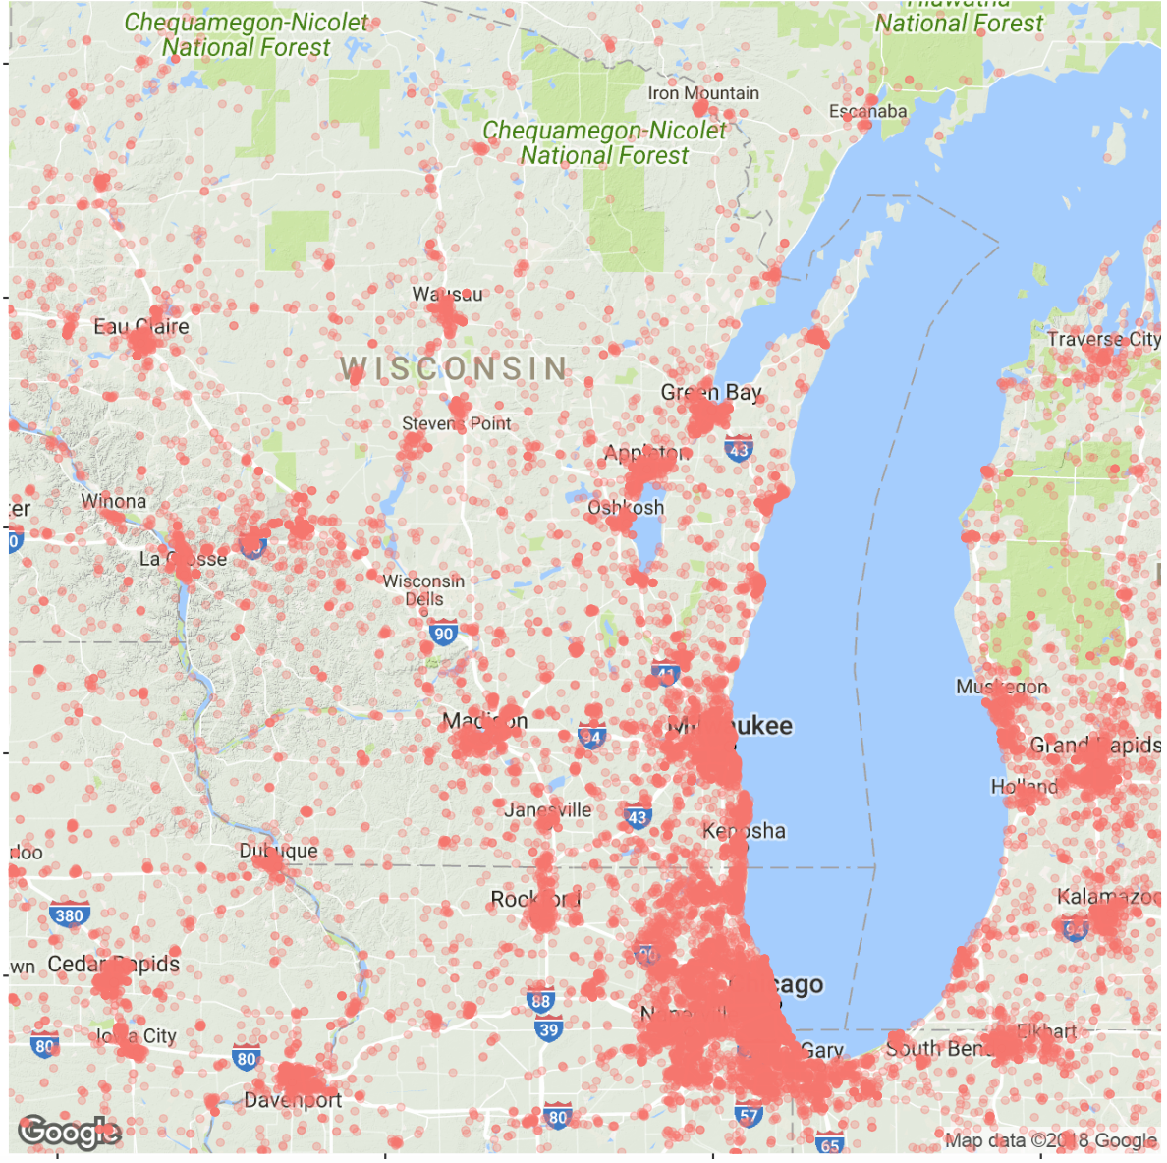
Rho Analysis
Patient Distribution
Rho Values for Arbitrary WI Cities
Waupaca | 33
Salem | 20
Black Creek | 17
Oshkosh | 11
Madison | 11
Milwaukee | 10
Metropolitan City = smaller Rho value
Rural City =
larger Rho Value
Notes:
In a crowded place, the tolerance for distance is low.
Verifies our assumption of rho.
When there are more patients, people tend to travel closer for certain services, which verifies our assumption for rho .

Slide 23
Determining Mu
 | MEDIAN | 10500 | 10213 | 12047 | 10623 | 12131 | 12073
10500 | 16 | 1
10213 | 29 | * | 1
12047 | 28 | * | 0.018 | 1
10623 | 22 | * | * | * | 1
12131 | 29 | * | 0.028 | 0.042 | * | 1
12073 | 34 | * | 0.07 | * | * | 0.592 | 1
* = A statistically significant difference in the median distances traveled for a selected sample of Service Codes

Slide 24
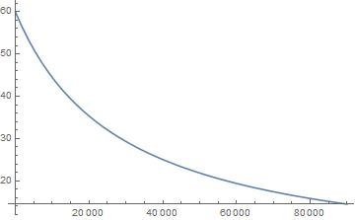
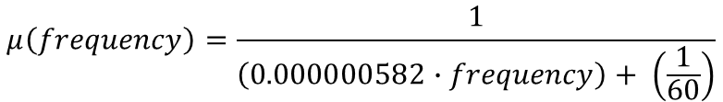
Determining Mu
$$μ\left(frequency\right)=\frac{1}{\left(0.000000582∙frequency\right)+ \left(\frac{1}{60}\right)}$$
Notes:
Give simple examples to put it into perspective

Slide 25
Mu Analysis
Service ID | Mu | Service Description
12215 | 58 | Traumatic Brain Injury
10545 | 19 | Vision
15000 | 18 | Dental Diagnostic
10500 | 17 | Audio
64031 | 15 | Dental Periodic Health Assessment
Notes:
Inverse exponential- No less than 15- not any more than 60. NEW values

Slide 26
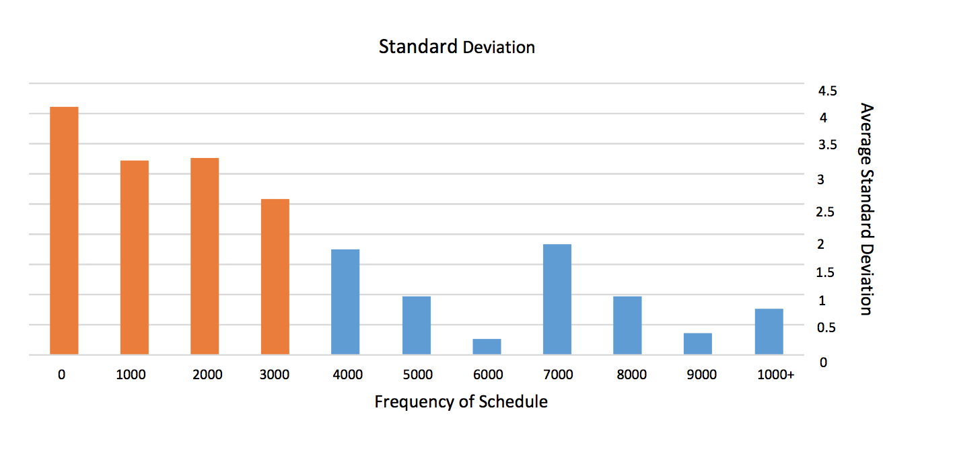
Mu Analysis
10,000+
Notes:
NEED to change these colors

Slide 27
Service 10500
 | Patient ID | Provider ID | Service ID | Provider Cost | Distance | Provider Score
1 | x | a | 10500 | 1.2 | 6.088 | 1.257
2 | x | b | 10500 | 1.3 | 5.747 | 1.181
3 | x | c | 10500 | 1.3 | 6.434 | 1.164
4 | x | d | 10500 | 1.594 | 6.173 | 0.978
5 | x | e | 10500 | 0.9 | 48.226 | 0.722
6 | x | f | 10500 | 0.9 | 55.335 | 0.66
7 | x | g | 10500 | 1.75 | 36.247 | 0.604
8 | x | h | 10500 | 1.658 | 40.898 | 0.593
Before applying Mu and Rho into our algorithm
 | Patient ID | Provider ID | Service ID | Provider Cost | Distance | Provider Score
1 | x | a | 10500 | 1.2 | 6.088 | 0.588
2 | x | b | 10500 | 1.3 | 5.747 | 0.585
3 | x | c | 10500 | 1.3 | 6.434 | 0.551
4 | x | d | 10500 | 1.594 | 6.173 | 0.51
After applying Mu and Rho into our algorithm
Notes:
Example service- answers enclosed

Slide 28
Results

Slide 29
Comparing Costs
If LHI were to use our algorithm in 2017 for WI, they would have reduced the cost of the original appointment by
14.28%
Notes:
Cost; yours; distance
Give percentage of how much $ we save
Make bar charts!

Slide 30
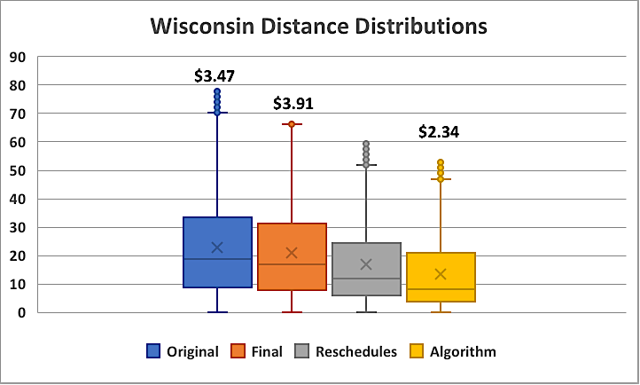
Results in Wisconsin
Results: Wisconsin, 2017

Slide 31
Results: Metropolitan Cities
Notes:
Works better for metropolitan

Slide 32
Results: Suburban Cities
Notes:
Katie- Explanations for why was this happening
Why are the La Crosse costs higher?

Slide 33
Results: Rural Cities

Slide 34
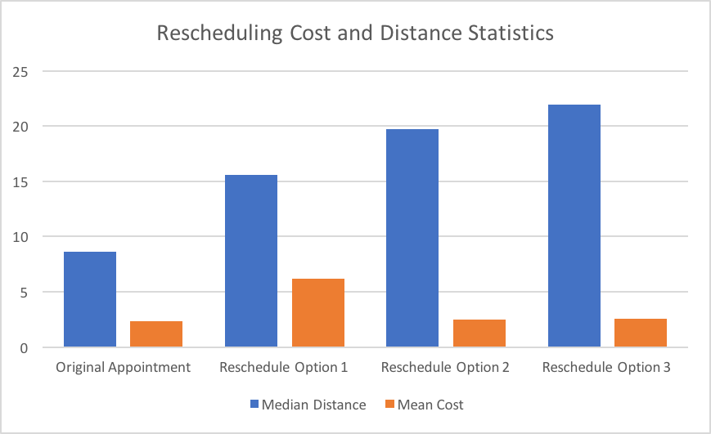
Rescheduling
22
20
16
8
7
3
3
3
Rank 1
Rank 2
Rank 3
Rank 4

Slide 35
Recommendations
Our algorithm can be used for
Rescheduling Call Center
Website
Notes:
Algorithm can be easily coded into their system
We suggest website picks first list, and assign patient to first
Automatic rescheduling online, so patient doesn’t have to call customer service representative

Slide 36
Conclusions
Developed an algorithm that minimizes the following
Number of reschedules
Cost
Notes:
Algorithm can be easily coded into their system
We suggest website picks first list, and assign patient to first
Automatic rescheduling online, so patient doesn’t have to call customer service representative
LHI faced 2 prob
We designed alg to solve problem at same time
Which is surprising because we have minimized

Slide 37
Future Work
Use driving distance in provider scoring
Incorporate additional variables (provider capacity)
Analyze regional coverage
Improve our Service Frequency Range Adjustment
Notes:
google map package
We are getting shorter distance and shorter cost- there is something we are missing, is it capacity?
Integrate Mu better, finding that Mu

Slide 38
Acknowledgements
UW La Crosse Mathematics Department- Industrial Mathematics
Faculty Advisors: Dr. Song Chen and Dr. Chad Vidden
Logistics Health Incorporated (LHI)

