Slide 1
MTH 445/545
Linear Regression and Correlation
Regression analysis is a statistical tool that utilizes the relation between two or more quantitative variables so that one variable can be predicted from the other, or others.
Some Examples:
  Height and weight of people
  Income and expenses of people
  Production size and production time
  Soil pH and the rate of growth of plants

Slide 2
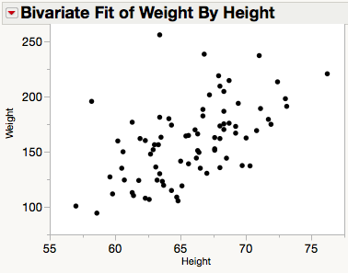

Correlation
An easy way to determine if two quantitative variables are linearly related is by looking at their scatterplot.
Another way is to calculate the correlation coefficient, denoted usually by r.
The Linear Correlation measures the strength of the linear relationship between explanatory variable (x) and the response variable (y). An estimate of this correlation parameter is provided by the Pearson sample correlation coefficient, r.
Note: -1 ≤ r ≤ 1.

Slide 3
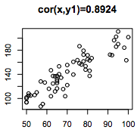
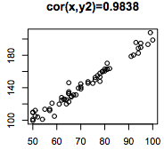
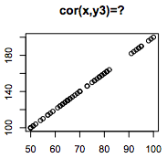
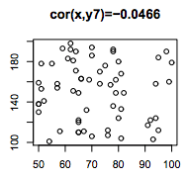
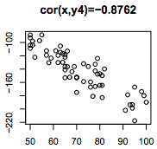
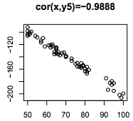
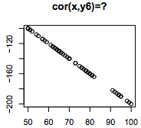
Example Scatterplots with Correlations
If X and Y are independent, then their correlation is 0.

Slide 4
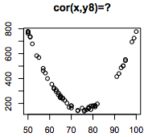
Correlation
If the correlation between X and Y is 0, it doesn’t mean they are independent. It only means that they are not linearly related.
Some Guidelines in Interpreting r.
One complain about the correlation is that it can be subjective when interpreting its value. Some people are very happy with r≈0.6, while others are not.
Value of |r| | Strength of linear relationship
If |r|≥ 0.95 | Very Strong
If 0.85 ≤ |r|< 0.95 | Strong
If 0.65 ≤ |r|< 0.85 | Moderate to Strong
If 0.45 ≤ |r|< 0.65 | Moderate
If 0.25 ≤ |r|< 0.45 | Weak
If|r|< 0.25 | Very weak/Close to none
Note: Correlation does not necessarily imply Causation!

Slide 5
Simple Linear Regression
Model: Y_{i}=(β₀+β₁x_{i}) + ε_{i}
where,
  Y_{i} is the i^{th} value of the response variable.
  x_{i} is the i^{th} value of the explanatory variable.
  ε_{i}’s are uncorrelated with a mean of 0 and constant variance σ².
Y=β₀+β₁x
Random Error
Observed point
*
y
*
*
*
ε₁
*
*
*
How do we determine the underlying linear relationship?
Well, since the points are following this linear trend, why don’t we look for a line that “best” fit the points.
But what do we mean by “best” fit? We need a criterion to help us determine which between 2 competing candidate lines is better.
L₄
*
Expected point
L₃
x₁
x
L₂
L₁

Slide 6




Method of Least Squares
Model: Y_{i}=(β₀+β₁x_{i}) + ε_{i}
where,
  Y_{i} is the i^{th} value of the response variable.
  x_{i} is the i^{th} value of the explanatory variable.
  ε_{i}’s are uncorrelated with a mean of 0 and constant variance σ².
Y=β₀+β₁x
y
*
Observed
*
P₁(x₁,y₁)
Predicted
*
Example:
2+.8x
y₁
*
*
e₁
*
*
Residual = (Observed y-value) – (Predicted y-value)
e₁= y₁ –
e₂
*
x₁
x
Method of Least Squares: Choose the line that minimizes the SSE as the “best” line. This line is unknown as the Least-Squares Regression Line.
Question: But there are infinite possible candidate lines, how can we find the one that minimizes the SSE?
Answer: Since SSE is a continuous function of 2 variables, we can use methods from calculus to minimize the SSE.

Slide 7
Model Assumptions
Model: Y_{i}=(β₀+β₁x_{i}) + ε_{i}
where,
  ε_{i}’s are uncorrelated with a mean of 0 and constant variance σ²_{ε}.
  ε_{i}’s are normally distributed. (This is needed in the test for the slope.)
Y=β₀+β₁x
Since the underlying (green) line is unknown to us, we can’t calculate the values of the error terms (ε_{i}). The best that we can do is study the residuals (e_{i}).
y
Observed point
*
ε₁
e₁
Expected point
Predicted point
x₁
x

