Slide 1
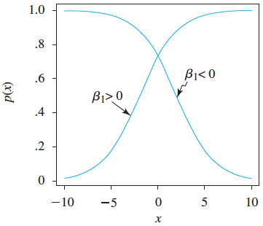
Logistic Regression
Logistic Regression is used to study or model the association between a binary response variable (y) and a set of explanatory variables.
Simple Logistic Regression Model:
where, p(x) is the probability that y equals 1 (success) when the independent variable is x.
Remarks:
The linear expression involving the explanatory variable (x) can take on values from - ∞ to ∞. However, p(x) is between 0 and 1, while, the odds are between 0 and ∞. But the log(odds) is from - ∞ to ∞.
The parameter β₁ measures the degree of association between the probability of the event occurring and the value of the independent variable x.

Slide 2
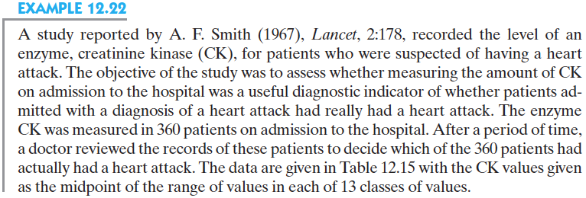
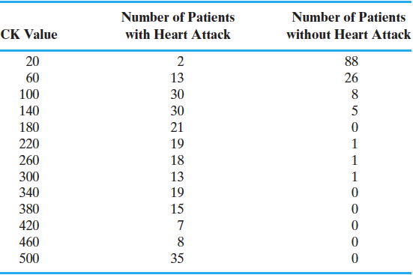
Simple Logistic Regression Example
(p. 703)
Note that this is a summarized version of the data.
data.ex12.22=read.csv("data_example12_22.csv",header=T)
head(data.ex12.22)
y ck
1 1 20
2 1 20
3 0 20
table(data.ex12.22)
ck
y 20 60 100 140 180 220 260 300 340 380 420 460 500
0 88 26 8 5 0 1 1 1 0 0 0 0 0
1 2 13 30 30 21 19 18 13 19 15 7 8 35

Slide 3
Simple Logistic Regression Using R
data.ex12.22=read.csv("data_example12_22.csv",header=T)
head(data.ex12.22)
y ck
1 1 20
2 1 20
3 0 20
result.ex12.22=glm(y~ck, family=binomial(link="logit"))
summary(result.ex12.22)$coef
Estimate Std. Error z value Pr(>|z|)
(Intercept) -3.02835960 0.366971041 -8.252312 1.553589e-16
ck 0.03510439 0.004080992 8.601927 7.838875e-18
This p-value can be used to test the null hypothesis H₀: β₁=0 vs. H_{a}: β₁ ≠ 0.
Since the estimate for β₁ is positive, this indicates that patients with higher levels of CK are associated with higher chance of having a heart attack .
These estimates are obtained using a Maximum Likelihood procedure.
This implies that an increase of 1 unit of x results in the odds of a “success” being multiplied by exp(β₁). In our example, exp(0.0351)=1.035723. Hence, as CK increases by 1 unit, the odds that the person had a heart attack increases by a factor of 1.036, or it increases by 3.6%.

Slide 4
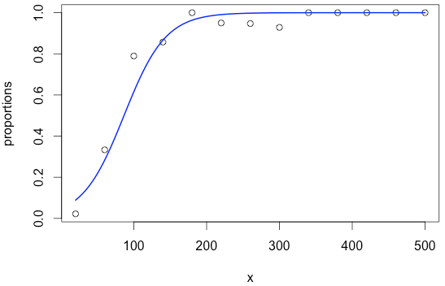
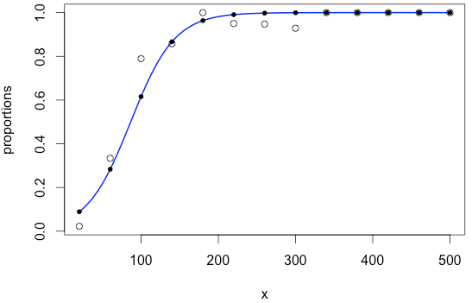
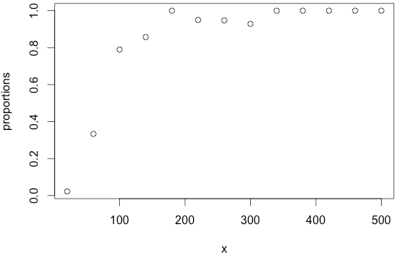
Simple Logistic Regression Using R
result.ex12.22=glm(y~ck, family=binomial(link="logit"))
summary(result.ex12.22)$coef
Estimate Std. Error z value Pr(>|z|)
(Intercept) -3.02835960 0.366971041 -8.252312 1.553589e-16
ck 0.03510439 0.004080992 8.601927 7.838875e-18
confint(result.ex12.22,level=.90)
Waiting for profiling to be done...
5 % 95 %
(Intercept) -3.66938129 -2.45759221
ck 0.02881989 0.04227805
x=seq(20,500,by=40)
proportions=tapply(y,ck,mean)
plot(x,proportions)
curve(exp(-3.0284+0.035*x)/(1+exp(-3.0284+0.035*x),20,500,lwd=2,col="blue",add=T)
points(x,exp(-3.0284+0.035*x)/(1+exp(-3.0284+0.035*x)),pch=20)
predict(result.ex12.22,newdata=data.frame(ck=x))
result.ex12.22$fitted
result.ex12.22$residuals
However, the residuals are not very informative, since the response variable is binary.
Therefore, we are 90% confident that β₁ is between 0.029 and 0.042.

Slide 5
Classifying Outcomes
After we obtained the probability estimate that the patient had a heart attack (‘success’), we still have to decide whether that patient had a heart attack or not.
rm(list=ls()) # This will clear the memory
data.ex12.22=read.csv("data_example12_22.csv",header=T)
attach(data.ex12.22)
result.ex12.22=glm(y~ck, family=binomial(link="logit"))
prediction=as.numeric(result.ex12.22$fitted>.7)
error=y-prediction
y.hat=result.ex12.22$fitted
data.frame(y,predicted=y.hat,
+prob=exp(y.hat)/(1+exp(y.hat)),prediction,error)[1:3,]
y predicted prob prediction error
1 1 0.08897039 0.5222279 0 1
2 1 0.08897039 0.5222279 0 1
3 0 0.08897039 0.5222279 0 0
percent.error=sum(abs(error))/length(error)
percent.error # 0.1472222
false.pos=sum((y==0)*(prediction==1)) # 8
false.neg=sum((y==1)*(prediction==0)) # 45
true.pos=sum((y==1)*(prediction==1)) # 185
true.neg=sum((y==0)*(prediction==0)) # 122
Actual Y value
Predicted | Y=1 | Y=0
Y=1 | 185 | 45
Y=0 | 8 | 122

Slide 6
Finding the Optimal Cut Off Value
##################################################
results=result.ex12.22;
success=y
# Finding the best cut off value
cutoff=seq(0,1,by=.05)
m=length(cutoff)
False.pos=array(99,m)
False.neg=array(99,m)
Errors=array(99,m)
for(i in 1:m)
{
prediction=as.numeric(results$fitted>cutoff[i])
error=success-prediction
False.pos[i]=sum((success==0)*(prediction==1))
False.neg[i]=sum((success==1)*(prediction==0))
Errors[i]=False.pos[i]+False.neg[i]
}
Percent.error=Errors/length(error)
data.frame(CutOff=cutoff,FalsePositive=False.pos,FalseNegative=False.neg,ErrorRate=Percent.error)
##################################################
CutOff FalsePositive FalseNegative ErrorRate
1 0.00 130 0 0.36111111
2 0.05 130 0 0.36111111
3 0.10 42 2 0.12222222
4 0.15 42 2 0.12222222
5 0.20 42 2 0.12222222
6 0.25 42 2 0.12222222
7 0.30 16 15 0.08611111
8 0.35 16 15 0.08611111
9 0.40 16 15 0.08611111
10 0.45 16 15 0.08611111
11 0.50 16 15 0.08611111
12 0.55 16 15 0.08611111
13 0.60 16 15 0.08611111
14 0.65 8 45 0.14722222
15 0.70 8 45 0.14722222
16 0.75 8 45 0.14722222
17 0.80 8 45 0.14722222
18 0.85 8 45 0.14722222
19 0.90 3 75 0.21666667
20 0.95 3 75 0.21666667
21 1.00 0 230 0.63888889
Therefore, use a cut off value of 0.45.

