Slide 1
Chapter 6: Multiple Regression
Multiple Regression Model:
where,
ε_{i}’s are uncorrelated with a mean of 0 and constant variance σ²_{ε}.
ε_{i}’s are normally distributed. (This is needed to do inferences about the coefficients.)
Least-Square Regression Equation:

Slide 2
Obtaining Model Parameter Estimates
data.health=read.csv("HealthExam.csv",header=T)
head(data.health)
Gender Age Height Weight Waist Pulse SysBP DiasBP Cholesterol BodyMass Leg Elbow Wrist Arm
1 F 12 63.3 156.3 81.4 64 104 41 89 27.5 41.0 6.8 5.5 33.0
2 F 16 57.0 100.7 68.7 64 106 64 2 21.9 33.8 5.6 4.6 26.4
3 M 17 63.0 156.3 86.7 96 109 65 78 27.8 44.2 7.1 5.3 31.7
attach(data.health)
result2=lm(Weight~Waist+Height)
summary(result2)
Coefficients:
Estimate Std. Error t value Pr(>|t|)
(Intercept) -201.5717 21.5686 -9.346 2.59e-14 ***
Waist 2.1565 0.1003 21.500 < 2e-16 ***
Height 2.5978 0.3438 7.557 7.22e-11 ***
---
Signif. codes: 0 ‘***’ 0.001 ‘**’ 0.01 ‘*’ 0.05 ‘.’ 0.1 ‘ ’ 1
Residual standard error: 11.2 on 77 degrees of freedom
Multiple R-squared: 0.8996, Adjusted R-squared: 0.8969
F-statistic: 344.8 on 2 and 77 DF, p-value: < 2.2e-16
Weight = -201.5717 + 2.1565*Waist + 2.5978*Height.
Both p-values are <0.05, therefore, both variables have significant effects on Weight.
Since R² will keep on increasing as we put more explanatory variables in the model, the adjusted R² is an alternative measure that can be used to help choose between two competing models. This measure gets a penalty for the number of explanatory variables in the model.
By including Height in the model we increased R² by 0.0745. Hence, our new model is able to explain 7.45% more of the variability in Weight.

Slide 3
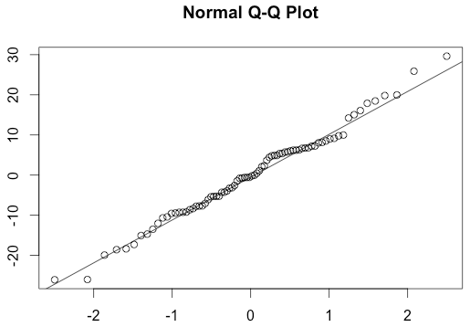
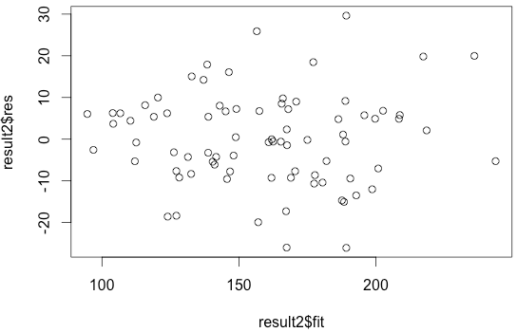
Prediction and Model Assessments
Predict the weight of 2 individuals – one with waist size of 80 cm and height of 60 in and another with waist size of 90 cm and height of 70 inches.
Since, Weight = -201.5717 + 2.1565*Waist + 2.5978*Height
Weight1=-201.5717+2.1565*80+2.5978*60 # 126.8163
Weight2=-201.5717+2.1565*90+2.5978*70 # 174.3593
predict(result2,newdata=data.frame(Waist=c(80,90),Height=c(60,70)))
1 2
126.8145 174.3573
confint(result2,level=.99)
0.5 % 99.5 %
(Intercept) -258.538718 -144.604756
Waist 1.891574 2.421405
Height 1.689847 3.505723
# Model Assessments
qqnorm(result2$res);qqline(result2$res)
shapiro.test(result2$res)
# W = 0.9884, p-value = 0.6898
plot(result2$fit,result2$res)

