Slide 1
Estimating the Variance of the Error Terms
The unbiased estimator for σ_{ε}² is
sse=sum(result$residuals^2) # 16811.16
mse=sse/(80-2) # 215.5277
sigma.hat=sqrt(mse) # 14.68086
anova(result)
Response: Weight
Df Sum Sq Mean Sq F value Pr(>F)
Waist 1 79284 79284 367.86 < 2.2e-16 ***
Residuals 78 16811 216
Total 79 96095
summary(result)
lm(formula = Weight ~ Waist)
Coefficients:
Estimate Std. Error t value Pr(>|t|)
(Intercept) -51.7279 11.1288 -4.648 1.34e-05 ***
Waist 2.3947 0.1249 19.180 < 2e-16 ***
Residual standard error: 14.68 on 78 degrees of freedom
Multiple R-squared: 0.8251, Adjusted R-squared: 0.8228
F-statistic: 367.9 on 1 and 78 DF, p-value: < 2.2e-16
P_{i}(x_{i},y_{i})
Y=β₀+β₁x
y_{i}
*
*
*
*
y
*
*
*
*
x_{i}
SSTO = SSE + SSR
Since the p-vlaue is less than 0.05, we conclude the the regression model account for a significant amount of the variability in weight.
R² = SSR/SSTO

Slide 2
Things that affect the slope estimate
Watch the regression podcast by Dr. Will posted on our course webpage.
Three things that affect the slope estimate:
Sample size (n).
Variability of the error terms (σ_{ε}²).
Spread of the independent variable.
summary(result)
lm(formula = Weight ~ Waist)
Coefficients:
Estimate Std. Error t value Pr(>|t|)
(Intercept) -51.7279 11.1288 -4.648 1.34e-05 ***
Waist 2.3947 0.1249 19.180 < 2e-16 ***
Testing H₀: β₁ = 0 vs. H₁: β₁ ≠ 0.
t.obs=(Beta1.hat-0)/SE.beta1 # 19.17971
p.value=2*(1-pt(19.18,df=78)) # virtually 0
The smaller σ_{ε} is, the smaller the standard error of the slope estimate.
MSE=anova(result)$Mean[2] # 215.5277
SE.beta1=sqrt(MSE/SSxx) # 0.1248554
SS=function(x,y){sum((x-mean(x))*(y-mean(y)))}
SSxy=SS(Waist,Weight) # 33108.35
SSxx=SS(Waist,Waist) # 13825.73
SSyy=SS(Weight,Weight) # 96095.4 = SSTO
Beta1.hat=SSxy/SSxx # 2.39469
As n increases, the standard error of the slope estimate decreases.

Slide 3
Confidence Intervals
The (1-α)100% C.I. for β₁:
Hence, the 90% C.I. for β₁ for our example is
Lower=Beta1.hat – qt(0.95,df=78)*SE.beta1 # 2.186853
Upper=Beta1.hat + qt(0.95,df=78)*SE.beta1 # 2.602528
confint(result,level=.90)
5 % 95 %
(Intercept) -70.253184 -33.202619
Waist 2.186853 2.602528
Estimating the mean response (μ_{y}) at a specified value of x:
predict(result,newdata=data.frame(Waist=c(80,90)))
1 2
139.8473 163.7942
Confidence interval for the mean response (μ_{y}) at a specified value of x:
predict(result,newdata=data.frame(Waist=c(80,90)),interval=”confidence”)
fit lwr upr
1 139.8473 136.0014 143.6932
2 163.7942 160.4946 167.0938

Slide 4
Prediction Intervals
Predicting the value of the response variable at a specified value of x:
predict(result,newdata=data.frame(Waist=c(80,90)))
1 2
139.8473 163.7942
Prediction interval for the value of new response value (y_{n+1}) at a specified value of x:
predict(result,newdata=data.frame(Waist=c(80,90)),interval=”prediction”)
fit lwr upr
1 139.8473 110.3680 169.3266
2 163.7942 134.3812 193.2072
predict(result,newdata=data.frame(Waist=c(80,90)),interval=”prediction”,level=.99)
fit lwr upr
1 139.8473 100.7507 178.9439
2 163.7942 124.7855 202.8029
Note that the only difference between the prediction interval and confidence interval for the mean response is the addition of 1 inside the square root. This makes the prediction intervals wider than the confidence intervals for the mean response.

Slide 5
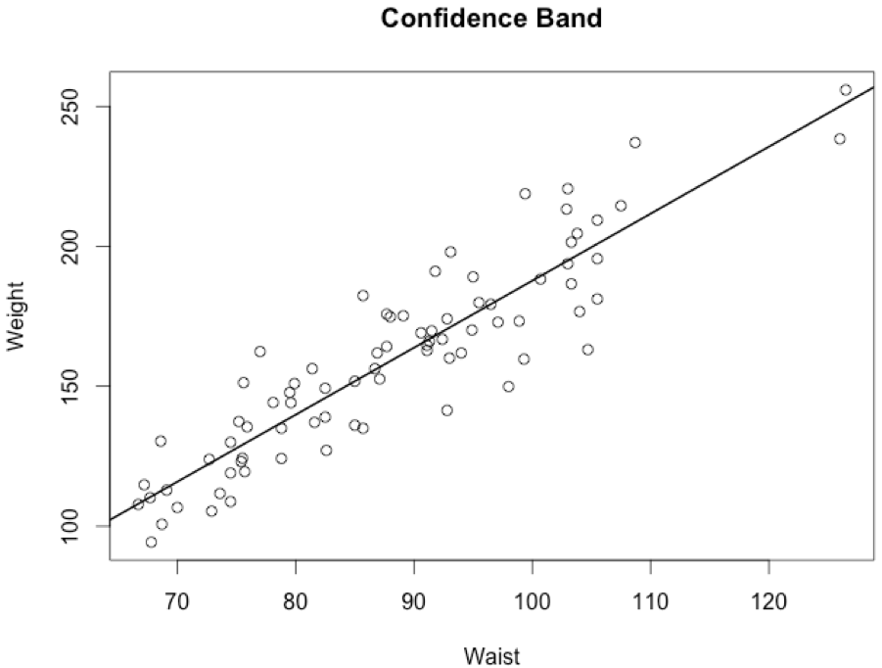
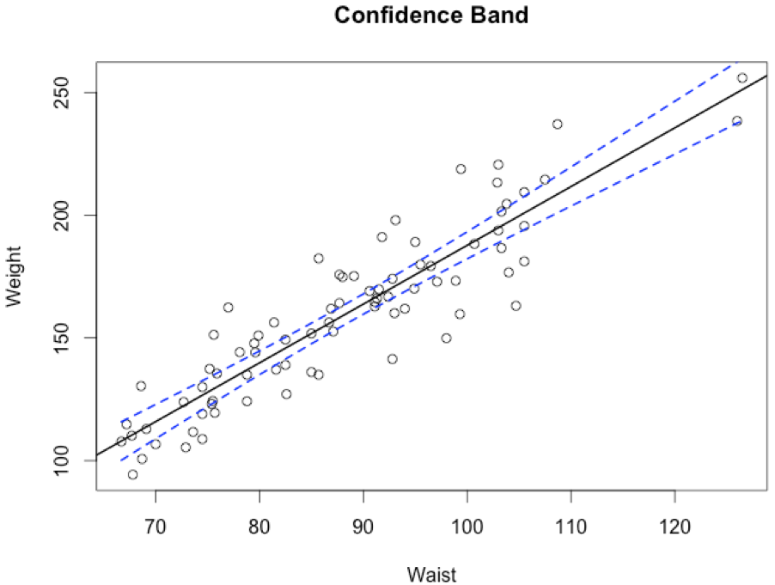
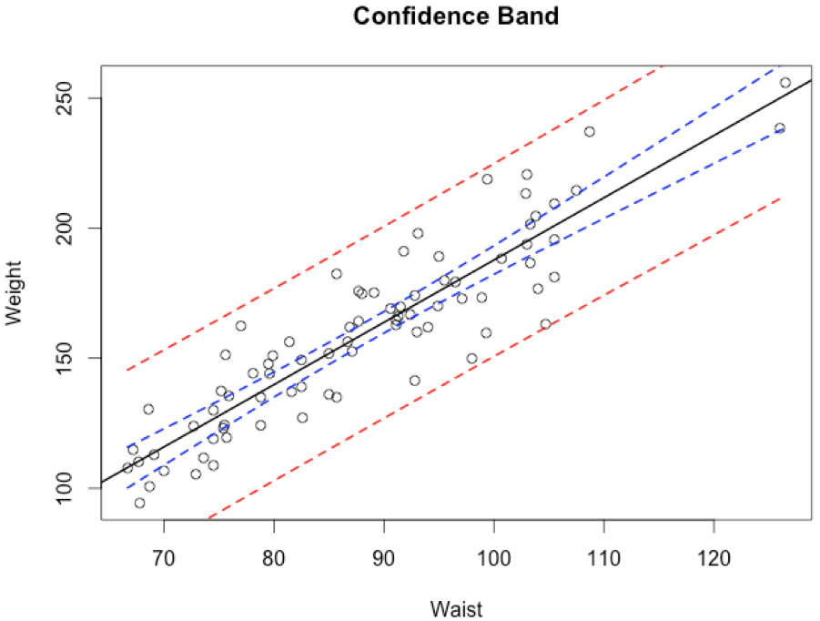
Confidence and Prediction Bands
,
Working-Hotelling (1-α)100% confidence band:
result=lm(Weight~Waist)
CI=predict(result,se.fit=TRUE) # se.fit=SE(mean)
W=sqrt(2*qf(0.95,2,78)) # 2.495513
band.lower=CI$fit - W*CI$se.fit
band.upper=CI$fit + W*CI$se.fit
plot(Waist,Weight,xlab="Waist”,ylab="Weight”,main="Confidence Band")
abline(result)
points(sort(Waist),sort(band.lower),type="l",lwd=2,lty=2,col=”Blue")
points(sort(Waist),sort(band.upper),type="l",lwd=2,lty=2,col=”Blue")
The ((1-α)100% Prediction Band:
mse=anova(result)$Mean[2]
se.pred=sqrt(CI$se.fit^2+mse)
band.lower.pred=CI$fit - W*se.pred
band.upper.pred=CI$fit + W*se.pred
points(sort(Waist),sort(band.lower.pred),type="l",lwd=2,lty=2,col="Red")
points(sort(Waist),sort(band.upper.pred),type="l",lwd=2,lty=2,col="Red”)

Slide 6
Tests for Correlations
Testing H₀: ρ = 0 vs. H₁: ρ ≠ 0.
cor(Waist,Weight) # Computes the Pearson correlation coefficient, r
0.9083268
cor.test(Waist,Weight, conf.level=.99) # Tests Ho:rho=0 and also constructs C.I. for rho
Pearson's product-moment correlation
data: Waist and Weight
t = 19.1797, df = 78, p-value < 2.2e-16
alternative hypothesis: true correlation is not equal to 0
99 percent confidence interval:
0.8409277 0.9479759
Testing H₀: ρ = 0 vs. H₁: ρ ≠ 0 using the (Nonparametric) Spearman’s method.
cor.test(Waist,Weight,method="spearman") # Test of independence using the
Spearman's rank correlation rho # Spearman Rank correlation
data: Waist and Weight
S = 8532, p-value < 2.2e-16
alternative hypothesis: true rho is not equal to 0
sample estimates:
rho
0.9
Note that the results are exactly the same as what we got when testing H₀: β₁ = 0 vs. H₁: β₁ ≠ 0.

Slide 7
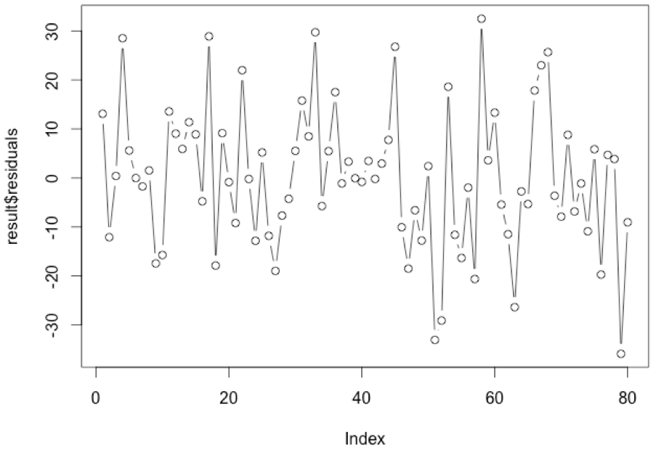
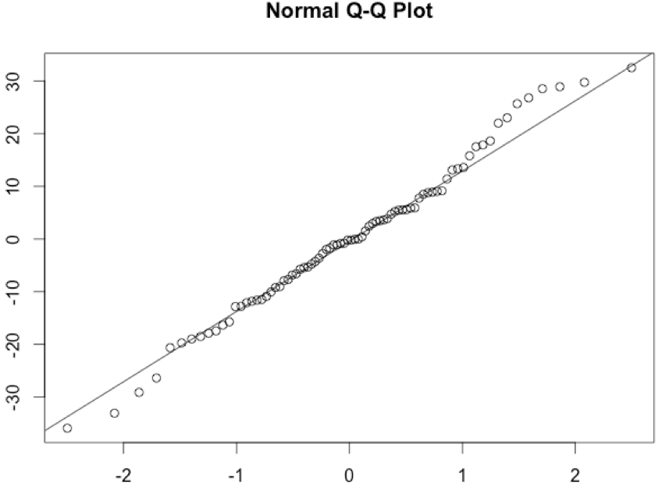
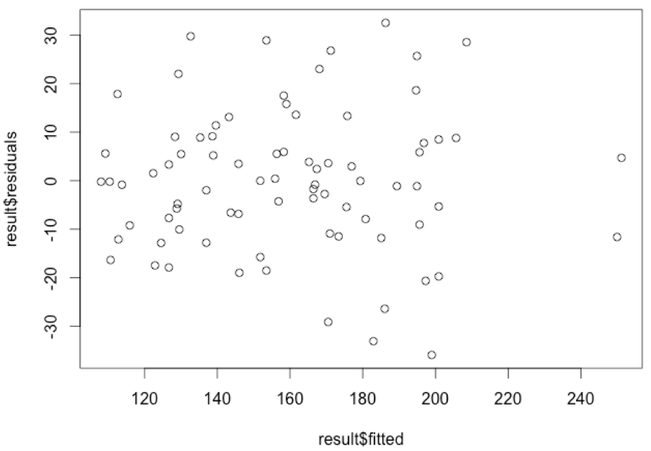
Model Diagnostics
Model: Y_{i}=(β₀+β₁x_{i}) + ε_{i}
where,
ε_{i}’s are uncorrelated with a mean of 0 and constant variance σ²_{ε}.
ε_{i}’s are normally distributed. (This is needed in the test for the slope.)
Assessing uncorrelatedness of the error terms
plot(result$residuals,type='b')
Assessing Normality
qqnorm(result$residuals); qqline(result$residuals)
shapiro.test(result$residuals)
W = 0.9884, p-value = 0.6937
Assessing Constant Variance
plot(result$fitted,result$residuals)
levene.test(result$residuals,Waist)
Test Statistic = 2.1156, p-value = 0.06764

