Slide 1
Type I and Type II Errors
Test H₀: Drug is not effective vs H₁: Drug is effective.
TRUTH
: Drug is not effective
: Drug is effective
 | H₀ is true | H₀ is false (H1 is true)
DECISION
Correct Decision
(Usually what researchers are hoping to get.)
Reject H₀
Type I error
(Consumer’s Risk)
(Power=1-β)
(Conclude Drug
is effective)
Pr(I error)=α
Do not reject H₀
Correct Decision
(Usually this result leads to no conclusion.)
Type II error
(Producer’s Risk)
Pr(II error)=β
The Power of the test is the probability of rejecting the null when it is false. It is the probability of saying the drug is effective when it is really effective. Power=1-β.

Slide 2
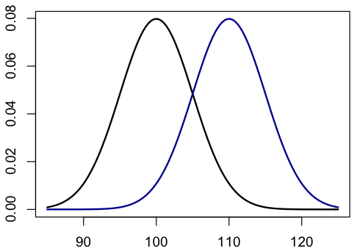
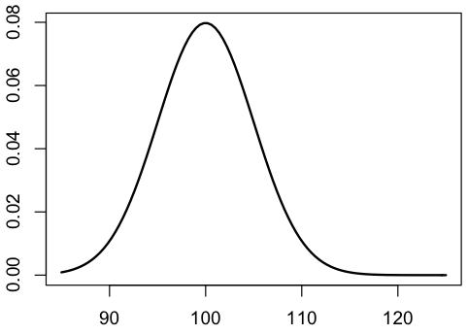
Relationships Between α, β, power, and n
H₀: μ=100 vs H₁: μ > 100
Use α=0.05.
α=P(Type I error)
=P(reject Ho when H₀ is true)
β=P(Type II error)
=P(not rejecting H₀ when H₁ is true)
Note: As α decreases, β increases.
(Keeping everything else the same.)
Q: Is there a way to lower α and β at the same time?
Increase Δ=(alternative mean)-(null mean).
Lower population standard deviation, σ.
Increase the sample size, n.
β
H₁: μ>100
H₀: μ=100
Rejection Region
α=0.05
Δ=10

