Slide 1
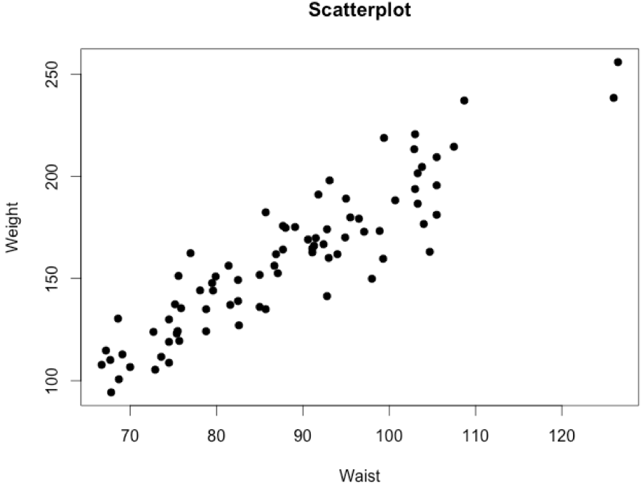
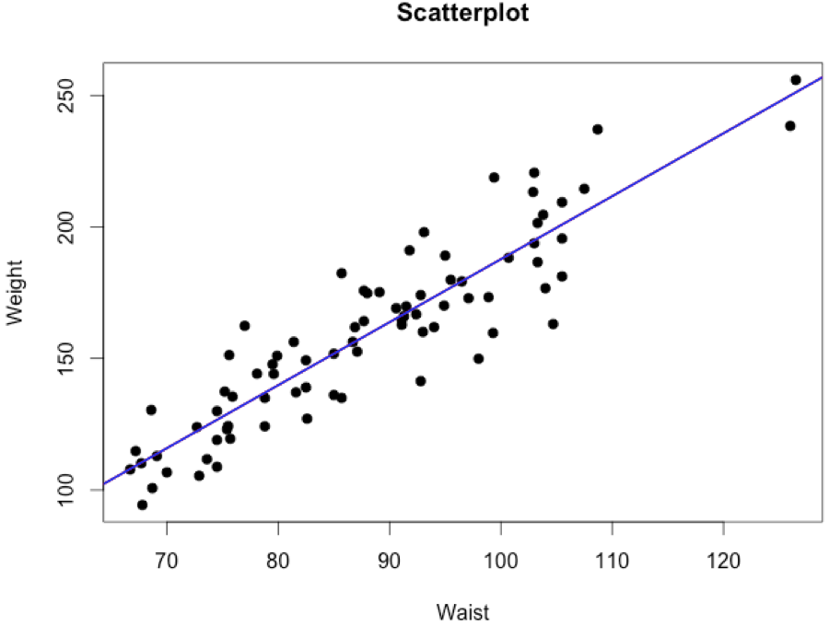
Obtaining the Regression Line in R
data.health=read.csv("HealthExam.csv",header=T)
head(data.health)
Gender Age Height Weight Waist Pulse SysBP DiasBP Cholesterol BodyMass Leg Elbow Wrist Arm
1 F 12 63.3 156.3 81.4 64 104 41 89 27.5 41.0 6.8 5.5 33.0
2 F 16 57.0 100.7 68.7 64 106 64 2 21.9 33.8 5.6 4.6 26.4
3 M 17 63.0 156.3 86.7 96 109 65 78 27.8 44.2 7.1 5.3 31.7
attach(health.exam)
plot(Waist,Weight,pch=19,main="Scatterplot")
result=lm(Weight~Waist)
coef(result)
(Intercept) Waist
-51.72790 2.39469
abline(a=-51.7279,b=2.39469,lwd=2,col="blue")
So, for the first person, her predicted weight is 143.2 pounds.
Predicted.1=-51.728+2.395*81.4 # 143.225 pounds
Since her actual weight is 156.3 pounds.
Residual.1=156.3-143.2 # 13.1 pounds
As waist increases by 1 cm, weight goes up by about 2.4 pounds.

Slide 2
What else do we get from the ‘lm’ function?
data.health=read.csv("HealthExam.csv",header=T)
attach(health.exam)
result=lm(Weight~Waist)
attributes(result)
$names
"coefficients" "residuals" "effects" "rank" "fitted.values" "assign" "qr" "df.residual" "xlevels" "call" "terms" "model"
result$fit[1] # 143.1999
result$res[1] # 13.10011
summary(result)
lm(formula = Weight ~ Waist)
Coefficients:
Estimate Std. Error t value Pr(>|t|)
(Intercept) -51.7279 11.1288 -4.648 1.34e-05 ***
Waist 2.3947 0.1249 19.180 < 2e-16 ***
---
Signif. codes: 0 ‘***’ 0.001 ‘**’ 0.01 ‘*’ 0.05 ‘.’ 0.1 ‘ ’ 1
Residual standard error: 14.68 on 78 degrees of freedom
Multiple R-squared: 0.8251, Adjusted R-squared: 0.8228
F-statistic: 367.9 on 1 and 78 DF, p-value: < 2.2e-16
Coefficient of Determination (R²) : This index measures the amount of variability in the dependent variable (y) that can be explained by the regression line. Hence, about 82.51% of the variability of weight can be explained by the regression line involving the waist size.
Testing H₀: β₁ = 0 vs. H₁: β₁ ≠ 0.
Since the p-vlaue is extremely small (<0.05), we can reject the null hypothesis and conclude that waist has a significant effect on weight.

Slide 3
Model Assumptions
Model: Y_{i}=(β₀+β₁x_{i}) + ε_{i}
where,
ε_{i}’s are uncorrelated with a mean of 0 and constant variance σ²_{ε}.
ε_{i}’s are normally distributed. (This is needed in the test for the slope.)
Y=β₀+β₁x
Since the underlying (green) line is unknown to us, we can’t calculate the values of the error terms (ε_{i}). The best that we can do is study the residuals (e_{i}).
y
Observed point
*
ε₁
e₁
Expected point
Predicted point
x₁
x

Slide 4
Estimating the Variance of the Error Terms
The unbiased estimator for σ_{ε}² is
sse=sum(result$residuals^2) # 16811.16
mse=sse/(80-2) # 215.5277
sigma.hat=sqrt(mse) # 14.68086
anova(result)
Response: Weight
Df Sum Sq Mean Sq F value Pr(>F)
Waist 1 79284 79284 367.86 < 2.2e-16 ***
Residuals 78 16811 216
Total 79 96095
summary(result)
lm(formula = Weight ~ Waist)
Coefficients:
Estimate Std. Error t value Pr(>|t|)
(Intercept) -51.7279 11.1288 -4.648 1.34e-05 ***
Waist 2.3947 0.1249 19.180 < 2e-16 ***
Residual standard error: 14.68 on 78 degrees of freedom
Multiple R-squared: 0.8251, Adjusted R-squared: 0.8228
F-statistic: 367.9 on 1 and 78 DF, p-value: < 2.2e-16
P_{i}(x_{i},y_{i})
Y=β₀+β₁x
y_{i}
*
*
*
*
y
*
*
*
*
x_{i}
SSTO = SSE + SSR
Since the p-vlaue is less than 0.05, we conclude the the regression model account for a significant amount of the variability in weight.
R² = SSR/SSTO

Slide 5
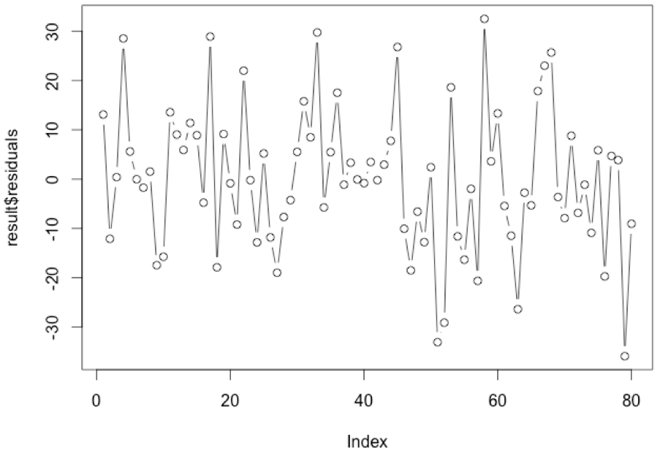
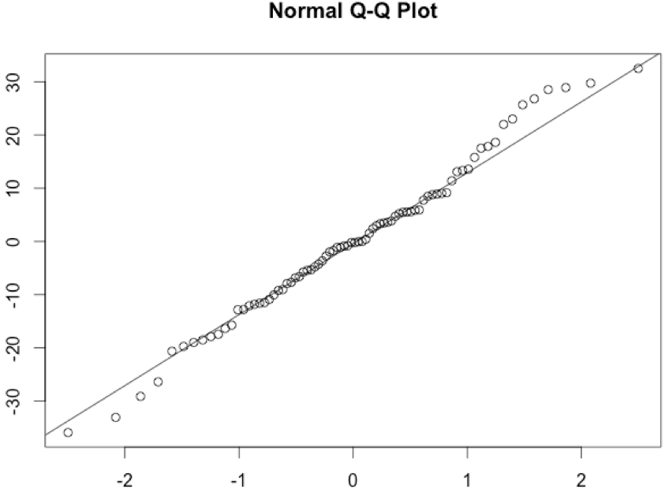
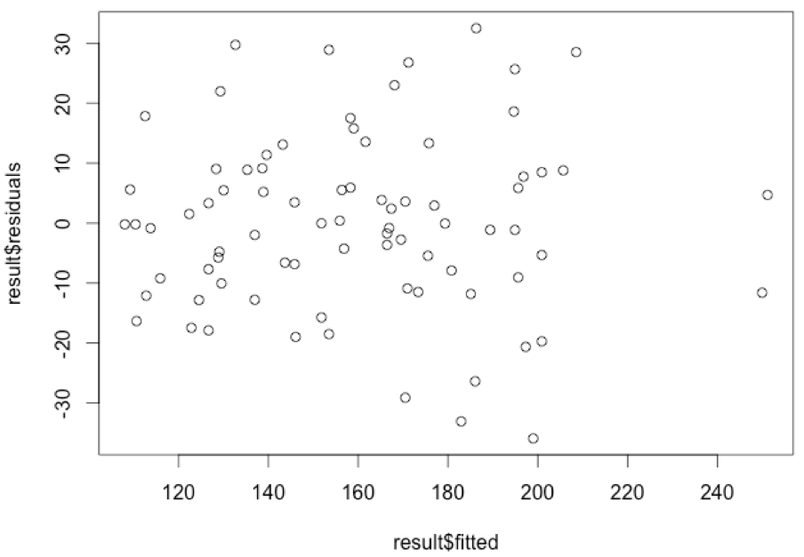
Model Diagnostics
Model: Y_{i}=(β₀+β₁x_{i}) + ε_{i}
where,
ε_{i}’s are uncorrelated with a mean of 0 and constant variance σ²_{ε}.
ε_{i}’s are normally distributed. (This is needed in the test for the slope.)
Assessing uncorrelatedness of the error terms
plot(result$residuals,type='b')
Assessing Normality
qqnorm(result$residuals); qqline(result$residuals)
shapiro.test(result$residuals)
W = 0.9884, p-value = 0.6937
Assessing Constant Variance
plot(result$fitted,result$residuals)
levene.test(result$residuals,Waist)
Test Statistic = 2.1156, p-value = 0.06764

