Slide 1
ECO 120 - Global Macroeconomics
Taggert J. Brooks

Slide 2
Module 02
Introduction to Macroeconomics

Slide 3
The Business Cycle
The business cycle is the short-run alternation between economic downturns and economic upturns.
US Business cycle dates from the NBER
http://www.nber.org/cycles.html

Slide 4
The Business Cycle
A depression is a very deep and prolonged downturn.
Recessions are periods of economic downturns when output and employment are falling.
Expansions, sometimes called recoveries, are periods of economic upturns when output and employment are rising.

Slide 5
The Business Cycle
The point at which the economy turns from expansion to recession is a business-cycle peak.
The point at which the economy turns from recession to expansion is a business-cycle trough.

Slide 6
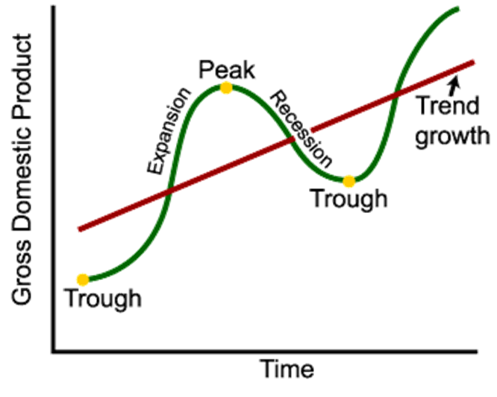
The Business Cycle

Slide 7
Employment, Unemployment, and the Business Cycle
Employment is the total number of people currently working for pay.
Unemployment is the total number of people who are actively looking for work but aren’t currently employed.

Slide 8
Employment, Unemployment, and the Business Cycle
The labor force is the sum of employment and unemployment.
The unemployment rate is the percentage of the labor force that is unemployed.

Slide 9
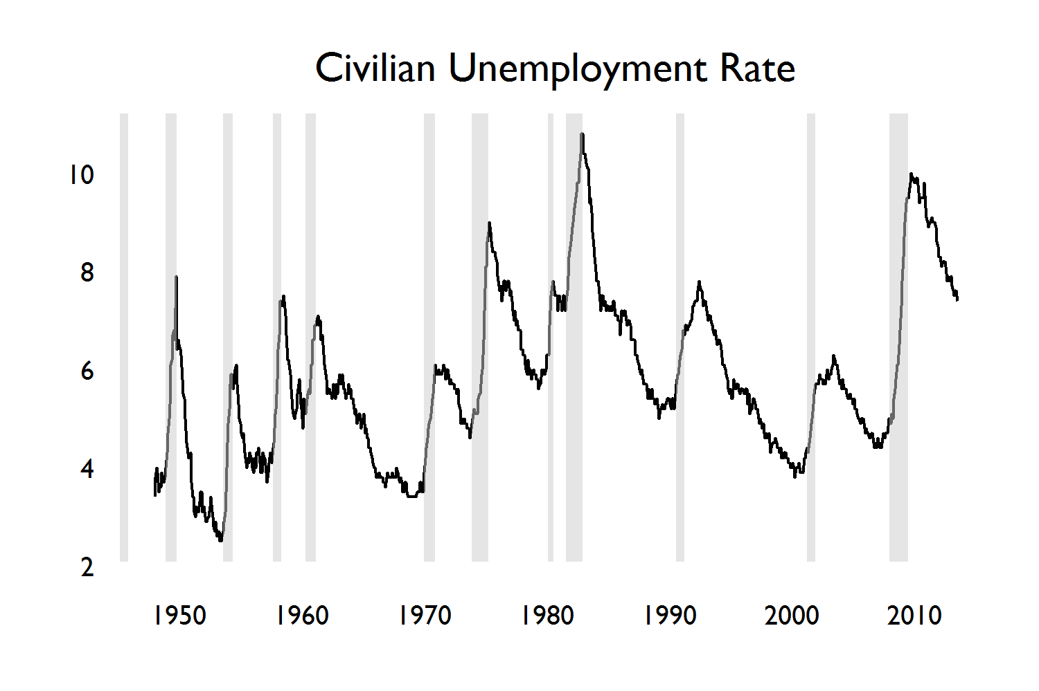
U.S. Unemployment Rate and the Timing of Business Cycles, 1945-2013
Monthly Unemployment Rate in percent, with grey bars representing recessions (from NBER).
Notes:
The unemployment rate, a measure of joblessness, rises sharply during recessions and usually falls during expansions.
Source: Bureau of Labor Statistics.

Slide 10
Aggregate Output and the Business Cycle
During a recession, the quantity of goods and services declines.
To measure the rise and fall of an economy’s output, we look at aggregate output.
Aggregate output is the economy’s total production of goods and services for a given time period.
Aggregate output normally falls during a recession and rises during an expansion.

Slide 11
Inflation, Deflation, and Price Stability
A rising aggregate price level is inflation.
A falling aggregate price level is deflation.
The inflation rate is the annual percent change in the aggregate price level.
The economy has price stability when the aggregate price level is changing only slowly.

Slide 12
Economic Growth
Americans have become able to afford many more material goods over time thanks to long-run economic growth.
Economic growth is an increase in the maximum possible output of an economy.

Slide 13
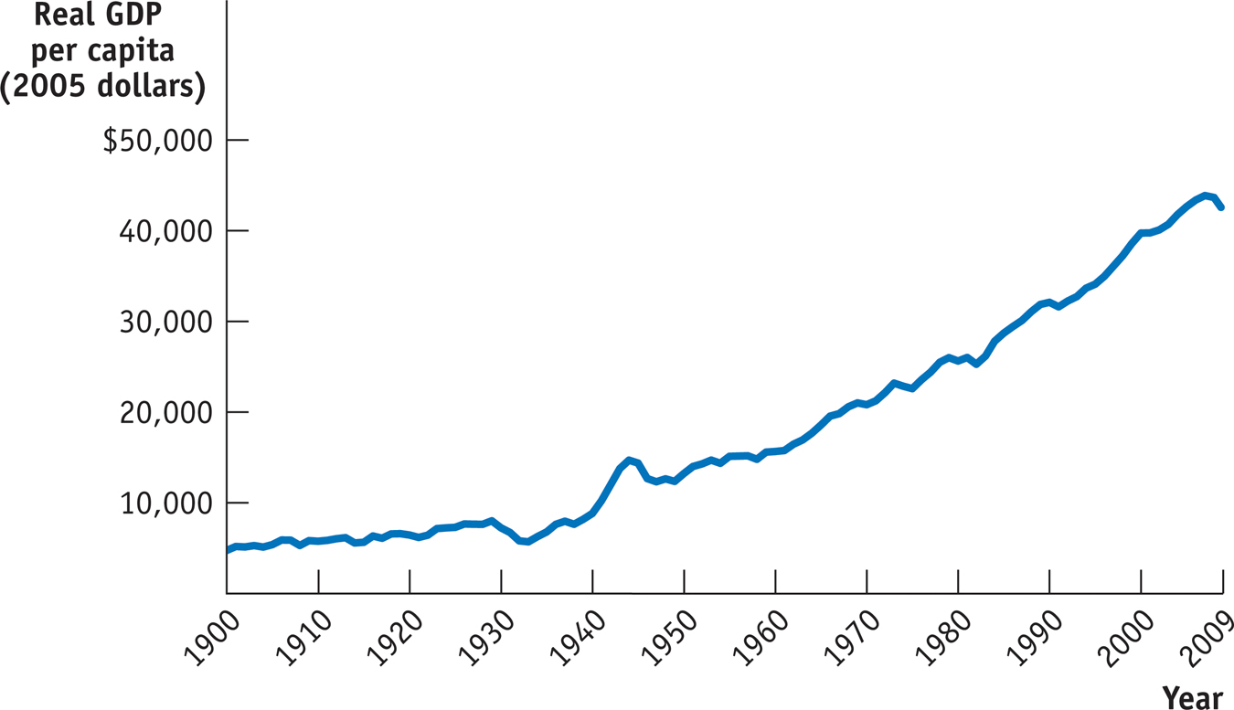
Growth, the Long View
Notes:
Figure Caption: Figure 2.2: Growth, the Long View
Over the long run, growth in real GDP per capita has dwarfed the ups and downs of the business cycle. Except for the recession that began the
Great Depression, recessions are almost invisible.
Source: Angus Maddison, Statistics on World Population, GDP, and Per Capita GDP, 1–2006AD, http://www.ggdc.net/maddison; Bureau of Economic Analysis.

Slide 14
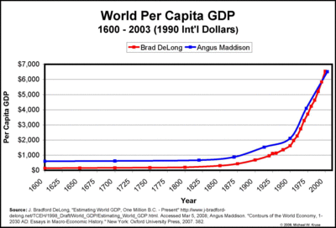
Growth, the Longer View
Notes:
http://krusekronicle.typepad.com/kruse_kronicle/2008/03/mec-measuring-i.html#.UiUpWDash8E

Slide 15
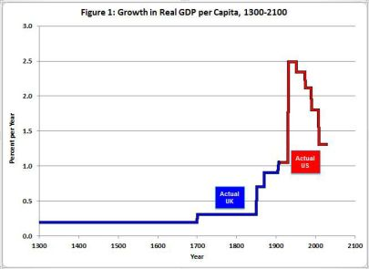
Growth Rate, the Really Long View
Notes:
“British data for 1300-1870 come from Broadberry et al. (2010) and are ratio-linked to Maddison’s U.K. data through 1906. U.S. data are based on NIPA Table 1.1.6 back to 1929 and are ratio-linked to annual GDP from Balke-Gordon (1989)”

Slide 16
Models in Economics
A model is a simplified representation of a real situation that is used to better understand real-life situations.
Create a real but simplified economy
Ex.: Cigarettes in World War II prison camps
Simulate an economy on a computer
Ex.: Tax models, money models…
Notes:
Note to the instructor:
Mentioning “Ceteris Paribus,” the Latin word for “other things equal” might be interesting for some students.

Slide 17
Models in Economics
The “other things equal” assumption means that all other relevant factors remain unchanged.
Notes:
Note to the instructor:
Mentioning “Ceteris Paribus”, the Latin word for “other things equal” might be interesting for some students.

Slide 18
Irrational Monkeys
http://www.ted.com/talks/laurie_santos.html
Notes:
http://www.ted.com/talks/laurie_santos.html

