Slide 1
Exchange Rate Demonstration

Slide 2
Exchange Rate
The price of one country’s currency measured in terms of another country’s currency
ex. $/Pound or Pound/$

Slide 3
Why do people want Foreign Currency?
The want to buy foreign goods
They want to buy foreign financial assets
The want to speculate

Slide 4
Actors in the Foreign Exchange Market
Hedgers (Traders)
Arbitrageur
Speculators
Central Bankers

Slide 5
The Foreign Exchange Market
Exchange rate
Peso/$
D
S
Supply of Dollars by
people who want pesos
Demand for Dollars by
people who have pesos
Foreign exchange (dollars)

Slide 6
Currency Depreciation and Appreciation
Currency depreciation is an increase in the number of units of a particular currency needed to purchase one unit of foreign exchange
Currency appreciation is a decrease in the number of units of a particular currency needed to purchase one unit of foreign exchange

Slide 7
Changes in the Equilibrium Exchange Rate
Supply of Dollars by
people who want pesos
Exchange rate
Peso/$
D
S
S’
$ -depreciation
Peso- appreciation
Demand for Dollars by
people who have pesos
Foreign exchange (dollars)

Slide 8
Purchasing Power Parity
The purchasing power parity theory predicts that exchange rates between two national currencies will adjust in the long run to reflect price-level differences in the two countries
example: If a bike cost $100 in US, and 300pesos in Mexico, PPP predicts that the Peso/$ exchange = 3. If not arbitrage would be profitable (buy bikes in Mexico and sell in US)

Slide 9
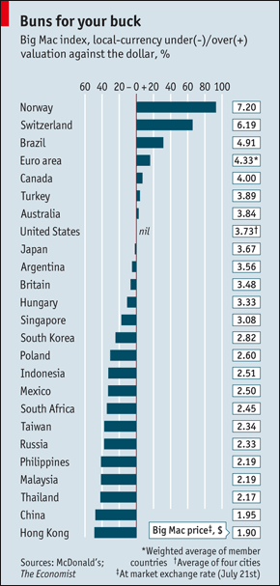
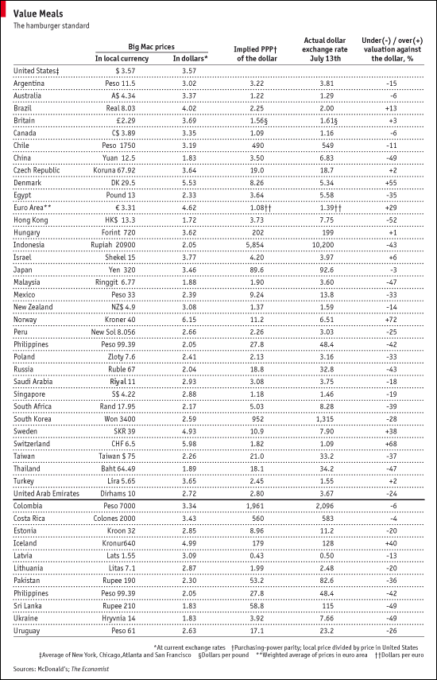

Slide 10
 | A | B | C | D | E | F
1 | country | In local currency | in US dollars | implied PPP | actual exchange rate | under (-) valued against dollar
2 | US | 3.54 | 3.54
3 | Argentina | 11.5 | 3.30 | 3.25 | 3.49 | -7%
4 | formulas |  | b3/e3 | b3/c2 |  | (d3-e3)/e3

Slide 11
Why does PPP Fail?
Non-Traded goods
Tariffs and Quotas
Productivity differentials
People demand foreign currency for reasons other then to buy traded goods
Notes:
Show Big Mac PPP Index

Slide 12
Exchange Rate Regimes
Flexible (Floating) exchange rates.
Fixed exchange rates.
Currency Board
Monetary Union
Managed Float (Dirty Float) exchange rates.

Slide 13
The Central Bank Can Intervene to Maintain Exchange Rates
Exchange rate
$/pound
D’’
D’
S
Foreign exchange (pounds)

Slide 14
Currency Crisis
Exchange rate
Baht/$
D’
D
52
S
25
Foreign exchange ($)

Slide 16
Problems
Foreigners can’t make their dollar denominated debt payments
Can’t afford foreign goods
Shopping opportunities

Slide 17
Currency Unions
Currency Unions are the adoptions of a single currency among several countries
European Union - currency (Euro)
The United States - currency (Dollar)

Slide 18
Actors in the Foreign Exchange Market
Hedgers (Traders)-A person who is buying a product or services from another country and is required to pay for it in that country’s currency
Arbitrageur—A person who takes advantage of temporary geographic differences in the exchange rate by simultaneously purchasing a currency in one market and selling it in another market
Speculators—A person who buys or sells foreign exchange in hopes of profiting from fluctuations in the exchange rate over time
Central Bankers- A government institution which can influence the exchange rate

Slide 19
Exchange Rates
Spot Market- The market for currency, where the contract negotiated is carried out immediately.
Forward Market- A contract is negotiated for the exchange of currency 3, 6, 9 months or more in the future. That is to say the rate is negotiated today for a transaction that will take place in the future.

Slide 20
Exchange Rate Regimes
Flexible (floating) exchange rates are determined solely by the forces of supply and demand without government intervention
Fixed exchange rates are pegged by a central banks and it conducts ongoing purchases and sales of currencies to defend the peg.
Managed Float (Dirty), there is an implicit or explicit target range for the exchange rate and the central bank defends it.

Slide 21
Changing the Value of Currency
Currency devaluation is an increase in the official pegged price of foreign exchange in terms of the domestic currency
Currency revaluation is a reduction in the official pegged price of foreign exchange in terms of the domestic currency

