Slide 1
ECO 120 - Global Macroeconomics
Taggert J. Brooks

Slide 2
Module 42
Supply and demand: Application exchange rates

Slide 3
The Role of The Exchange Rate
Currencies are traded in the foreign exchange market.
The prices at which currencies trade are known as exchange rates.
When a currency becomes more valuable in terms of other currencies, it appreciates.
When a currency becomes less valuable in terms of other currencies, it depreciates.

Slide 4
The Foreign Exchange Market
Notes:
Figure Caption: Figure 42.1: The Foreign Exchange Market
The foreign exchange market matches up the demand for a currency from foreigners who want to buy domestic goods, services, and assets with the supply of a currency from domestic residents who want to buy foreign goods, services, and assets. Here, the equilibrium in the market for dollars is at point E, corresponding to an equilibrium exchange rate of † 0.95 per $1.00. The equilibrium exchange rate is the exchange rate at which the quantity of a currency demanded in the foreign exchange market is equal to the quantity supplied.

Slide 5
Equilibrium Exchange Rate
The equilibrium exchange rate is the exchange rate at which the quantity of a currency demanded in the foreign exchange market is equal to the quantity supplied.

Slide 6
An Increase in the Demand for U.S. Dollars
Notes:
Figure Caption: Figure 42.2: An Increase in the Demand for U.S. Dollars
An increase in the demand for U.S. dollars might result from a higher rate of return available in the United States. The demand curve for U.S. dollars shifts from D₁ to D₂. So the equilibrium number of euros per U.S. dollar rises—the dollar appreciates. As a result, the balance of payments on current account falls as the balance of payments on financial account rises.

Slide 7
Purchasing Power Parity
The purchasing power parity between two countries’ currencies is the nominal exchange rate at which a given basket of goods and services would cost the same amount in each country.

Slide 8
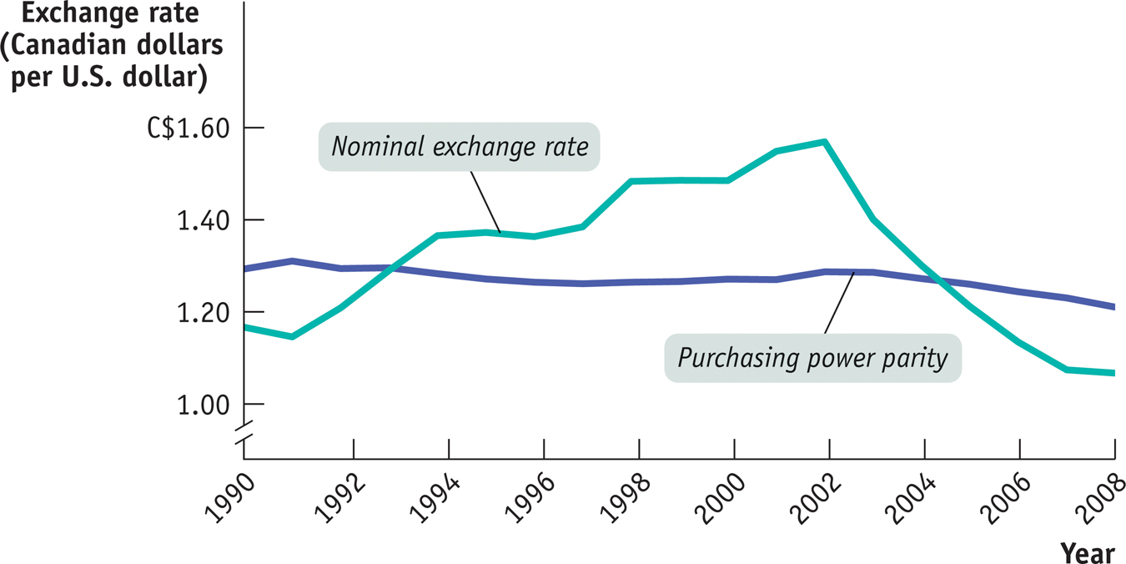
Purchasing Power Parity
Notes:
Figure Caption: Figure 42.4: Purchasing Power Parity versus the Nominal Exchange Rate, 1990–2008
The purchasing power parity between U.S. and Canada—the exchange rate at which a basket of goods and services would have cost the same amount in both countries—changed very little over the period shown, staying near C$1.20 per US$1. But the nominal exchange rate fluctuated widely.

Slide 9
Inflation and Real Exchange Rates
Real exchange rates are exchange rates adjusted for international differences in aggregate price levels.
Real exchange rate =
Mexican pesos per U.S. dollars × P_{US} /P_{Mex}

Slide 10
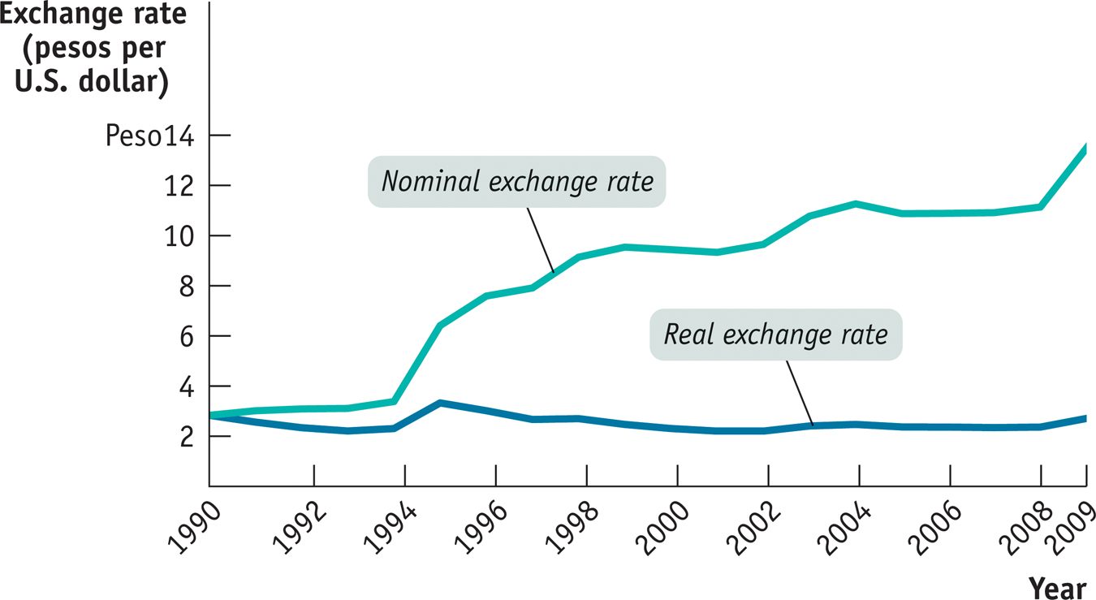
Real versus Nominal Exchange Rates
Notes:
Figure Caption: Figure 42.3: Real versus Nominal Exchange Rates, 1990-2009
Between 1990 and 2009, the price of a dollar in Mexican pesos increased dramatically. But because Mexico had higher inflation than the United States, the real exchange rate, which measures the relative price of Mexican goods and services, ended up roughly where it started.

