Slide 1
ECO 120 - Global Macroeconomics
Taggert J. Brooks

Slide 2
Module 10
Circular flow and Gdp

Slide 3
The National Accounts
Almost all countries calculate a set of numbers known as the national income and product accounts.
The national income and product accounts, or national accounts, keep track of the flows of money between different parts of the economy.

Slide 4
The Simple Circular-Flow Diagram
The simplest circular-flow diagram illustrates an economy that contains only two inhabitants: households and firms.
A household consists of either an individual or group of people who share their income.
A firm is an organization that produces goods and services for sale—and that employs members of households.

Slide 5
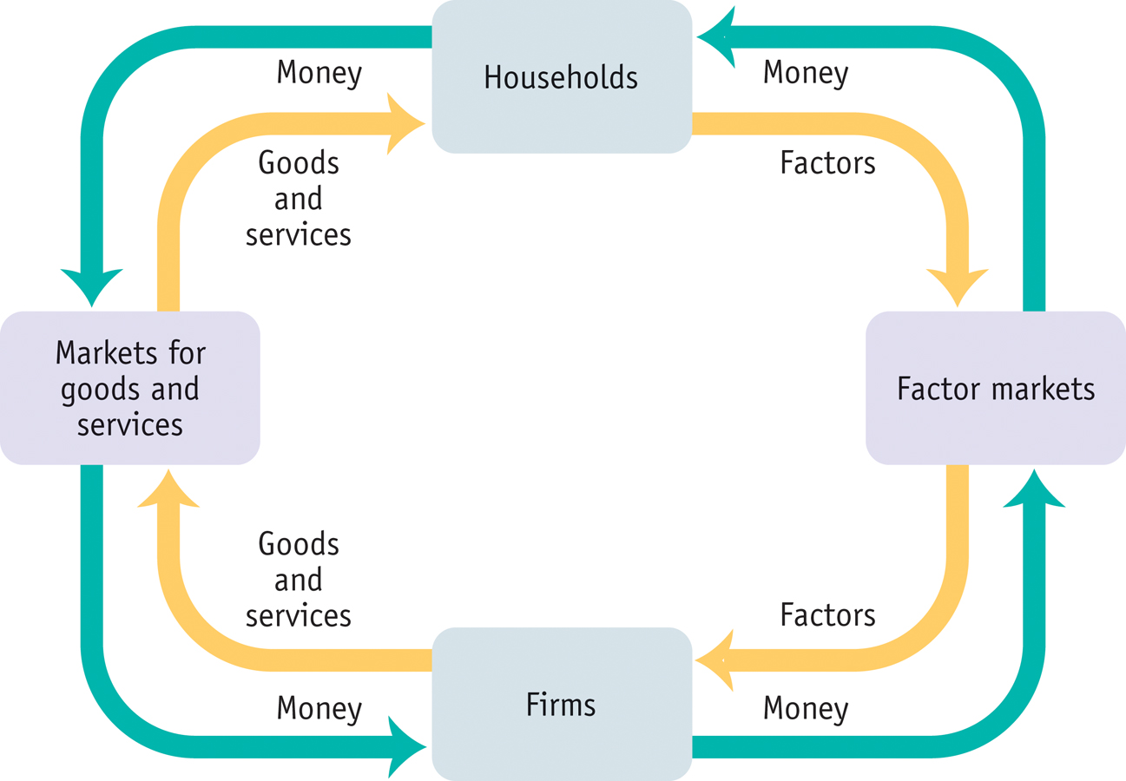
The Circular-Flow Diagram
Notes:
Figure Caption: Figure 10.1: This diagram represents the flows of money and goods and services in the economy. In the markets for goods and services, households purchase goods and services from firms, generating a flow of money to the firms and a flow of goods are services to the households. The money flows back to households as firms purchase factors of production from the households in factor markets.

Slide 6
An Expanded Circular-Flow Diagram
Government purchases of goods and services
Government borrowing
Government
Consumer spending
Taxes
Government transfers
Private savings
Households
Wages, profit, interest, rent
Markets for goods and services
Factor Markets
Financial Markets
Borrowing and
stock issues
by firms
GDP
Wages, profit, interest, rent
Firms
Foreign borrowing and sales of stock
Exports
Rest of the world
Imports
Foreign lending and purchases of stock
Notes:
Figure Caption: Figure 10.2: An Expanded Circular-Flow Diagram: The Flows of Money Through the Economy
A circular flow of funds connects the four sectors of the economy—households, firms, government, and the rest of the world—via three types of markets: the factor markets, the markets for goods and services, and the financial markets. Funds flow from firms to households in the form of wages, profit, interest, and rent through the factor markets. After paying taxes to the government and receiving government transfers, households allocate the remaining income— disposable income—to private savings and consumer spending. Via the financial markets, private savings and funds from the rest of the world are channeled into investment spending by firms, government borrowing, foreign borrowing and lending, and foreign transactions of stocks. In turn, funds flow from the government and households to firms to pay for purchases of goods and services. Finally, exports to the rest of the world generate a flow of funds into the economy and imports lead to a flow of funds out of the economy. If we add up consumer spending on goods and services, investment spending by firms, government purchases of goods and services, and exports, then subtract the value of imports, the total flow of funds represented by this calculation is total spending on final goods and services produced in the United States. Equivalently, it’s the value of all the final goods and services produced in the United States—that is, the gross domestic product of the economy.

Slide 7
The National Accounts
Households engage in consumer spending.
Households own factors of production. They sell these factors to firms, receiving rent, wages, interest on bonds, dividends on stocks.
In addition, households receive government transfers from the government.
Disposable income, total household income minus taxes, is available to spend on consumption or to save.

Slide 8
The National Accounts
Private savings, equal to disposable income minus consumer spending, is disposable income that is not spent on consumption.
The banking, stock, and bond markets, which channel private savings and foreign lending into investment spending, government borrowing, and foreign borrowing, are known as the financial markets.

Slide 9
The National Accounts
Government purchases of goods and services (G) is paid for by tax receipts as well as by government borrowing.
Exports (X) generate an inflow of funds into the country from the rest of the world, while imports (IM) lead to an outflow of funds to the rest of the world.

Slide 10
The National Accounts
Inventories are stocks of goods and raw materials held to facilitate business operations.
Investment spending is spending on productive physical capital, such as machinery and construction of structures, and on changes to inventories.

Slide 11
Gross Domestic Product
Final goods and services are goods and services sold to the final, or end, user.
Intermediate goods and services are goods and services—bought from one firm by another firm—that are inputs for production of final goods and services.

Slide 12
Gross Domestic Product
Gross domestic product or GDP measures the total value of all final goods and services produced in the economy during a given year.
GDP does not include the value of intermediate goods.

Slide 13
Calculating Gross Domestic Product
GDP can be calculated three ways:
  Add up the value added of all producers
  Add up all aggregate spending on domestically-produced final goods and services. This results in the equation: GDP = C + I + G + X - IM
  Add up all income paid to factors of production

Slide 14
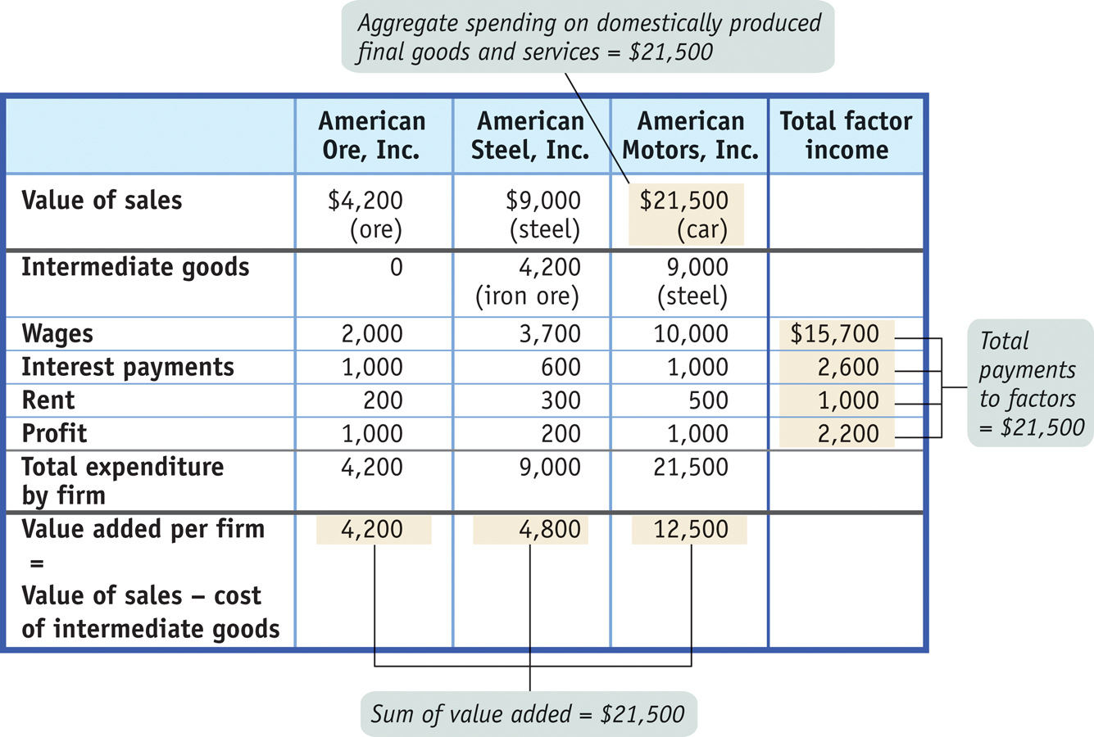
Calculating Gross Domestic Product
Notes:
Figure Caption: Figure 10.3: Calculating GDP
In this hypothetical economy consisting of three firms, GDP can be calculated in three different ways: measuring GDP as the value of production of final goods and services, by summing each firm’s value added; measuring GDP as aggregate spending on domestically produced final goods and services; and measuring GDP as factor income earned by households from firms in the economy.

Slide 15
Calculating Gross Domestic Product
Components of GDP (billions of dollars)
$15,000
10,000
5,000
0
-5,000
Value added by government
= 12.3%
Government purchases of goods and services
= 20.6%
Value added by households
= 12.8%
Investment spending
= 11.4%
C + I + G
= $14,649
Value added by business
= 74.8%
Consumer spending
= 70.8%
Value added by sector
Net exports X – IM = –$390 (–2.7%)
Spending on domestically produced final goods and services
Notes:
Figure Caption: Figure 10.4: U.S. GDP in 2009: Two Methods of Calculating GDP
The two bars show two equivalent ways of calculating GDP. The height of each bar above the horizontal axis represents $14,259 billion, U.S. GDP in 2009. The left bar shows the breakdown of GDP according to the value added of each sector of the economy. The right bar shows the breakdown of GDP according to the four types of aggregate spending: C + I + G + X − IM. The right bar has a total length of $14,259 billion + $390 billion = $14,649 billion. The $390 billion, shown as the area extending below the horizontal axis, is the amount of total spending absorbed by net imports (negative net exports) in 2009. (Numbers don’t add up to 100 due to rounding.)
Source: Bureau of Economic Analysis.

