Slide 1
ECO 120 - Global Macroeconomics
Taggert J. Brooks

Slide 2
Module 12
Unemployment rate: Meaning and calculation

Slide 3
Unemployment Rate
Employment is the number of people currently employed in the economy, either full time or part time.
Unemployment is the number of people who are actively looking for work but aren’t currently employed.
The labor force is equal to the sum of employment and unemployment.

Slide 4
Unemployment Rate
The labor force participation rate is the percentage of the population aged 16 or older that is in the labor force.
The unemployment rate is the percentage of the total number of people in the labor force who are unemployed.

Slide 5
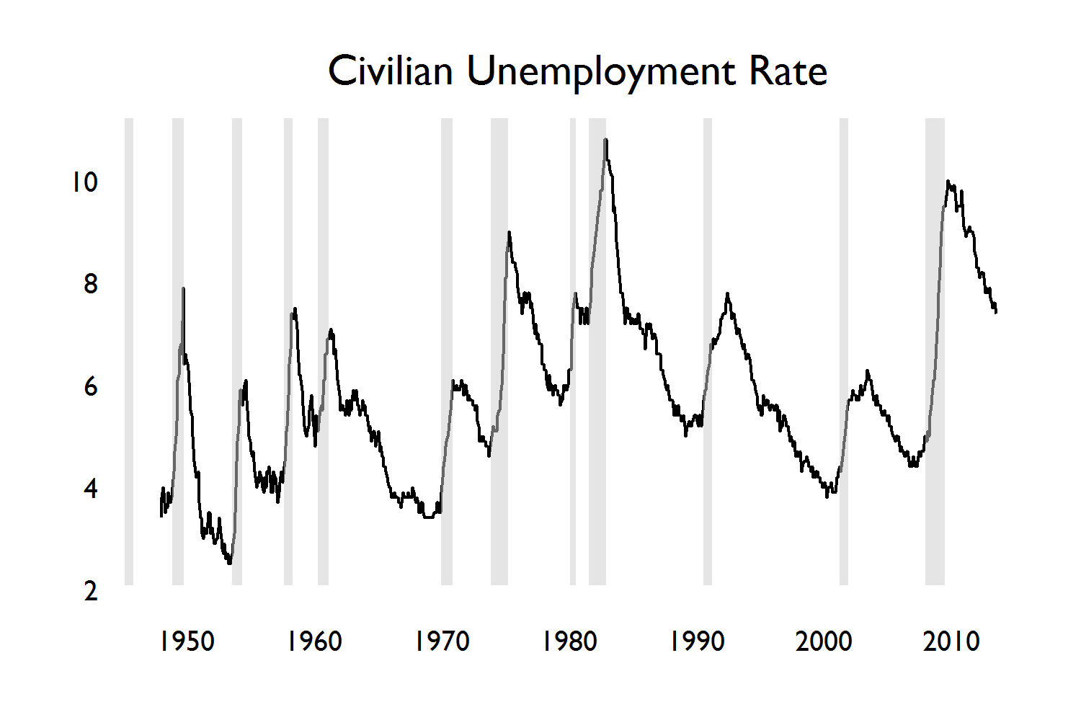
Unemployment Rate
Notes:
Figure Caption: Figure 12.1: The U.S. Unemployment Rate, 1948–2013
The unemployment rate has fluctuated widely over time. It always rises during recessions, which are shown by the shaded bars. It usually, but not always, falls during periods of economic expansion. Source: Bureau of Labor Statistics; National Bureau of Economic Research. Can you identify the empirical

Slide 6
The Significance of the Unemployment Rate
The unemployment rate can overstate the true level of unemployment while people who are easily employed look for the right job.

Slide 7
The Significance of the Unemployment Rate
The unemployment rate can be understated by not including.
  Discouraged workers are nonworking people who are capable of working but have given up looking for a job given the state of the job market.
  Marginally attached workers would like to be employed and have looked for a job in the recent past but are not currently looking for work.
  Underemployment is the number of people who work part time because they cannot find full-time jobs.

Slide 8
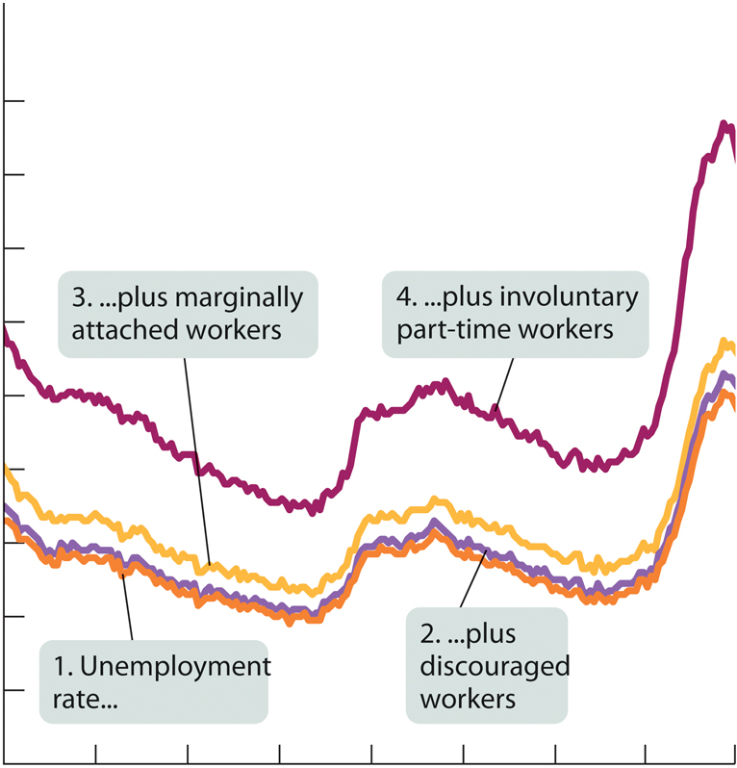
The Significance of the Unemployment Rate
Percentage of labor force
Alternative Measures of Unemployment, 1994–2010
18%
16
14
12
10
8
6
4
2
1994 1996 1998 2000 2002 2004 2006 2008 2010
Notes:
Figure Caption: Figure 12-2: Alternative Measures of Unemployment, 1994–2010
The unemployment number usually quoted in the news media counts someone as unemployed only if he or she has been looking for work during the past four weeks. Broader measures also count discouraged workers, marginally attached workers, and the underemployed. These broader measures show a higher unemployment rate—but they move closely in parallel with the standard rate.
Source: Bureau of Labor Statistics.

Slide 9
The Significance of the Unemployment Rate
Unemployment Rates of Different Groups, 2007
Unemployment rate
35%
30
25
20
15
10
5
0
31.2%
14.4%
7.7%
4.7%
Overall
African-American
White
teenager
African-American
teenager
Notes:
Figure Caption: Figure 24-3: Unemployment Rates of Different Groups, 2007
Unemployment rates vary greatly among different demographic groups. For example, although the overall unemployment rate in August 2007 was 4.7%, the unemployment rate among African-American teenagers was 31.2%. As a result, even during periods of low overall unemployment, unemployment remains a serious problem for some groups.

Slide 10
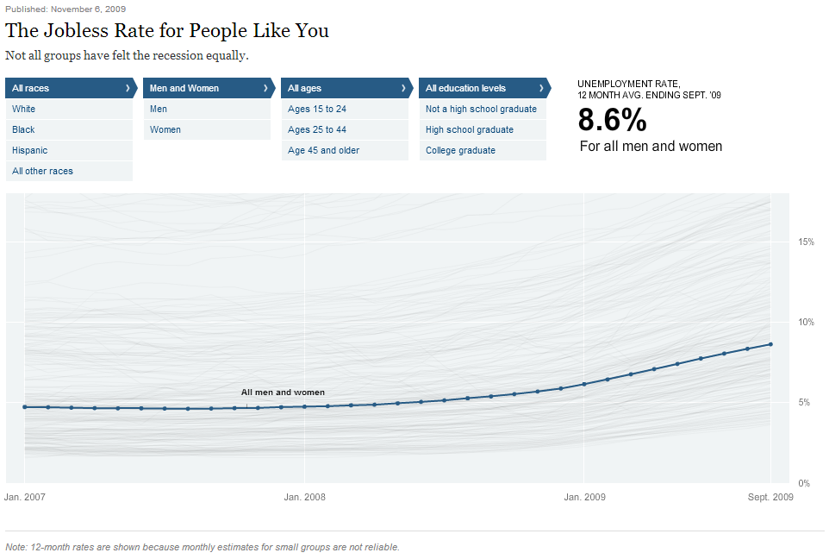
NYTimes Interactive: http://goo.gl/GnglFW
Notes:
While it is a few years old, this interactive graphic gives you a great sense of how unemployment varies among different demographic groups. Click on the link and take a look around. Who is it highest for and who is it lowest for? Differences in race? Gender? education?
Here is another one: http://www.roadtolarissa.com/unemployment/

Slide 11
Growth and Unemployment
During every recession in the last 30 years, the unemployment rate rose.
During periods of expansion, the unemployment rate usually falls, however, not always.

Slide 12
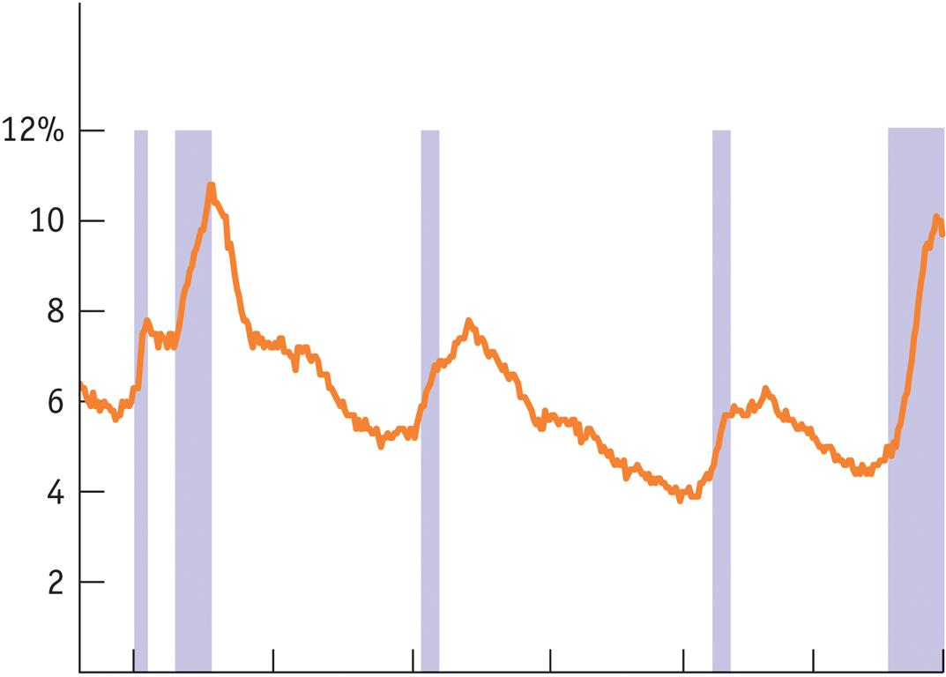
Unemployment Rate
Unemployment Rate
Unemployment and Recessions, 1978-2010
1980 1985 1990 1995 2000 2005 2010
Year
Notes:
Figure Caption: Figure 12-4: Unemployment and Recessions, 1978–2010
This figure shows a close-up of the unemployment rate for the past 30 years, with the shaded bars indicating recessions. It’s clear that unemployment always rises during recessions and usually falls during expansions. But in both the early 1990s and the early 2000s, unemployment continued to rise for some time after the recession was officially declared over.
Source: Bureau of Labor Statistics; National Bureau of Economic Research.

Slide 13
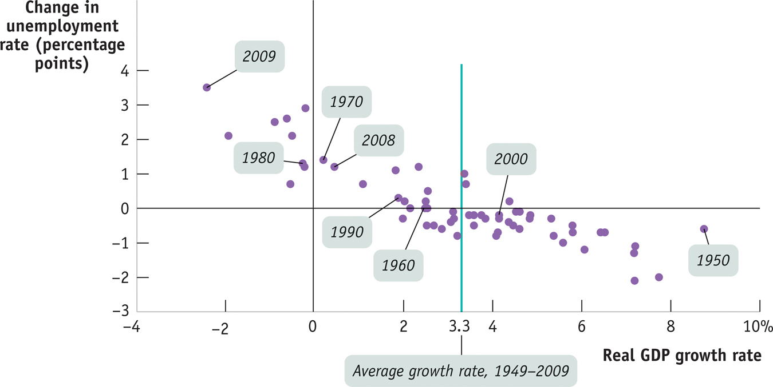
Unemployment Rate
Growth and Changes in Unemployment, 1949-2009
Average growth rate, 1949–2009
Notes:
Figure Caption: Figure 12-5: Growth and Changes in Unemployment, 1949–2009
Each dot shows the growth rate of the economy and the change in the unemployment rate for a specific year between 1949 and 2007. For example, in 2000 the economy grew 3.7% and the unemployment rate fell 0.2 percentage points, from 4.2% to 4.0%. In general, the unemployment rate fell when growth was above its average rate of 3.4% a year and rose when growth was below average. Unemployment always rose when real GDP fell.
Source: Bureau of Labor Statistics; Bureau of Economic Analysis.

