Slide 1
ECO 120 - Global Macroeconomics
Taggert J. Brooks

Slide 2
Module 16
Income and Expenditure

Slide 3
The Multiplier:
An Informal Introduction
The marginal propensity to consume, or MPC, is the increase in consumer spending when disposable income rises by $1.
The marginal propensity to save, or MPS, is the increase in household savings when disposable income rises by $1.

Slide 4
The Multiplier:
An Informal Introduction
Increase in investment spending = $100 billion
  + Second-round increase in consumer spending
  = MPC × $100 billion
  + Third-round increase in consumer spending
  = MPC² × $100 billion
  + Fourth-round increase in consumer spending
  = MPC³ × $100 billion
• • • • • • • • • • • •
Total increase in real GDP
= (1 + MPC + MPC2 + MPC3 + . . .) × $100 billion

Slide 5
The Multiplier:
An Informal Introduction
The $100 billion increase in investment spending sets off a chain reaction in the economy.
The net result of this chain reaction is that a $100 billion increase in investment spending leads to a change in real GDP that is a multiple of the size of that initial change in spending.
How large is this multiple?

Slide 6
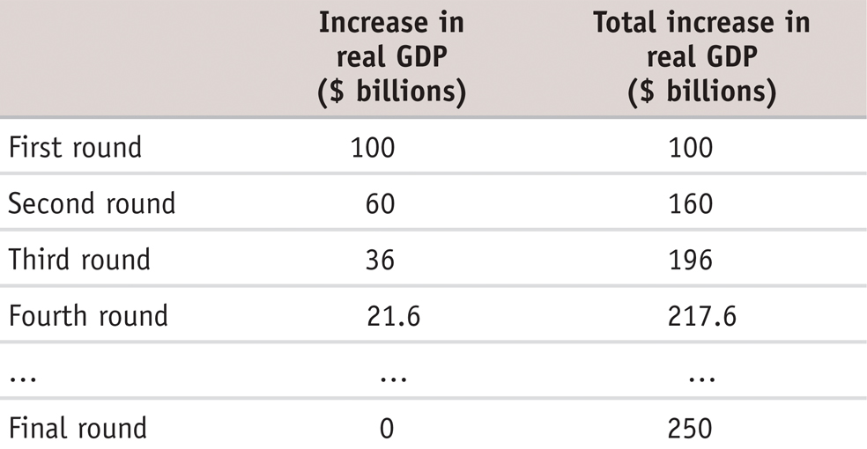
The Multiplier:
Numerical Example
Rounds of Increases of Real GDP When MPC = 0.6

Slide 7
The Multiplier:
Numerical Example
In the end, real GDP rises by $250 billion as a consequence of the initial $100 billion rise in investment spending:
1/(1 − 0.6) × $100 billion
= 2.5 × $100 billion
= $250 billion

Slide 8
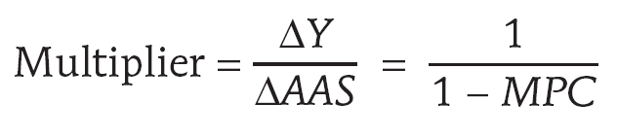
The Multiplier:
An Informal Introduction
An autonomous change in aggregate spending is an initial change in the desired level of spending by firms, households, or government at a given level of real GDP.
The multiplier is the ratio of the total change in real GDP caused by an autonomous change in aggregate spending to the size of that autonomous change.
Simple Keynesian
Multiplier

Slide 9
The Multiplier and the Great Depression
The concept of the multiplier was originally devised by economists trying to understand the Great Depression. Most economists believe that the slump from 1929 to 1933 was driven by a collapse in investment spending.
But as the economy shrank, consumer spending also fell sharply, multiplying the effect on real GDP.
In the modern U.S. economy, taxes are much higher than in 1929, and so is government spending.
Why does this matter? Because taxes and some government programs act as automatic stabilizers, reducing the size of the multiplier.

Slide 10

Consumer Spending
The consumption function is an equation showing how an individual household’s consumer spending varies with the household’s current disposable income.

Slide 11
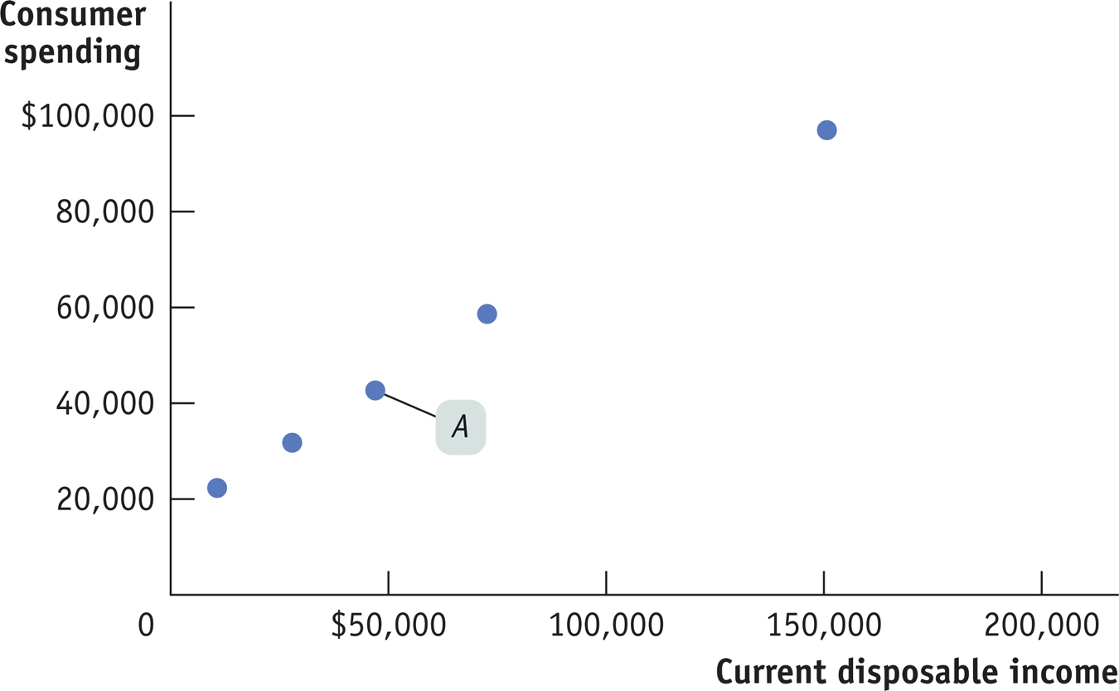
Disposable Income and Consumer Spending
Notes:
Figure Caption: Figure 16.1: Current Disposable Income and Consumer Spending for American Households in 2008
For each income groups of households, average current disposable income in 2006 is plotted versus average consumer spending in 2006. For example, the middle income group, with an annual income of $36,271 to $59,086, is represented by point A, indicating a household average current disposable income of $46,936 and average household consumer spending of $42,659. The data clearly show a positive relationship between current disposable income and consumer spending: families with higher current disposable income have higher consumer spending.

Slide 12
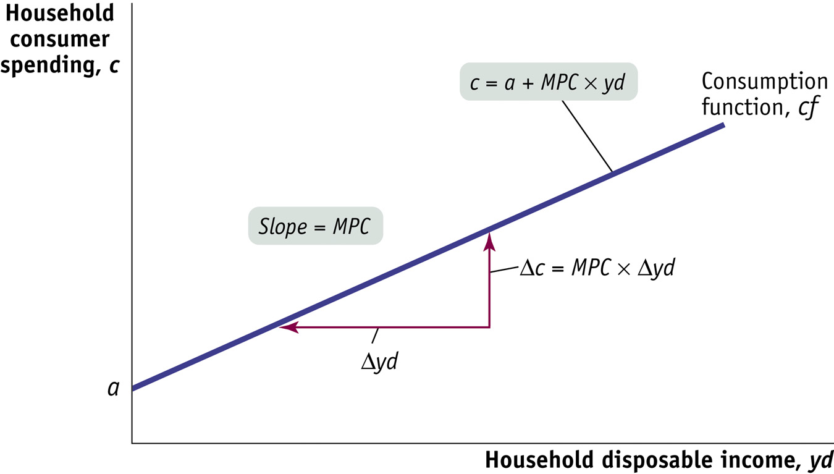
The Consumption Function
Notes:
Figure Caption: Figure 16.2: The Consumption Function
The consumption function relates a household’s current disposable income to its consumer spending. The vertical intercept, a, is individual household autonomous spending: the amount of a household’s consumer spending if its current disposable income is zero. The slope of the consumption function line, cf, is the marginal propensity to consume, or MPC: of every additional $1 of current disposable income, MPC × $1 of it is spent.

Slide 13
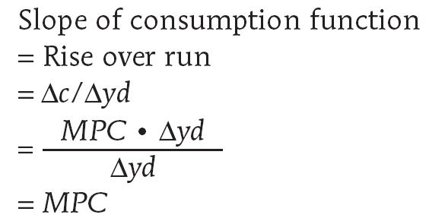
The Consumption Function
Deriving the Slope of the Consumption Function

Slide 14
The Consumption Function
For American households, the best estimate of the average household’s autonomous consumer spending is $17,484 and the best estimate of the MPC is 0.534.

Slide 15
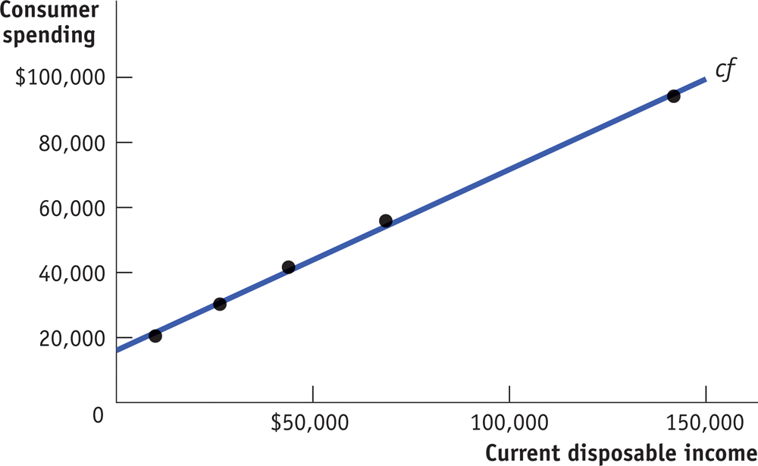
A Consumption Function
Fitted to Data
Notes:
Figure Caption: Figure 16.3: A Consumption Function Fitted to Data
The data from Figure 16.1 are reproduced here, along with a line drawn to fit the date as closely as possible. For American households in 2006, the best estimate of the average household’s autonomous consumer spending, a , is $17,484 and the best estimate of 0.534 or approximately 0.53.

Slide 16
Shifts of the Aggregate Consumption Function
The aggregate consumption function is the relationship for the economy as a whole between aggregate current disposable income and aggregate consumer spending.

Slide 17
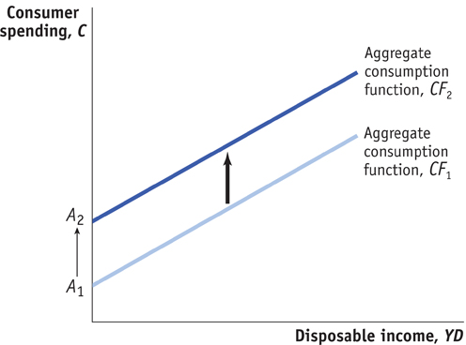
Shifts of the Aggregate Consumption Function
The aggregate consumption function shifts in response to changes in expected future disposable income and changes in aggregate wealth.
Notes:
Figure Caption: Figure 16.4 (a): An Upwards Shift of the Aggregate Consumption Function
The effect of an increase in expected future disposable income. Consumers will spend more at every given level of current disposable income, YD. As a result, the initial aggregate consumption function CF₁, with aggregate autonomous spending A1, shifts up to a new position at CF2 and aggregate autonomous spending A2. An increase in aggregate wealth will also shift the aggregate consumption up.

Slide 18
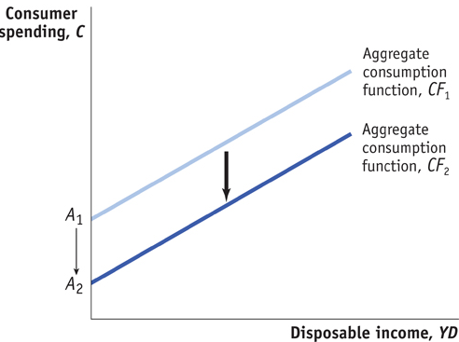
Shifts of the Aggregate Consumption Function
Notes:
Figure Caption: Figure 16.4 (b): An Downward Shift of the Aggregate Consumption Function
The effect of a reduction in expected future disposable income. Consumers will spend less at every given level of current disposable income, YD. Consequently, the initial aggregate consumption function CF₁, with aggregate autonomous spending A₁, shifts down to a new position at CF₂ and aggregate autonomous spending A₂. A reduction in aggregate wealth will have the same effect.

Slide 19
Investment Spending
Planned investment spending is the investment spending that businesses plan to undertake during a given period.
It depends negatively on:
  interest rate
  existing production capacity
and positively on:
  expected future real GDP

Slide 20
Expected Future Real GDP, Production Capacity, and Investment Spending
Expected future sales has a positive effect on investment spending.
The current level of productive capacity has a negative effect on investment spending.
Therefore, firms will be most likely to undertake high levels of investment when they expect sales to grow rapidly.
This growth of sales will take up any excess capacity and encourage investment.

Slide 21
Fluctuations in Investment Spending and Consumer Spending
Consumer spending
Investment spending
5%
2.9%
2.4%
0
-5
-0.6%
-1.2%
-1.1%
-10
-10.1%
-15
-10.6%
-15.9%
-20
-25
-22.5%
-28.8%
-30
1973–1975 1980 1981–1982 1990 – 1991 2001
Notes:
Figure Caption: Figure 16.5: Fluctuations in Investment Spending and Consumer Spending
The bars illustrate annual percentage changes in investment spending and consumer spending during the last five recessions. As the lengths of the bars show, swings in investment spending were much larger in percentage terms than those in consumer spending. This has led economists to believe that recessions typically originate as a slump in investment spending.

Slide 22
Inventories and Unplanned Investment Spending
Inventories are stocks of goods held to satisfy future sales.
Inventory investment is the value of the change in total inventories held in the economy during a given period.
Unplanned inventory investment occurs when actual sales are more or less than businesses expected, leading to unplanned changes in inventories.

Slide 23
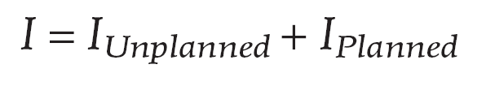
Inventories and Unplanned Investment Spending
Actual investment spending is the sum of planned investment spending and unplanned inventory investment.

