Slide 1
ECO 120 - Global Macroeconomics
Taggert J. Brooks

Slide 2
Module 18
Aggregate Supply: Introduction and Determinants

Slide 3
Aggregate Supply
The aggregate supply curve shows the relationship between the aggregate price level and the quantity of aggregate output in the economy.

Slide 4
The Short-Run Aggregate Supply Curve
The short-run aggregate supply curve is upward-sloping because nominal wages are sticky in the short run:
a higher aggregate price level leads to higher profits and increased aggregate output in the short run.
The nominal wage is the dollar amount of the wage paid.
Sticky wages are nominal wages that are slow to fall even in the face of high unemployment and slow to rise even in the face of labor shortages.

Slide 5
The Short-Run Aggregate Supply Curve
Short-run aggregate
supply curve, SRAS
Aggregate price
level (GDP deflator,
2005 = 100)
10.6
1929
7.9
A movement down
the SRAS curve leads
to deflation and lower
aggregate output.
1933
0
$716
977
Real GDP (billions of
2005 dollars)
Notes:
Figure Caption: Figure 18.1: The Short-Run Aggregate Supply Curve
The short-run aggregate supply curve shows the relationship between the aggregate price level and the quantity of aggregate output supplied in the short run, the period in which many production costs such as nominal wages are fixed. It is upward sloping because a higher aggregate price level leads to higher profit per unit of output and higher aggregate output given fixed nominal wages. Here we show numbers corresponding to the Great Depression, from 1929 to 1933: when deflation occurred and the aggregate price
level fell from 10.6 (in 1929) to 7.9 (in 1933), firms responded by reducing the quantity of aggregate output supplied from $977 billion to $716 billion measured in 2000 dollars.

Slide 6
Shifts of the Short-Run Aggregate Supply Curve
(a) Leftward Shift
(b) Rightward Shift
Aggregate price level
Aggregate
price level
SRAS
2
SRAS
1
SRAS
1
SRAS
2
Decrease in short-run aggregate supply
Increase in short-run
aggregate supply
Real GDP
Real GDP
Notes:
Figure Caption: Figure 18.2: Shifts of the Short-Run Aggregate Supply Curve
Panel (a): A decrease in short-run aggregate supply: the short-run aggregate supply curve shifts leftward from SRAS1 to SRAS2, and the quantity of aggregate output supplied at any given aggregate price level falls.
Panel (b): An increase in short-run aggregate supply: the short-run aggregate supply curve shifts rightward from SRAS1 to SRAS2,and the quantity of aggregate output supplied at any given aggregate price level rises.

Slide 7
Shifts of the Short-Run Aggregate Supply Curve
Changes in commodity prices, nominal wages, or productivity lead to changes in producers’ profits and shift the short-run aggregate supply curve.

Slide 8
Factors that Shift Short-Run Aggregate Supply
Changes in commodity prices
If commodity prices fall If commodity prices rise | Short-run aggregate supply increases Short-run aggregate supply decreases
Changes in nominal wages
If nominal wages fall If nominal wages rise | Short-run aggregate supply increases Short-run aggregate supply decreases
Changes in productivity
If workers become more productive If workers become less productive | Short-run aggregate supply increases Short-run aggregate supply decreases

Slide 9
Long-Run Aggregate Supply Curve
The long-run aggregate supply curve shows the relationship between the aggregate price level and the quantity of aggregate output supplied that would exist if all prices, including nominal wages, were fully flexible.

Slide 10
Long-Run Aggregate Supply Curve
Aggregate price
level (GDP deflator,
2005 = 100)
Long-run aggregate
supply curve, LRAS
15.0
…leaves the quantity
of aggregate output
supplied unchanged
in the long run.
A fall in the aggregate price level
7.5
0
Potential output, YP
$800
Real GDP (billions of
2005 dollars)
Notes:
Figure Caption: Figure 18.3: Long-Run Aggregate Supply Curve
The long-run aggregate supply curve shows the quantity of aggregate output supplied when all prices, including nominal wages, are flexible. It is vertical at potential output, Y_{P} , because in the long run an increase in the aggregate price level has no effect on the quantity of aggregate output supplied.

Slide 11
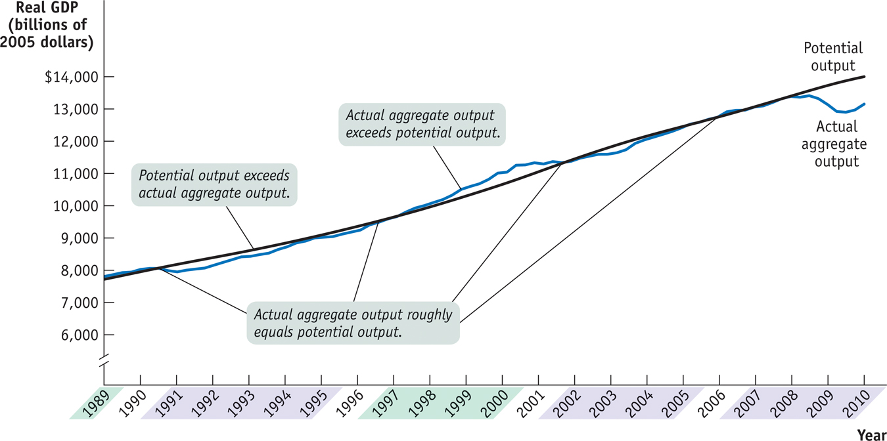
Actual and Potential Output from 1989 to 2009
Notes:
Figure Caption: Figure 18.4: Actual and Potential Output from 1989 to 2009
This figure shows the performance of actual and potential output in the United States from 1989 to 2009. The black line shows estimates of U.S. potential output, produced by the Congressional Budget Office, and the blue line shows actual aggregate output. The purple-shaded years are periods in which actual aggregate output fell below potential output, and the green-shaded years are periods in which actual aggregate output exceeded potential output. As shown, significant shortfalls occurred in the recessions of the early 1990s and after 2000—particularly during the recession that began in 2007. Actual aggregate output was significantly above potential output in the boom of the late 1990s.
Source: Congressional Budget Office; Bureau of Economic Analysis.

Slide 12
From the Short Run to the Long Run
(a) Leftward Shift of the Short-Run
Aggregate Supply Curve
(b) Rightward Shift of the Short-Run
Aggregate Supply Curve
Aggregate
price level
Aggregate
price level
L
R
AS
L
R
AS
S
R
AS
1
S
R
AS
2
S
R
AS
2
S
R
AS
1
A fall in nominal wages shifts SRAS rightward.
P
A₁
A₁
1
P
1
A rise in nominal
wages shifts SRAS
leftward.
Y
P
Y
1
Real GDP
Y
1
Y
P
Real GDP
Notes:
Figure Caption: Figure 18.5: From the Short Run to the Long Run
Panel (a): The initial short-run aggregate supply curve is SRAS₁. At the aggregate price level, P₁, the quantity of aggregate output supplied, Y₁, exceeds potential output, Y_{P}. Eventually, low unemployment will cause nominal wages to rise, leading to a leftward shift of the short-run aggregate supply curve from SRAS₁ to SRAS₂.
Panel (b): At the aggregate price level, P₁, the quantity of aggregate output supplied is less than potential output. This reflects the fact that the short-run aggregate supply curve has shifted to the right, due to both the short-run adjustment process in the economy and to a rightward shift of the long-run aggregate supply curve.

Slide 13
Prices and Output During the Great Depression
Notes:
Figure Caption: Prices and Output During the Great Depression
From 1929 to 1933, prices and aggregate output fell together. And from 1933 to 1937, prices and aggregate output rose together. That is, during the period of 1929 to 1937, the economy behaved as if it were first moving down and then up the short-run aggregate supply curve. By the late 1930s, however, aggregate output was above 1929 levels even though the aggregate price level was still lower than it was in 1929. This reflects the fact that the short-run aggregate supply curve had shifted to the right during this period, due to both the short-run adjustment process in the economy and to a rightward shift of the long-run aggregate supply curve.

