Slide 1
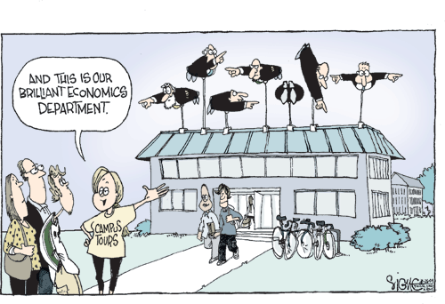

Slide 8
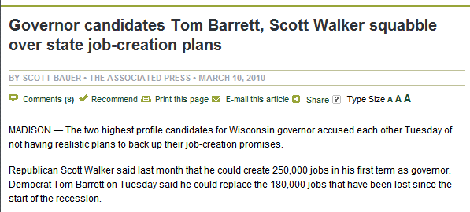

Slide 12
Expand Coverage
Increase Access
Cost Controls
Taxes and Fees

Slide 13
Expand Coverage
32 Million more Americans covered, about half through Medicaid

Slide 14
National Compensation Measures as a Share of GDP, NIPA 1960-2006
Private Group Health Insurance
56.3% of GDP
56.4% of GDP
Other Fringe Benefits and Payroll Taxes
3.8%
6.7%
0.6%
4.1%
Wages
51.8%
45.6%
2006
Source: Kaiser Family Foundation analysis of data from the U.S. Department of Commerce, Bureau of Economic Analysis, National Income and Product Accounts, 1960-2006, Tables 1.1.5, 2.1, 6.11B, 6.11C, & 6.11D, 2008.
Notes:
Although total compensation – wages plus benefits – has remained fairly stable as a share of our nation's economy since 1960, health benefit costs paid by employers has risen from 0.6 percent of GDP in 1960 to 4.1 percent in 2006.

Slide 15
Cost Controls
Independent Medicare Board

Slide 16
Long Term Fiscal Problems
Medicare and Medicaid.
Notes:
As much as 53 Trillion dollars. 34 trillion for medicare (of which about 8 trillion is prescription drugs) and the rest social security.

Slide 18
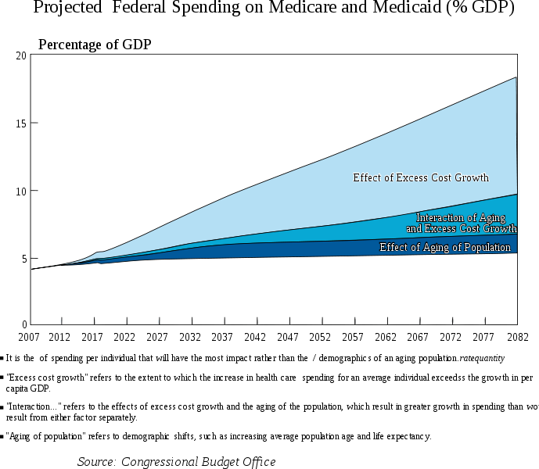

Slide 19
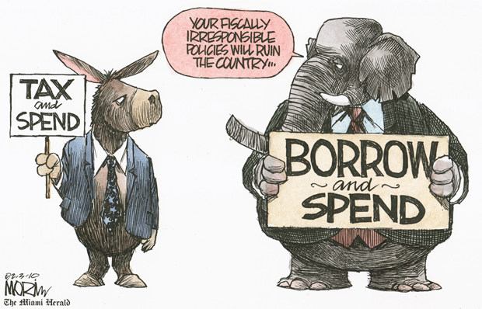

Slide 20
Taxes and Fees
Notes:
2018 cadillac tax

Slide 24
Panelists
Mark Glendenning,
Inland Label and Marketing Services
Jerry Arndt,
Gundersen Lutheran
Mike Cichanowski,
Wenonah Canoe

