Slide 1
ECO 120 - Global Macroeconomics
Taggert J. Brooks

Slide 2
Module 21
Fiscal Policy and the Multiplier

Slide 3
Using the Multiplier to Estimate the Influence of Government Policy
Fiscal policy has a multiplier effect on the economy.
Fiscal policy can take the form of changes in taxes, transfers, and government spending.
Expansionary fiscal policy leads to an increase in real GDP larger than the initial rise in aggregate spending caused by the policy.
Conversely, contractionary fiscal policy leads to a fall in real GDP larger than the initial reduction in aggregate spending caused by the policy.

Slide 4
Using the Multiplier to Estimate the Influence of Government Policy
The multiplier on changes in government purchases is 1/(1 − MPC).
This is the “Simple Keynesian Multiplier”. Named after the model of John Maynard Keynes.

Slide 5
Multiplier Effects of Changes in Taxes and Government Transfers
Example: The government hands out $50 billion in the form of tax cuts.
There is no direct effect on aggregate demand by government purchases of goods and services; GDP goes up only because households spend some of that $50 billion.
How much will they spend?
MPC × $50 billion. For example, if MPC = 0.6, the first-round increase in consumer spending will be $30 billion (0.6 × $50 billion = $30 billion).
This initial rise in consumer spending will lead to a series of subsequent rounds in which real GDP, disposable income, and consumer spending rise further.
Notes:
Notes to the Instructor:
But because the initial impact of the tax cut was smaller than that of an equal-sized increase in government purchases, the overall effect on GDP will also be smaller. In general, $1 of tax cuts will increase GDP by $MPC/(1 − MPC), less than the multiplier on increases in government purchases, which is 1/(1 − MPC). For example, if the marginal propensity to consume is 0.6, each dollar increase in government purchases of goods and services raises GDP by $1/(1 − 0.6) = $2.50, but each dollar of tax cuts raises GDP by only $0.6/(1 − 0.6) = $1.50.

Slide 6
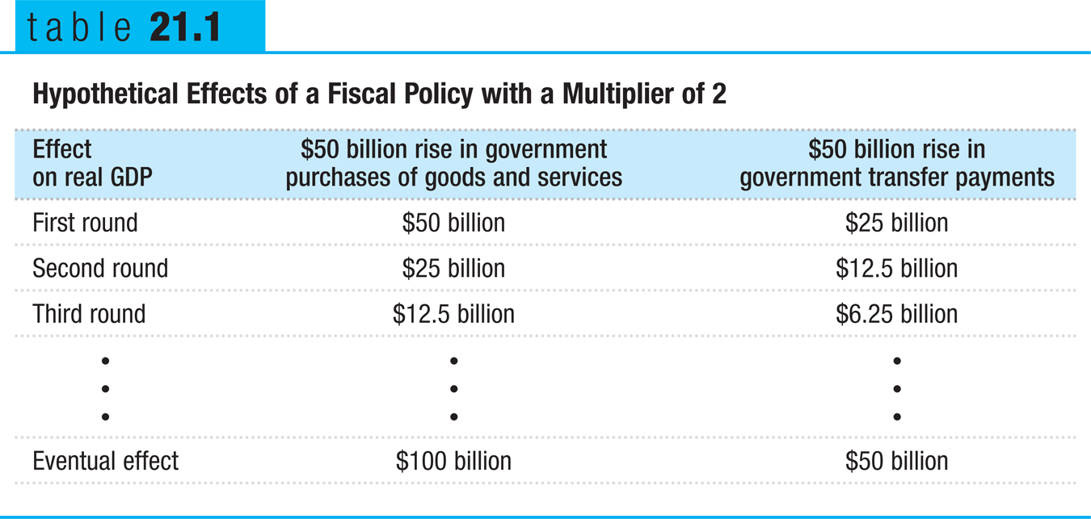
Multiplier Effects of Changes in Government Transfers and Taxes

Slide 7
Multiplier Effects of Changes in Government Transfers and Taxes
The multiplier on changes in taxes or transfers, MPC/(1 − MPC), because part of any change in taxes or transfers is absorbed by savings.
The results from changes in taxes are complicated by the fact that governments rarely impose lump sum taxes.
Changes in government purchases have a more powerful effect on the economy than equal-sized changes in taxes or transfers.

Slide 8
How Taxes Affect the Multiplier
Rules governing taxes and some transfers act as automatic stabilizers, reducing the size of the multiplier and automatically reducing the size of fluctuations in the business cycle.
In contrast, discretionary fiscal policy arises from deliberate actions by policy makers rather than from the business cycle.

