Slide 1
ECO 120 - Global Macroeconomics
Taggert J. Brooks

Slide 2
Module 24
The Time Value of Money

Slide 3
The Concept of Present Value
When someone borrows money for a year, the interest rate is the price, calculated as a percentage of the amount borrowed, charged by the lender.
The interest rate can be used to compare the value of a dollar realized today with the value of a dollar realized later, because it correctly measures the cost of delaying a dollar of benefit (and the benefit of delaying a dollar of cost).
The present value of $1 realized one year from now is equal to $1/(1 + r): the amount of money you must lend out today in order to have $1 in one year. It is the value to you today of $1 realized one year from now.

Slide 4
Present Value
Let’s call $X the amount of money you need to lend today, at an interest rate of r in order to have $1 in two years.
So if you lend $X today, you will receive $X(1 + r) in one year.
And if you re-lend that sum for yet another year, you will receive $X × (1 + r) × (1 + r) = $X × (1 + r)² at the end of the second year.
At the end of two years, $X will be worth $X × (1 + r)²;
If r = 0.10, then this becomes $X × (1.10)² = $X × (1.21).

Slide 5
Present Value
What is $1 realized two years in the future worth today?
In order for the amount lent today, $X, to be worth $1 two years from now, it must satisfy this formula:
$X × (1 + r)² = $1
If r = 0.10, $X = $1/(1 + r)² = $1/1.21 = $0.83
The present value formula is equal to $1/(1 + r)^{N}

Slide 6
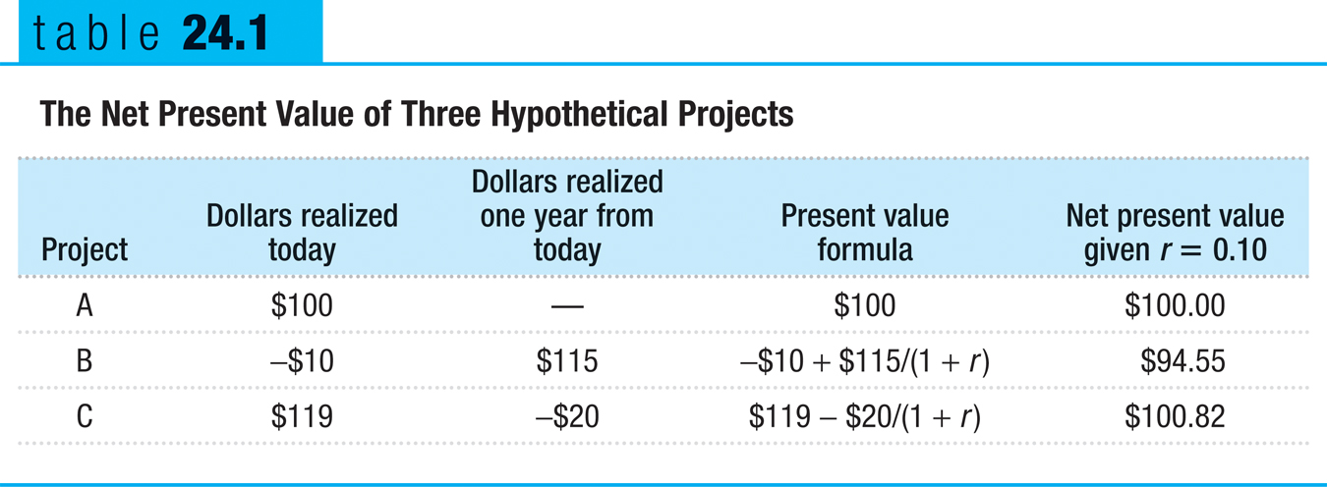
Using Present Value
The net present value of a project is the present value of current and future benefits minus the present value of current and future costs.

