Slide 1
ECO 120 - Global Macroeconomics
Taggert J. Brooks
Spring 2014

Slide 2
Module 25
Banking and Money Creation

Slide 3
The Monetary Role of Banks
A bank is a financial intermediary that uses liquid assets in the form of bank deposits to finance the illiquid investments of borrowers.
A T-account is a tool for analyzing a business’s financial position by showing, in a single table, the business’s assets (on the left) and liabilities (on the right).
Notes:
Figure 25.1 A T-Account for Samantha’s Smoothies: A T-Account summarizes a business’s financial position. Its assets, in this case consisting of a building and some smoothie-making machinery, are on the left side. Its liabilities, consisting of the money it owes to a local bank.

Slide 4
The Monetary Role of Banks
Bank reserves are the currency banks hold in their vaults plus their deposits at the Federal Reserve.
The reserve ratio is the fraction of bank deposits that a bank holds as reserves.

Slide 5
Assets and Liabilities of First Street Bank
The Federal reserve sets a required reserve ratio.
A T-account summarizes a bank’s financial position. The bank’s assets, $900,000 in outstanding loans to borrowers and reserves of $100,000, are entered on the left side. Its liabilities, $1,000,000 in bank deposits held for depositors, are entered on the right side.
Notes:
Figure 25.2: Assets and Liabilities of First Street Bank. First Street Bank’s assets consist of $1,000,000 in loans and $100,000 in reserves. Its liabilities consist of $1,000,000 in deposits—money owed to people who have placed funds in First Street’s hands.

Slide 6
The Problem of Bank Runs
A bank run is a phenomenon in which many of a bank’s depositors try to withdraw their funds due to fears of a bank failure.
Historically, they have often proved contagious, with a run on one bank leading to a loss of faith in other banks, causing additional bank runs.

Slide 7
Bank Regulations
Deposit Insurance guarantees that a bank’s depositors will be paid even if the bank can’t come up with the funds, up to a maximum amount per account.
The FDIC currently guarantees the first $250,000 of each account.

Slide 8
Bank Regulations
Capital Requirements - regulators require that the owners of banks hold substantially more assets than the value of bank deposits.
In practice, banks’ capital is equal to 7% or more of their assets.

Slide 9
Bank Regulations
Reserve Requirements - rules set by the Federal Reserve that determine the minimum reserve ratio for a bank. For example, in the United States, the minimum reserve ratio for checkable bank deposits is 10%.
The discount window is an arrangement in which the Federal Reserve stands ready to lend money to banks in trouble.

Slide 10
Determining the Money Supply
Effect on the Money Supply of a Deposit at First Street Bank Initial Effect Before Bank Makes New Loans:
Notes:
Figure Caption: Figure 25.3 (a): Effect on the Money Supply of a Deposit at First Street Bank
When Silas deposits $1,000 (which had been stashed under his mattress) in a bank account, there is initially no effect on the money supply: currency in circulation falls by $1,000, but bank deposits rise by $1,000. The corresponding entries on the bank’s T-account show deposits initially rising by $1,000 and the bank’s reserves initially rising by $1,000.

Slide 11
Determining the Money Supply
Effect on the Money Supply of a Deposit at First Street Bank Effect After Bank Makes New Loans:
Notes:
Figure Caption: Figure 25.3 (b): Effect on the Money Supply of a Deposit at First Street Bank
In the second stage, the bank holds 10% of Silas’s deposit ($100) as reserves and lends out the rest ($900) to Mary. As a result, its reserves fall by $900 and its loans increase by $900. Its liabilities, including Silas’s $1,000 deposit, are unchanged. The money supply, the sum of bank deposits and currency in circulation, has now increased by $900—the $900 now held by Mary.

Slide 12
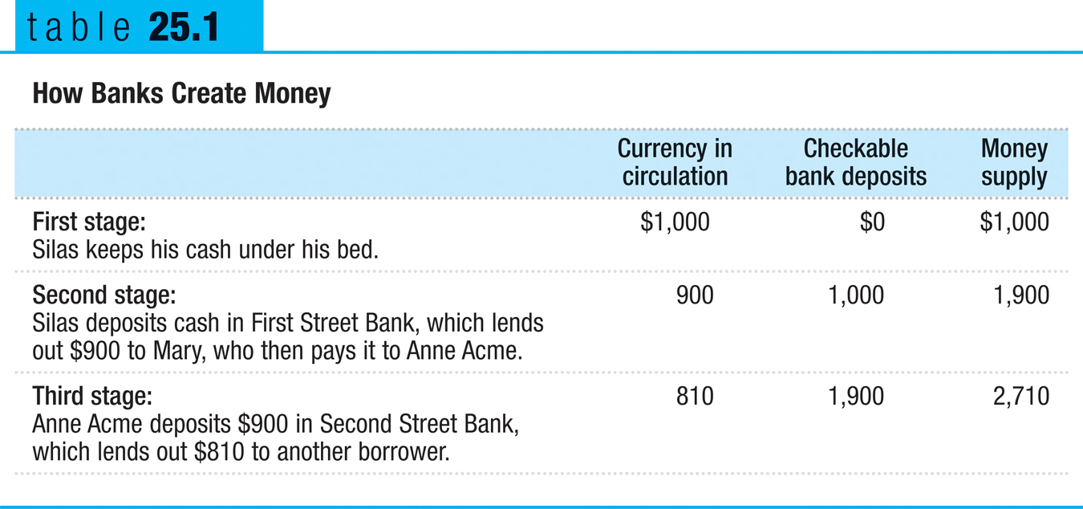
How Banks Create Money

Slide 13
Reserves, Bank Deposits, and the Money Multiplier
Excess reserves are bank reserves over and above its required reserves.
Increase in bank deposits from $1,000 in excess reserves = $1,000 + $1,000 × (1 − rr) + $1,000 × (1 − rr)2 + $1,000 × (1 − rr)3 + . . .
This can be simplified to:
Increase in bank deposits from $1,000 in excess reserves = $1,000/rr

Slide 14
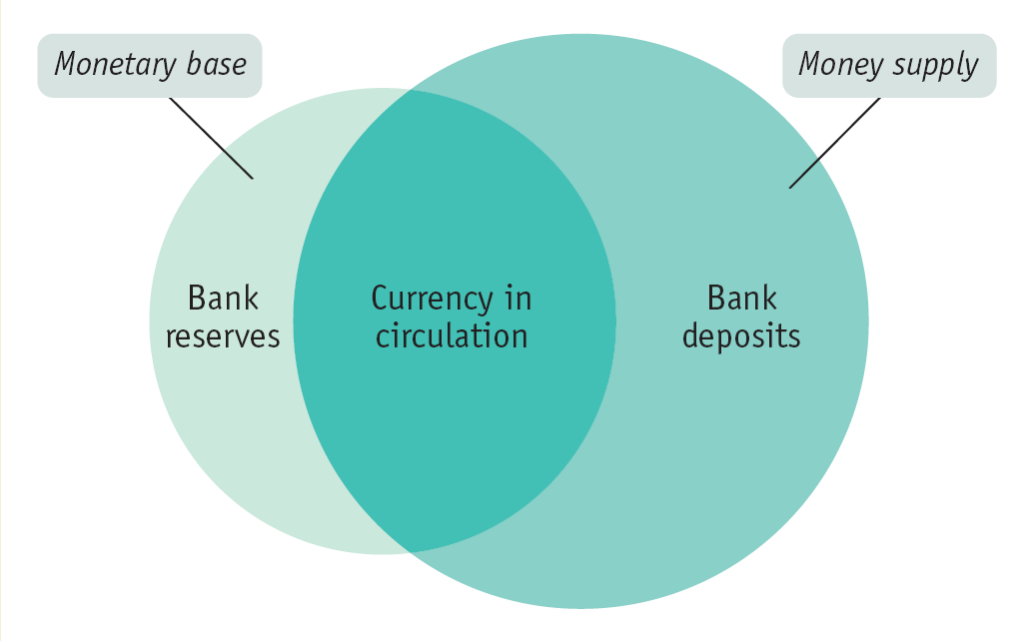
The Money Multiplier in Reality
The monetary base is the sum of currency in circulation and bank reserves.
The money multiplier is the ratio of the money supply to the monetary base.
Notes:
Figure Caption: Figure 25.4: The Monetary Base and the Money Supply
It is different from the money supply, bank deposits plus currency in circulation. Each dollar of bank reserves backs several dollars of bank deposits, making the money supply larger than the monetary base.

