Slide 1
ECO 120 - Global Macroeconomics
Taggert J. Brooks
Spring 2014

Slide 2
Module 27
The Federal Reserve System-Monetary Policy

Slide 3
The Functions of the Federal Reserve System
Provide financial services
Supervise and regulate banking institutions
Maintain the stability of the financial system
Conduct monetary policy

Slide 4
What the Fed Does
Sets reserve requirements - rules set by the Federal Reserve that determine the minimum reserve ratio for a bank.
For example, in the United States, the minimum reserve ratio for checkable bank deposits is 10%.
The federal funds market allows banks that fall short of the reserve requirement to borrow funds from banks with excess reserves.
The federal funds rate is the interest rate determined in the federal funds market.

Slide 5
Reserve Requirements and the Discount Rate
Operates the discount window – an arrangement in which the Federal Reserve stands ready to lend money to banks in trouble.
The discount rate is the rate of interest the Fed charges on loans to banks.

Slide 6
Open-Market Operations
Conducts open-market operations – the principal tool of monetary policy.
The Fed can increase or reduce the monetary base by buying government debt (U.S. Treasury Bills) from banks or selling government debt to banks.
The Federal Reserve’s Assets and Liabilities:
Notes:
Figure 27.1: The Federal reserve’s Assets and Liabilities. The Federal Reserve holds its assets mostly in short-term government bonds called U.S. Treasury bills. Its liabilities are the monetary base—currency in circulation plus bank reserves.

Slide 7
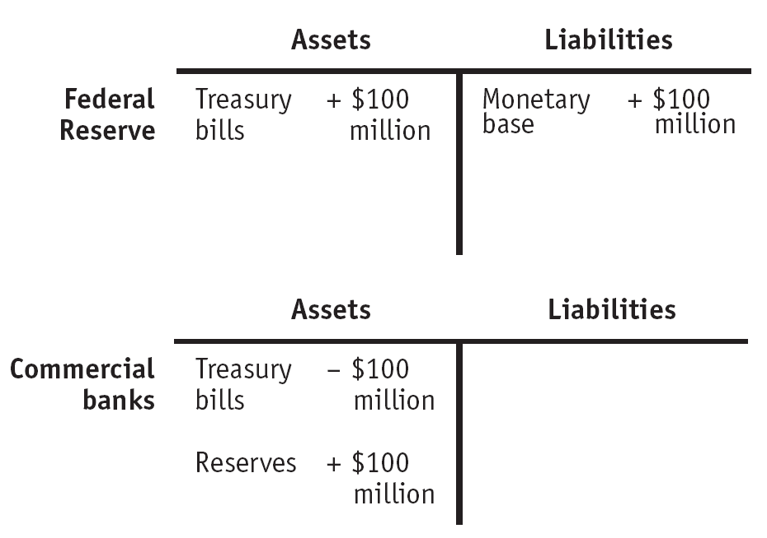
Open-Market Operations by the Federal Reserve
An Open-Market Purchase of $100 Million
Notes:
Figure Caption: Figure 27.2 (a): Open-Market Operations by the Federal Reserve
In panel (a), the Federal Reserve increases the monetary base by purchasing U.S. Treasury bills from private commercial banks in an open-market operation. Here, a $100 million purchase of U.S. Treasury bills by the Federal Reserve is paid for by a $100 million addition to private bank reserves, generating a $100 million increase in the monetary base. This will ultimately lead to an increase in the money supply via the money multiplier as banks lend out some of these new reserves.

Slide 8
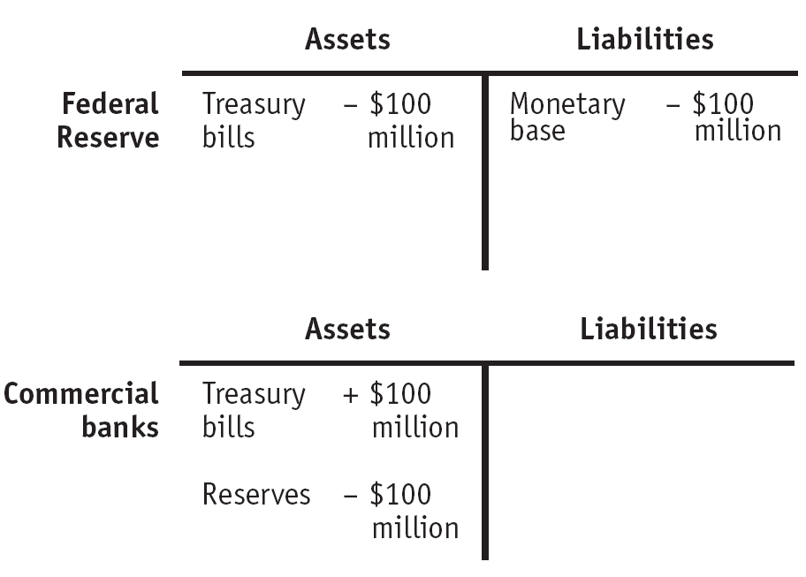
Open-Market Operations by the Federal Reserve
An Open-Market Sale of $100 Million
Notes:
Figure Caption: Figure 27.2 (b): Open-Market Operations by the Federal Reserve
In panel (b), the Federal Reserve reduces the monetary base by selling U.S. Treasury bills to private commercial banks in an open-market operation. Here, a $100 million sale of U.S. Treasury bills leads to a $100 million reduction in private bank reserves, resulting in a $100 million decrease in the monetary base. This will ultimately lead to a fall in the money supply via the money multiplier as banks reduce their loans in response to a fall in their reserves.

Slide 9
Open-Market Operations by the Federal Reserve
Who Gets the Interest on the Fed’s Assets?
Who gets the profits? U.S. taxpayers do.
The Fed keeps some of the interest it receives to finance its operations, but turns most of it over to the U.S. Treasury.
For example, in 2007 the Federal Reserve system received $40.3 billion in interest on its holdings of Treasury bills, of which $34.6 billion was returned to the Treasury.
The Fed decides on the size of the monetary base based on economic considerations—in particular, the Fed doesn’t let the monetary base get too large, because that can cause inflation.
Notes:
Figure Caption: Figure 27.2 (b): Open-Market Operations by the Federal Reserve
In panel (b), the Federal Reserve reduces the monetary base by selling U.S. Treasury bills to private commercial banks in an open-market operation. Here, a $100 million sale of U.S. Treasury bills leads to a $100 million reduction in private bank reserves, resulting in a $100 million decrease in the monetary base. This will ultimately lead to a fall in the money supply via the money multiplier as banks reduce their loans in response to a fall in their reserves.

