Slide 1
ECO 120 - Global Macroeconomics
Taggert J. Brooks
Spring 2014

Slide 2
Module 28
The Money Market

Slide 3
The Demand for Money
The Opportunity Cost of Holding Money
The decision process to hold money is the same process as the decision to purchase goods: is the benefit of holding money greater than the cost of holding money?
The interest rate reflects the opportunity cost of holding money.
Short-term interest rates are the interest rates on financial assets that mature within six months or less.
Long-term interest rates are interest rates on financial assets that mature a number of years in the future.

Slide 4
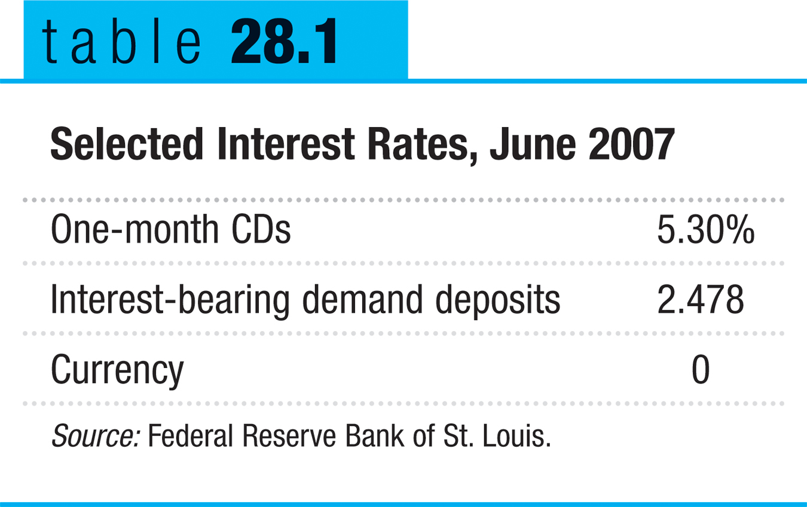
The Monetary Role of Banks
Notes:
Table 28.1: Source: Federal Reserve Bank of St. Louis

Slide 5
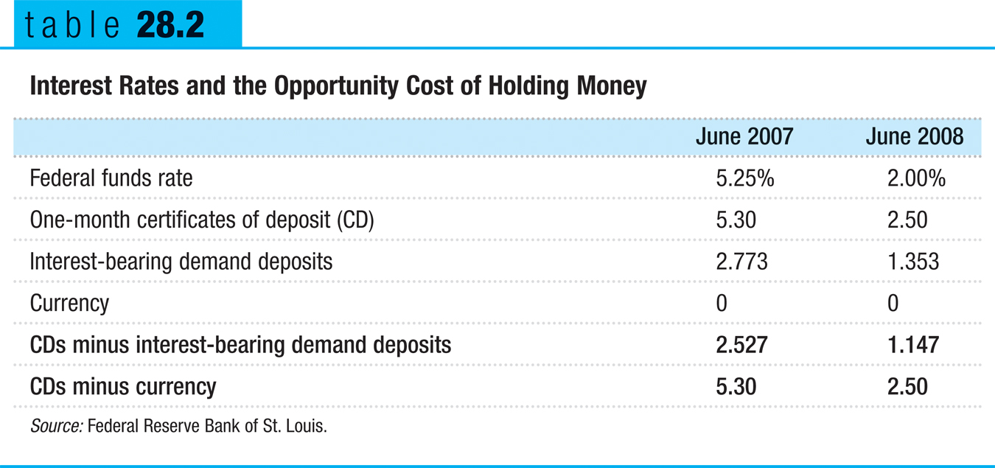
The Demand for Money
Notes:
Table 28.2: Source: Federal Reserve Bank of St. Louis.

Slide 6
Long-term Interest Rates
Long-term interest rates don’t necessarily move with short-term interest rates.
If investors expect short-term interest rates to rise, investors may buy short-term bonds even if long-term bonds offer a higher interest rate.
In practice, long-term interest rates reflect the average expectation in the market about what’s going to happen to short-term rates in the future.
Notes:
Table 28.2: Source: Federal Reserve Bank of St. Louis.

Slide 7
The Money Demand Curve
The money demand curve shows the relationship between the quantity of money demanded and the interest rate.

Slide 8
The Money Demand Curve
Interest rate, r
Money demand curve, MD
Quantity of money
Notes:
Figure Caption: Figure 28.1: The Money Demand Curve
The money demand curve illustrates the relationship between the interest rate and the quantity of money demanded. It slopes downward: a higher interest rate leads to a higher opportunity cost of holding money and reduces the quantity of money demanded.

Slide 9
Shifts of the Real Money Demand Curve
Changes in aggregate price level
Changes in real GDP
Changes in technology
Changes in institutions

Slide 10
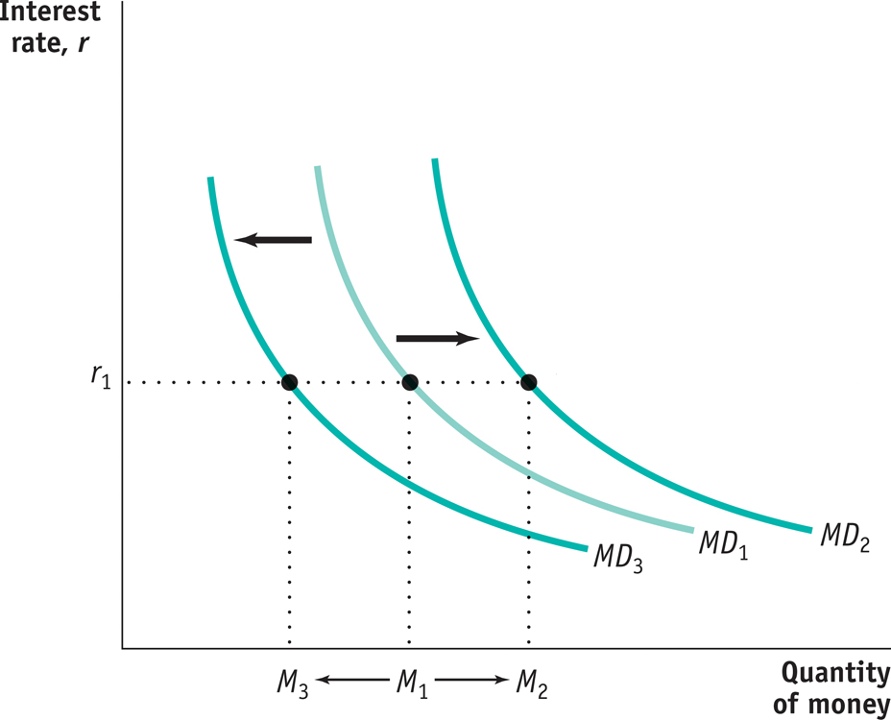
Increases and Decreases in the Demand for Money
A fall in money demand shifts the money demand curve to the left.
A rise in money demand
shifts the money demand
curve to the right.
Notes:
Figure Caption: Figure 28.2: Increases and Decreases in the Demand for Money
A rise in money demand shifts the money demand curve to the right, from MD1 to MD2, and the quantity of money demanded rises at any given interest rate. A fall in money demand shifts the money demand curve to the left, from MD1 to MD3, and the quantity of money demanded falls at any given interest rate.

Slide 11
Money and Interest Rates
According to the liquidity preference model of the interest rate, the interest rate is determined by the supply and demand for money.
The money supply curve shows how the nominal quantity of money supplied varies with the interest rate.

Slide 12
Equilibrium in the Money Market
Interest
rate, r
Money supply
curve, MS
r
H
H
Equilibrium
Equilibrium interest rate
r
E
E
L
r
L
MD
M
H
M
M
L
Quantity of money
Money supply
chosen by the Fed
Notes:
Figure Caption: Figure 28.3: Equilibrium in the Money Market
The money supply curve, MS, is vertical at the money supply chosen by the Federal Reserve, M. The money market is in equilibrium at the interest rate rE: the quantity of money demanded by the public is equal to M, the quantity of money supplied. At a point such as L, the interest rate, rL, is below rE and the corresponding quantity of money demanded, ML, exceeds the money supply, M. In an attempt to shift their wealth out of non-money interest-bearing financial assets and raise their money holdings, investors drive the interest rate up to rE. At a point such as H, the interest rate rH is above rE and the corresponding quantity of money demanded, MH, is less than the money supply, M. In an attempt to shift out of money holdings into non-money interest-bearing financial assets, investors drive the interest rate down to rE.

Slide 13
Two Models of the Interest Rate
This module has developed the liquidity preference model of the interest rate.
This model is consistent with another model known as the loanable funds model of the interest rate, developed in Module 29.

