Slide 1
ECO 120 - Global Macroeconomics
Taggert J. Brooks
Spring 2014

Slide 2
Module 29
The Market for Loanable Funds

Slide 3
The Market for Loanable Funds
The loanable funds market is a hypothetical market that examines the market outcome of the demand for funds generated by borrowers and the supply of funds provided by lenders.
The interest rate is the price, calculated as a percentage of the amount borrowed, charged by the lender to a borrower for the use of their savings for one year.

Slide 4
The Monetary Role of Banks The Market for Loanable Funds
The rate of return on a project is the profit earned on the project expressed as a percentage of its cost.

Slide 5
The Demand for Loanable Funds
Interest rate
A
12%
B
4
Demand for loanable funds, D
0
$150
450
Quantity of loanable funds
(billions of dollars)
Notes:
Figure Caption: Figure 29.1: The Demand for Loanable Funds
The demand curve for loanable funds slopes downward: the lower the interest rate, the greater the quantity of loanable funds demanded. Here, reducing the interest rate from 12% to 4% increases the quantity of loanable funds demanded from $150 billion to $450 billion.

Slide 6
The Supply for Loanable Funds
Interest rate
Supply of loanable funds, S
12%
Y
4
X
0
$150
450
Quantity of loanable funds
(billions of dollars)
Notes:
Figure Caption: Figure 29.2: The Supply of Loanable Funds
The supply curve for loanable funds slopes upward: the higher the interest rate, the greater the quantity of loanable funds supplied. Here, increasing the interest rate from 4% to 12% increases the quantity of loanable funds supplied from $150 billion to $450 billion.

Slide 7
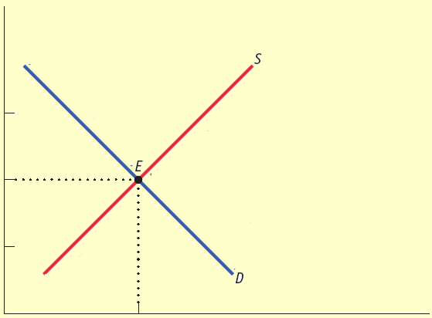
Equilibrium in the Loanable Funds Market
Interest rate
Projects with rate of return
8% or greater are funded.
12%
Offers not accepted from
lenders who demand interest
rate of more than 8%.
r*
8
Projects with rate of return
less than 8% are not funded.
4
Offers accepted from lenders willing to lend at interest rate of 8% or less.
0
$300
Quantity of loanable funds
(billions of dollars)
Q*
Notes:
Figure Caption: Figure 29.3: Equilibrium in the Loanable Funds Market
At the equilibrium interest rate, the quantity of loanable funds supplied equals the quantity of loanable funds demanded. Here, the equilibrium interest rate is 8%, with $300 billion of funds lent and borrowed. Investment spending projects with a rate of return of 8% or higher receive funding; those with a lower rate of return do not. Lenders who demand an interest rate of 8% or lower have their offers of loans accepted; those who demand a higher interest rate do not.

Slide 8
Shifts of the Demand for Loanable Funds
Factors that can cause the demand curve for loanable funds to shift include:
Changes in perceived business opportunities
Changes in the government’s borrowing
Crowding out occurs when a government deficit drives up the interest rate and leads to reduced investment spending.

Slide 9
An Increase in the Demand for Loanable Funds
Interest rate
S
An increase in the demand for loanable funds . . .
r
2
. . . leads to a rise in the equilibrium interest rate.
r
1
D
2
D
1
Quantity of loanable funds
Notes:
Figure Caption: Figure 29.4: An Increase in the Demand for Loanable Funds
If the quantity of funds demanded by borrowers rises at any given interest rate, the demand for loanable funds shifts rightward from D1 to D2. As a result, the equilibrium interest rate rises from r1 to r2.

Slide 10
Shifts of the Supply of Loanable Funds
Factors that can cause the supply of loanable funds to shift include:
Changes in private savings behavior: Between 2000 and 2006 rising home prices in the United States made many homeowners feel richer, making them willing to spend more and save less. This shifted the supply of loanable funds to the left.
Changes in capital inflows: The U.S. has received large capital inflows in recent years, with much of the money coming from China and the Middle East. Those inflows helped fuel a big increase in residential investment spending from 2003 to 2006. As a result of the worldwide slump, those inflows began to trail off in 2008.

Slide 11
An Increase in the Supply of Loanable Funds
Interest rate
S
1
S
2
… leads to a fall in equilibrium interest rate.
r
1
An increase in the supply for loanable funds . . .
r
2
D
Quantity of loanable funds
Notes:
Figure Caption: Figure 29.5: An Increase in the Supply of Loanable Funds
If the quantity of funds supplied by lenders rises at any given interest rate, the supply of loanable funds shifts rightward from S1 to S2. As a result, the equilibrium interest rate falls from r1 to r2.

Slide 12
Inflation and Interest Rates
Anything that shifts either the supply of loanable funds curve or the demand for loanable funds curve changes the interest rate.
Historically, major changes in interest rates have been driven by many factors, including:
changes in government policy
technological innovations that created new investment opportunities

Slide 13
Inflation and Interest Rates
However, arguably the most important factor affecting interest rates over time is changing expectations about future inflation.
This shifts both the supply and the demand for loanable funds.
This is the reason, for example, that interest rates today are much lower than they were in the late 1970s and early 1980s.

Slide 14
Inflation and Interest Rates
Real interest rate = nominal interest rate - inflation rate
In the real world neither borrowers nor lenders know what the future inflation rate will be when they make a deal. Actual loan contracts, therefore, specify a nominal interest rate rather than a real interest rate.

Slide 15
The Fisher Effect
According to the Fisher effect, an increase in expected future inflation drives up the nominal interest rate, leaving the expected real interest rate unchanged.

Slide 16
The Fisher Effect
Nominal
Interest rate
Demand for loanable funds
at 10% expected inflation
Supply of loanable funds
at 10% expected inflation
S
10
E
10
14%
Supply of loanable
funds at 0%
expected inflation
D
10
Demand for loanable funds
at 0% expected inflation
S
0
4
E
0
D
0
0
Q*
Quantity of loanable funds
Notes:
Figure Caption: Figure 29.6: The Fisher Effect
D₀ and S₀ are the demand and supply curves for loanable funds when the expected future inflation rate is 0%. At an expected inflation rate of 0%, the equilibrium nominal interest rate is 4%. An increase in expected future inflation pushes both the demand and supply curves upward by 1 percentage point for every percentage point increase in expected future inflation. D₁₀ and S₁₀ are the demand and supply curves for loanable funds when the expected future inflation rate is 10%. The 10 percentage point increase in expected future inflation raises the equilibrium nominal interest rate to 14%. The expected real interest rate remains at 4%, and the equilibrium quantity of loanable funds also remains unchanged.

Slide 17
Reconciling the Two Interest Rate Models
The Interest Rate in the Short Run
According to the liquidity preference model, a fall in the interest rate leads to a rise in investment spending, I, which leads to a rise in real GDP and consumer spending, C.
Increasing GDP also leads to an increase in Saving because of the savings-investment spending identity.
After a decrease in the interest rate, the quantity of savings supplied rises exactly enough to match the quantity of savings demanded.

Slide 18
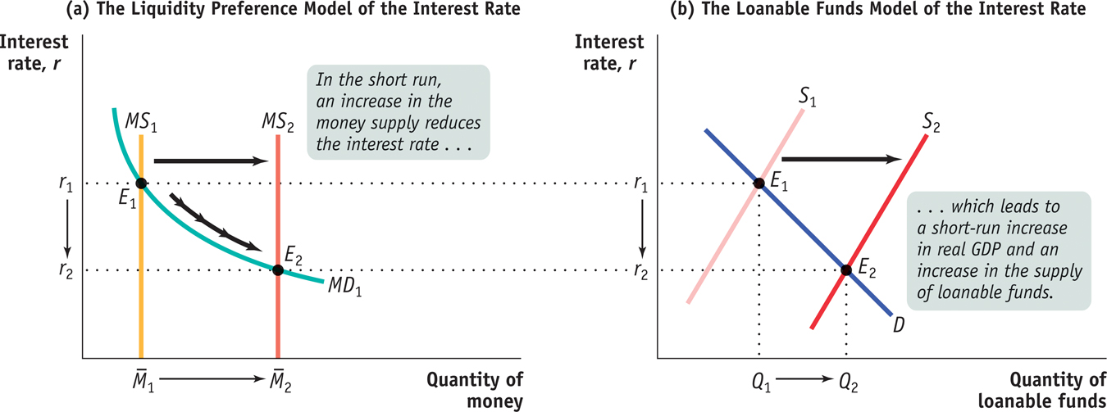
The Short-run Determination of the Interest Rate
Notes:
Figure Caption: Figure 29.7: Panel (a) shows the liquidity preference model of the interest rate: the equilibrium interest rate matches the money supply to the quantity of money demanded. In the short run, the interest rate is determined in the money market, where an increase in the money supply, from M₁ to M₂, pushes the equilibrium interest rate down from r₁ to r₂. Panel (b) shows the loanable funds model of the interest rate. The fall in the interest rate in the money market leads , through the multiplier effect, to an increase in real GDP and savings; to a rightward shift of the supply curve of loanable funds, from S₁ to S₂; and to a fall in the interest rate from r₁ to r₂. As a result, the new equilibrium interest rate in the loanable funds market matches the new equilibrium interest rate in the money market at r₂.

Slide 19
Reconciling the Two Interest Rate Models
The Interest Rate in the Long Run
In the long run, changes in the money supply don’t affect the interest rate.

Slide 20
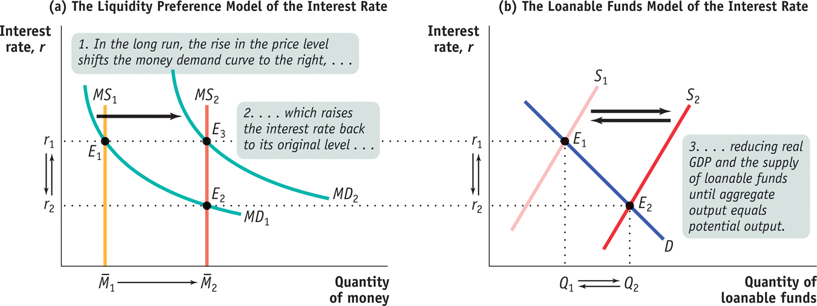
The Long-run Determination of the Interest Rate
Notes:
Figure Caption: Figure 29.8: Panel (a) shows the liquidity preference model long-run adjustment to an increase in the money supply from M₁ to M₂. Panel (b) shows the corresponding long-run adjustment in the loanable funds market. As we discussed in Figure 29.7, the increase in the money supply reduces the interest rate from r₁ to r₂, increases real GDP, and increases savings in the short run. This is shown in panel (a) and (b) as the movement from E₁ to E₂. In the long run, however, the increase in the money supply raises wages and other nominal prices; this shifts the money demand curve in panel (a) from MD₁ to MD₂, leading to an increase in the interest rate from r₁ to r₂ as the economy moves from E₂ to E₃. The rise in the interest rate causes a fall in real GDP and a fall in savings, shifting the loanable funds supply curve back to S₁ from S₂ and moving the loanable funds market from E₂ back to E₁. In the long run, the equilibrium interest rate is the rate that matches the supply and demand for loanable funds when real GDP equals potential output.

