Slide 1
ECO 120 - Global Macroeconomics
Taggert J. Brooks

Slide 2
Module 30
Long-run Implications of Fiscal Policy: Deficits and the Public Debt

Slide 3
The Budget Balance
The budget balance is the difference between the government’s tax revenue and its spending both on goods and services and on government transfers.
Other things equal, discretionary expansionary fiscal policies—increased government purchases of goods and services, higher government transfers, or lower taxes—reduce the budget balance for that year.

Slide 4
The Budget Balance
That is, expansionary fiscal policies make a budget surplus smaller or a budget deficit bigger.
Conversely, contractionary fiscal policies—smaller government purchases of goods and services, smaller government transfers, or higher taxes—increase the budget balance for that year, making a budget surplus bigger or a budget deficit smaller.

Slide 5
The Budget Balance
Some of the fluctuations in the budget balance are due to the effects of the business cycle.
In order to separate the effects of the business cycle from the effects of discretionary fiscal policy, governments estimate the cyclically adjusted budget balance.
The cyclically adjusted budget balance is an estimate of the budget balance if the economy were at potential output.

Slide 6
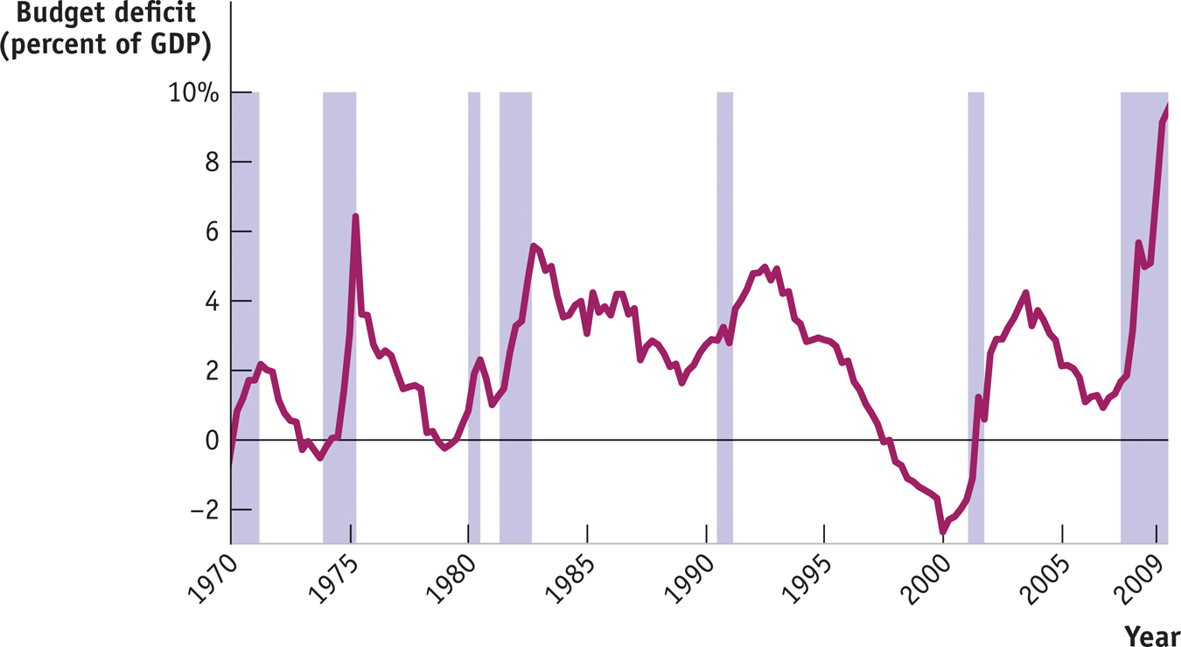
The Budget Balance
The budget deficit as a percentage of GDP tends to rise during recessions (indicated by shaded areas) and fall during expansions.
Notes:
Figure Caption: Figure 30.1: The U.S. Federal Budget Deficit and the Business Cycle
The budget deficit as a percentage of GDP tends to rise during recessions (indicated by shaded areas) and fall during expansions.
Source: Bureau of Economic Analysis; National Bureau of Economic Research.

Slide 7
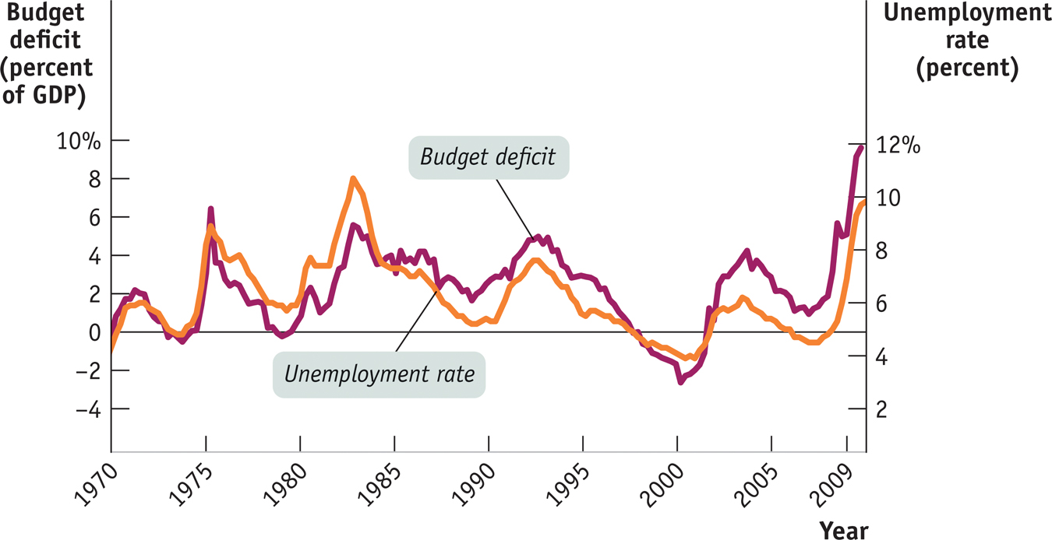
The Budget Balance
The budget deficit as a percentage of GDP moves closely in tandem with the unemployment rate.
Notes:
Figure Caption: Figure 30.2: The U.S. Federal Budget Deficit and the Unemployment Rate
There is a close relationship between the budget balance and the business cycle: a recession moves the budget balance toward deficit, but an expansion moves it toward surplus. Here, the unemployment rate serves as an indicator of the business cycle, and we should expect to see a higher unemployment rate associated with a higher budget deficit. This is confirmed by the figure: the budget deficit as a percentage of GDP moves closely in tandem with the unemployment rate.
Source: Bureau of Economic Analysis;
Bureau of Labor Statistics.

Slide 8
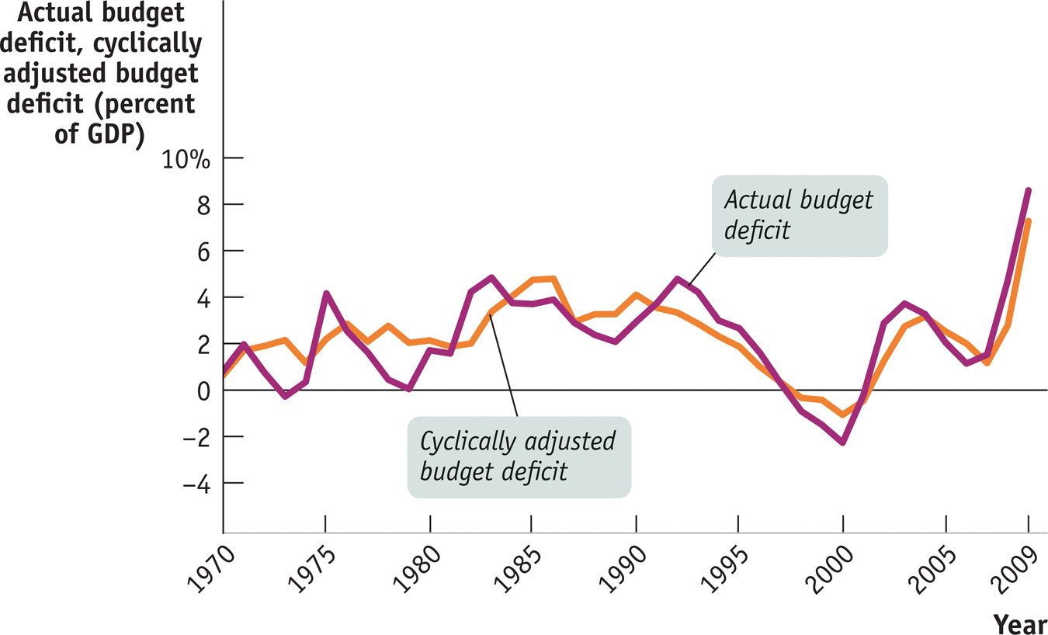
The Budget Balance
Notes:
Figure Caption: Figure 30.3: The Actual Budget Deficit versus the Cyclically Adjusted Budget Deficit
The cyclically adjusted budget deficit is an estimate of what the budget deficit would be if the economy were at potential output. It fluctuates less than the actual budget deficit, because years of large budget deficits also tend to be years when the economy has a large recessionary gap.
Source: Congressional Budget Office

Slide 9
Should the Budget Be Balanced?
Most economists don’t believe the government should be forced to run a balanced budget every year because this would undermine the role of taxes and transfers as automatic stabilizers.
Yet policy makers concerned about excessive deficits sometimes feel that rigid rules prohibiting—or at least setting an upper limit on—deficits are necessary.

Slide 10
Long-Run Implications of Fiscal Policy
U.S. government budget accounting is calculated on the basis of fiscal years.
A fiscal year runs from October 1 to September 30 and is labeled according to the calendar year in which it ends.
Persistent budget deficits have long-run consequences because they lead to an increase in public debt.

Slide 11
Problems Posed by Rising Government Debt
Public debt may “crowd out” investment spending, which reduces long-run economic growth.
And in extreme cases, rising debt may lead to government default, resulting in economic and financial turmoil.
Can’t a government that has trouble borrowing just print money to pay its bills?
Yes, it can, but this leads to another problem: inflation.

Slide 12
Deficits and Debt in Practice
A widely used measure of fiscal health is the debt–GDP ratio.
This number can remain stable or fall even in the face of moderate budget deficits if GDP rises over time.

Slide 13
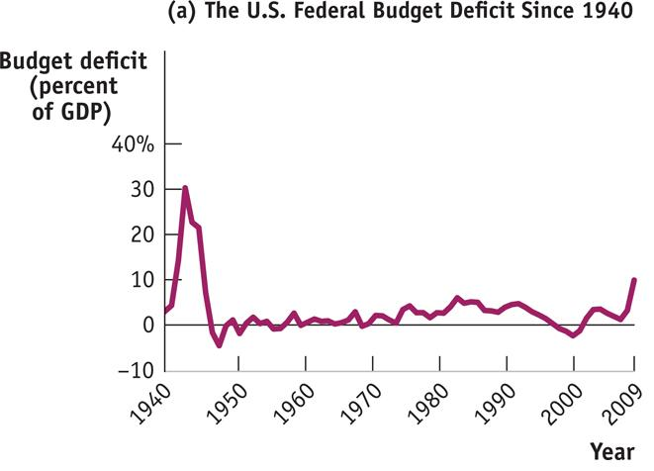
U.S. Federal Deficits and Debt
Notes:
Figure Caption: Figure 30.4: U.S. Federal Deficits and Debt
Panel (a) shows the U.S. federal budget deficit as a percentage of GDP since 1940. The U.S. government ran huge deficits during World War II and has usually run smaller deficits ever since.
Source: Office of Management and Budget

Slide 14
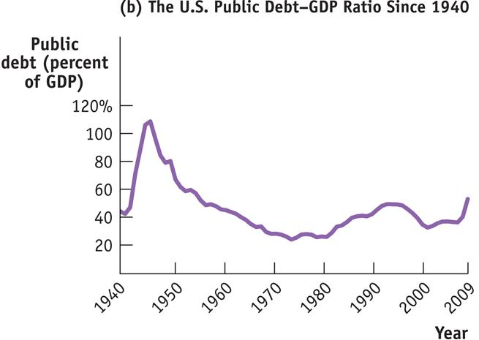
U.S. Federal Deficits and Debt
Notes:
Figure Caption: Figure 30.4 (b): U.S. Federal Deficits and Debt
Panel (b) shows the U.S. debt–GDP ratio. Comparing panels (a) and (b), you can see that in many years the debt–GDP ratio has declined in spite of government deficits. This seeming paradox reflects the fact that the debt–GDP ratio can fall, even when debt is rising, as long as GDP grows faster than debt.
Source: Office of Management and Budget

