Slide 1
ECO 120 - Global Macroeconomics
Taggert J. Brooks

Slide 2
Module 31
Monetary Policy and the Interest Rate

Slide 3
Monetary Policy and the Interest Rate
An increase or decreasing the money supply, the Federal Reserve can set the interest rate.
In practice, the Federal Open Market Committee sets a target federal funds rate.
The Open Market Desk then adjusts the money supply through open-market operations.

Slide 4
The Effect of an Increase in the Money Supply on the Interest Rate
Interest
rate, r
An increase
in the money
supply . . .
MS
1
MS
2
. . . leads to
a fall in the
interest rate.
r
E
1
1
E
2
r
2
MD
M
M
Quantity of money
1
2
Notes:
Figure Caption: Figure 31.1: The Effect of an Increase in the Money Supply on the Interest Rate
The Federal Reserve can lower the interest rate by increasing the money supply. Here, the equilibrium interest rate falls from r1 to r2 in response to an increase in the money supply from M1 to M2. In order to induce people to hold a larger quantity of money, the interest rate must fall from r1 to r2.

Slide 5
Setting the Federal Funds Rate
Pushing the Interest Rate Down to the Target Rate
Interest
rate, r
The target federal funds rate is the Federal Reserve’s desired federal funds rate.
An open-market
purchase . . .
MS
1
MS
2
. . . drives the interest rate down.
r
E
1
1
r
E
2
T
MD
M
1
M
2
Quantity of money
Notes:
Figure Caption: Figure 31.2 (a): Setting the Federal Funds Rate
The Federal Reserve sets a target for the federal funds rate and uses open-market operations to achieve that target. In panel (a) the initial equilibrium interest rate, r₁, is above the target rate. The Fed increases the money supply by making an open-market purchase of Treasury bills, pushing the money supply curve rightward, from MS₁ to MS₂, and driving the interest rate down to r_{T}.

Slide 6
Setting the Federal Funds Rate
Pushing the Interest Rate Up to the Target Rate
Interest
rate, r
An open-market
sale . . .
MS
2
MS
1
. . . drives the interest rate up.
r
E
T
2
r
E
1
1
MD
M
2
M
1
Quantity of money
Notes:
Figure Caption: Figure 31.2 (b): Setting the Federal Funds Rate
The Federal Reserve sets a target for the federal funds rate and uses open-market operations to achieve that target. In panel (b) the initial equilibrium interest rate, r₁, is below the target rate. The Fed reduces the money supply by making an open-market sale of Treasury bills, pushing the money supply curve leftward, from MS₁ to MS₂, and driving the interest rate up to r_{T}.

Slide 7
Setting the Federal Funds Rate
The Fed Reverses Course
On August 7, 2007, the Federal Open Market Committee decided to make no change in its interest rate policy.
On September 18, the Fed cut the target federal funds rate “to help forestall some of the adverse effects on the broader economy that might otherwise arise from the disruptions in financial markets.”
This was a reversal of previous policy. Previously the Fed had generally been raising rates, not reducing them, out of concern that inflation might become a problem.
Starting in September 2007, fighting the financial crisis took priority.
Notes:
Figure Caption: Figure 31.2 (b): Setting the Federal Funds Rate
The Federal Reserve sets a target for the federal funds rate and uses open-market operations to achieve that target. In panel (b) the initial equilibrium interest rate, r₁, is below the target rate. The Fed reduces the money supply by making an open-market sale of Treasury bills, pushing the money supply curve leftward, from MS₁ to MS₂, and driving the interest rate up to r_{T}.

Slide 8
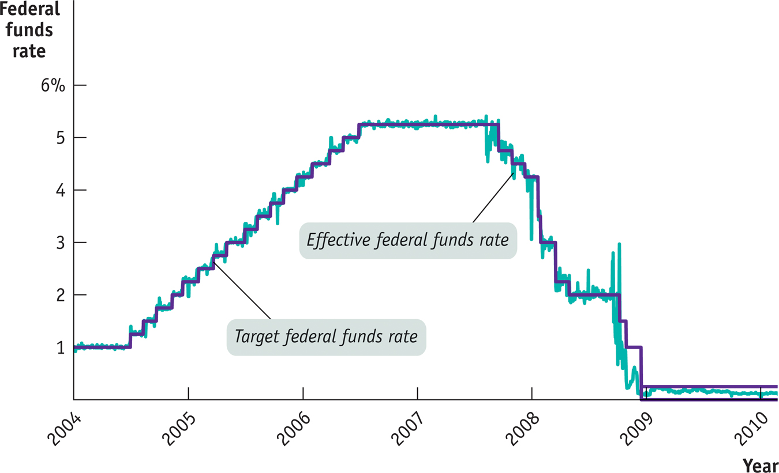
The Fed Reverses Course
Notes:
Figure Caption: The Fed Reverses Course
In September 2007, the Fed, worried about the emerging financial crisis, began cutting the target federal funds rate. This was a reversal of its previous policy, which had involved a series of rate increases intended to control inflation. The actual federal funds rate fluctuated to some extent—that is, the Fed didn’t always succeed in hitting its target. Overall, however, the Fed achieved a large reduction in the rate at which banks lend to each other.
Source: Federal Reserve Bank of St. Louis.

Slide 9
Monetary Policy and Aggregate Demand
Expansionary monetary policy is monetary policy that increases aggregate demand.
Contractionary monetary policy is monetary policy that reduces aggregate demand.

Slide 10
Monetary Policy and Aggregate Demand
(a) Expansionary Monetary Policy
(b) Contractionary Monetary Policy
Aggregate price level
Aggregate price level
AD
1
AD
2
AD
3
AD
1
Real GDP
Real GDP
Notes:
Figure Caption: Figure 31.3: Monetary Policy and Aggregate Demand
An expansionary monetary policy, shown in panel (a), shifts the aggregate demand curve to the right from AD1 to AD2. A contractionary monetary policy, shown in panel (b), shifts the aggregate demand curve to the left, from AD1 to AD3.

Slide 11
Monetary Policy in Practice
Policy makers try to fight recessions, but they also try to ensure price stability.
The Taylor rule for monetary policy is a rule for setting the federal funds rate that takes into account both the inflation rate and the output gap.
Monetary policy is the main tool of stabilization policy.
Federal funds rate = 1+(1.5 x inflation rate) + (0.5 x output gap)

Slide 12
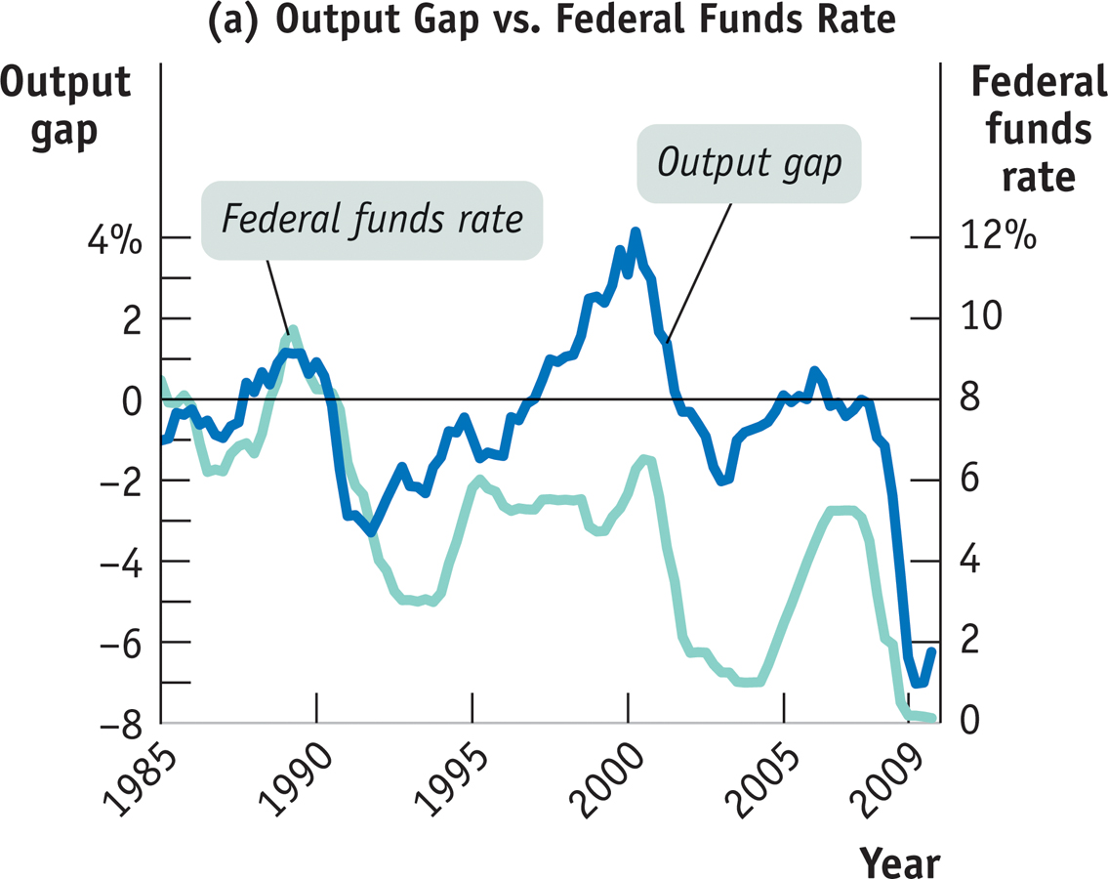
Tracking Monetary Policy
Notes:
Figure Caption: Figure 31.4 (a): Tracking Monetary Policy Using the Output Gap, Inflation , and the Taylor Rule
Panel (a) shows that the federal funds rate usually rises when the output gap is positive—that is, when actual real GDP is above potential output—and falls when the output gap is negative.
Sources: Federal Reserve Bank of St. Louis; Bureau of Economic Analysis; Bureau of Labor Statistics.

Slide 13
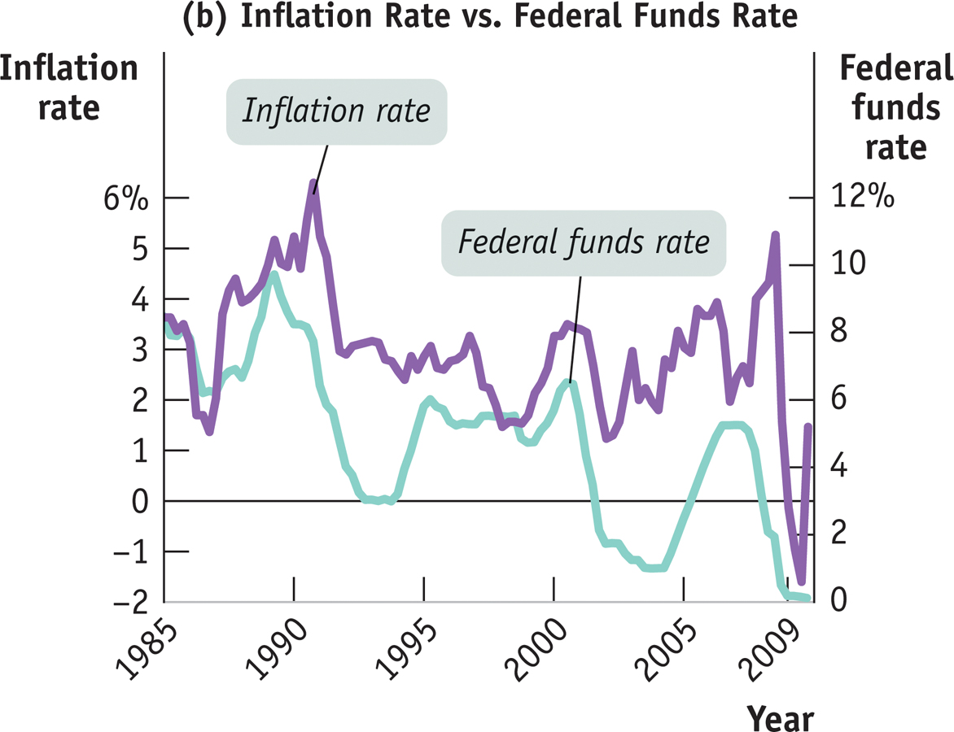
Tracking Monetary Policy
Notes:
Figure Caption: Figure 31.4 (b): Tracking Monetary Policy Using the Output Gap, Inflation, and the Taylor Rule
Panel (b) illustrates that the federal funds rate tends to be high when inflation is high and low when inflation is low.
Sources: Federal Reserve Bank of St. Louis; Bureau of Economic Analysis; Bureau of Labor Statistics.

Slide 14
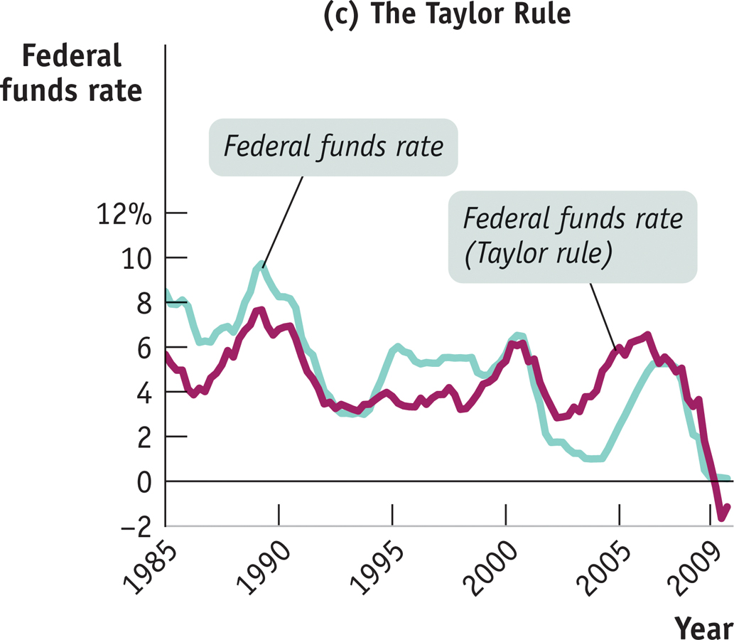
Tracking Monetary Policy
Notes:
Figure Caption: Figure 31.4 (c): Tracking Monetary Policy Using the Output Gap, Inflation , and the Taylor Rule
Panel (c) shows the Taylor rule in action. The green line shows the actual federal funds rate from 1985 to 2009. The purple line shows the interest rate the Fed should have set according to the Taylor rule. The fit isn’t perfect, but the Taylor rule does a better job of tracking U.S. monetary policy than either the output gap or the inflation rate alone.
Sources: Federal Reserve Bank of St. Louis; Bureau of Economic Analysis; Bureau of Labor Statistics.

