Slide 1
ECO 120 - Global Macroeconomics
Taggert J. Brooks

Slide 2
Module 32
Money, Output, and Prices in the Long Run

Slide 3
Money, Output, and Prices
Because of its expansionary and contractionary effects, monetary policy is generally the policy tool of choice to help stabilize the economy.
The economy is self-correcting in the long run: a demand shock has only a temporary effect on aggregate output.

Slide 4
The Short-Run and Long-Run Effects of an Increase in the Money Supply
Aggregate
price level
An increase in the
money supply reduces
the interest rate and
increases aggregate
demand . . .
L
R
AS
S
R
AS
2
S
R
AS
1
E
3
P
3
. . . but the eventual
rise in nominal wages
leads to a fall in
short-run aggregate
supply and aggregate
output falls back to
potential output.
P
2
E
2
P
1
AD
E
1
2
AD
1
Y
1
Y
2
Real GDP
Potential output
Notes:
Figure Caption: Figure 31.1: The Short-Run and Long-Run Effects of an Increase in the Money Supply
An increase in the money supply generates a positive short-run effect, but no long-run effect, on real GDP. Here, the economy begins at E1, a point of short-run and long-run equilibrium. An increase in the money supply shifts the AD curve rightward, and the economy moves to a new short-run equilibrium at E2 and a new real GDP of Y2. But E2 is not a long-run equilibrium: Y2 exceeds potential output, Y1, inducing over time an increase in nominal wages in the economy. In the long run, the increase in nominal wages will shift the short-run aggregate supply curve leftward, to a new position at SRAS2.
The economy reaches a new short-run and long-run equilibrium at E3 on the LRAS curve, and output falls back to potential output, Y1. The only long-run effect of an increase in the money supply is an increase in the aggregate price level, P1 to P3.

Slide 5
Monetary Neutrality
In the long run, changes in the money supply affect the aggregate price level but not real GDP or the interest rate.
In fact, there is monetary neutrality: changes in the money supply have no real effect on the economy. So monetary policy is ineffectual in the long run.

Slide 6
The Long-Run Determination of the Interest Rate
Interest
rate, r
An increase in the money
supply lowers the interest
rate in the short run . . .
MS
1
MS
2
. . . but in the long run higher
prices lead to greater money
demand, raising the interest
rate to its original level.
E
1
E
r
1
3
E
2
r
2
MD
MD
2
1
M
1
M
2
Quantity of money
Notes:
Figure Caption: Figure 32.2: The Long-Run Determination of the Interest Rate
In the short run, an increase in the money supply from M1 to M2 pushes the interest rate down from r1 to r2 and the economy moves to E2, a short-run equilibrium. In the long run, however, the aggregate price level rises in proportion to the increase in the money supply, leading to an increase in money demand at any given interest rate in proportion to the increase in the aggregate price level, as shown by the shift from MD1 to MD2. The result is that the quantity of money demanded at any given interest rate rises by the same amount as the quantity of money supplied. The economy moves to long-run equilibrium at E3 and the interest rate returns to r1.

Slide 7
Monetary Neutrality: International Evidence
All of the major central banks try to keep the aggregate price level roughly stable.
However, if we look at a longer period and a wider group of countries, we see large differences in the growth of the money supply. Between 1970 and the present, the money supply rose only a few percent per year in some countries.
The figure on the next slide shows the annual percentage increases in the money supply and average annual increases in the aggregate price.
The scatter of points clearly lies close to a 45-degree line, showing a more or less proportional relationship between money and the aggregate price level.
The data support the concept of monetary neutrality in the long run.

Slide 8
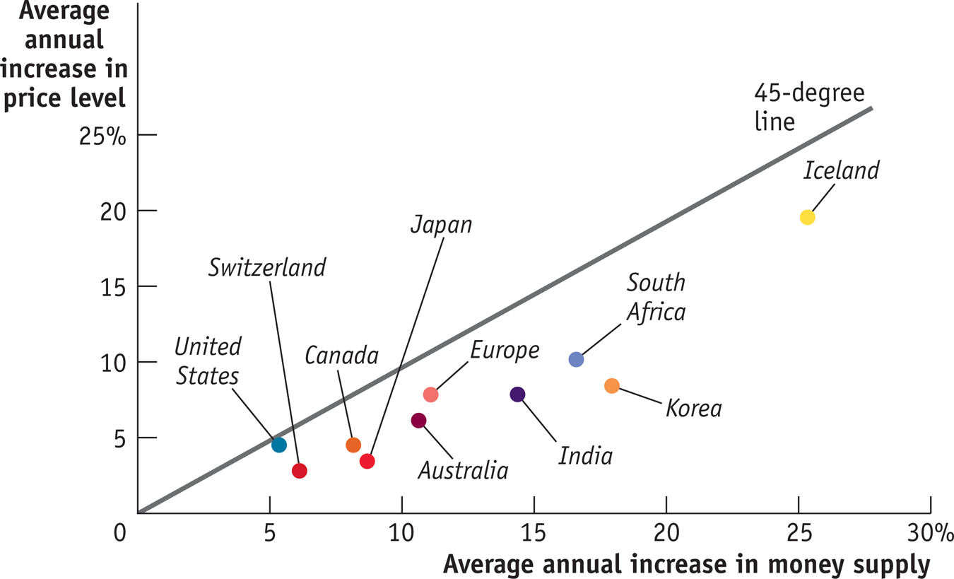
The Long-Run Relationship Between Money and Inflation

