Slide 1
ECO 120 - Global Macroeconomics
Taggert J. Brooks

Slide 2
Module 33
Types of Inflation, Disinflation, and Deflation

Slide 3
Money and Inflation
According to the classical model of the price level, the real quantity of money is always at its long-run equilibrium level.
The real quantity of money is M/P.
A change in the nominal money supply, M, leads in the long run to a change in the aggregate price level.

Slide 4
Money and Prices
Aggregate
price level
L
R
AS
S
R
AS
2
S
R
AS
1
E
3
P
3
P
E
E
2
1
2
P
1
AD
2
AD
1
Potential
output
Y
Y
Real GDP
P
1
Notes:
Figure Caption: Figure 33.1: The Classical Model of the Price Level
Starting at E1, an increase in the money supply shifts the aggregate demand curve rightward, as shown by the movement from AD1 to AD2. There is a new short-run equilibrium at E2 and a higher price level at P2. In the long run, nominal wages adjust upward and push the SRAS curve leftward to SRAS2. The total percent increase in the price level from P1 to P3 is equal to the percent increase in the money supply. In the classical model of the price level, we ignore the transition period and think of the price level as rising to P3 immediately. This is a good approximation of the conditions of high inflation.

Slide 5
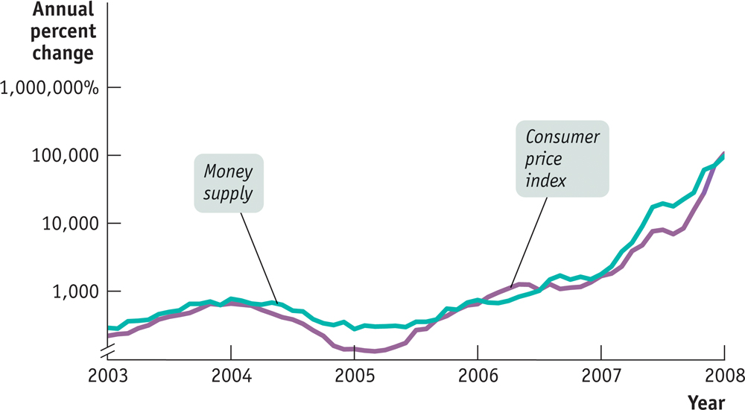
Money Supply Growth and Inflation in Zimbabwe
Notes:
Figure Caption: Figure 33.2: Money Supply Growth and Inflation in Zimbabwe
This figure, drawn on a logarithmic scale, shows the annual rates of change of the money supply and the price level in Zimbabwe from 2003 through January 2008. The surges in the money supply were quickly reflected in a roughly equal surge in the price level.
Source: Reserve Bank of Zimbabwe.

Slide 6
The Inflation Tax
The inflation tax is the reduction in the real value of money held by the public caused by inflation, equal to the inflation rate times the money supply, on those who hold money.
The real value of resources captured by the government is reflected by the real inflation tax, the inflation rate times the real money supply.

Slide 7
The Logic of Hyperinflation
In order to avoid paying the inflation tax, people reduce their real money holdings and force the government to increase inflation to capture the same amount of real inflation tax.
In some cases, this leads to a vicious circle of a shrinking real money supply and a rising rate of inflation.
This leads to hyperinflation and a fiscal crisis.

Slide 8
The Logic of Hyperinflation
High inflation arises when the government must print a large quantity of money to cover a large budget deficit.
Seinorage = ∆M
Real Seinorage = ∆M
P
Real Seinorage = ∆M M
M P
Real Seinorage = Rate of growth of the money supply x Real money supply
x

Slide 9
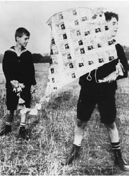
The Logic of Hyperinflation
In 1923, Germany’s money was worth so little that children used stacks of banknotes as building blocks or built kites with them.

Slide 10
Zimbabwe’s Inflation
Zimbabwe’s money supply growth was matched by almost simultaneous surges in its inflation rate. Why did Zimbabwe’s government pursue policies that led to runaway inflation?
The reason boils down to political instability, which in turn had its roots in Zimbabwe’s history.
Robert Mugabe, Zimbabwe’s president, tried to solidify his position by seizing farms and turning them over to his political supporters.
But because this seizure disrupted production, the result was to undermine the country’s economy and its tax base. It became impossible for the country’s government to balance its budget either by raising taxes or by cutting spending.

Slide 11
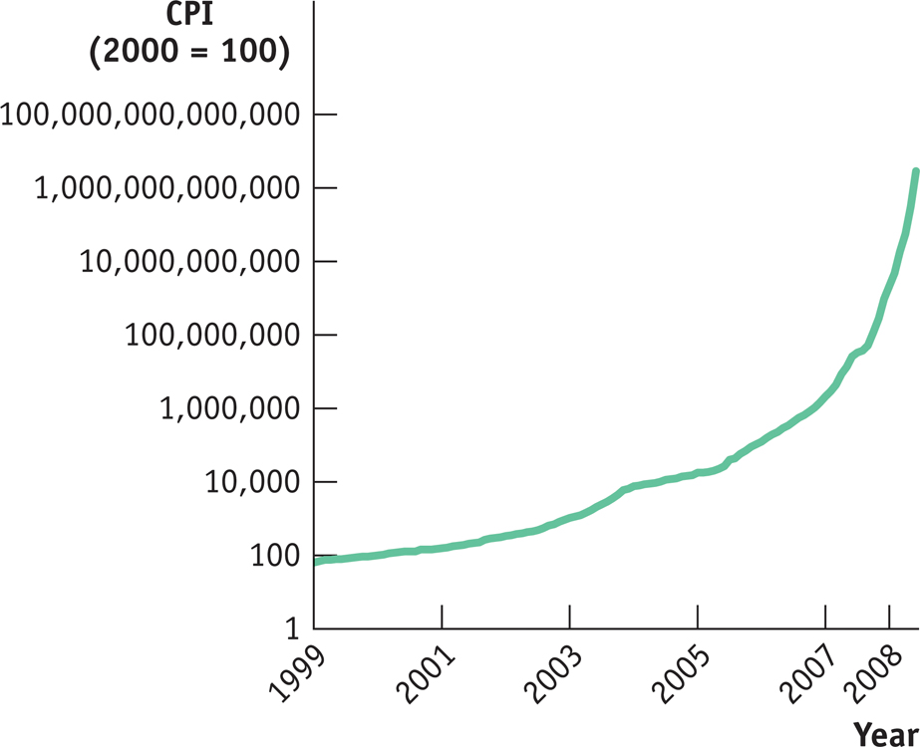
Zimbabwe’s Inflation

Slide 12
Moderate Inflation and Disinflation
The governments of wealthy, politically stable countries like the United States and Britain don’t find themselves forced to print money to pay their bills.
Yet over the past 40 years both countries, along with a number of other nations, have experienced uncomfortable episodes of inflation.
In the United States, the inflation rate peaked at 13% at the beginning of the 1980s. In Britain, the inflation rate reached 26% in 1975.

Slide 13
Moderate Inflation and Disinflation
A decrease in aggregate supply because of an increase in the price of an input is cost-push inflation.
An increase in aggregate demand that increases the price level is demand-pull inflation.
In the short run, policies that produce a booming economy also tend to lead to higher inflation, and policies that reduce inflation tend to depress the economy.
This creates both temptations and dilemmas for governments.

Slide 14
The Output Gap and the Unemployment Rate
When actual aggregate output is equal to potential output, the actual unemployment rate is equal to the natural rate of unemployment.
When the output gap is positive (an inflationary gap), the unemployment rate is below the natural rate.
When the output gap is negative (a recessionary gap), the unemployment rate is above the natural rate.

Slide 15
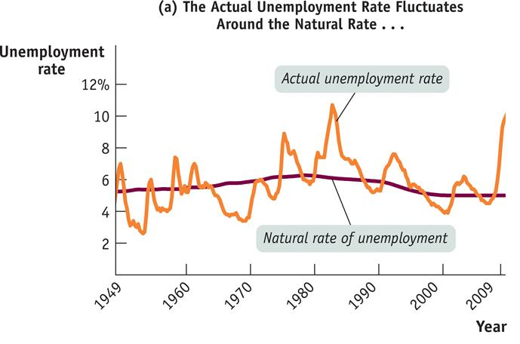
Cyclical Unemployment and the Output Gap
Notes:
Figure Caption: Figure 33.3 (a): Cyclical Unemployment and the Output Gap
Panel (a) shows the actual U.S. unemployment rate from 1949 to 2008, together with the Congressional Budget Office estimate of the natural rate of unemployment. The actual rate fluctuates around the natural rate, often for extended periods.
Source: Congressional Budget Office; Bureau of Labor Statistics; Bureau of Economic Analysis.

Slide 16
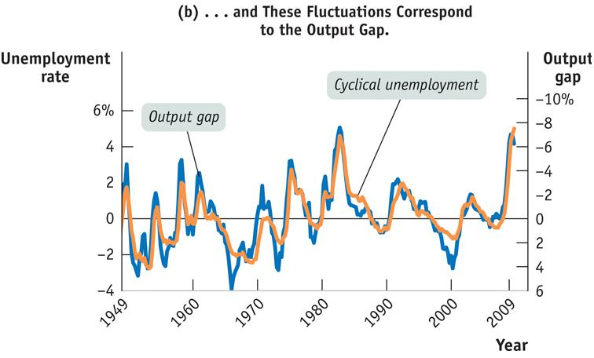
Cyclical Unemployment and the Output Gap
Notes:
Figure Caption: Figure 33.3 (b): Cyclical Unemployment and the Output Gap
Panel (b) shows cyclical unemployment— the difference between the actual unemployment rate and the natural rate of unemployment—and the output gap, also estimated by the CBO. The unemployment rate is measured on the left vertical axis, and the output gap is measured with an inverted scale on the right vertical axis. With an inverted scale, it moves in the same direction as the unemployment rate: when the output gap is positive, the actual unemployment rate is below its natural rate; when the output gap is negative, the actual unemployment rate is above its natural rate. The two series track one another closely, showing the strong relationship between the output gap and cyclical unemployment.
Source: Congressional Budget Office; Bureau of Labor Statistics; Bureau of Economic Analysis

