Slide 1
ECO 120 - Global Macroeconomics
Taggert J. Brooks

Slide 2
Module 37
Long-run Economic Growth

Slide 3
Comparing Economies Across Time and Space
The key statistic used to track economic growth is real GDP per capita.
Real GDP per capita is real GDP divided by population size.

Slide 4
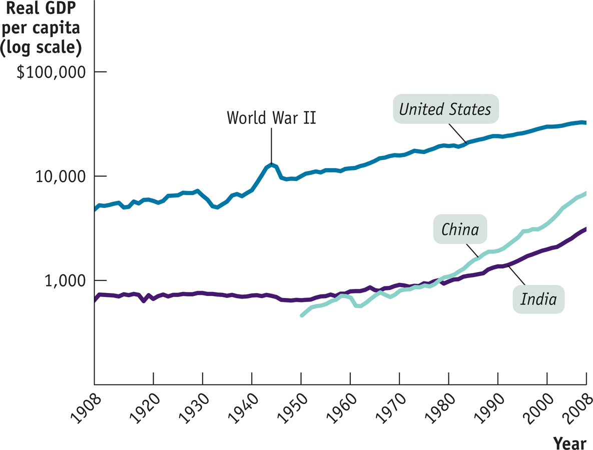
Comparing Economies Across Time and Space
Notes:
Figure Caption: Figure 37.1: Economic Growth in the United States, India, and China over the Past Century
Real GDP per capita from 1907 to 2007, measured in 1990 dollars, is shown for the United States, India, and China. Equal percent changes in real GDP per capita are drawn the same size. India and China currently have a much higher growth rate than the United States. However, China has only just attained the standard of living achieved in the United States in 1907, while India is still poorer than the United States was in 1907.
Source: Angus Maddison, Statistics on World Population, GDP, and Per Capita GDP, 1–2006AD, http://www.ggdc.net/maddison; International Monetary Fund

Slide 5
Real GDP per Capita
Year | Percentage of 1908 real GDP per capita | Percentage of 2008 real GDP per capita
1908 | 100% | 15%
1928 | 144 | 21
1948 | 199 | 29
1968 | 326 | 48
1988 | 493 | 72
2008 | 684 | 100
Notes:
Table 37.1: U.S. Real GDP per Capita Percentage
Source: Angus Maddison, Statistics on World Population, GDP, and Per Capita GDP, 1–2006AD, http://www.ggdc.net/maddison; Bureau of Economic Analysis
This says income per capita was in 2008 6.84 times as much as in 1908. Or in 1908 it was only 15% of 2008.

Slide 6
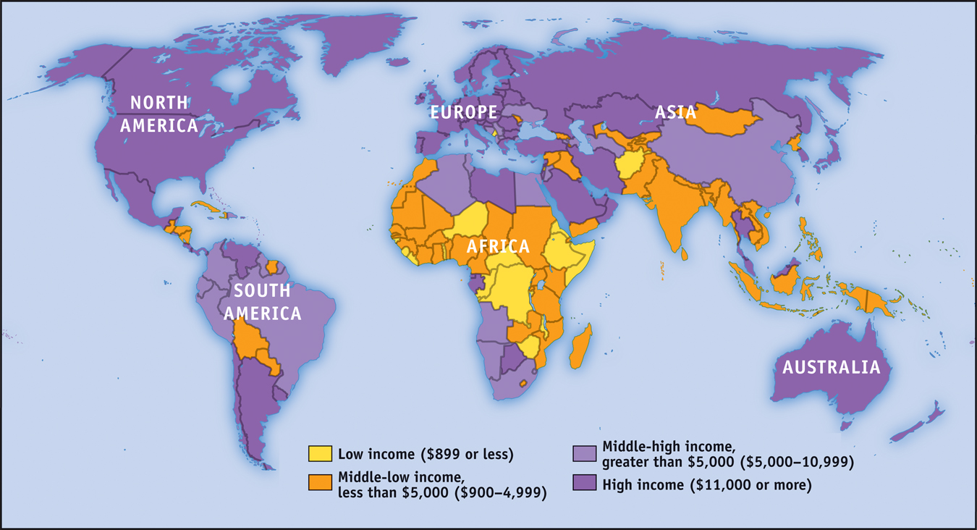
Income Around the World, 2008
Notes:
Figure Caption: Figure 37.2: Incomes Around the World, 2008
Although the countries of Europe and North America—along with a few in the Pacific—have high incomes, much of the world is still very poor. Today, more than 50% of the world’s population lives in countries with a lower standard of living than the United States had a century ago.
Source: International Monetary Fund

Slide 7
Growth Rates
How did the United States manage to produce over six times more per person in 2008 than in 1908?
A little bit at a time.
Long-run economic growth is normally a gradual process, in which real GDP per capita grows at most a few percent per year.
From 1908 to 2008, real GDP per capita in the United States increased an average of 1.9% each year.

Slide 8
Growth Rates
The Rule of 70 tells us that the time it takes a variable that grows gradually over time to double is approximately 70 divided by that variable’s annual growth rate.
70
Annual growth rate of variable
Number of years for variable to double =
Notes:
Notes to the instructor:
If real GDP per capita grows at 1% per year, it will take 70 years to double. If it grows at 2% per year, it will take only 35 years to double. In fact, U.S. real GDP per capita rose on average 1.9% per year over the last century. Applying the Rule of 70 to this information implies that it should have taken 37 years for real GDP per capita to double; it would have taken 111 years—three periods of 37 years each—for U.S. real GDP per capita to double three times. That is, the Rule of 70 implies that over the course of 111 years U.S. real GDP per capita should have increased by a factor of 2 × 2 × 2 = 8. And this does turn out to be a pretty good approximation to reality, once we adjust for the fact that a century is a bit less than 111 years. During the twentieth century, U.S. real GDP per capita rose seven-fold, a bit less than eight-fold.
http://en.wikipedia.org/wiki/Rule_of_72

Slide 9
Growth Rates
Average annual growth rate of real GDP per capita,
1980-2008
10%
8
6
4
2
0
-2
8.8%
4.1%
3.9%
1.9%
1.5%
1.2%
-1.8%
China
India
Ireland
United States
France
Argentina
Zimbabwe
Notes:
Figure Caption: Figure 37.3: Comparing Recent Growth Rates
Here the average annual rate of growth of real GDP per capita from 1980 to 2008 is shown for selected countries. China and, to a lesser extent, India and Ireland have achieved impressive growth. The United States and France have had moderate growth. Despite having once been considered an economically advanced country, Argentina has had sluggish growth. Still others, such as Zimbabwe, have slid backward.
Source: International Monetary Fund

Slide 10
In Real Life
India Takes Off
India achieved independence from Great Britain in 1947, becoming the world’s most populous democracy—a status it has maintained to this day.
In India, real GDP per capita has grown at an average rate of 4.1% a year, tripling between 1980 and 2007.
What went right in India after 1980? Many economists point to policy reforms. A series of reforms opened the economy to international trade and freed up domestic competition.

Slide 11
The Sources of Long-Run Growth
Labor productivity, often referred to simply as productivity, is output per worker.
Physical capital consists of human-made resources such as buildings and machines.
Human capital is the improvement in labor created by the education and knowledge embodied in the workforce.
Technology is the technical means for the production of goods and services.

Slide 12
The Wal-Mart Effect
The Wal-Mart Effect
After 20 years of being sluggish, U.S. productivity growth accelerated sharply (grew at a much faster rate) in the late 1990s.
What caused that acceleration?
According to McKinsey, the major source of productivity improvement after 1995 was a surge in output per worker in retailing.
Stores were selling much more merchandise per worker.
Wal-Mart has been a pioneer in using modern technology (for example, computers) to improve productivity.

