Slide 1
ECO 120 - Global Macroeconomics
Taggert J. Brooks

Slide 2
Module 38
Productivity and Growth

Slide 3
Accounting for Growth: The Aggregate Production Function
The aggregate production function is a hypothetical function that shows how productivity (real GDP per worker) depends on the quantities of physical capital per worker and human capital per worker as well as the state of technology.

Slide 4
Accounting for Growth: The Aggregate Production Function
A recent example of an aggregate production function applied to real data comes from a comparative study of Chinese and Indian economic growth by the economists Barry Bosworth and Susan Collins of the Brookings Institution.
They used the following aggregate production function:
Notes:
Notes to the instructor:
where T represented an estimate of the level of technology and they assumed that each year of education raises workers’ human capital by 7%.

Slide 5
Accounting for Growth: The Aggregate Production Function
Using this function, they tried to explain why China grew faster than India between 1978 and 2004.
They found that about half the difference was due to China’s higher levels of investment spending, which raised its level of physical capital per worker.
The other half was due to faster Chinese technological progress.

Slide 6
Accounting for Growth: The Aggregate Production Function
An aggregate production function exhibits diminishing returns to physical capital when, holding the amount of human capital and the state of technology fixed, each successive increase in the amount of physical capital leads to a smaller increase in productivity.

Slide 7
Accounting for Growth: The Aggregate Production Function
A Hypothetical Example: How Physical Capital per Worker Affects Productivity, Holding Human Capital and Technology Fixed
Physical capital per worker | Real GDP per worker
$0 | $0
15,000 | 30,000
30,000 | 45,000
45,000 | 55,000

Slide 8
Physical Capital and Productivity
Real GDP per worker
1. The increase in real GDP per worker becomes smaller …
$60,000
50,000
30,000
0
C
B
A
$20,000 50,000 80,000
Physical capital per worker (2000 dollars)
2. as physical capital per worker rises…
Notes:
Figure Caption: Figure 38.1: Physical Capital and Productivity
Other things equal, a greater quantity of physical capital per worker leads to higher real GDP per worker but is subject to diminishing returns: each successive addition to physical capital per worker produces a smaller increase in productivity. Starting at point A, with $20,000 in physical capital per worker, a $30,000 increase in physical capital per worker leads to an increase of $20,000 in real GDP per worker. At point B, with $50,000 in physical capital per worker, a $30,000 increase in physical capital per worker leads to an increase of only $10,000 in real GDP per worker.

Slide 9
Accounting for Growth: The Aggregate Production Function
Growth accounting estimates the contribution of each major factor in the aggregate production function to economic growth.
The amount of physical capital per worker grows 3% a year.
According to estimates of the aggregate production function, each 1% rise in physical capital per worker, holding human capital and technology constant, raises output per worker by 1⁄3 of 1%, or 0.33%.
Total factor productivity is the amount of output that can be achieved with a given amount of factor inputs.

Slide 10
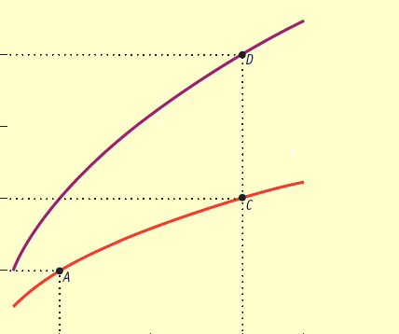
Technological Progress and Productivity Growth
Real GDP per worker (2000 dollars)
$120,000
90,000
60,000
30,000
0
Rising total factor productivity shifts curve up
$20,000 50,000 80,000 100,000
Physical capital per worker (2000 dollars)
Notes:
Figure Caption: Figure 38.2: Technological Progress and Productivity Growth
Technological progress shifts the productivity curve upward. Here we hold human capital per worker fixed. We assume that the lower curve (the same curve as in Figure 25-4) reflects technology in 1937 and the upper curve reflects technology in 2007. Holding technology and human capital fixed, quadrupling physical capital per worker from $20,000 to$80,000 leads to a doubling of real GDP per worker, from $30,000 to $60,000. This is shown by the movement from point A to point C, reflecting an approximately 1% per year rise in real GDP per worker. In reality, technological progress shifted the productivity curve upward and the actual rise in real GDP per worker is shown by the movement from point A to point D. Real GDP per worker grew 2% per year, leading to a quadrupling during the period. The extra 1% in growth of real GDP per worker is due to higher total factor productivity.

Slide 11
What about Natural Resources?
In the modern world, natural resources are a much less important determinant of productivity than human or physical capital for the great majority of countries.
For example, some nations with very high real GDP per capita, such as Japan, have very few natural resources. Some resource-rich nations, such as Nigeria (which has sizable oil deposits), are very poor.

Slide 12
The Information Technology Paradox
Why didn’t information technology show large rewards?
Many economists were puzzled by the slowdown in the U.S. growth rate of labor productivity.
There was a fall from an average annual growth rate of 3% in the late 1960s to slightly less than 1% in the mid-1980s.
This was surprising given that there appeared to be rapid progress in technology.

Slide 13
The Information Technology Paradox
Robert Solow declared that the information technology revolution could be seen everywhere except in the economic statistics.
Paul David suggested that a new technology doesn’t yield its full potential if you use it in old ways.
He asserted that productivity would take off when people really changed their way of doing business to take advantage of the new technology—such as, replacing letters and phone calls with electronic communications.
Sure enough, productivity growth accelerated dramatically in the second half of the 1990…

Slide 14
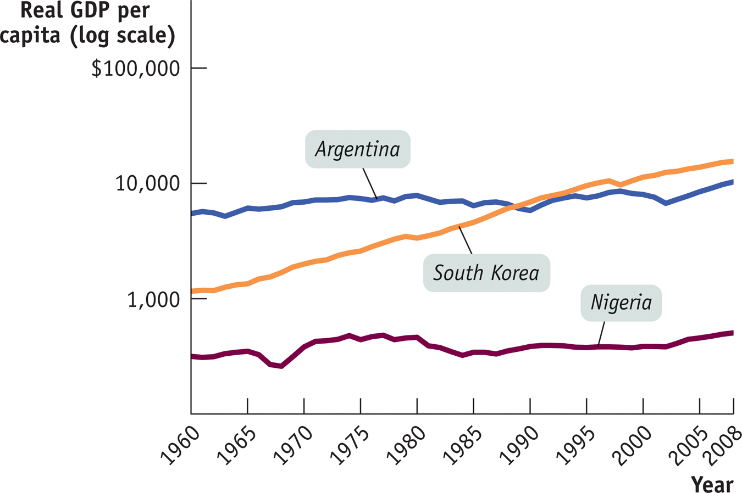
Success, Disappointment, and Failure
Notes:
Figure Caption: Figure 38.3 Success and Disappointment
Real GDP per capita from 1960 to 2008, measured in 2000 dollars, is shown for Argentina, South Korea, and Nigeria, using a logarithmic scale. South Korea and some other East Asian countries have been highly successful at achieving economic growth. Argentina, like much of Latin America, has had several setbacks, slowing its growth. Nigeria’s standard of living in 2007 was only barely higher than it had been in 1960, an experience shared by many African countries.
Source: World Bank

Slide 15
Success, Disappointment, and Failure
The world economy contains examples of success and failure in the effort to achieve long-run economic growth.
East Asian economies have done many things right and achieved very high growth rates.
In Latin America, where some important conditions are lacking, growth has generally been disappointing.
In Africa, real GDP per capita has declined for several decades (there are some signs of progress now).

Slide 16
Success, Disappointment, and Failure
The growth rates of economically advanced countries have converged, but not the growth rates of countries across the world.
This has led economists to believe that the convergence hypothesis fits the data only when factors that affect growth (i.e. education, infrastructure, and favorable policies and institutions) are held equal across countries.

Slide 17
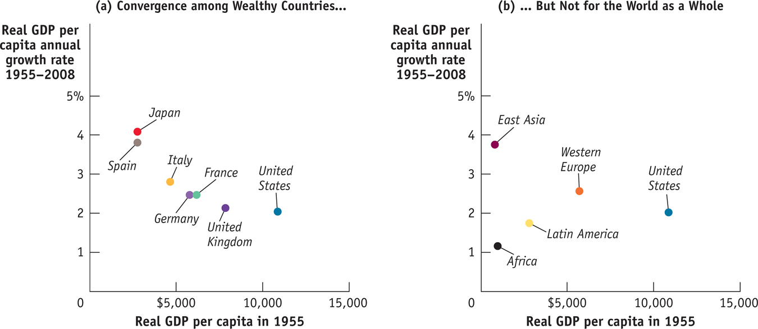
Are Economies Converging?

Slide 18
Success, Disappointment, and Failure
East Asia’s spectacular growth was generated by high savings and investment spending rates, emphasis on education, and adoption of technological advances from other countries.
Poor education, political instability, and irresponsible government policies are major factors in the slow growth of Latin America.
In sub-Saharan Africa, severe instability, war, and poor infrastructure— particularly affecting public health—have resulted in a catastrophic failure of growth.

