Slide 1
ECO 120 - Global Macroeconomics
Taggert J. Brooks

Slide 2
Module 40
Economic Growth in Macroeconomic Models

Slide 3
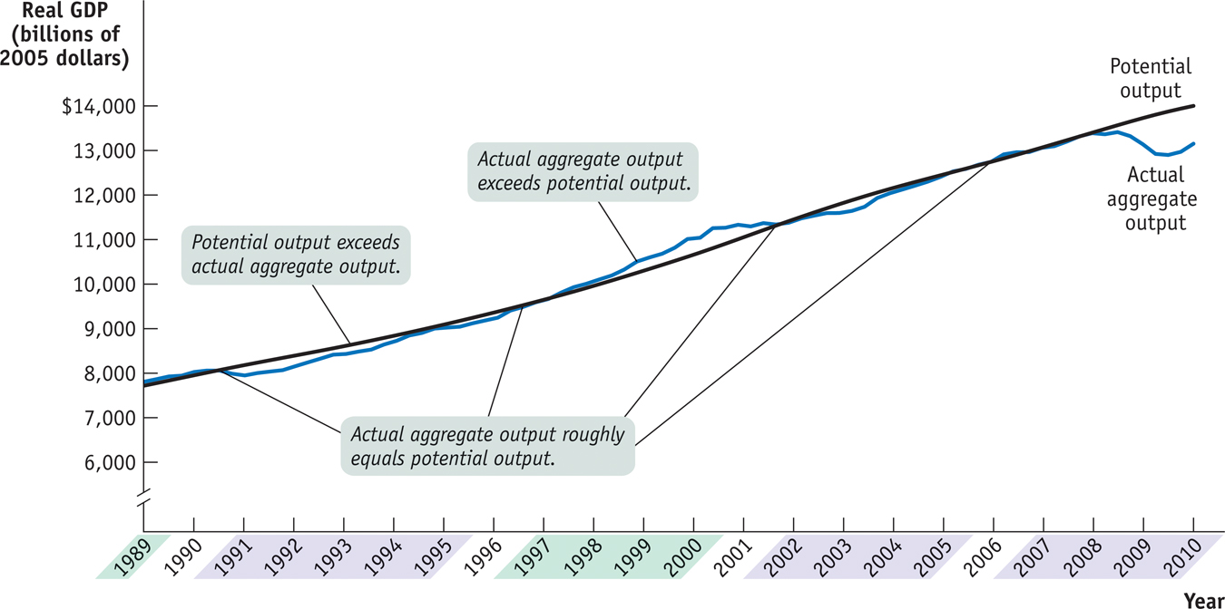
Actual and Potential Output from 1989 to 2009
Notes:
Figure Caption: Figure 40-1: Actual and Potential Output from 1989 to 2009
This figure shows the performance of actual and potential output in the United States from 1989 to 2009. The black line shows estimates of U.S. potential output, produced by the Congressional Budget Office, and the blue line shows actual aggregate output. The purple-shaded years are periods in which actual aggregate output fell below potential output, and the green-shaded years are periods in which actual aggregate output exceeded potential output. As shown, significant shortfalls occurred in the recessions of the early 1990s and after 2000. Actual aggregate output was significantly above potential output in the boom of the late 1990s.
Source: Congressional Budget Office; Bureau of Economic Analysis

Slide 4
Long-run Economic Growth and the Production Possibilities Frontier
Economic growth can be shown on a production possibility frontier as a shift outward of the frontier.
There is a trade-off between investment and consumer goods.
Depreciation is a loss in the value of physical capital due to wear, age or obsolescence.
Some investment is needed to counteract depreciation.

Slide 5
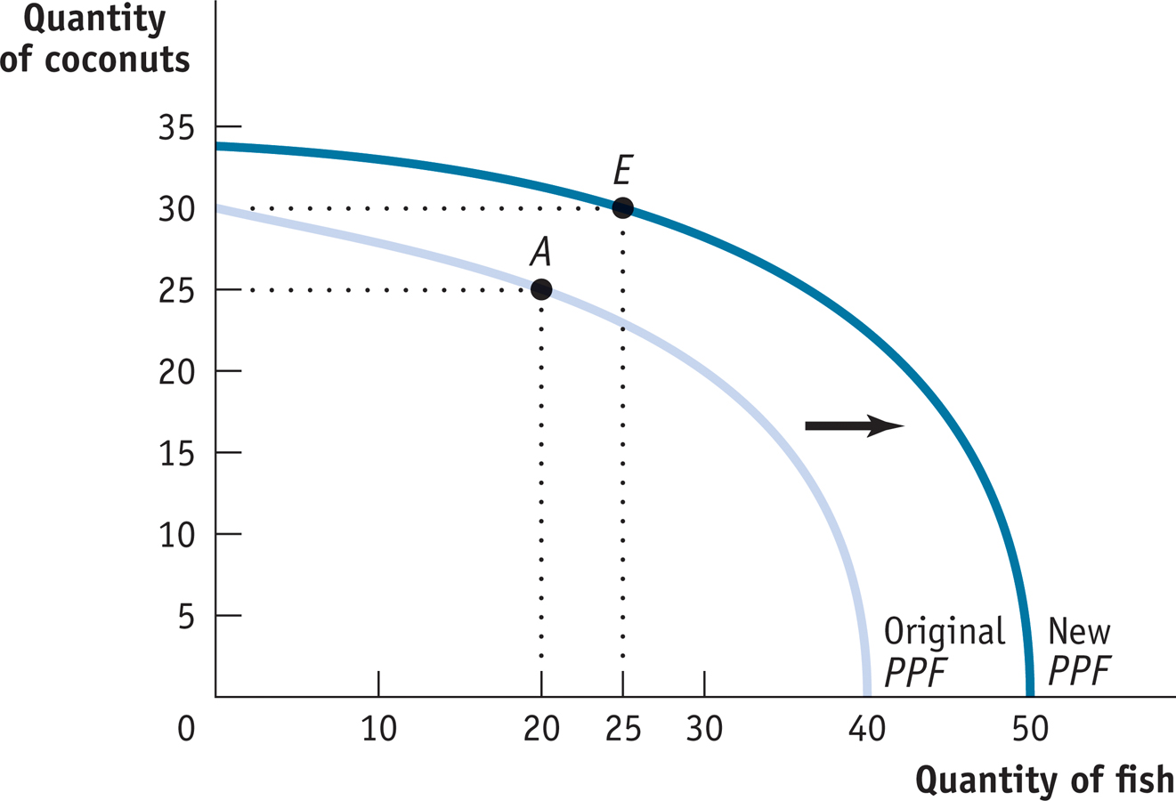
Economic Growth
Notes:
Figure Caption: Figure 40.2: Economic growth results in an outward shift of the production possibility frontier because production possibilities are expanded. The economy can now produce more of everything. For example, if production is initially at point A (20 fish and 25 coconuts), it could move to point E (25 fish and 30 coconuts).

Slide 6
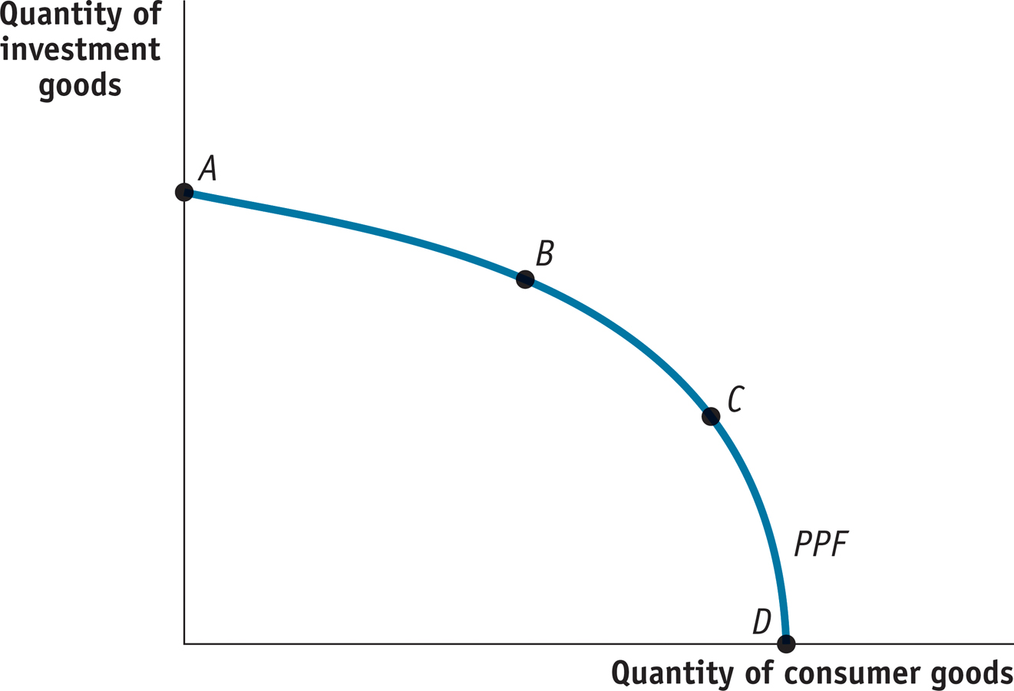
The Trade-off Between Investment and Consumer Goods
Notes:
Figure Caption: Figure 40.3: The Trade-off Between Investment and Consumer Goods.

Slide 7
Long-run Economic Growth and the Aggregate Demand - Aggregate Supply Model
Recall that in the aggregate demand-aggregate supply model, the long-run aggregate supply curve shows the relationship between the aggregate price level and the quantity of aggregate output supplied when all prices are flexible.
Increases in potential output are reflected in a rightward shift of the LRAS curve.
Decreases in potential output are reflected in a leftward shift of the LRAS curve.

Slide 8
Long-Run Aggregate Supply Curve
Aggregate price
level
Long-run aggregate
supply curve, LRAS
P₁
…leaves the quantity
of aggregate output
supplied unchanged
in the long run.
A fall in the
aggregate
price level…
P₂
0
Potential output
Y_{P}
Real GDP
Notes:
Figure Caption: Figure 40.4: Long-Run Aggregate Supply Curve
The long-run aggregate supply curve shows the quantity of aggregate output supplied when all prices, including nominal wages, are flexible. It is vertical at potential output, Y_{P} , because in the long run an increase in the aggregate price level has no effect on the quantity of aggregate output supplied.

Slide 9
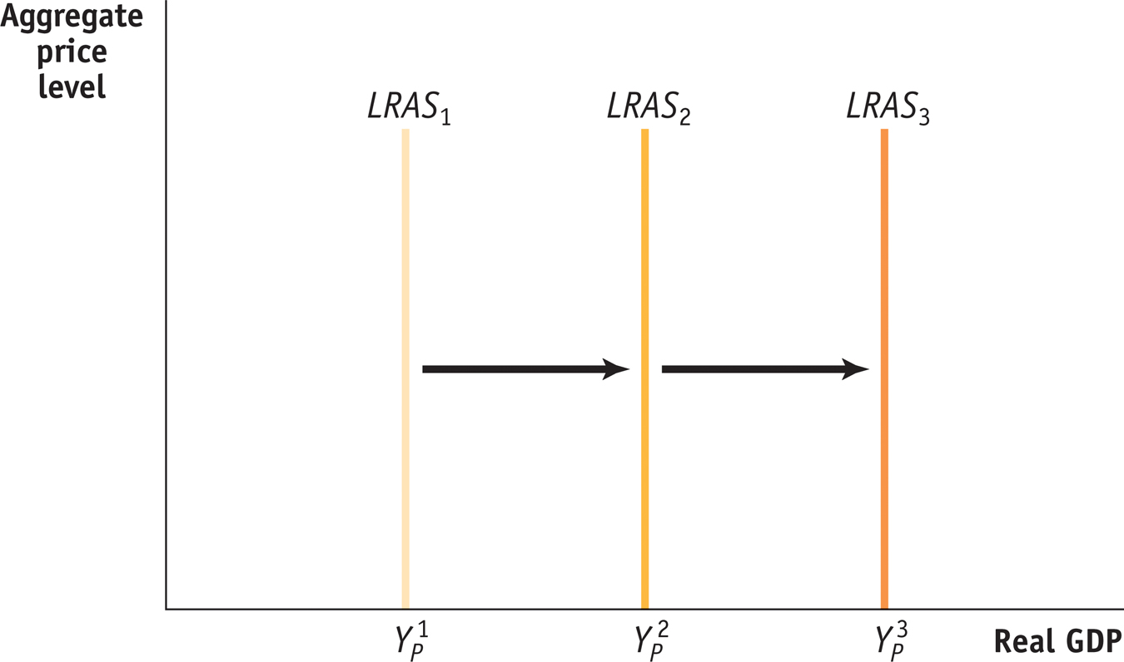
Economic Growth Shifts the LRAS Curve Rightward
Notes:
Figure Caption: Figure 40.5: Long-run Growth and the LRAS Curve. The growth in potential output over time can be shown as a rightward shift of the long-run aggregate supply curve.

Slide 10
Distinguishing Between Long-run Growth and Short-run Fluctuations
The points along a production possibility frontier are achievable if all of an economy’s resources are used efficiently.
If the economy experiences macroeconomic fluctuations due to a recession, production falls to a point inside the production possibility frontier.
Long-run growth will appear as an outward shift of the production possibility frontier.

Slide 11
Distinguishing Between Long-run Growth and Short-run Fluctuations
In the aggregate demand-aggregate supply model, fluctuations of actual aggregate output around potential output are illustrated by shifts in aggregate demand or short-run aggregate supply.
Long-run economic growth is illustrated by a shift of the LRAS curve.

Slide 12
From the Short Run to the Long Run
(a) Leftward Shift of the Short-Run
Aggregate Supply Curve
(b) Rightward Shift of the Short-Run
Aggregate Supply Curve
Aggregate price level
Aggregate price level
L
R
AS
L
R
AS
S
R
AS
1
S
R
AS
2
S
R
AS
2
S
R
AS
E₂
1
A fall in nominal
wages shifts SRAS rightward.
E₁
E₁
P
1
P
1
A rise in nominal
wages shifts SRAS
leftward.
E₂
AD
AD
Y
P
Y
1
Real GDP
Y
1
Y
P
Real GDP
Notes:
Figure Caption: Figure 40.6: From the Short Run to the Long Run
Panel (a): The initial short-run aggregate supply curve is SRAS₁. At the aggregate price level, P₁, the quantity of aggregate output supplied, Y₁, exceeds potential output, Y_{P}. Eventually, low unemployment will cause nominal wages to rise, leading to a leftward shift of the short-run aggregate supply curve from SRAS₁ to SRAS₂.
Panel (b): At the aggregate price level, P₁, the quantity of aggregate output supplied is less than potential output. This reflects the fact that the short-run aggregate supply curve has shifted to the right, due to both the short-run adjustment process in the economy and to a rightward shift of the long-run aggregate supply curve.

