Slide 1
ECO 120 - Global Macroeconomics
Taggert J. Brooks

Slide 2
Module 35
History and Alternative Views of Macroeconomics

Slide 3
Classical Macroeconomics
Classical macroeconomics asserted that monetary policy affected only the aggregate price level, not aggregate output.
Classical macroeconomics asserted that the short run was unimportant.
According to the classical model, prices are flexible, making the aggregate supply curve vertical even in the short run.

Slide 4
Classical Macroeconomics
As a result, an increase in the money supply leads, other things equal, to an equal proportional rise in the aggregate price level, with no effect on aggregate output.
Increases in the money supply lead to inflation, and that’s all.

Slide 5
Classical Macroeconomics
By the 1930s, measurement of business cycles was a well-established subject, but there was no widely accepted theory of business cycles.

Slide 6
The Great Depression and the Keynesian Revolution
In 1936, Keynes presented his analysis of the Great Depression—his explanation of what was wrong with the economy’s alternator—in a book titled The General Theory of Employment, Interest, and Money.
The school of thought that emerged out of the works of John Maynard Keynes is known as Keynesian economics.

Slide 7
The Great Depression and the Keynesian Revolution
Keynesian economics reflected two innovations:
Short-run effects of shifts in aggregate demand on aggregate output.
Keynes argued that other factors than money are mainly responsible for business cycles.

Slide 8
Classical versus Keynesian Macroeconomics
Notes:
Figure Caption: Figure 35.1: Classical versus Keynesian Macroeconomics
One important difference between classical and Keynesian economics involves the short-run aggregate supply curve.
Panel (a) shows the classical view: the SRAS curve is vertical, so shifts in aggregate demand affect the aggregate price level but not aggregate output. Panel (b) shows the Keynesian view: in the short run the SRAS curve slopes upward, so shifts in aggregate demand affect aggregate output as well as aggregate prices.

Slide 9
Policy to Fight Recessions
The main practical consequence of Keynes’s work was that it legitimized macroeconomic policy activism—the use of monetary and fiscal policy to smooth out the business cycle.

Slide 10
End of Great Depression
The basic message many of the young economists who adopted Keynes’s ideas in the 1930s took from his work was that economic recovery requires aggressive fiscal expansion—deficit spending on a large scale to create jobs.
And that is what they eventually got, but it wasn’t because politicians were persuaded.
Instead, what happened was a very large and expensive war, World War II.

Slide 11
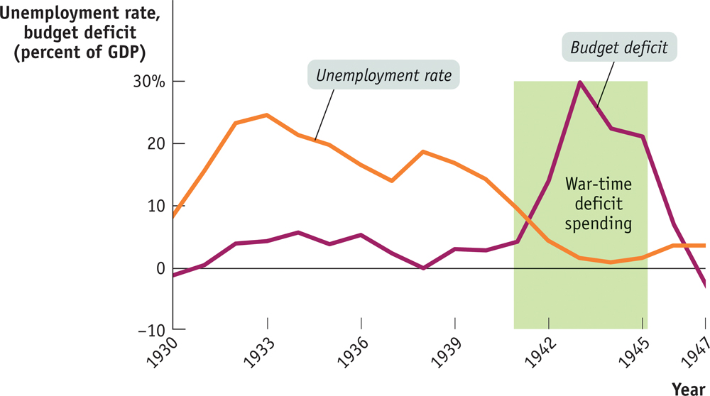
End of Great Depression

Slide 12
End of Great Depression
The previous figure shows the U.S. unemployment rate and the federal budget deficit as a share of GDP from 1930 to 1947.
As you can see, deficit spending during the 1930s was on a modest scale.
In 1940, as the risk of war grew larger, the United States began a large military buildup, and the budget moved deep into deficit.
After the attack on Pearl Harbor on December 7, 1941, the country began deficit spending on an enormous scale.

Slide 13
Challenges to Keynesian Economics
Monetarism asserted that GDP will grow steadily if the money supply grows steadily.
It called for a shift from monetary policy rule to that of a discretionary monetary policy.
It argued that GDP would grow steadily if the money supply grew steadily.
Monetarism was influential for a time, but was eventually rejected by many macroeconomists.

Slide 14
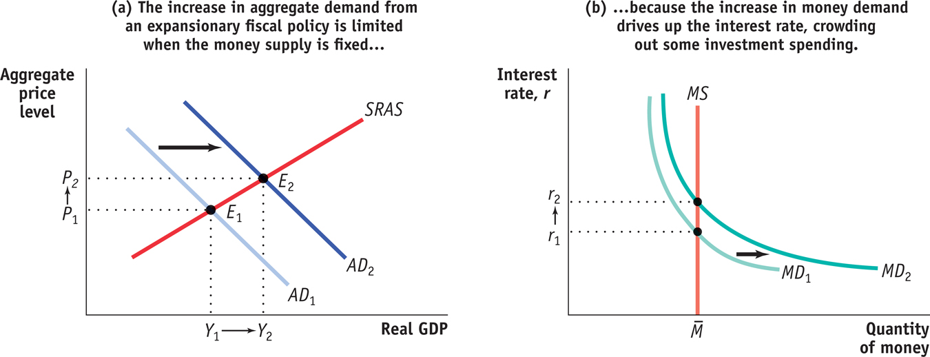
Fiscal Policy with a Fixed Money Supply
Notes:
Figure Caption: Figure 35.2: Fiscal Policy with a Fixed Money Supply
In panel (a) an expansionary fiscal policy shifts the AD curve rightward, driving up both the aggregate price level and aggregate output. However, this leads to an increase in the demand for money. If the money supply is held fixed, as in panel (b), the increase in money demand drives up the interest rate, reducing investment spending and offsetting part of the fiscal expansion. So the shift of the AD curve is less than it would otherwise be: fiscal policy becomes less effective when the money supply is held fixed.

Slide 15
Monetarism
When the central bank changes interest rates or the money supply based on its assessment of the state of the economy, it is engaged in discretionary monetary policy.
A monetary policy rule is a formula that determines the central bank’s actions.
The velocity of money is the ratio of nominal GDP to the money supply.
The velocity equation: M × V = P × Y
Notes:
Notes to the Instructor: If the government makes an effort to keep unemployment below the natural rate of unemployment, the short-run Phillips curve implies that this will lead to a higher inflation rate than people expect. Over time, however, people will come to expect this higher level of inflation, and the short-run Phillips curve will shift upward. If the government insists on keeping unemployment below its natural rate, this will lead to further increases in expected inflation, and so on. So keeping unemployment below its natural rate requires an ever-higher rate of inflation. This analysis suggests that policy makers should not try to achieve an unemployment rate below the natural rate. However there can be political opportunism and/or wishful thinking.

Slide 16
Monetarism
Monetarists believed that V was stable, so they believed that if the Federal Reserve kept M on a steady growth path, nominal GDP would also grow steadily.

Slide 17
Inflation and the Natural Rate of Unemployment
The natural rate of unemployment is also the non-accelerating-inflation rate of unemployment, or NAIRU.
According to the natural rate hypothesis, because inflation is eventually embedded into expectations, to avoid accelerating inflation over time the unemployment rate must be high enough that the actual inflation rate equals the expected inflation rate.
Notes:
Notes to the Instructor: In 1968, Milton Friedman and Edmund Phelps of Columbia University, working independently, proposed the concept of the natural rate of unemployment.

Slide 18
Inflation and the Natural Rate of Unemployment
The natural rate hypothesis limits the role of macroeconomic policy in stabilizing the economy.
The goal is not to seek a permanently lower unemployment rate, but to keep it stable
The natural rate hypothesis became almost universally accepted.
Notes:
Notes to the Instructor: In 1968, Milton Friedman and Edmund Phelps of Columbia University, working independently, proposed the concept of the natural rate of unemployment.

Slide 19
The Political Business Cycle
A political business cycle results when politicians use macroeconomic policy to serve political ends.
Fear of a political business cycle led to a consensus that monetary policy should be insulated from politics.

Slide 20
Rational Expectations, Real Business Cycles, and New Classical Macroeconomics
New classical macroeconomics is an approach to the business cycle.
It returns to the classical view that shifts in the aggregate demand curve affect only the aggregate price level, not aggregate output.

Slide 21
Rational Expectations
Rational expectations is the view that individuals and firms make decisions optimally, using all available information.
The idea of rational expectations did serve as a useful caution for macroeconomists who had become excessively optimistic about their ability to manage the economy.

Slide 22
Real Business Cycle Theory
According to new Keynesian economics, market imperfections can lead to price stickiness for the economy as a whole.
Real business cycle theory says that fluctuations in the rate of growth of total factor productivity cause the business cycle.
Notes:
Notes to the Instructor: Current status of RBC:
The theory is widely recognized as having made valuable contributions to our understanding of the economy, and it serves as a useful caution against too much emphasis on aggregate demand. But many of the real business cycle theorists themselves now acknowledge that their models need an upward-sloping aggregate supply curve to fit the data—and that this gives aggregate demand a potential role in determining aggregate output. And as we have seen, policy makers believe strongly that aggregate demand policy has an important role to play in fighting recessions.

