Slide 1
Freakonomics

Slide 2
Market Distortions when Agents are Better Informed: The Value of Information in Real Estate Transactions
Steve Levitt
Chad Syverson

Slide 3
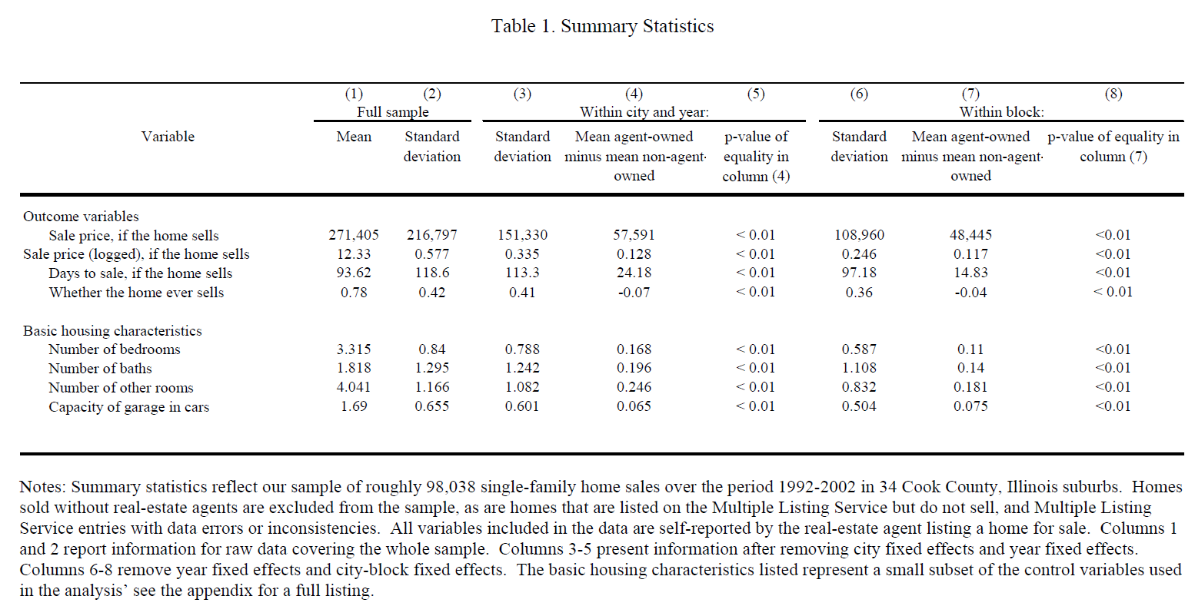

Slide 4
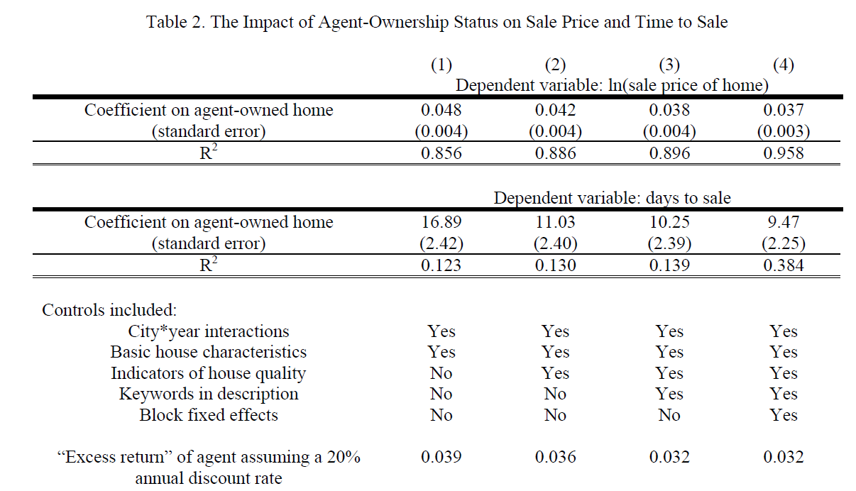

Slide 5
