Slide 1
The Affordable Care Act
The Initial Effort to Overhaul the American Health Care System
Thomas Schlesinger, Ph.D.
Executive Consultant

Slide 2
Access Quality
Cost
Notes:
The topic of HC systems represents incredibly, broad, diverse topic
With wealth of details
Helpful to agree on a framework in which to discuss
COST, QUALITY, AND ACCESS – briefly discuss (3 Titles)

Slide 3
Given that the market, has been unable to address these problems, could the government used Medicare to reform healthcare?

Slide 4


What About the “Affordable Care Act?”

Slide 5
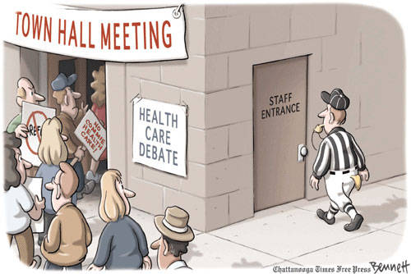

Slide 6

The Ideological Divide
LIBERAL
CONSERVATIVE
Emphasis on Equity/Fairness
Role of Government to correct market failures
Individual Responsibility
Liberty/ Minimal government
Free Market

Slide 7
A Belief in Personal Liberty
Underlying several of these issues, is the foundational American belief in the importance of personal freedom.
Ironically, one of the traits that was responsible for economic success may threaten it
Have our technological capabilities outstripped our ability to pay for it?

Slide 8
The Affordable Care Act
Issues It Sought to Address
Access to Care- Universal Coverage?
Cost of Care
Quality
Restructuring System
Notes:
Access is fairly easy to fix although expensive
We are not sure of answers to cost of care
Lots of things tried for cost of care

Slide 9

The Affordable Care Act
What’s the Law All About
Access to Care- Universal Coverage?
Notes:
Access is fairly easy to fix although expensive
We are not sure of answers to cost of care
Lots of things tried for cost of care
Difference between nationalized and universal coverage

Slide 10
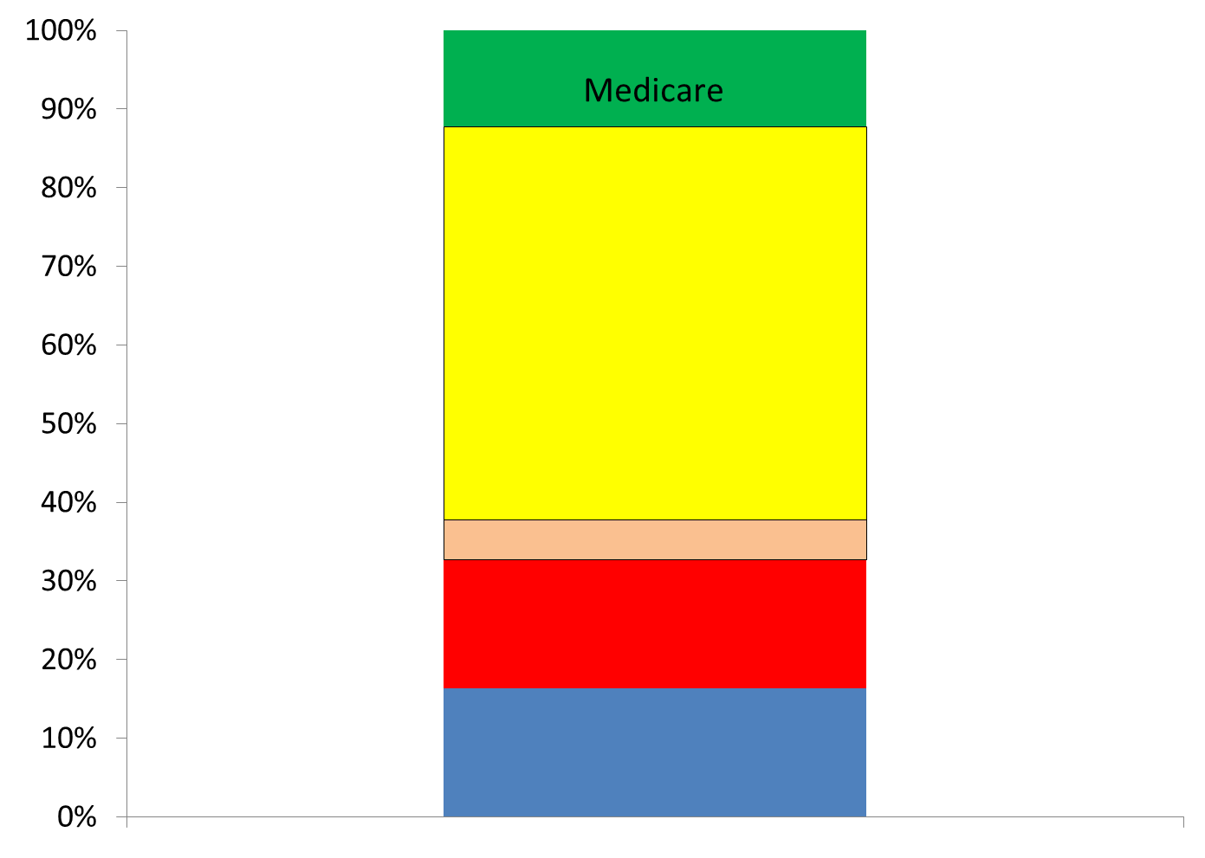
Incremental Expansion of Coverage
Employer
Based
-Group
Individual
Healthcare Exchange
Uninsured
Medicaid Expansion
Medicaid

Slide 11
Government Takeover?
Funding | Claims Administration | Actual Delivery System | Example
Public | Public | Public | Great Britain
Public | Public | Private | France, Italy, Traditional Medicare
Public | Private | Private | Germany, Netherlands, Medicare Advantage
Private/ Public | Private/ Public | Private | United States

Slide 12
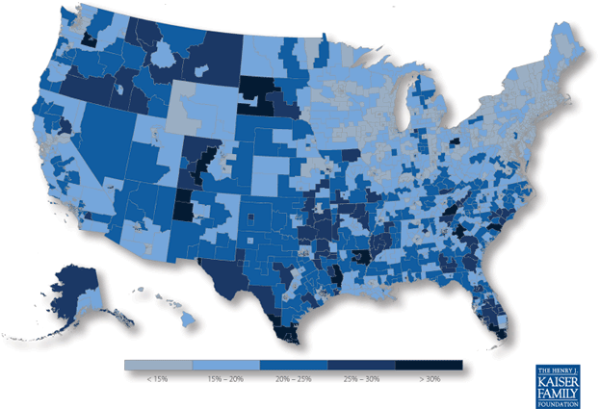
Who Benefits from the Affordable Care Act Coverage Expansions?
Percentage of the Nonelderly Population With Income Up to Four Times the Poverty level
Who Were Uninsured or Purchasing Individual Coverage, 2010
Notes:
http://healthreform.kff.org/coverage-expansion-map.aspx
Biggest Gains in south, southwest and some mountain states

Slide 13
The ACA
Medicaid Expansion
Feds currently pay 50-70%
ACA – 100% then 90% of costs
  Expedited enrollment - state costs
10 already ‘generous’ states would see decreased Medicaid expenditure -including Wisconsin

Slide 14
The ACA
Medicaid Expansion
What is the Coverage Expansion
  Up to 138% of Federal Poverty Level
  In Medicaid, poverty is not the only criteria
    Not all poor are covered
    In WI, expansion would most benefit childless adults (200k)
Notes:
Financially the coverage expansion will be attractive to states because it leverages federal dollars and would decrease state expenses to cover uninsured population
Per KFF. On Nov 13, Walker said he will decline Medicaid expansion but there has been no official announcement
http://dl.ebmcdn.net/~advisoryboard/infographics/Where-the-States-Stand22/story.html
States that would save money - http://www.advisory.com/Daily-Briefing/2012/11/27/Which-states-would-save-money-under-ACA-Medicaid-expansion
Connecticut; Delaware; Hawaii; Iowa;Maine; Maryland; Massachusetts;New York;Vermont; and Wisconsin.

Slide 15

The ACA
--Healthcare Exchanges--

Slide 16

Health Care Exchanges
The Concept
Online marketplace
Transparency on cost and quality
State/federal/hybrid
Active purchaser vs. passive purchaser
Basically a conservative, market-based idea
  But the controversy is in the details
Disruptive innovation to insurance marketplace?
Notes:
The marketplace idea would typically be more attractive to conservatives

Slide 17
Health Care Exchanges
In the ACA Plan
Cost of expansion
  Federal Government subsidy available - to 400% FPL
Like mandate/Medicaid expansion, exchanges get into controversy of role of government in the economy
More regulated or more free market approach
  Massachusetts Utah
Notes:
Mike
The marketplace idea would typically be more attractive to conservatives

Slide 18
Getting to Universal Coverage in a System with ‘voluntary’ Insurance

Slide 19


Why was Individual Mandate Such a Lightning Rod?
First, why the requirement/mandate?
Individual responsibility vs. personal liberty
What is a ‘free rider’?
Notes:
If someone chooses not to have insurance, society will bear the costs of their decision, and it would not be right to mandate that insurers pick them up once they are sick

Slide 20
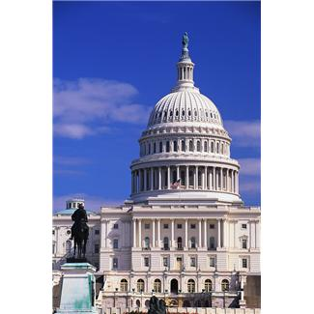
How to minimize role of government yet achieve universal coverage?
One way is ‘mandate’ with a penalty
Other ways it could have been done:
  Posting a bond
  Limiting enrollment to every five years
Notes:
Individual Mandatte
Health insurance exchange, subsidies
Subsidies for individuals and small business
Discussing tax penalty for individuals who do not enroll

Slide 21

The ACA and Cost Reform

Slide 22

Federal spending on health care single largest factor driving the deficit
Medicare
Medicaid
CHIP
Notes:
unsustainable

Slide 23
What’s Driving the Cost Increases in Healthcare?
Technology About 50%
Obesity ~ 25%
Aging <10%
Administrative <10%
Defensive Med 10-15%??
Each factor is compounded by FFS payment
Notes:
High and rising health care costs: Demystifying U.S. health care spending - Ginsburg

Slide 24
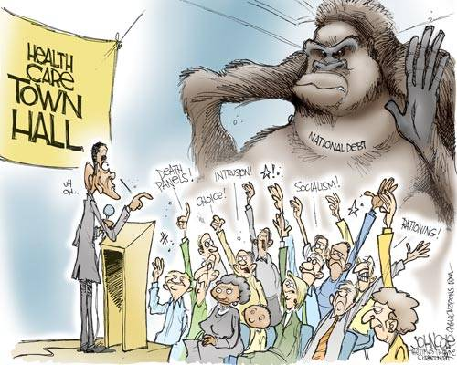

Slide 25

Payment Reform
Re-aligning Incentives is Fundamental to all reform

Slide 26
Shift of Incentive from:
Treating Sickness to Encouraging Healthiness
Moving Beyond FFS and P4P

Slide 27
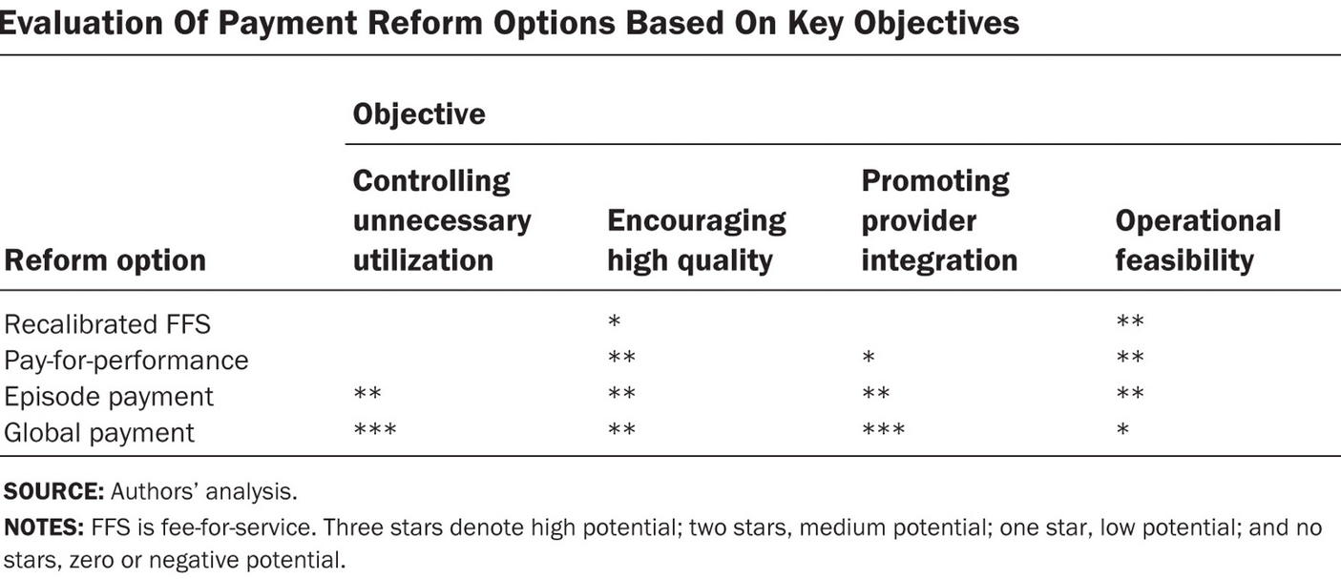
Health Affairs 3/09
Notes:
http://content.healthaffairs.org/content/28/2/w262/T1.expansion.html

Slide 28
COST- Reform
Sort of

Slide 29
1. A Fragmented System
Up until just a few years ago, what percent of American physicians were in solo or single specialty practices*
Hing, National Center for Health Statistics
Notes:
These small offices lack the expertise and infrastructure to deliver patient education
Office-based Medical Practices: Methods and
Estimates from the National Ambulatory Medical Care Survey
by Esther Hing, M.P.H., and Catharine W. Burt, Ed.D., Division of Health Care Statistics
Advance Data No. 383 + March 12, 2007

Slide 30

1. A Fragmented System
80%
Hing, National Center for Health Statistics
Notes:
Who is from other parts of the country? What was it like?
These small offices lack the expertise and infrastructure to deliver patient education
Office-based Medical Practices: Methods and
Estimates from the National Ambulatory Medical Care Survey
by Esther Hing, M.P.H., and Catharine W. Burt, Ed.D., Division of Health Care Statistics
Advance Data No. 383 + March 12, 2007

Slide 31

2. Fragmented system prevents payment reform
Fee-for-service volume incentive
  Bundled payment/ global payment
Care is too fragmented for bundled/capitated
  ACO
  Poor reimbursement for primary care
  Increase primary care/coordination
But can’t bundle payment until larger systems of care- enter the ACO

Slide 32
1. Reducing fragmentation – payment reform
Accountable Care Organizations (ACO)
    Umbrella organizations to provide systems/processes and skills
  Move from FFS to bundled/global pay
Notes:
Voluntary- PSOs did not spread after 97 BBA
Spending by region differs by a factor of 3. Experts believe there are large amounts of care being delivered of marginal value.

Slide 33
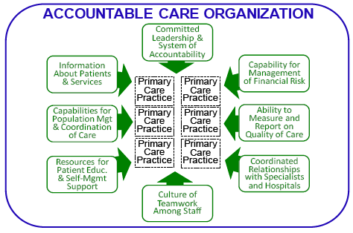
Ancillary
Care
Specialty Care
Inpatient
Care

Slide 34
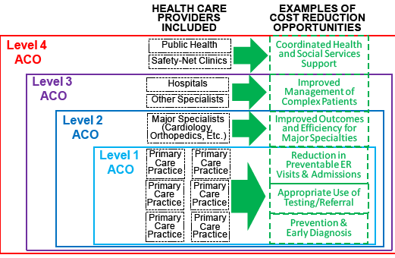
Possible Structure for an ACO?
Notes:
Diagram from CHQPR

Slide 35
A changing marketplace
Independent physicians and small hospitals will be looking for partners with infrastructure
We are seeing wave of consolidation likely due to economic downturn and ACO discussion
Larger systems are looking to grow and gain efficiencies of scale

Slide 36
COST- Reform
Other Cost Control
Benefits plans-> tax ‘cadillac’ health plans limited
Congress seems unable to cut spending
  Independent Payment Advisory Board (IPAB)
  NOT benefits, ration care, raise taxes, premiums, cost-sharing
Lawsuits->State grants to pilot tort reform
Notes:
The Quality Care Coalition unveiled the final legislative language, which will establish two studies to be conducted by the independent and respected Institute of Medicine, to improve geographic inequities and improve quality care. The recommendations from both studies are schedule to be implemented prior to 2013, when enrollment for the public plan begins. The first study will evaluate and make necessary corrections to the current geographic adjustments to physician payments. The second study will provide recommendations on changing the Medicare payment system to reward efficient delivery of high quality, evidence-based, patient centered care.

Slide 37
COST- Reform
Insurance Markets -> Exchanges
  Intent is to reduce cost and expand coverage
    Small business and individual
    Reimbursement public or private
Marginal care driven by Fee for Service
  Comparative Effectiveness Research
Prices-> Reduced annual payment updates
Notes:
Spending by region differs by a factor of 3Experts believe there are large amounts of care being delivered of marginal value.
Exchanges are optional by state for more than 100 employees

Slide 38
The legislative victory was not the final story
The Passage of the Legislation was just Round 1.

Slide 39
Victories are rare in politics; issues just shift from one forum to the next
Congress
Supreme Court
Presidential Election
States
?
ACA
Notes:
Mike
True of other contentious issue such as abortion

Slide 40
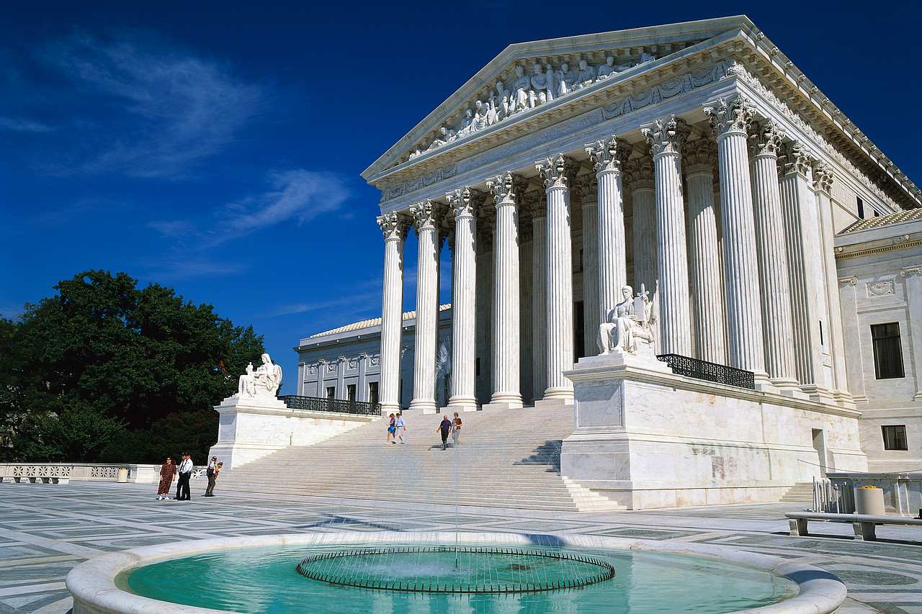
SCOTUS

Slide 41
Primary Questions
Individual Mandate
  Did Congress act within its power?
    Commerce Clause?
    Taxing Clause?
Medicaid Expansion
  Was the ACA’s expansion of Medicaid coverage unconstitutionally coercive?
Notes:
Coercive because it compelss the states to enact a federal regulatory program without choice

Slide 42
Implications Going Forward
Backdrop of lowered reimbursement rates
Coverage Expansion scheduled for 2014 but…
Medicaid Expansion-some states will not do so
  Republican governors tend to oppose
What this means to providers?
Notes:
CMS has many payment reform initiatives started, that will continue. Some private insurers also beginning this
Health Exchange blueprint deadline Nov 2012

Slide 43
Health Insurance
Coverage
Employer
Based
Individual
Health Care Exchange
Uninsured
Medicaid Expansion
Medicaid

Slide 44
Implications Going Forward
Health Exchanges
  Only 15 states met deadline,
    Some not started
  WI eventually opted for federal exchange
    Federal? A lot of work to do
ACA payment reform will continue
  Putting providers at risk for performance
    P4P, bundling, global payment, readmission penalties
Continued pressure to reduce cost of care
Notes:
CMS has many payment reform initiatives started, that will continue. Some private insurers also beginning this
Health Exchange blueprint deadline Nov 2012

Slide 45
Final victories are rare on controversial issues…

Slide 46
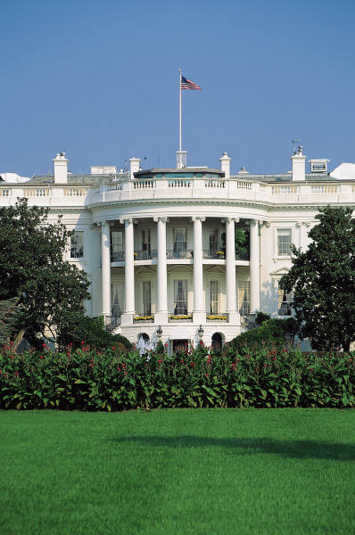
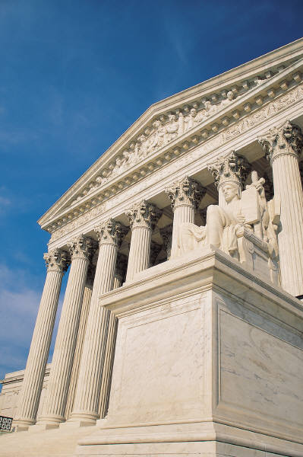
The Election and the Balance of Power
5-4
Future Appointees?
House
Senate
Notes:
Mike
Little change from before the election. A few more Dems in Senate (not filibuster proof)
System of checks and balances tends to favor status quo unless idea very popular or one house controls all Pres/Cong

Slide 47

The ACA Has Worked Through
Congress, the Courts, the Election…now the States
Much of the implementation is based on decisions at the state-level
In particular, decisions about Medicaid expansion and how to implement exchanges

Slide 48
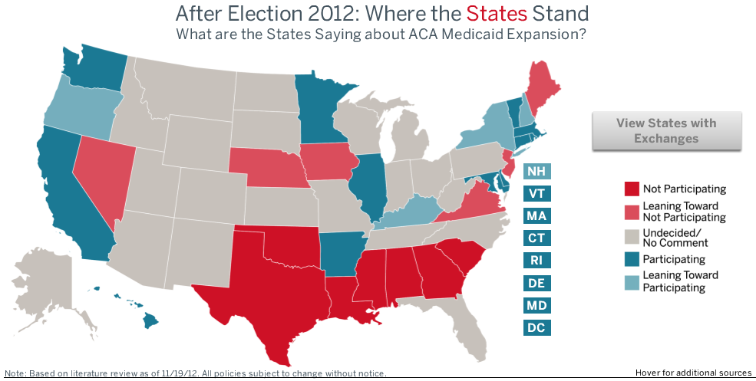
Supreme Court Leaves it to the States, so…
What are the States Saying about ACA Medicaid Expansion
?
Notes:
Southern, typically more conservative states are choosing not to participate in Medicaid expansion. Probably because they philosophically oppose Washington intrusion into state affairs, and simply opposition to ACA
Some experts believe there will be pressure to do so due to low state cost
Verbally, after the election, Gov Walker said he would not expand Medicaid. No official word

Slide 49
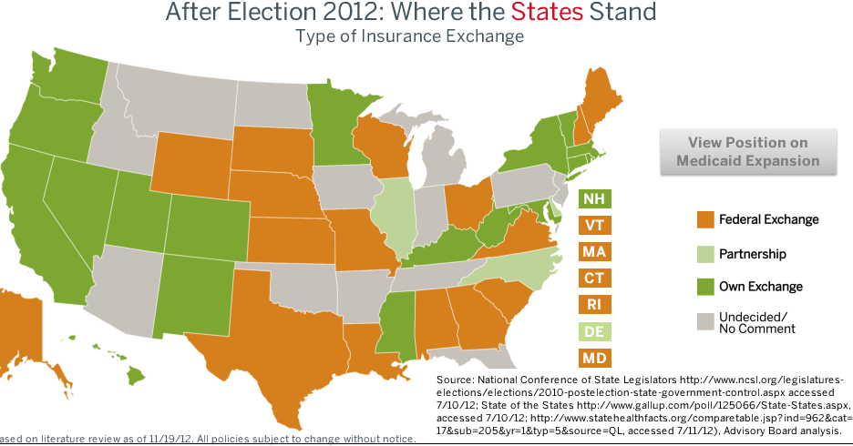
How Might a State Exchange Differ From a Federal One?

Slide 50
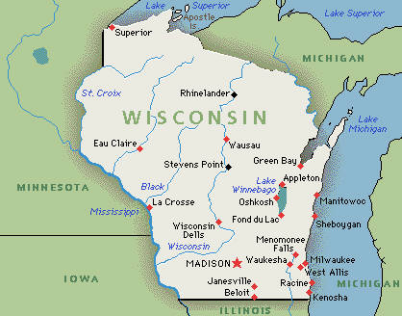
The Status of the Exchange for Wisconsin
Why a federal exchange?
What it might mean?

Slide 51
What’s the Latest News on Exchanges
Insurers predict that costs for individual/small business will increase substantially
  25-50%
  Due to guaranteed acceptance
  Minimizing age-based costs
  Richer benefit package

Slide 52
discussion

