Slide 1
Health Economics
Taggert J. Brooks
Spring 2013

Slide 2
“The curious task of economics is to demonstrate to men how little they really know about what they imagine they can design.”
~F. A. Hayek The Fatal Conceit

Slide 3
Why study health economics?

Slide 4
The basic economic questions which every society faces
PPF
Opportunity cost
Pareto optimal
Positive versus normative
Notes:
Draw a PPF with Housing and Health.
Discuss tradeoffs.

Slide 5
Research in Economics
RAND Health Experiment
  Gold standard, randomized treatments
Notes:
Discuss the self selection bias common to most research.

Slide 6
What is special about Health (Care) Economics?
Uncertainty and Incomplete Information
Asymmetric Information
Regulation and Government Intervention
Externalities

Slide 7
Uncertainty and Incomplete Information
Random illness striking individuals
Random outcomes from medical interventions
Professional uncertainty about efficacy of treatment
Notes:
In traditional micro models we assume complete or full information.
Will genetic testing and profiling help reduce some of these uncertainties?
People are heterogeneous in their responses to treatment, and genetics may be part of the causal heterogeneity
Uncertainty versus Risk.
So how should we think about risk and uncertainty? A logical starting place is Frank Knight's distinction: Risk has an unknown outcome, but we know what the underlying outcome distribution looks like. Uncertainty also implies an unknown outcome, but we don't know what the underlying distribution looks like. So games of chance like roulette or blackjack are risky, while the outcome of a war is uncertain. Knight said that objective probability is the basis for risk, while subjective probability underlies uncertainty.

Slide 8
Asymmetric Information
Health professional know more about the healing process and the efficacy of different treatments
Consumers know more about their own health condition than insurers
Physician Agency
Notes:
Asymmetric information is when one party to a transaction has information unavailable to the other.

Slide 9
Regulation and Government Intervention
Health Practitioners (Licensure)
Drugs and Products
Price Controls
Capital Construction, entry, and exit
Provision of insurance
Research and Development
Professional Education
Favored Tax Treatment

Slide 10
Externalities
Negative
  Communicable Diseases
  Reckless Lifestyles (e.g., Drunk Driving)
  Gun Ownership
Positive
  Production of Knowledge

Slide 11
Medical Care vs. Health Care
Most of the improvement in life expectancy comes from public health
  Chlorinated and Filtered water.
Effect of medical care on health
  Limited
  Extensive versus Intensive Margins

Slide 12
From: Peter Orszag - Director CBO
Notes:
Spending per beneficiary. Note this includes price of services and quantity of services.
Total Spending/capita covered=P*Q

Slide 13
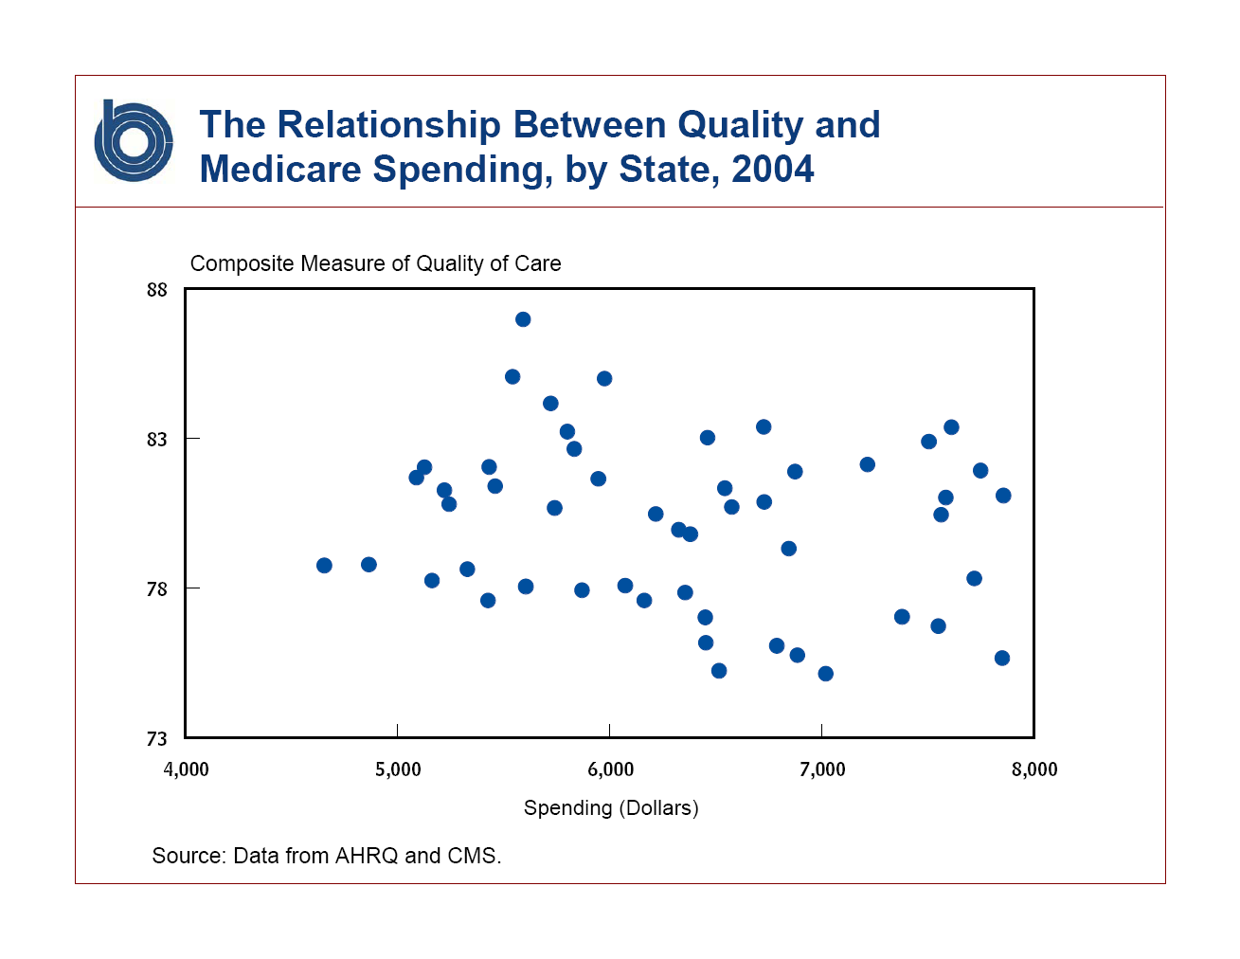
From: Peter Orszag - Director CBO

Slide 14
Grossman Model
Economists think about Health in terms of a stock of Health.
  The stock of health generates flow of utility increasing life
  Medical Care is an investment in that stock
  Other investments
Notes:
Stock of Health is a durable good, much like a car, which generates services.
The car generates transportation services which yields utility (pleasure). Health generates a flow of services you can consume and their for get utility from. So the health services (“feeling good”) are a complement to other consumption you might do.
Investments can be health services, pharma services, or exercise services.

Slide 15
Preconceptions
Health Care Spending as % of GDP
Government’s Share of Health Care Spending
% of people covered by health insurance
Life Expectancy at Birth.

Slide 16
Spring 2010

Slide 17
Spring 2013

Slide 18
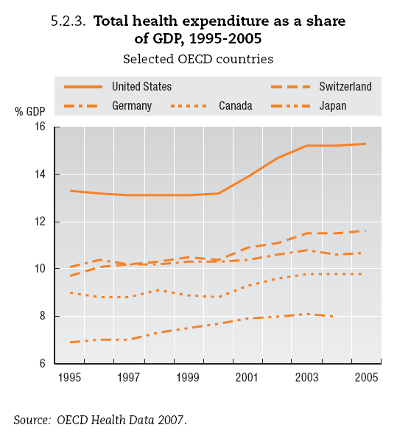

Slide 19
Spring 2010

Slide 20
Spring 2011

Slide 21
Spring 2013

Slide 23
Spring 2010

Slide 24
Spring 2011

Slide 25
Spring 2013

Slide 26

Health Insurance Coverage in the U.S., 2008
Total = 300.5 million
NOTE: Includes those over age 65. Medicaid/Other Public includes Medicaid, SCHIP, other state programs, and military-related coverage. Those enrolled in both Medicare and Medicaid (1.9% of total population) are shown as Medicare beneficiaries. SOURCE: Kaiser Commission on Medicaid and the Uninsured/Urban Institute analysis of March 2009 CPS
Notes:
85% are covered by some insurance

Slide 27
Impact of Unemployment Growth on Medicaid and SCHIP and the Number Uninsured
$3.4
$1.4
State
1.1
1.0
=
1%
&
Increase in National Unemployment Rate
$2.0
Federal
Increase in Medicaid and SCHIP Enrollment
(million)
Increase in Uninsured
(million)
Increase in Medicaid and SCHIP Spending
(billion)
Source: Stan Dorn, Bowen Garrett, John Holahan, and Aimee Williams, Medicaid, SCHIP and Economic Downturn: Policy Challenges and Policy Responses, prepared for the Kaiser Commission on Medicaid and the Uninsured, April 2008
Notes:
27
A one percent rise in the nation's unemployment rate is projected to increase the number of uninsured by 1.1 million and result in an additional 1 million (600,000 children and 400,000 adults) enrolling in Medicaid, increasing state Medicaid spending by $1.4 billion at time when their tax revenues would fall by 3 to 4 percent.

Slide 29
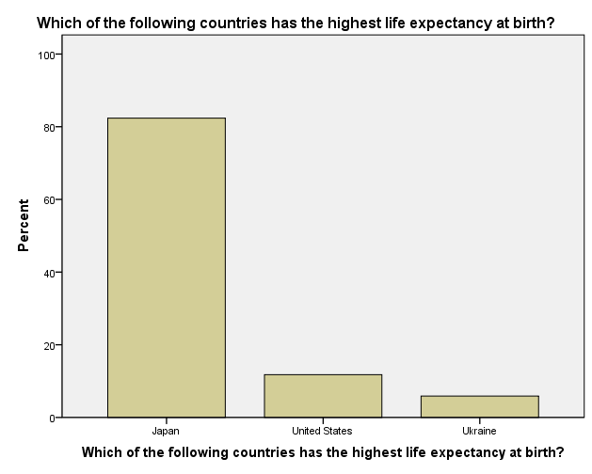

Slide 30
Life Expectancy at Birth
Rank | Country | Life
3 | Japan | 82.12
50 | US | 78.11
103 | Venezuela | 73.61
150 | Ukraine | 68.25
Notes:
3 Japan 82.12
50 United States 78.11
103 Venezuela 73.61
150 Ukraine 68.25

Slide 32
Notes:
3 Japan 82.12
50 United States 78.11
103 Venezuela 73.61
150 Ukraine 68.25

Slide 33
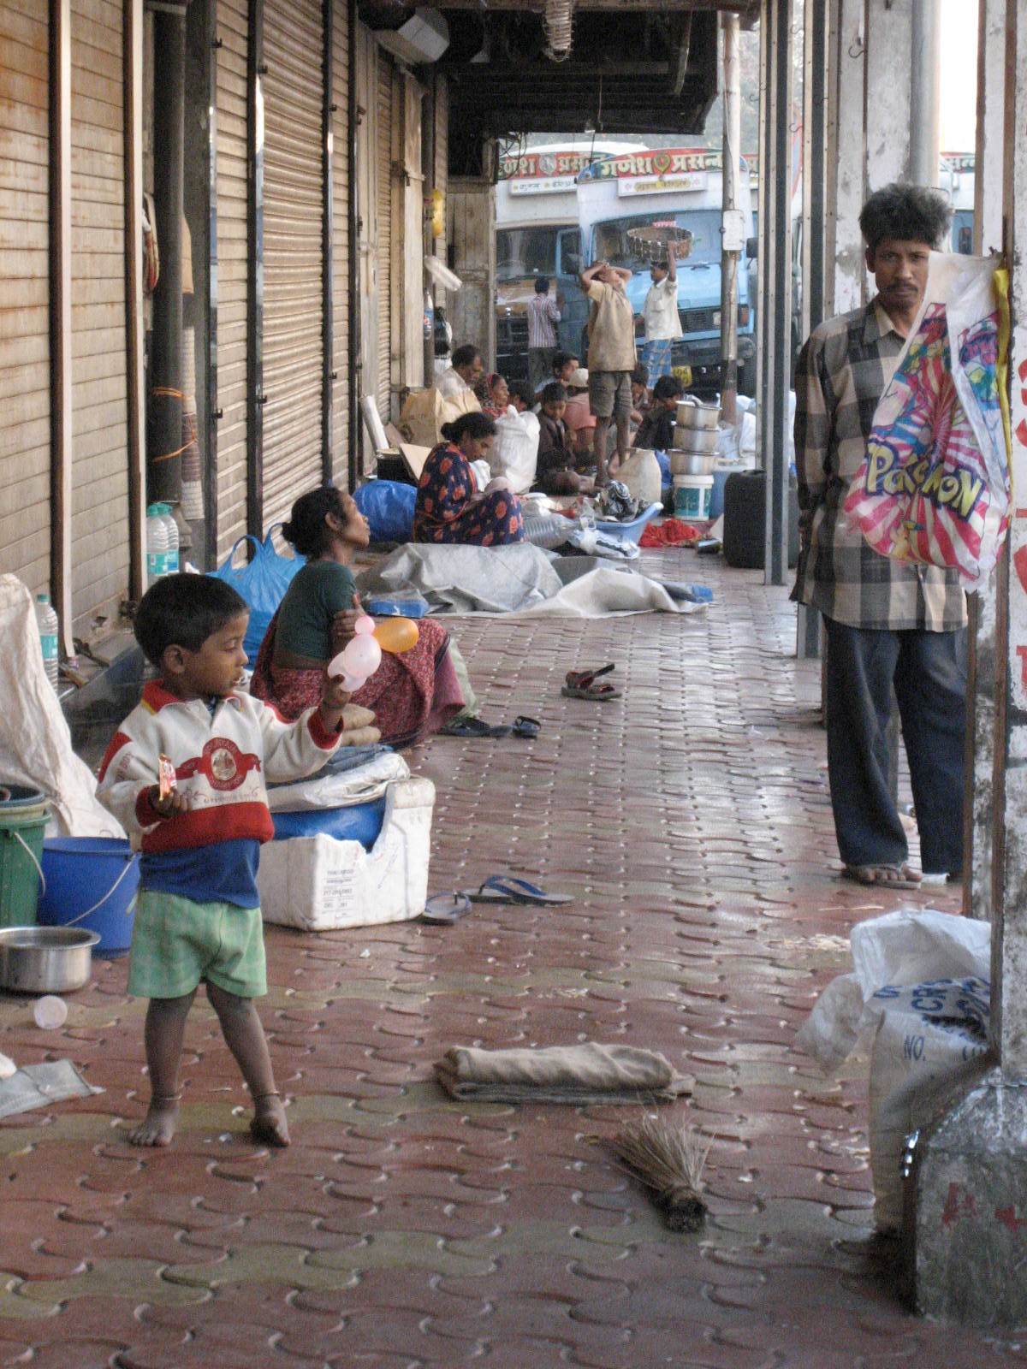
Notes:
Gains from public health.
Cities can be bad for health.
http://www.marginalrevolution.com/marginalrevolution/2010/02/joel-mokyr-on-living-standards-during-the-industrial-revolution.html
One of the notable arithmetical truths about the period of the Industrial Revolution is that it is quite possible (if not certain) that biological living standards in both urban and rural areas rose and yet average living standards declined. This can happen if urban living conditions are significantly worse than rural ones, and the proportion of people living in cities is rising because of migration from the countryside to the towns. It seems likely that the biological measures of living standards were especially sensitive to urbanization. While urban areas may have offered some positive amenities (such as entertainment and more choice in shopping), healthy living conditions were surely not among them.

Slide 34
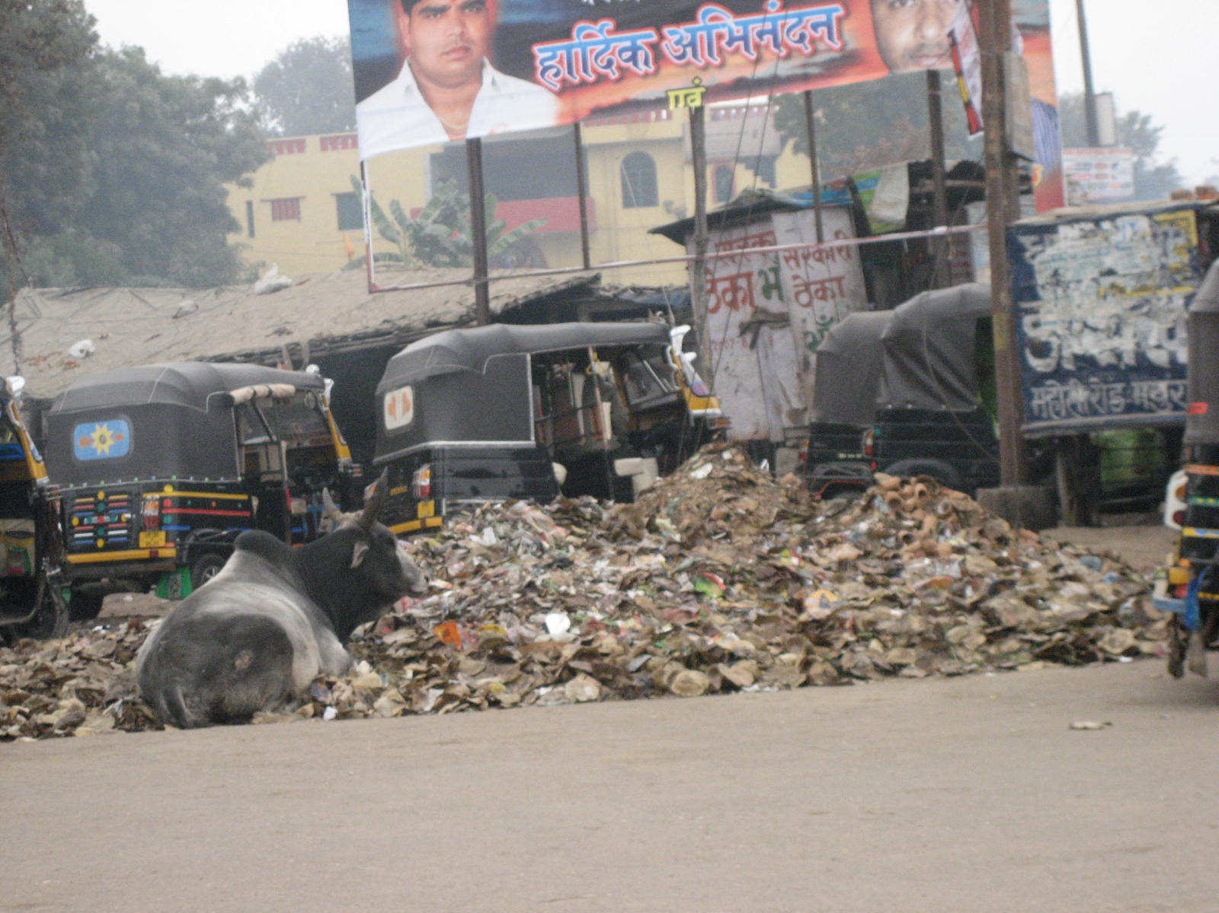

Slide 35
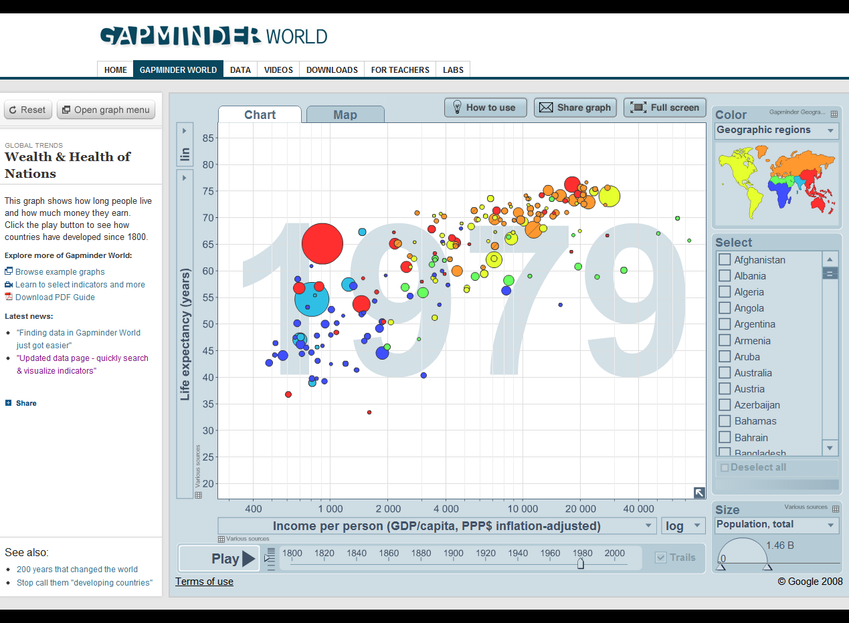
Notes:
Gapminder.org

Slide 36
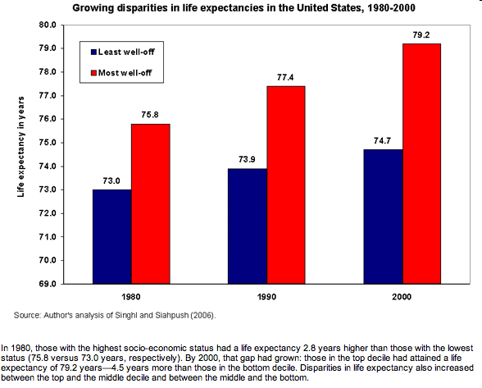
Notes:
http://delong.typepad.com/sdj/2008/08/epis-state-of-w.html

Slide 37
Sources of Rising “Costs”
Expenditures = Price X Quantity

Slide 38
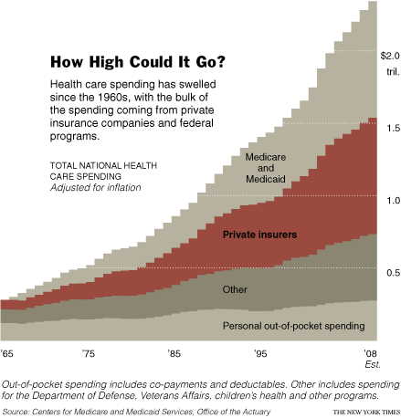

Slide 39
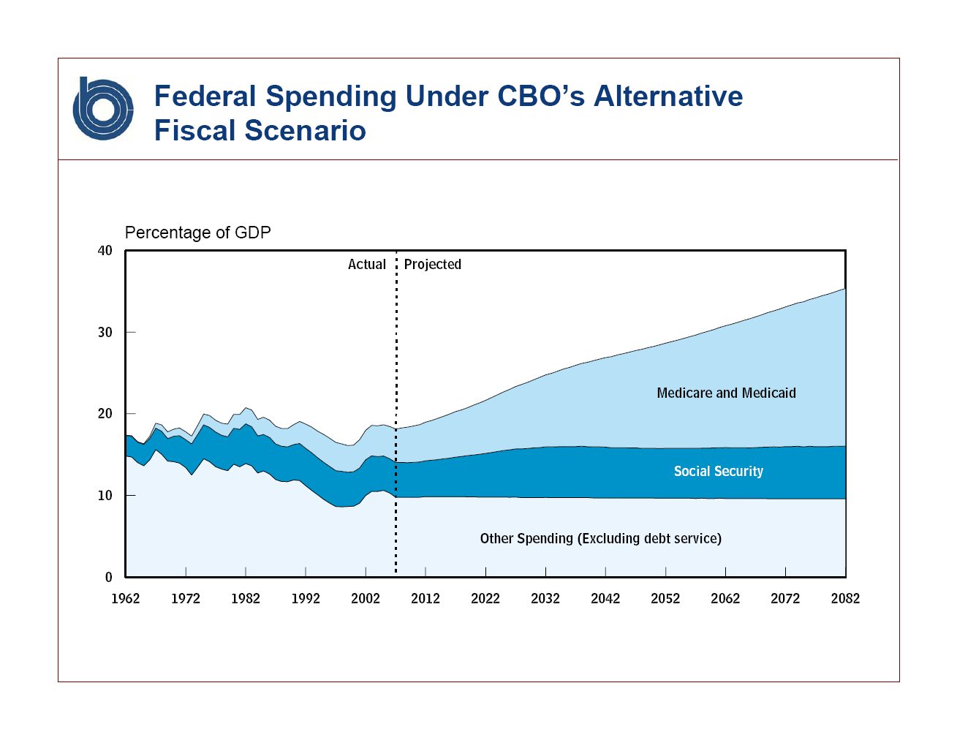
From: Peter Orszag - Director CBO

Slide 40
National Compensation Measures as a Share of GDP, NIPA 1960-2006
Private Group Health Insurance
56.3% of GDP
56.4% of GDP
3.8%
Other Fringe Benefits and Payroll Taxes
6.7%
0.6%
4.1%
Wages
51.8%
45.6%
2006
Source: Kaiser Family Foundation analysis of data from the U.S. Department of Commerce, Bureau of Economic Analysis, National Income and Product Accounts, 1960-2006, Tables 1.1.5, 2.1, 6.11B, 6.11C, & 6.11D, 2008.
Notes:
40
Although total compensation – wages plus benefits – has remained fairly stable as a share of our nation's economy since 1960, health benefit costs paid by employers has risen from 0.6 percent of GDP in 1960 to 4.1 percent in 2006.

Slide 41
Health Care as an Economic Issue
Which of the following is the single most important economic issue facing you and your family? (Feb. 2008, registered voters)
Inflation or rising prices overall
High taxes
Price of gasoline
Health care costs
Problem getting a good-paying job or a raise in pay
Cost of housing
Difficulty saving for retirement
Credit card debt and other personal debt
All of these/Other/Don’t Know
SOURCE: Kaiser Health Tracking Poll: Election 2008 Issue 6: March 2008 (conducted February 7-16, 2008)
Notes:
41

Slide 42
Problems Experienced as a Result of Changes in the Economy
As a result of recent changes in the economy, have you and your family experienced any of the following problems, or not? Was this a serious problem, or not?
Percent saying each was a “serious problem”
Problems paying for gas
Problems getting a good-paying job or a raise in pay
Problems paying for health care and health insurance
Problems paying your
rent or mortgage
Problems paying for food
Problems with credit card debt or other personal debt
Losing money in the stock market
SOURCE: Kaiser Family Foundation Health Tracking Poll: Election 2008 (conducted April 3-13, 2008)

Slide 43
Mean Health Insurance Costs Per Worker Hour for Employees with Access to Coverage, 1999-2005
Source: Kaiser Family Foundation analysis based on data from the National Compensation Survey, 1999-2005, conducted by the Bureau of Labor Statistics.
Notes:
43
Average employer costs for health insurance per employee hour rose from $1.60 in 1999 to $2.59 in 2005 among workers with access to health benefits. This almost 62% increase greatly exceeds the 23% increase in average per hour employer payroll costs over the same period.

Slide 44
International comparisons:
Some stylized facts about health care

Slide 45
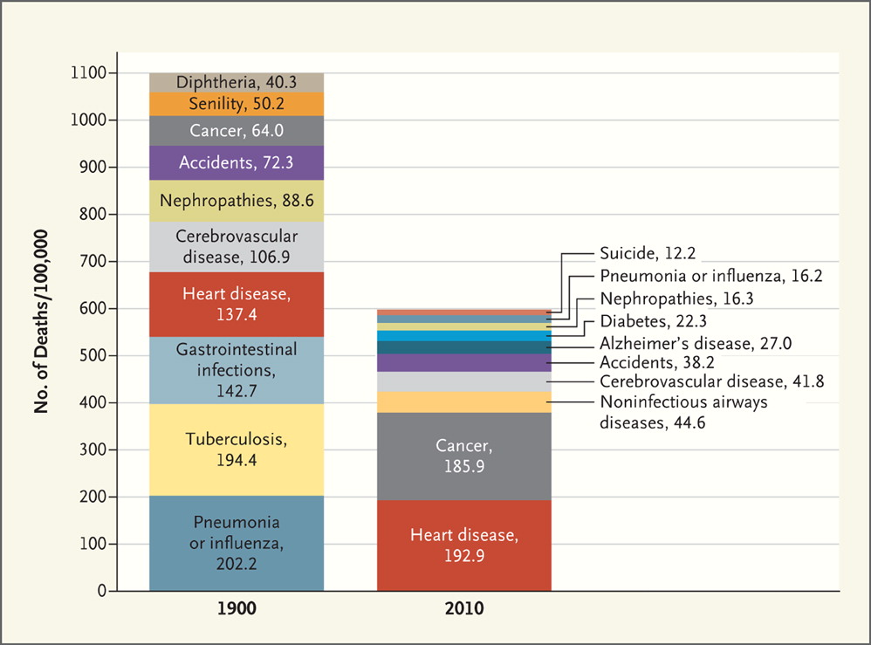

Top 10 Causes of Death: 1900 vs. 2010.
Jones DS et al. N Engl J Med 2012;366:2333-2338.
Notes:
Top 10 Causes of Death: 1900 vs. 2010. Data are from the Centers for Disease Control and Prevention.
http://www.nejm.org/doi/full/10.1056/NEJMp1113569

Slide 46
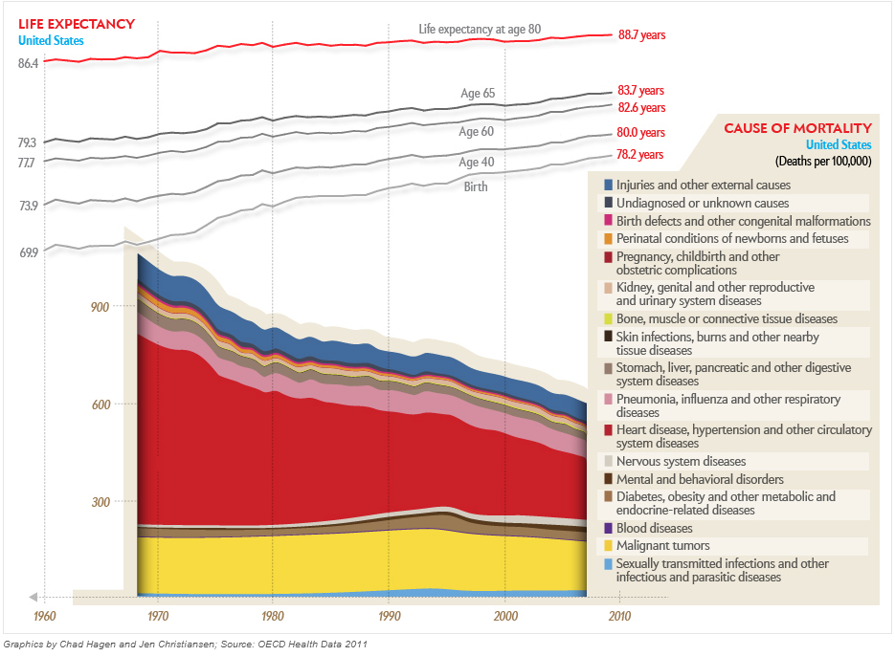
Notes:
US
http://www.scientificamerican.com/article.cfm?id=longevity-why-we-die-global-life-expectancy#

Slide 47
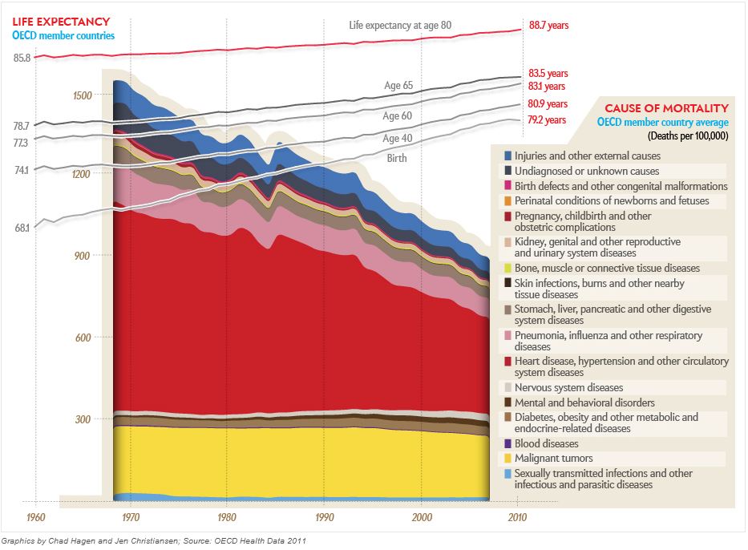

Slide 48
Notes:
Ranking methodology subjected to significant criticism in academic circles (Science, Health Economics)
•But oft cited as ‘authoritative’nonetheless …
•Relatively poor U.S. rank in part attributable to
–High levels of health spending
–Relatively mediocre population health outcomes
–Inequitable access for the uninsured
4

Slide 52
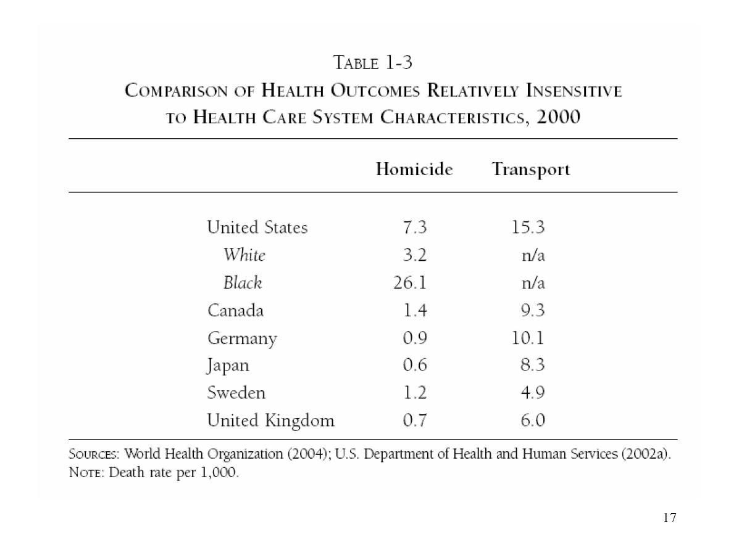

Slide 53
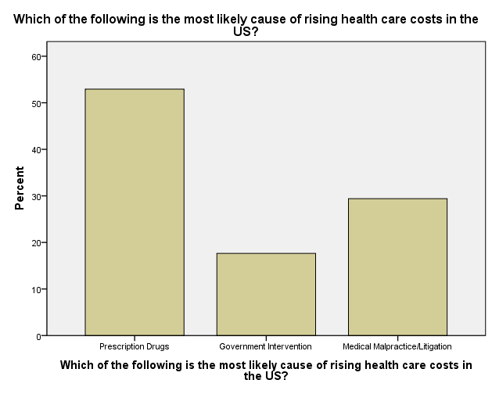

Slide 57
Notes:
  Differences in mortality, life expectancy at different ages and causes of death over time and across countries

