Slide 1
Comparative Health Systems

Slide 2
What Metrics are important?
When comparing health systems, what metrics would you use?
Be specific.

Slide 3
Gruber: ACA
http://www.youtube.com/watch?v=qEAyoxhj7O0
Or cspan link
http://www.c-spanvideo.org/program/303580-1
At minute 38 discussion of US v other systems

Slide 4
Categories of Health Systems
National Health Insurance (Canada)
government is third party payer
National Health Care system (UK)
government provides health care
Community sickness funds w/subsidy (FR & GE)
Mixed public and private (US, Japan, Australia)

Slide 5
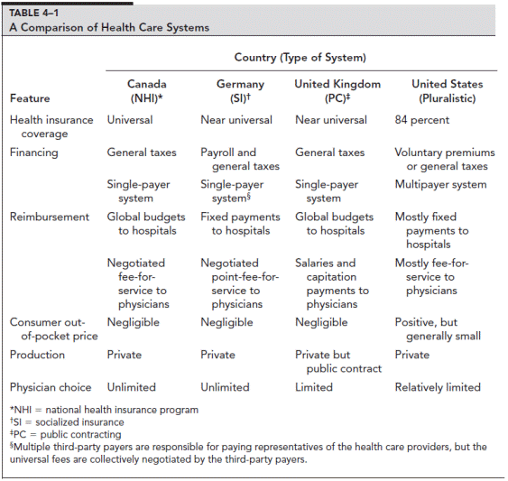

Slide 9
Notes:
http://www.businessweek.com/the_thread/economicsunbound/archives/2009/09/where_are_healt.html

Slide 12
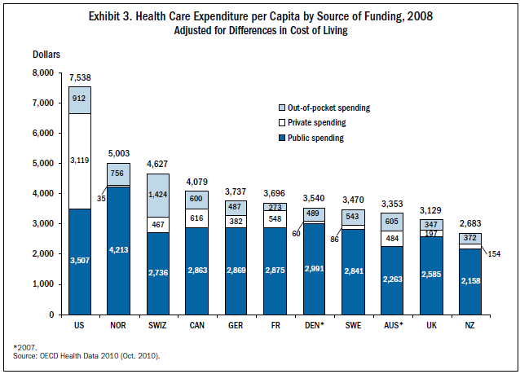

Slide 13
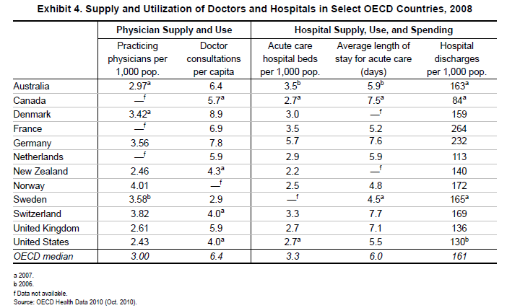

Slide 14
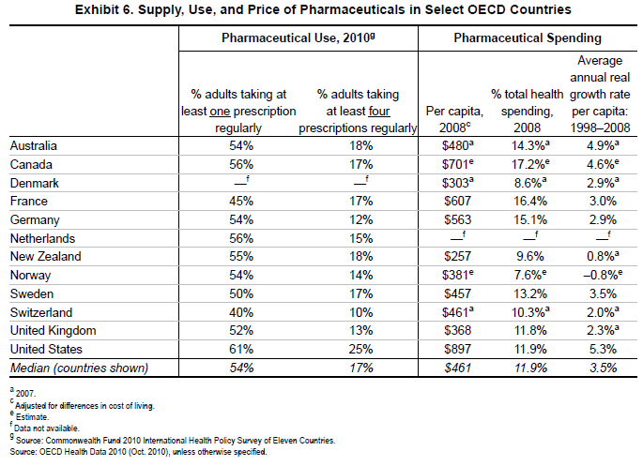

Slide 15
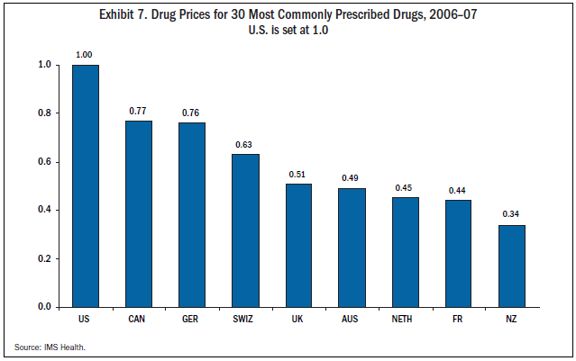
Notes:
Is this just price discrimination by pharmaceutical companies? Price discrimination interacted with national government’s policy?

Slide 16
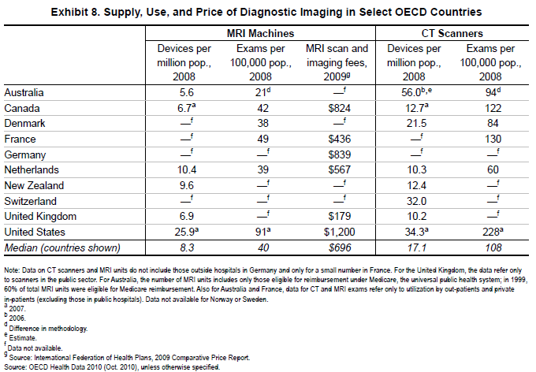

Slide 17
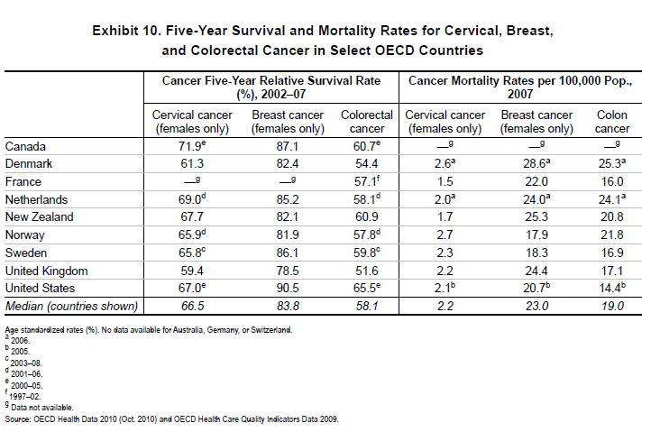

Slide 18
Canadian Health System
Single Payer
Financed out of income tax revenue
No “official” gate keepers
No parallel private insurance allowed
Supplementary insurance subsidized as employer based in US

Slide 19
Canadian Health System
Physicians and Hospitals
Diffusion and Use of technology
Role of Insurance
Divergence between US and Canada

Slide 20
German
Sickness Funds
Private Insurance
Reforms of the 1990s
Hospitals Mixed public/private

Slide 21
German
Physicians and Hospitals
Technology
Effects of Financing through Payroll Tax
With elastic labor supply the decrease in demand results in lower employment rather than lower wages

Slide 22
UK
Structure of NHS
Rationing by queuing
Private parallel insurance
Physicians compensation
Hospitals (Salary)
Non-Hospital (Capitation)

Slide 23
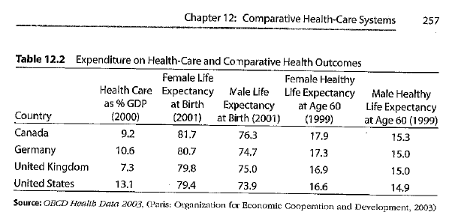

Slide 25
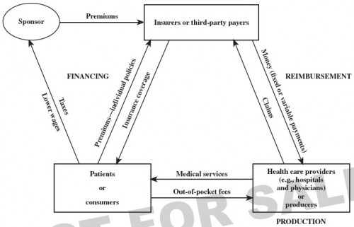

Slide 26
Summary
Canada has best health outcomes
UK spends the least.
Germany has the greatest Hospital/Physician capacity
US Spends the most, and has the worst outcomes as measured by life expectancy

