Slide 1
Taggert J. Brooks, PhD
Associate Professor of Economics
University of Wisconsin-La Crosse
The Great Recession
2007

Slide 2




Economic Indicators:
An Update for the 7 Rivers Region

Slide 3
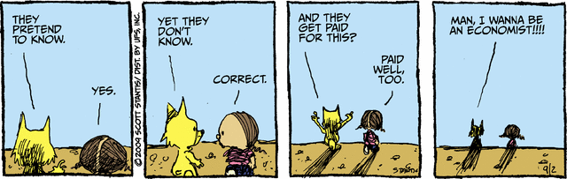

Slide 7
Housing Market
Foreclosures and prices
Notes:
Effectiveness:
The political process robbed the stimulus of its maximum possible effectiveness.

Slide 8
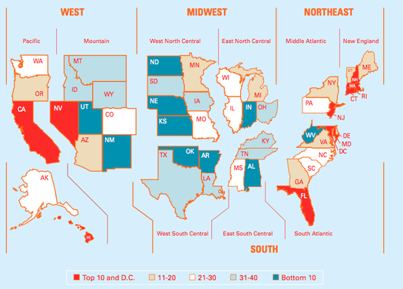
House Price Risk
Notes:
chart courtesy of PMI
http://bigpicture.typepad.com/comments/2007/02/geographic_dist.html

Slide 11
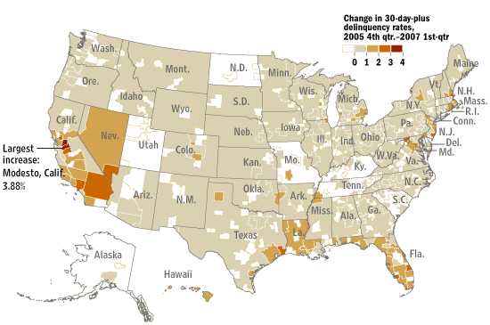
Mortgage Delinquency
Notes:
Delinquancies happen because of job loss, divorce, or medical bills.
http://online.wsj.com/public/resources/documents/info-Delinquency0704-sort.html
The mortgage delinquency rate climbed to 2.87% in the first-quarter, up from a recent low of 2.03% in the fourth quarter of 2005. The rate is at its highest level since at least 2000. The rise in delinquencies has been steepest in Modesto, Stockton and Merced, Calif., and the Port. St. Lucie-Fort Pierce metro areas in Florida. On an absolute basis, delinquencies are highest in Detroit-Livonia-Dearborn, Mich. and Brownville-Harlingen, Texas. — Ruth Simon
Source: Equifax/Moody's Economy.com

Slide 12
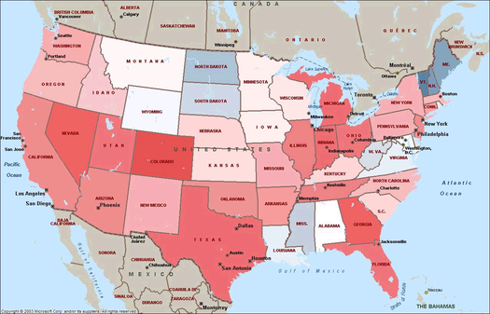
Per Capita Foreclosure Filings
Notes:
http://bigpicture.typepad.com/comments/2007/02/foreclosure_hea.html
http://www.realtytrac.com/
Heatmap

Slide 13
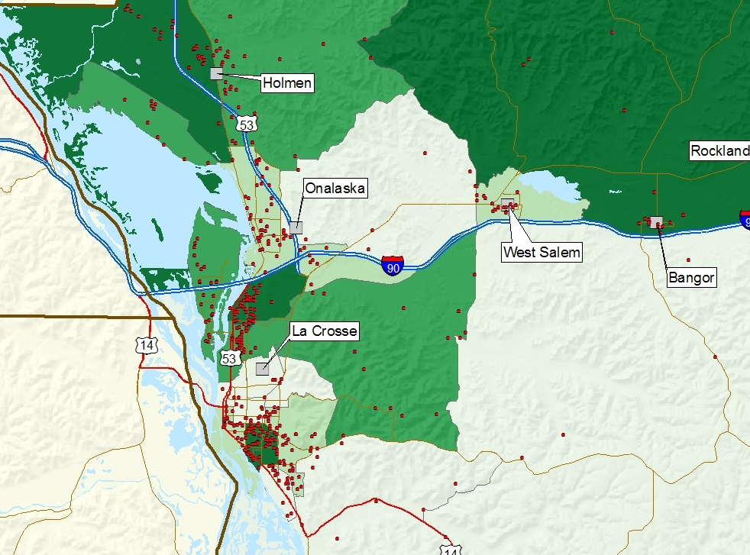
Notes:
In 2008 foreclosures in the 7 rivers region were up 23%
Darker green represents higher foreclosure rates per 100 homes. Areas are based on census tracts.
Thank matt kures and russ kashian.

Slide 14
Notes:
15.9% increase from 2008.

Slide 15
http://www.uwlax.edu/faculty/brooks/prof/charts/foreclosure-state.htm

Slide 19
Optimism:
I'm delighted to report that over the break we learned that our campus has produced so many graduates currently working as Peace Corps volunteers that we are among the Top 25 medium-sized schools in the nation.
-Joe Gow
The Economist:
Oh no. They couldn’t find jobs.

Slide 25
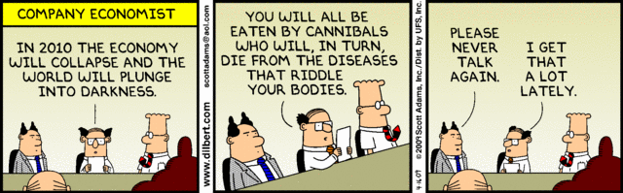

Slide 31

79.1
69.9
Notes:
Photo credit: http://www.flickr.com/photos/michaelholden/2104218938/sizes/l/
Local seven rivers region declined from 791.-69.9 while the national index declined from 70.8 to 61.2
Current conditions fell by more than the national numbers. Whereas future expectations fell by less.

Slide 32
Falling Confidence
Falling Consumption

Slide 33


Slide 34

CL
SED
Notes:
A recession is when someone you know loses a job, a depression is when you lose a job.
A recession is when someone you know loses their starbucks, a depression is when you lose yours.

Slide 35
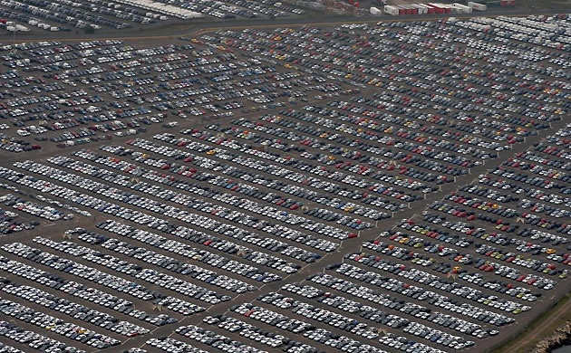
Cars accumulate at the ports

Slide 36
Notes:
Current ratio of vehicles registration to new vehicles sales puts the fleet replacement at 25 years. The average is normally 10-15 years. So either people will return to buying vehicles or the number of registered vehicles will decline.

Slide 38

Notes:
40 basis point funding advantage relative to comparable securities due to implicit government backing. 7 Basis points of which make its way to borrowers…the rest lost to executive compensation
http://www.economics.harvard.edu/faculty/mankiw/files/fanfred_ft.pdf

Slide 39
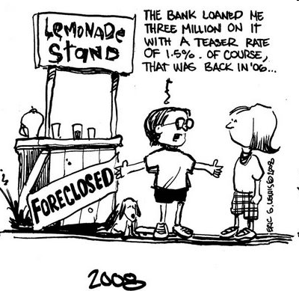

Slide 40
Notes:
Treasury eurodollar (LIBOR) spread.

Slide 41
Notes:
If you bought a 100,000 house in all three cities in
Jan 2000, the max price is 171,000 in MSP, 227,000 in Phoenix and 145,00 in LSE
Currently that same house is worth 127,000 in MSP, 123,000 in Phoenix and 145,000 in LSE.
Number of days on the market has increased and the number of listings sold has fallen, but prices have not fallen.
Every dollar increase in home value raises consumption by 5-8 cents.

Slide 42
Notes:
This is designed to demonstrate 2 things. Local companies have outperformed the market.
Wealth held in the stock market has declined substantially.
However most wealth is held in equity in your home.

Slide 43
Wealth
Consumption
Notes:
Even if the banks were completely liquid, we have restructuring to do and consumption contraction to endure.

Slide 44
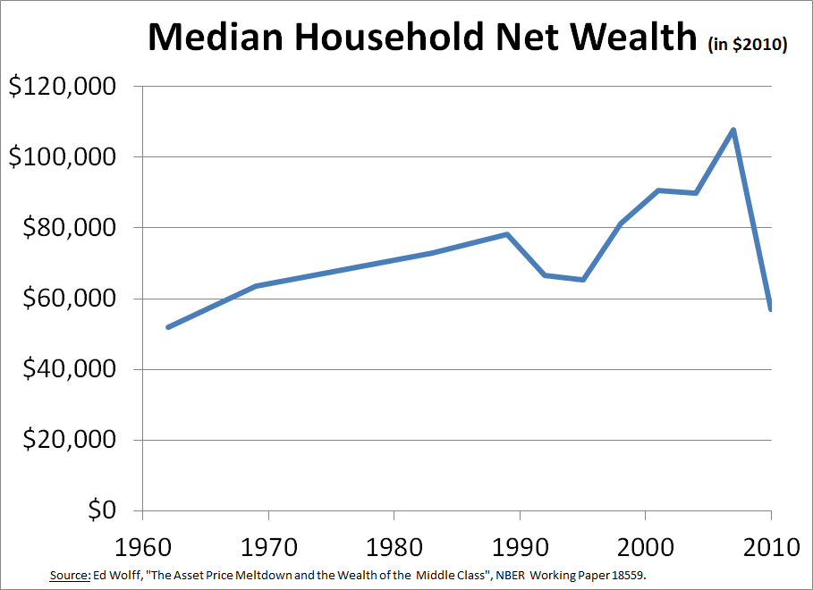

Slide 45
Recession…
It’s no longer the banks

Slide 46
Monetary Policy Response
TALF

Slide 48
Troubled
Asset
Relief
Program
Dynamic Government Intervention

Slide 49
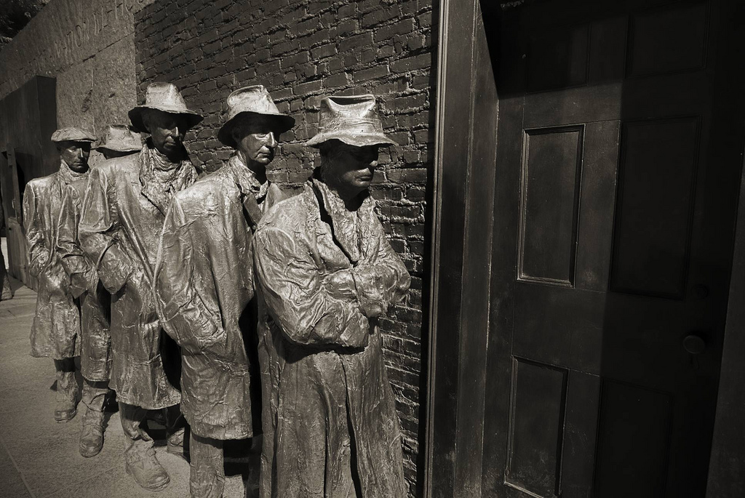
Notes:
http://www.flickr.com/photos/b-tal/2767650536/sizes/l/
The FDR memorial soup line from the great depression.

Slide 50

Banks:
Solvency or
Liquidity Issues?
Notes:
http://www.flickr.com/photos/18805629@N00/1420189899/sizes/o/

Slide 51
TARP:
$700 Billion of which
$384.6 Billion allocated

Slide 52
The Lost Decade
Notes:
NYTimes “Today, years after the recovery, even well-off Japanese households use old bath water to do laundry, a popular way to save on utility bills. Sales of whiskey, the favorite drink among moneyed Tokyoites in the booming ’80s, have fallen to a fifth of their peak. And the nation is losing interest in cars; sales have fallen by half since 1990.”
The peak was about 7 million units and it is expected to be down to <4 million in 2009

Slide 54
Fiscal Policy Response
Stimulus
Notes:
As much as 53 Trillion dollars. 34 trillion for medicare (of which about 8 trillion is prescription drugs) and the rest social security.

Slide 55
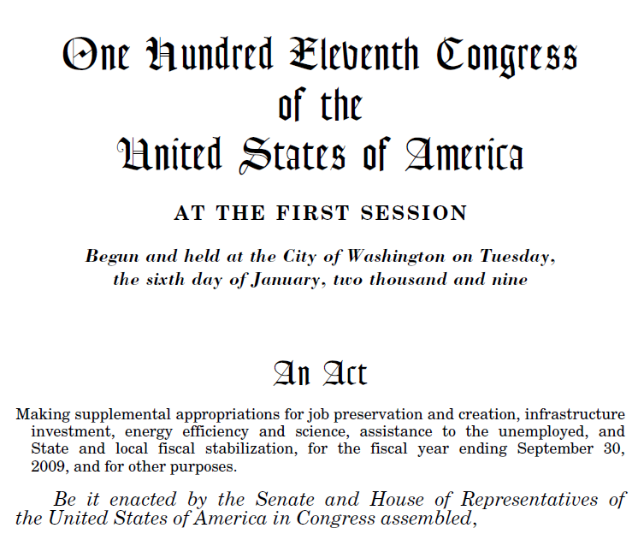
Notes:
The American Recovery and Reinvestment Act

Slide 56
The Stimulus…
Obama’s Wager

Slide 57
Stimulus
Effectiveness
Size
Long Run Consequences
Notes:
Effectiveness:
The political process robbed the stimulus of its maximum possible effectiveness.

Slide 58
State Budgets
Spending Cuts and Furloughs…
Notes:
Effectiveness:
The political process robbed the stimulus of its maximum possible effectiveness.

Slide 59
New Furnace
Tax Credits offset Increased Costs
Notes:
Effectiveness:
The political process robbed the stimulus of its maximum possible effectiveness.

Slide 62

Look, we enter the government essentially in a hotel that is on fire. We’re throwing people from the windows into the pool to save their lives and this is the evaluation of the Olympic diving committee: Well, the splash was too big.
Notes:
http://www.businessinsider.com/henry-blodget-austan-goolsbee-answers-the-white-houses-economic-critics-2009-5

Slide 63


Slide 64
Per Capita Stimulus Spending from ARRA
$3
$10
$1,334
$26
$90
$24

Slide 65
Long Term Consequences
Increase in publicly held debt.

Slide 70

Notes:
Credit: http://acrossthestreetnet.wordpress.com/2009/02/21/m-c-escher-economist/

Slide 71
Inflation
Is not the worry. Overly aggressive monetary policy is…
Notes:
Effectiveness:
The political process robbed the stimulus of its maximum possible effectiveness.

Slide 72
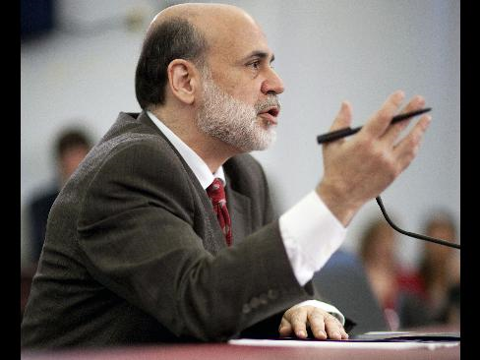
“Either cuts in spending or increases in taxes will be necessary to stabilize the fiscal situation,”
“The Federal Reserve will not monetize the debt.”

Slide 73

Green Shoots?
Notes:
http://www.flickr.com/photos/innpictime/3204618172/

Slide 75
Economic Indicators:
An Update for the 7 Rivers Region

Slide 76
Non-Standard Disclaimer:
I’ve been sent by the Obama campaign to tell you that you are better off now than you were 4 years ago.
I’ve been sent by the Romney campaign to tell you that you are worse off now than you were 4 years ago.

Slide 79

Euro Crisis
Notes:
Explain the challenges in Europe.
http://www.flickr.com/photos/mammal/3455272493/sizes/l/

Slide 81
Euro Crisis
Notes:
Explain the challenges in Europe.
http://www.flickr.com/photos/mammal/3455272493/sizes/l/

Slide 83


Slide 84
Euro Crisis
Notes:
Explain the challenges in Europe.
http://www.flickr.com/photos/mammal/3455272493/sizes/l/

Slide 85

The Fiscal Cliff
Notes:
http://www.flickr.com/photos/border0/5574007369/sizes/o/in/photostream/

Slide 86
Table 1. Tax Relief from a One-Year Extension of Bush Tax Cuts and AMT Patch
 | Extension with AMT Patch |  |  | Extension without AMT Patch
 | As a Share of Income |  | Per Tax Return | As a Share of Income | Per Tax Return
Iowa | 3.65% | $1,882 |  | 2.27% | $1,167
Minnesota | 4.76% | $2,833 |  | 2.48% | $1,474
Wisconsin | 4.19% | $2,196 |  | 2.33% | $1,224
Notes:
A regional MPC of 60% says local consumption falls by 1,200 per return!

Slide 87
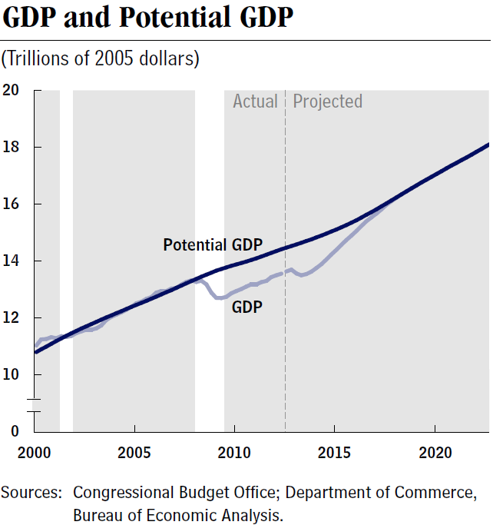

Slide 89
Notes:
Marginally attached workers are persons who currently are neither working nor looking for work but indicate that they want and are available for a job and have looked for work sometime in the recent past. Discouraged workers, a subset of the marginally attached, have given a job-market related reason for not looking currently for a job. Persons employed part time for economic reasons are those who want and are available for full-time work but have had to settle for a part-time schedule.

Slide 91
Notes:
Notes: Public data exclude temporary Census workers. The line for each recession begins at the official start of the recession, so the length of the line to the left of zero indicates the length of each recession.
Source: EPI -Authors' analysis of Bureau of Labor Statistics' Current Employment Statistics public data series

Slide 92
Notes:
http://www.clevelandfed.org/research/data/credit_easing/index.cfm
QE3 will be hard. The govt is the only bond buyer.

Slide 94
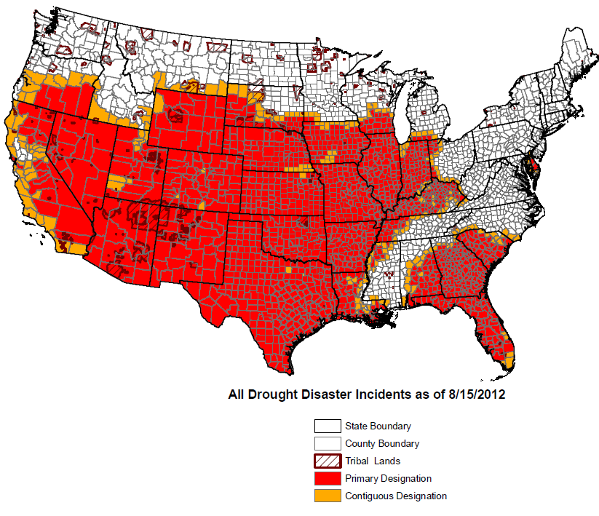
Drought 2012

Slide 95
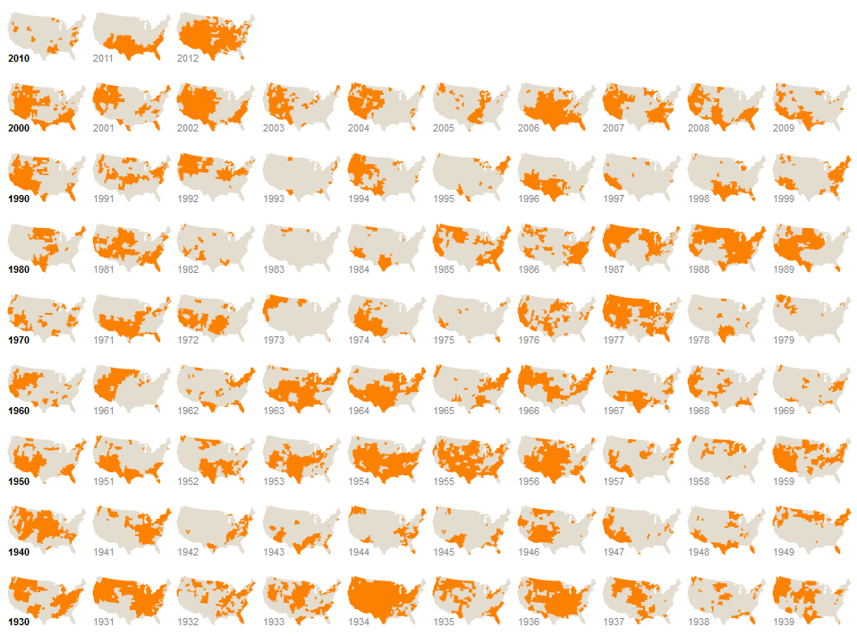
Notes:
http://www.nytimes.com/interactive/2012/07/20/us/drought-footprint.html

Slide 96

Notes:
Discuss local impacts. Increased feed prices and that means food prices and fuel. But it is small relatively speaking.
The USDA estimates that the consumer price index for “All Food” (both food at home and food away from home) will rise by 2.5% to 3.5% in 2012 and 3.0% to 4.0% in 2013
Corn production in the U.S., the world’s largest grower and exporter, will drop 13 percent to a six-year low after the worst drought in more than 50 years damaged Midwest fields, the government said. Analysts were expecting an even bigger decline

Slide 97
Data Sources
Bureau of Labor and Statistics
Wisconsin Department of Workforce Development
Federal Reserve Bank of St. Louis
Federal Reserve Bank of Cleveland
Bureau of Economic Analysis
Economagic.com
Other Assorted Blogs
Photo Credits: Flickr.com

