Slide 1
Business Cycle Symposium

Slide 2
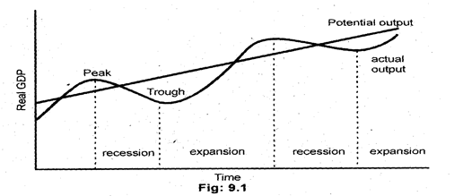

Slide 3
Comovement of Economic Variables and Business Cycles Stylized Facts

Slide 4
Outline of the class:
Characteristics of comovement: (a) correlation; (b) relative volatility; (c) leading/lagging
Behavior of main economic variables during the business cycles

Slide 5
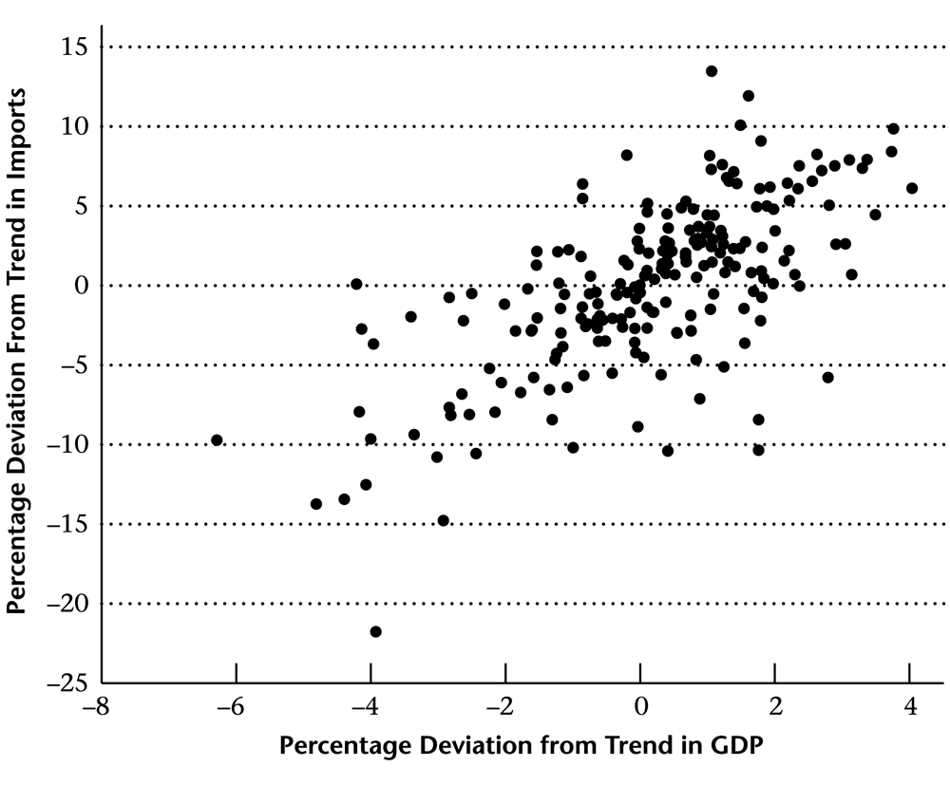
Two graphical ways of illustrating correlation
time series plot
scatter plot

Slide 6
Comovement with GDP: If an economic variable is positively correlated with GDP => it is called procyclical If an economic variable is negatively correlated with GDP => it is called countercyclical If an economic variable is not correlated with GDP => it is called acyclical

Slide 7
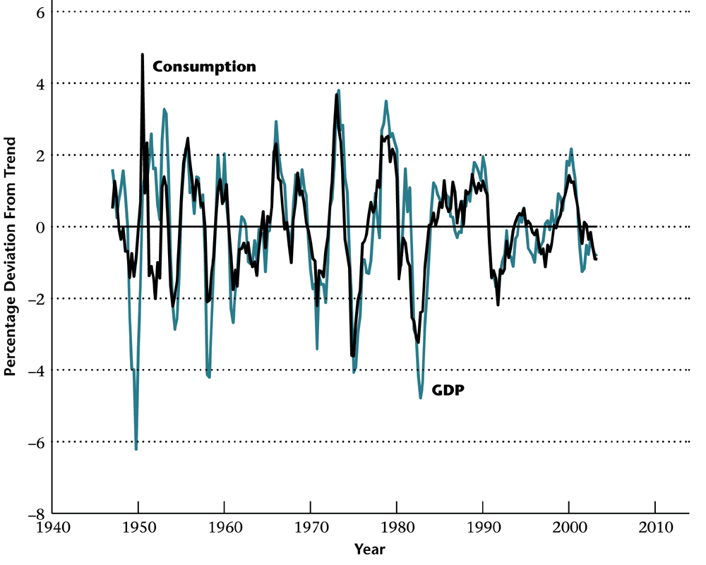
Correlation is not the only regularity that we may observe by comparing two time series!
GDP and Import
GDP and Consumption
Consumption is less volatile than GDP
(Consumption varies less than GDP)
In statistics, the volatility of a variable (its percentage deviations from trend) is measured by the standard deviation (std)
Import is more volatile than GDP
(Import varies more than GDP)

Slide 8
Macroeconomic variables can be characterized as - procyclical / countercyclical / acyclical - more or less volatile than GDP
Is there a third dimension for characterization?
Yes! A variable can lead or lag GDP!

Slide 9
Leading and Lagging variables
x is a leading variable,
(changes in GDP follow changes in x)
x helps to predict GDP
y is a lagging variable,
(changes in y follow changes in GDP)
GDP helps to predict y
If a variable neither leads nor lags, it is called a coincident

Slide 10
GDP and the Index of Leading Economic Indicators
The Index of Leading Economic Indicators: (a) is positively correlated with GDP (b) leads GDP (c) is slightly more volatile than GDP

Slide 11
Which variables may help to predict GDP?
Index of leading economic indicators is a function of the following variables: Average workweek
Initial unemployment claims
New orders for consumer goods
Vendor performance
Plant and equipment orders
Building permits
An increase in unfilled durable orders
Stock prices (S&P 500)
Money supply
Index of consumer expectations
The government uses Index of leading economic indicators to predict recessions
+ + + + + + -- + + +

Slide 12
Business cycles facts
Thus by observing the behavior of macroeconomic variables during the business cycles, we can
1) describe their cyclical properties
2) compare their volatility to the volatility of GDP
3) point out whether the variable leads GDP, lags GDP or coincides with GDP
These properties (relationship between GDP and other macro variables) are called business cycles stylized facts

Slide 13
Behavior of main economic variables
during the business cycles
The variables of interest:
consumption
investment
employment
wages
money supply
price level

Slide 14
GDP and Consumption
Consumption: (a) is positively correlated with GDP (corr. coeff. = 0.76) (b) coincides with GDP (c) is slightly less volatile than GDP (std(C)=0.75*std(GDP))
Can you explain these properties intuitively?

Slide 15
GDP and Investment
Investment: (a) is positively correlated with GDP (corr. coeff. = 0.86) (b) coincides with GDP (c) is much more volatile than GDP (std(C)=4.69*std(GDP))
Can you explain these properties intuitively?

Slide 16
GDP and Employment
Employment: (a) is positively correlated with GDP (corr. coeff. = 0.81) (b) lags GDP (c) is less volatile than GDP (std(C)=0.60*std(GDP))
Can you explain these properties intuitively?

Slide 17
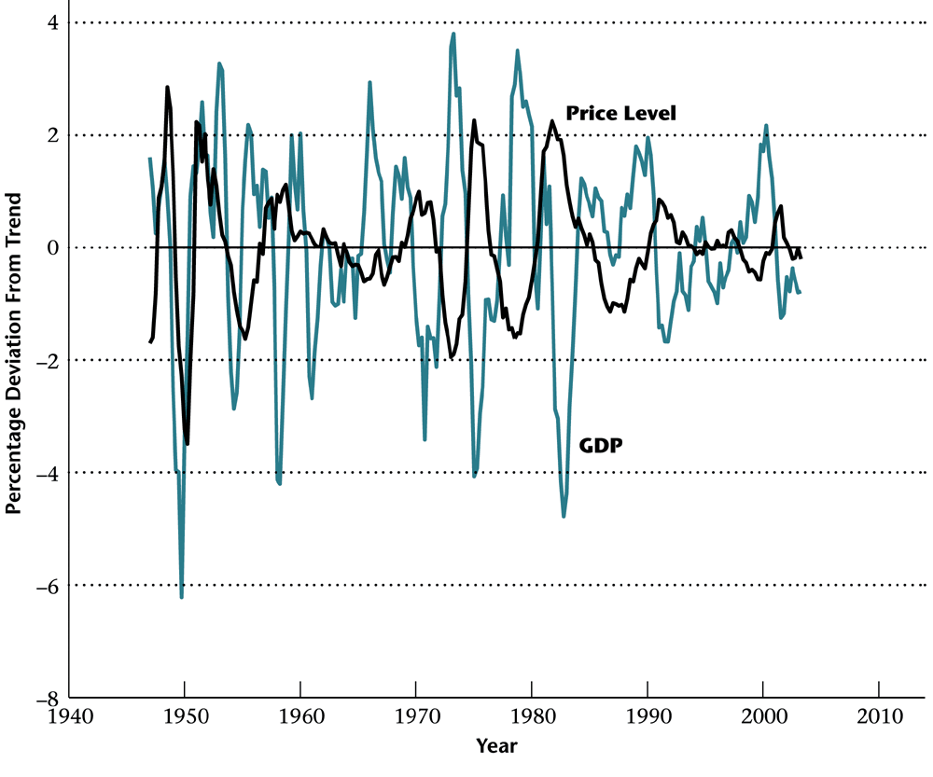
GDP and Price Level
Prices: (a) are negatively correlated with GDP (corr. coeff. = -0.26) (b) coincide with GDP (c) are less volatile than GDP (std(C)=0.58*std(GDP))
Can you explain these properties intuitively?

Slide 18
GDP and Money Supply
Money supply: (a) is positively correlated with GDP (corr. coeff. = 0.36) (b) leads GDP (c) is slightly less volatile than GDP (std(C)=0.77*std(GDP))
Can you explain these properties intuitively?

Slide 19
GDP and Employment
Employment: (a) is positively correlated with GDP (corr. coeff. = 0.81) (b) lags GDP (c) is less volatile than GDP (std(C)=0.60*std(GDP))

Slide 20
GDP and Labor Productivity
Labor productivity = output / employment: (a) is positively correlated with GDP (corr. coeff. = 0.83) (b) coincides with GDP (c) is less volatile than GDP (std(C)=0.63*std(GDP))

Slide 21
Summary of Business Cycles Stylized Facts

Slide 22
5 Questions about Business Cycles
Have Business Cycles Moderated Recently?
Do Expansions (or Contractions) Die of Old Age?
What Are the Defining Characteristics of the Business Cycle?
How Can Secular Growth Be Distinguished from Cyclical Fluctuations?
How Can Business Cycles Be Forecast?

Slide 23
Have Business Cycles Moderated Recently?

Slide 24
Do Expansions (or Contractions) Die of Old Age?
Expansions not duration dependent
Contractions are duration dependent
Cycle periodicity? No

Slide 25
What Are the Defining Characteristics of the Business Cycle?
Co-movement

Slide 26
How Can Secular Growth Be Distinguished from Cyclical Fluctuations?
Trend Stationary (TS)
Difference Stationary (DS)

Slide 27
How Can Business Cycles Be Forecast?
Nope, not really.
Poor forecastability from leading indicators available ex-post, even worse with real time data.

Slide 28
Romer 1999

Slide 29
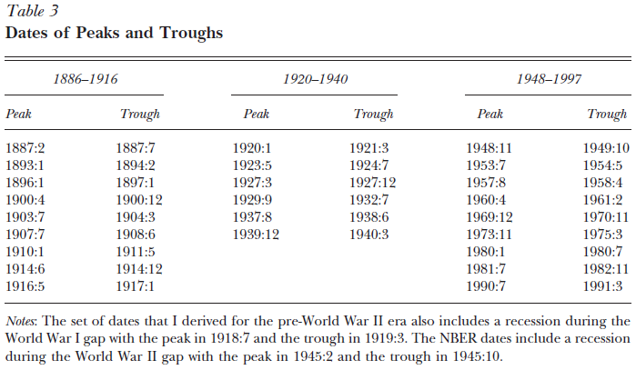

Slide 30
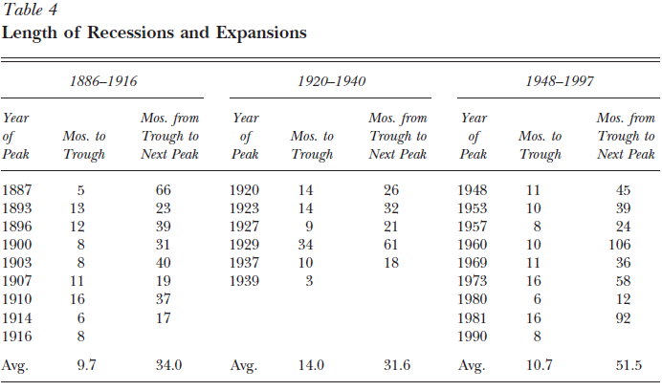

Slide 31
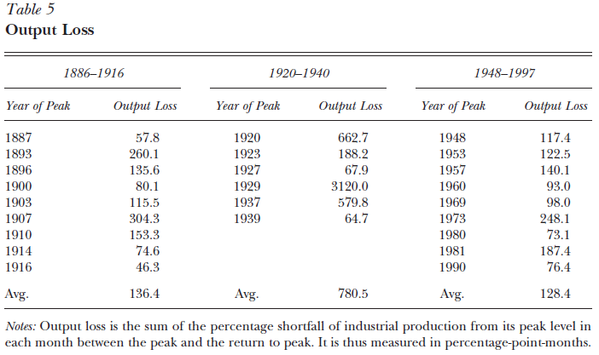

Slide 32
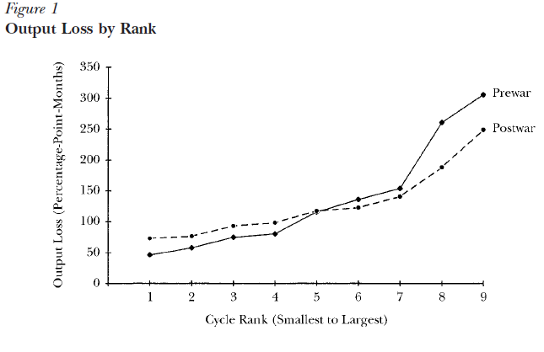

Slide 33
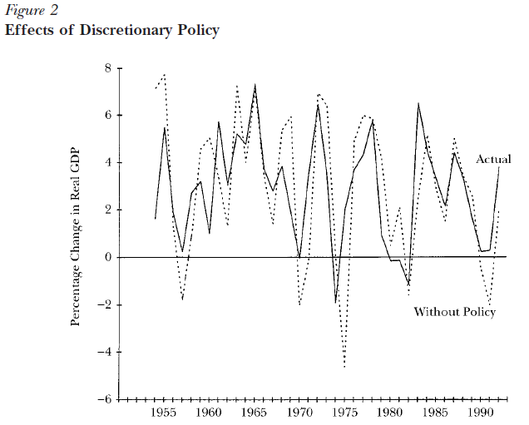

Slide 34
