Slide 1
Understanding
Interest Rates

Slide 2
Lottery Options
Option 1: you get a check today for $10,000 and one a year from now for $10,000.
Option 2: pays you $2,000 today and each of the next 29 years.
Notes:
Option #1 PV(0.12,2,10000,0,1)= ($18,928.57)
Option #2PV(0.12,30,2000,0,1)= ($18,043.61)
Clearly option number 1 is worth more so you should choose #1, unless you place a much lower rate of discount on future payments. You would use a much lower interest rate, say 10%. Then the Present Values are as follows:
Option #1 PV(0.1,2,10000,0,1)= ($19,090.91)
Option #2PV(0.1,30,2000,0,1)= ($20,739.21)
Now option #2 is worth more.
The future is uncertain, the interest rate is just one estimate of the markets view of that uncertainty.
Make comparisons and connections to CRT research. Those with higher CRT would tend to prefer option #2

Slide 3
Lottery Options (cont)
What are the present values of these two options, assuming a 12% interest rate. Which option do you prefer? Why?
What if the interest rate was 10%?
What if you thought you might die, what does that mean for the interest rate you’d use?
Other considerations?
Notes:
Option #1 PV(0.12,2,10000,0,1)= ($18,928.57)
Option #2PV(0.12,30,2000,0,1)= ($18,043.61)
Clearly option number 1 is worth more so you should choose #1, unless you place a much lower rate of discount on future payments. You would use a much lower interest rate, say 10%. Then the Present Values are as follows:
Option #1 PV(0.1,2,10000,0,1)= ($19,090.91)
Option #2PV(0.1,30,2000,0,1)= ($20,739.21)
Now option #2 is worth more.
The future is uncertain, the interest rate is just one estimate of the markets view of that uncertainty.
Make comparisons and connections to CRT research. Those with higher CRT would tend to prefer option #2

Slide 4
Present Value
A dollar paid to you one year from now
is less valuable than a dollar paid to
you today

Slide 5
Discounting the Future

Slide 6
Simple Present Value

Slide 7
Four Types of
Credit Market Instruments
Simple Loan
Fixed Payment Loan
Coupon Bond
Discount Bond

Slide 8
Yield to Maturity
The interest rate that equates the present value of cash flow payments received from a debt instrument with its value today.

Slide 9
Simple Loan—Yield to Maturity

Slide 10
Fixed Payment Loan—
Yield to Maturity

Slide 11
Coupon Bond—Yield to Maturity

Slide 12
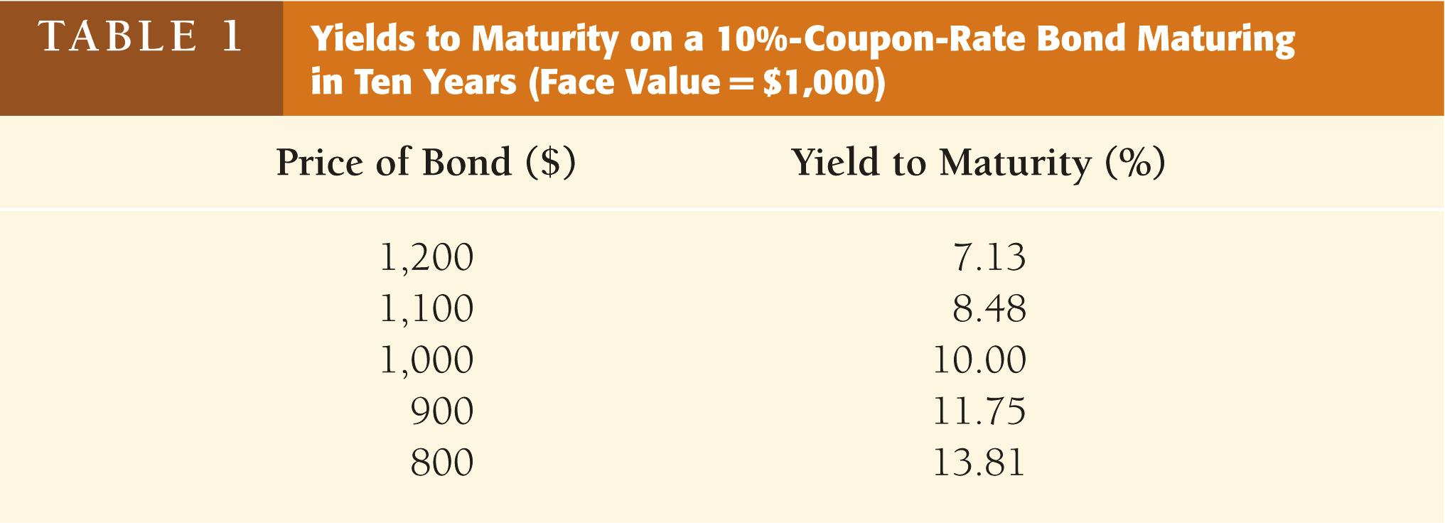
When the coupon bond is priced at its face value, the yield to maturity equals the coupon rate
The price of a coupon bond and the yield to maturity are negatively related
The yield to maturity is greater than the coupon rate when the bond price is below its face value
Notes:
Three Interesting Facts in Table 1
1. When bond is at par, yield equals coupon rate
2. Price and yield are negatively related
3. Yield greater than coupon rate when bond price is below par value

Slide 13
Discount Bond—Yield to Maturity

Slide 14
Yield on a Discount Basis

Slide 15
Distinction Between:
Interest Rates and Returns

Slide 16
Rate of Return and Interest Rates
The return equals the yield to maturity only if the holding period equals the time to maturity
A rise in interest rates is associated with a fall in bond prices, resulting in a capital loss if time to maturity is longer than the holding period
The more distant a bond’s maturity, the greater the size of the percentage price change associated with an interest-rate change
Notes:
Key Findings from Table 2
1. Only bond whose return = yield is one with maturity = holding period
2. For bonds with maturity > holding period, i ↑ P↓ implying capital loss
3. Longer is maturity, greater is % price change associated with interest rate change
4. Longer is maturity, more return changes with change in interest rate
5. Bond with high initial interest rate can still have negative return if i ↑
Conclusion from Table 2 Analysis
1. Prices and returns more volatile for long-term bonds because have higher interest-rate risk
2. No interest-rate risk for any bond whose maturity equals holding period

Slide 17
Rate of Return and Interest Rates (cont’d)
The more distant a bond’s maturity, the lower the rate of return the occurs as a result of an increase in the interest rate
Even if a bond has a substantial initial
interest rate, its return can be negative if interest rates rise
Notes:
Key Findings from Table 2
1. Only bond whose return = yield is one with maturity = holding period
2. For bonds with maturity > holding period, i ↑ P↓ implying capital loss
3. Longer is maturity, greater is % price change associated with interest rate change
4. Longer is maturity, more return changes with change in interest rate
5. Bond with high initial interest rate can still have negative return if i ↑
Conclusion from Table 2 Analysis
1. Prices and returns more volatile for long-term bonds because have higher interest-rate risk
2. No interest-rate risk for any bond whose maturity equals holding period

Slide 18
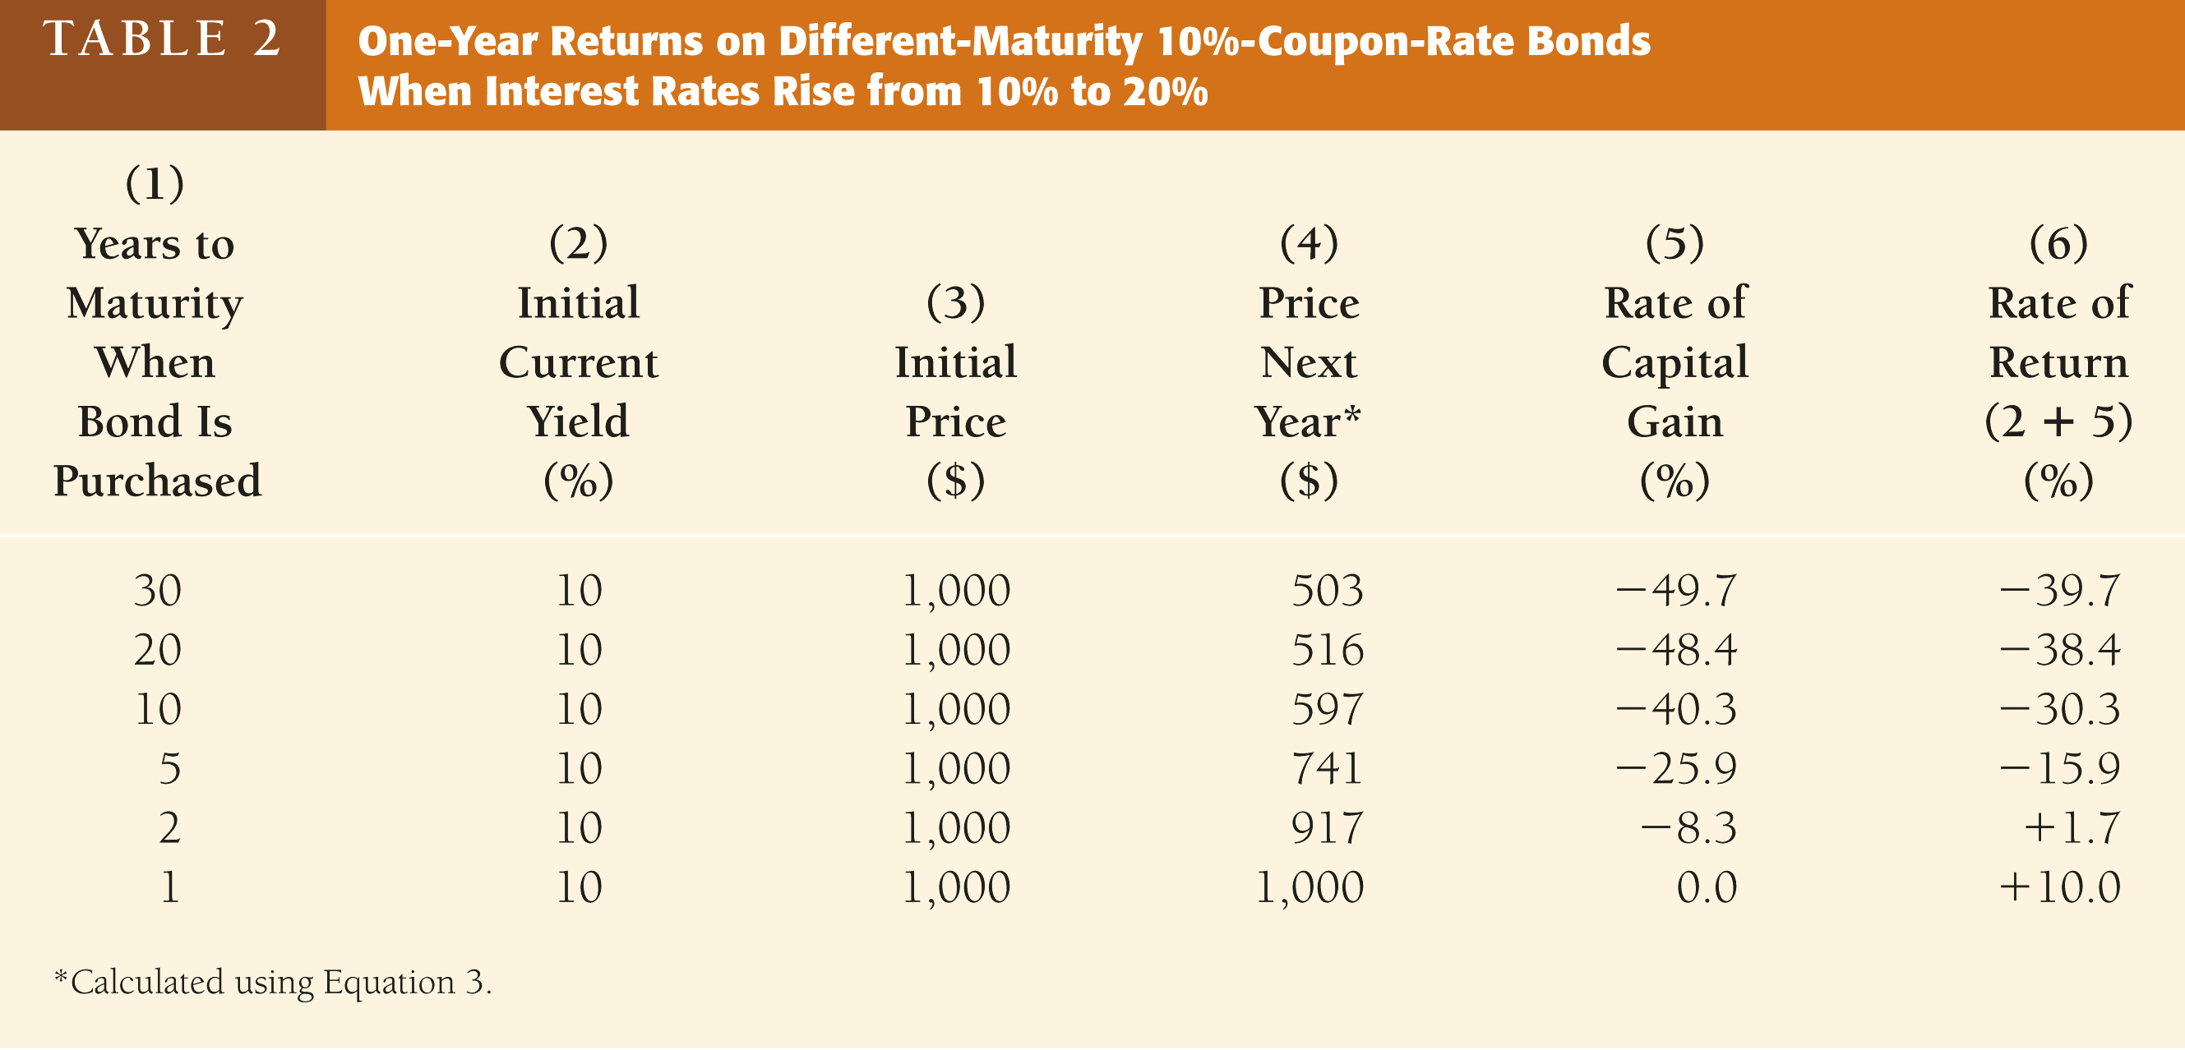
Rate of Return and Interest Rates

Slide 19
Interest-Rate Risk
Prices and returns for long-term
bonds are more volatile than those for
shorter-term bonds
There is no interest-rate risk for any bond whose time to maturity matches the holding period

Slide 20
Real and Nominal Interest Rates
Nominal interest rate makes no allowance
for inflation
Real interest rate is adjusted for changes in price level so it more accurately reflects the cost of borrowing
Ex ante real interest rate is adjusted for expected changes in the price level
Ex post real interest rate is adjusted for actual changes in the price level

Slide 21
Fisher Equation

Slide 22
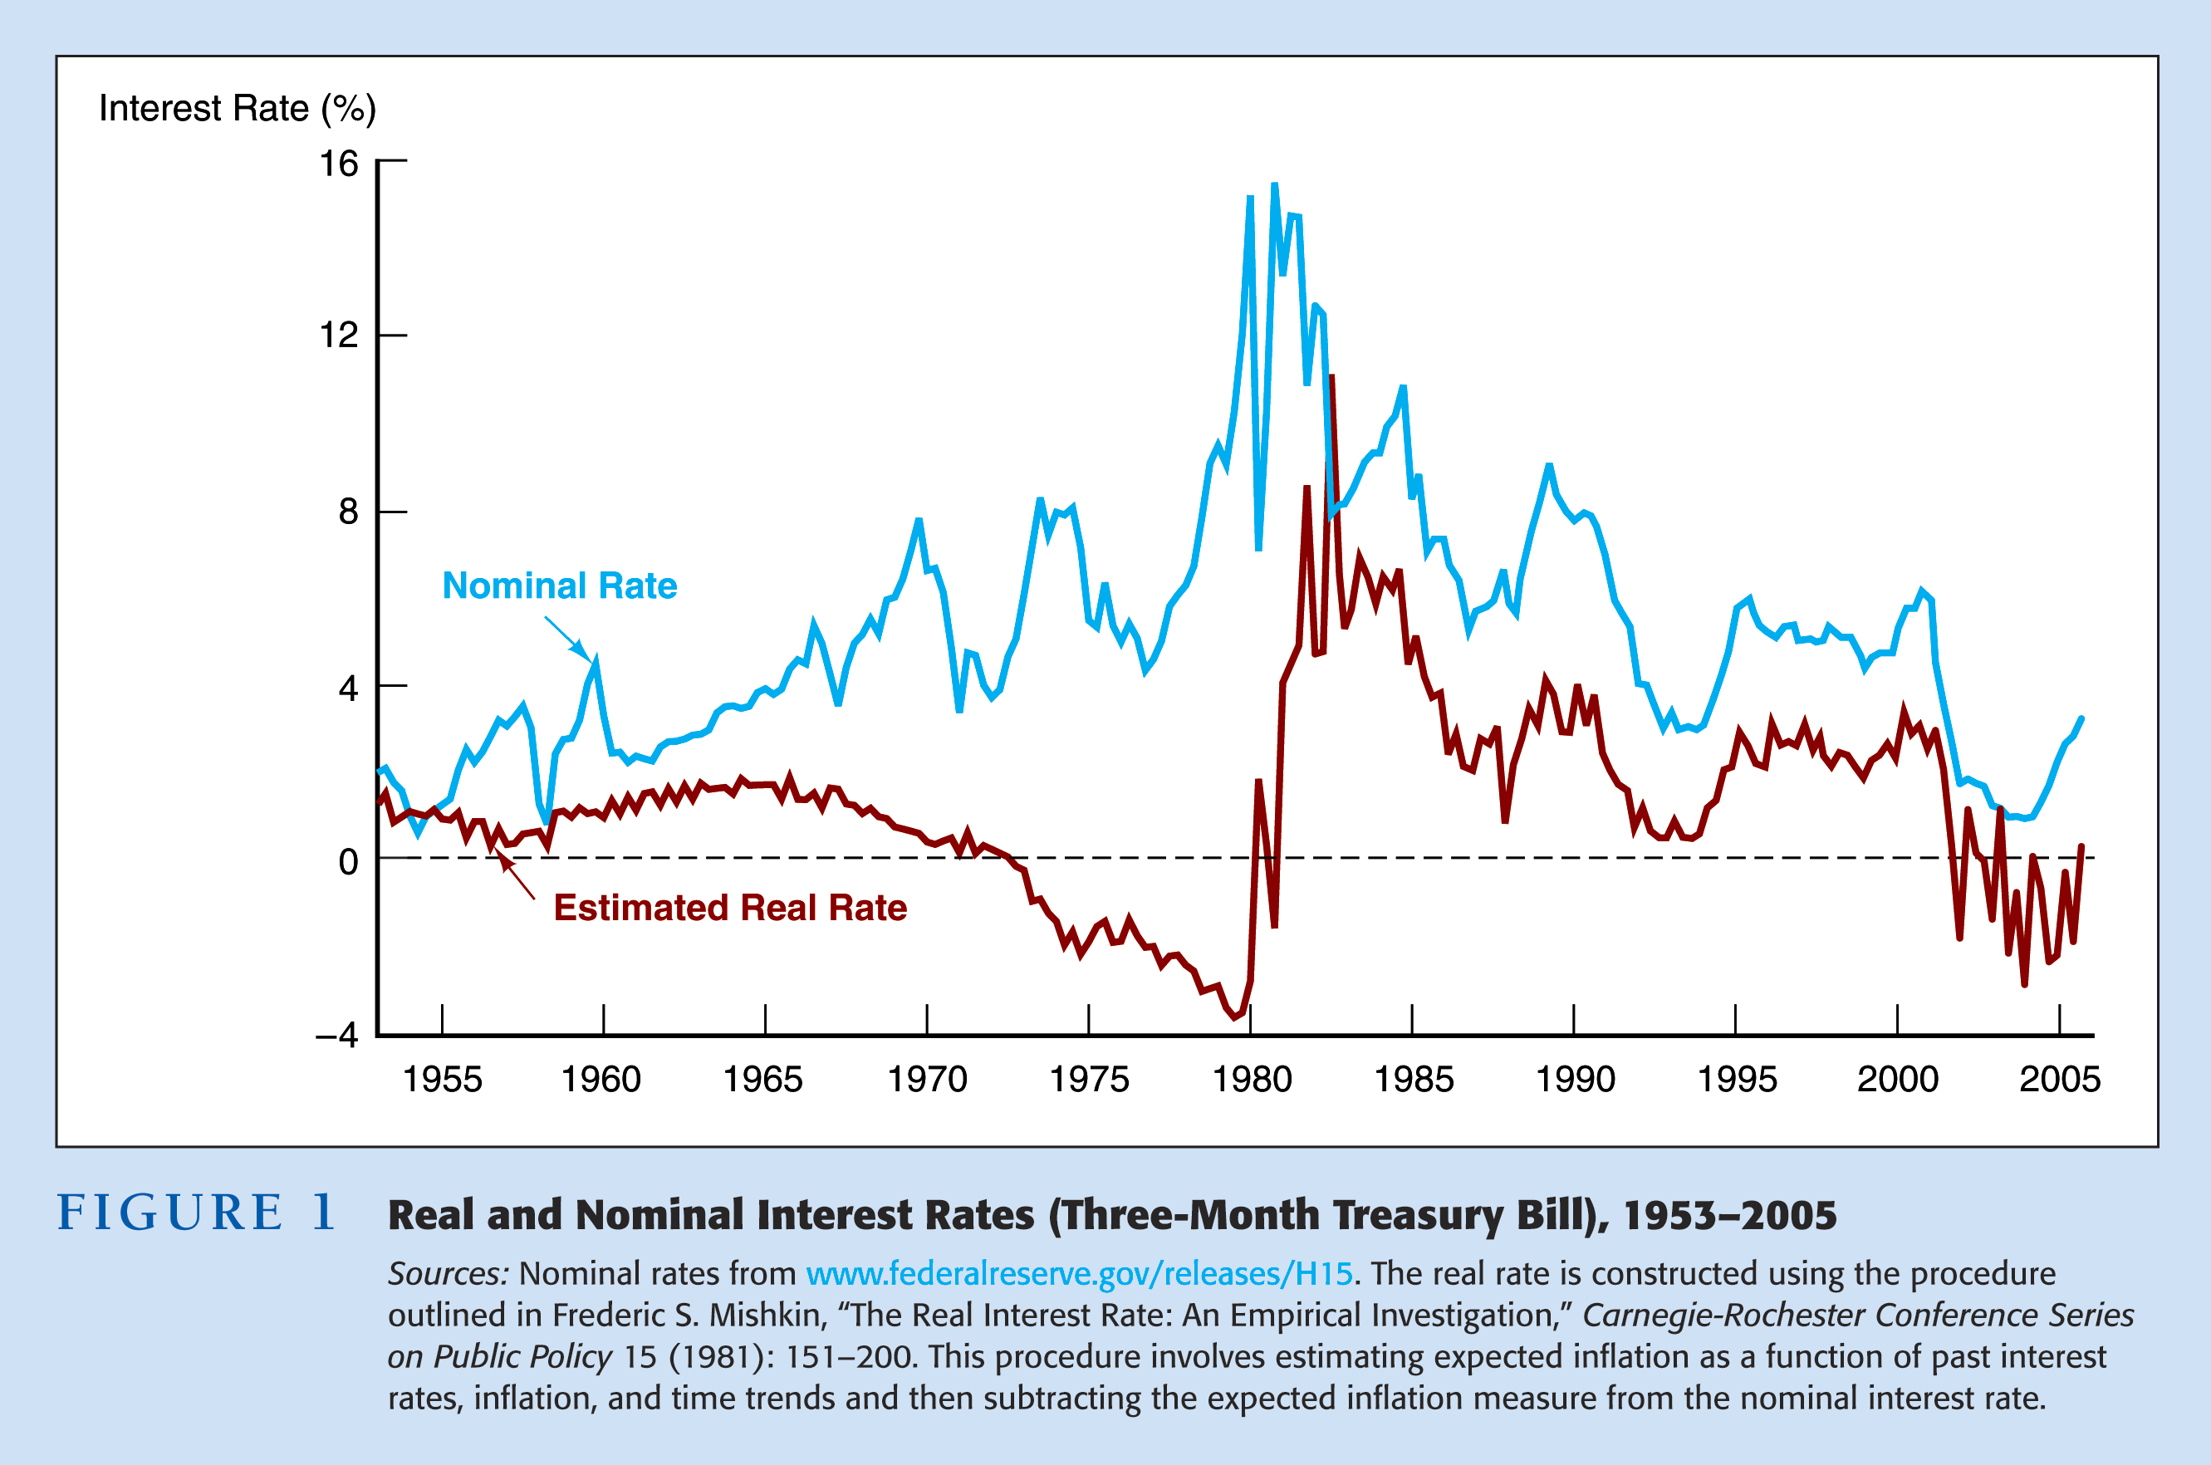
Real and Nominal Interest Rates

Slide 23
Appendix
Slides after this point will most likely not be covered in class. However they may contain useful definitions, or further elaborate on important concepts, particularly materials covered in the text book.
They may contain examples I’ve used in the past, or slides I just don’t want to delete as I may use them in the future.

Slide 24
Consol or Perpetuity
A bond with no maturity date that does not repay principal but pays fixed coupon payments forever

Slide 25
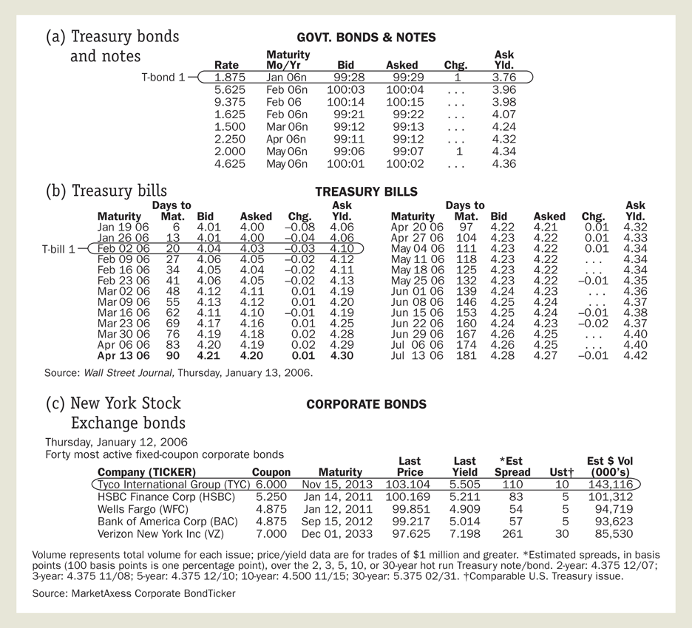
Following the Financial News:
Bond Prices and Interest Rates

Slide 26
The Behavior of Interest Rates

Slide 27
Determining the
Quantity Demanded of an Asset
Wealth—the total resources owned by the individual, including all assets
Expected Return—the return expected over the next period on one asset relative to alternative assets
Risk—the degree of uncertainty associated with the return on one asset relative to alternative assets
Liquidity—the ease and speed with which an asset can be turned into cash relative to alternative assets

Slide 28
Theory of Asset Demand
Holding all other factors constant:
  The quantity demanded of an asset is positively related to wealth
  The quantity demanded of an asset is positively related to its expected return relative to
  alternative assets
  The quantity demanded of an asset is negatively related to the risk of its returns relative to alternative assets
  The quantity demanded of an asset is positively related to its liquidity relative to alternative assets

Slide 29
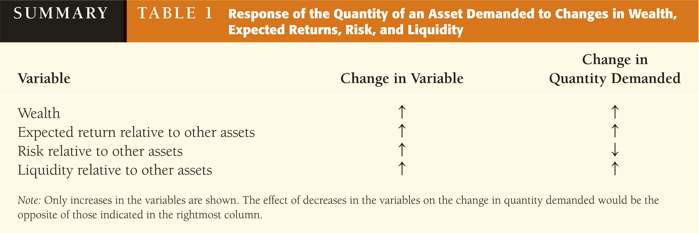

Slide 30
Supply and Demand for Bonds
At lower prices (higher interest rates), ceteris paribus, the quantity demanded of bonds is higher—an inverse relationship
At lower prices (higher interest rates), ceteris paribus, the quantity supplied of bonds is lower—a positive relationship
Notes:
(F – P)
i = RET^{e} =
P
Point A:
P = $950
($1000 – $950)
i = = 0.053 = 5.3%
$950
B^{d} = $100 billion
Point B:
P = $900
($1000 – $900)
i = = 0.111 = 11.1%
$900
B^{d} = $200 billion
Point C: P = $850, i = 17.6% B^{d} = $300 billion
Point D: P = $800, i = 25.0% B^{d} = $400 billion
Point E: P = $750, i = 33.0% B^{d} = $500 billion
Demand Curve is B^{d} in Figure 1 which connects points A, B, C, D, E.
Has usual downward slope
Point F: P = $750, i = 33.0%, B^{s} = $100 billion
Point G: P = $800, i = 25.0%, B^{s} = $200 billion
Point C: P = $850, i = 17.6%, B^{s} = $300 billion
Point H: P = $900, i = 11.1%, B^{s} = $400 billion
Point I: P = $950, i = 5.3%, B^{s} = $500 billion
Supply Curve is B^{s} that connects points F, G, C, H, I, and has upward slope

Slide 31
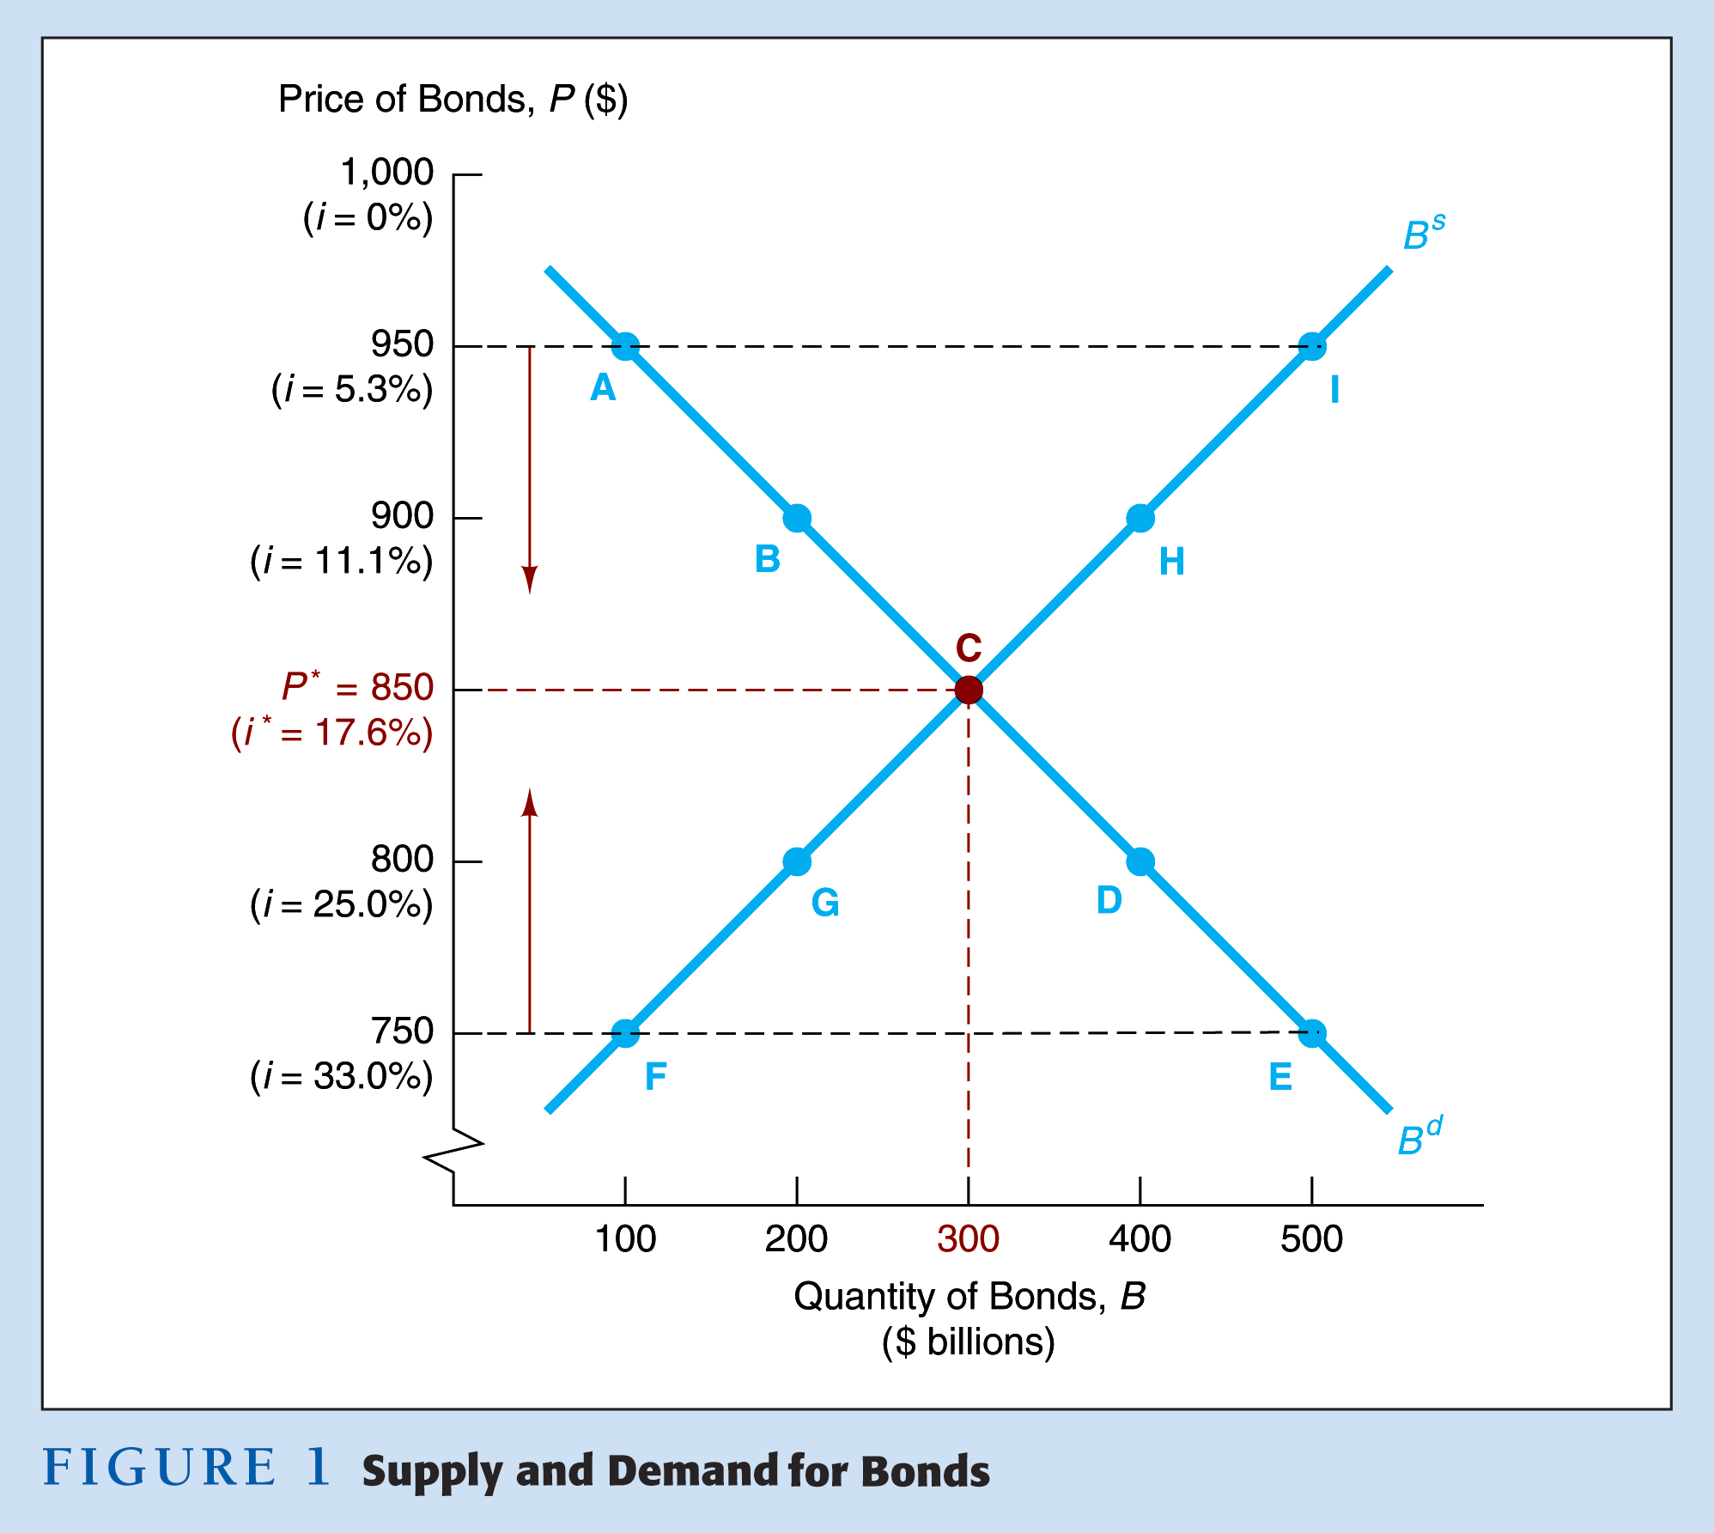

Slide 32
Market Equilibrium
Occurs when the amount that people are willing to buy (demand) equals the amount
that people are willing to sell (supply) at a given price
When B^{d} = B^{s}  the equilibrium (or market clearing) price and interest rate
When B^{d} > B^{s}  excess demand  price will rise and interest rate will fall
When B^{d} < B^{s}  excess supply  price will
fall and interest rate will rise
Notes:
Market Equilibrium
1. Occurs when Bd = Bs, at P* = $850, i* = 17.6%
2. When P = $950, i = 5.3%, Bs > Bd (excess supply): P  to P*, i to i*
3. When P = $750, i = 33.0, Bd > Bs (excess demand): P  to P*, i  to i*

Slide 33
Shifts in the Demand for Bonds
Wealth—in an expansion with growing wealth, the demand curve for bonds shifts to the right
Expected Returns—higher expected interest rates in the future lower the expected return for long-term bonds, shifting the demand curve to the left
Expected Inflation—an increase in the expected rate of inflations lowers the expected return for bonds, causing the demand curve to shift to the left
Risk—an increase in the riskiness of bonds causes the demand curve to shift to the left
Liquidity—increased liquidity of bonds results in the demand curve shifting right
Notes:
How do we measure risk?
The probability of a loss. One such measure is the standard deviation of the returns.
How do we measure liquidity?
The speed and ease with which an asset is converted into a medium of exchange. The greater the trading volume, the better is liquidity, ceteris paribus.

Slide 34
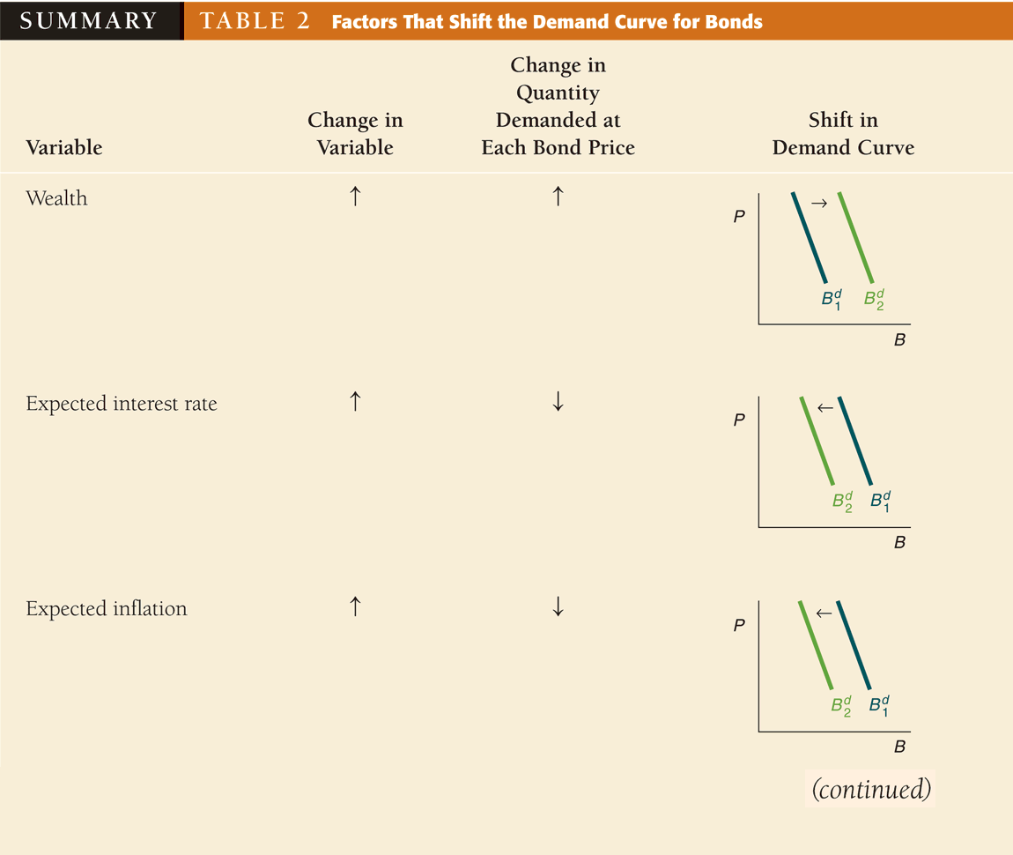

Slide 35
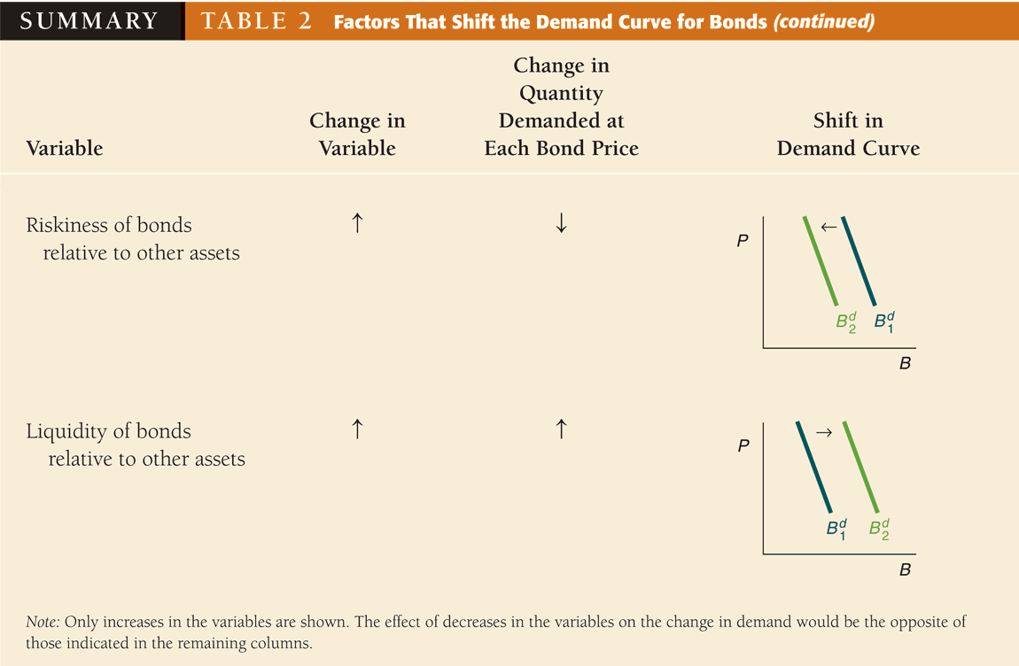

Slide 36
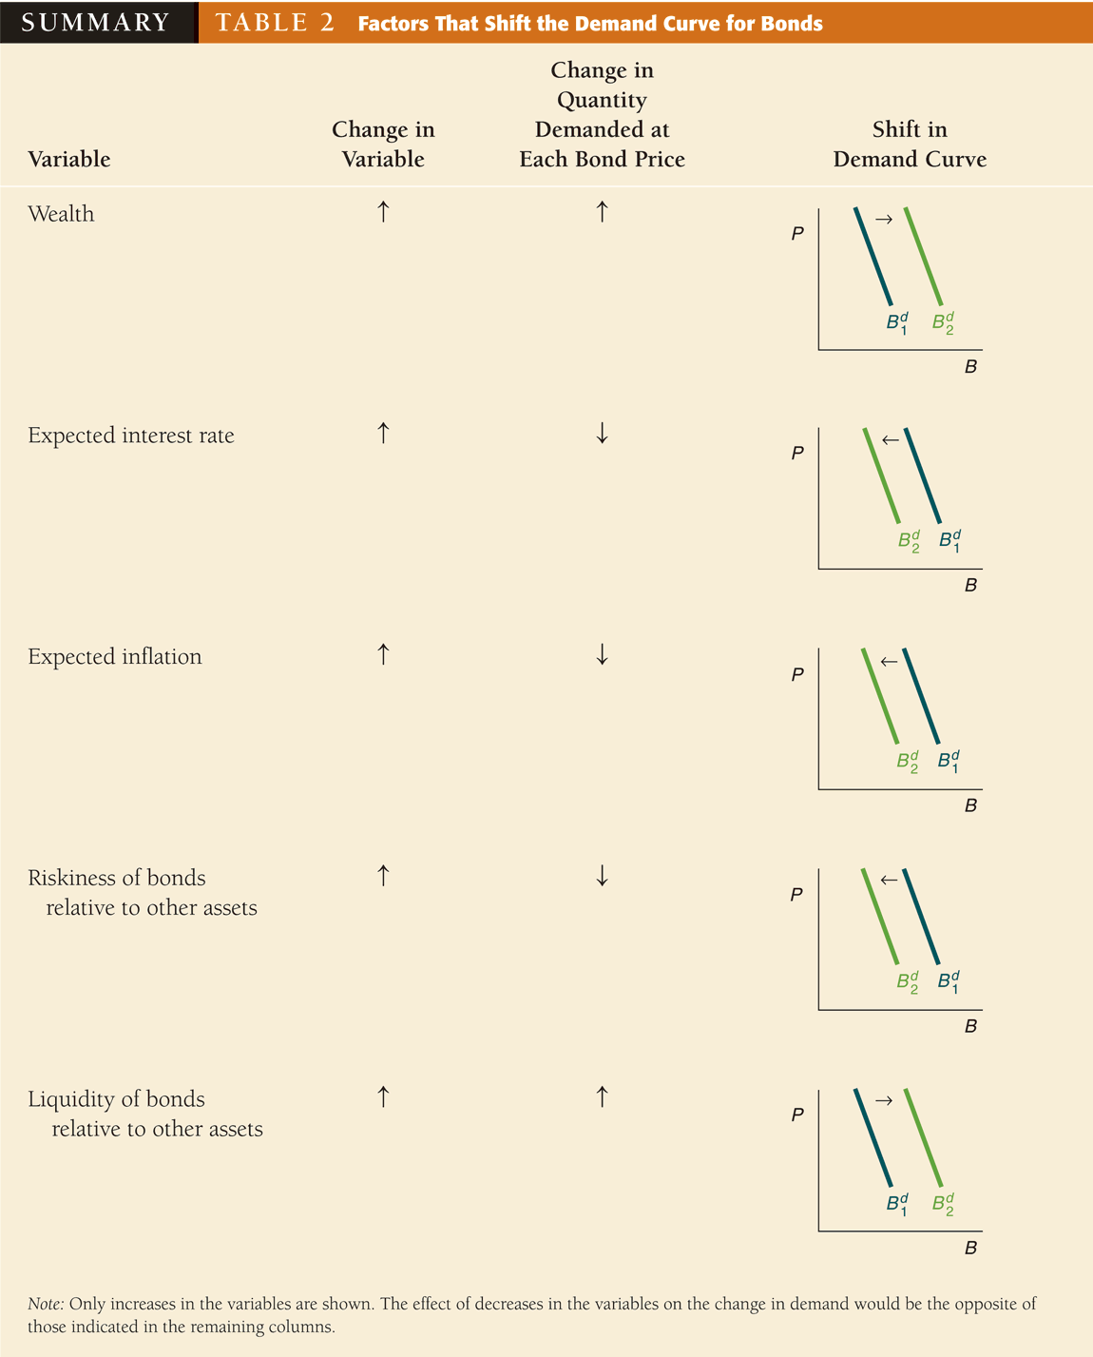

Slide 37
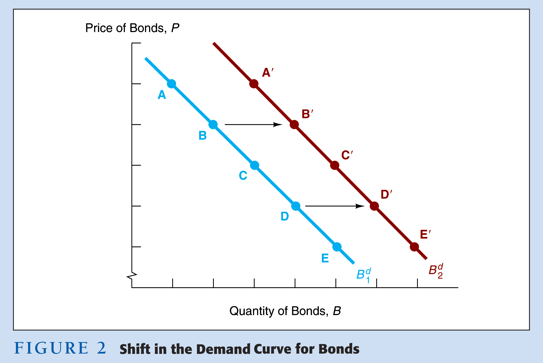
Shift in Demand

Slide 38
Factors that Shift the Bond Demand Curve
1. Wealth
  A. Economy grows, wealth ↑, B^{d} ↑, B^{d} shifts out to right
2. Expected Return
  A. i ↓ in future, R^{e} for long-term bonds ↑, B^{d} shifts out to right
  B. π^{e} ↓, Relative R^{e} ↑, B^{d} shifts out to right
  C. Expected return of other assets ↓, B^{d} ↑, B^{d} shifts out to right
3. Risk
  A. Risk of bonds ↓, B^{d} ↑, B^{d} shifts out to right
  B. Risk of other assets ↑, B^{d} ↑, B^{d} shifts out to right
4. Liquidity
  A. Liquidity of Bonds ↑, B^{d} ↑, B^{d} shifts out to right
  B. Liquidity of other assets ↓, B^{d} ↑, B^{d} shifts out to right

Slide 39
Shifts in the Supply of Bonds
Expected profitability of investment opportunities—in an expansion, the supply curve shifts to the right
Expected inflation—an increase in expected inflation shifts the supply curve for bonds to the right
Government budget—increased budget deficits shift the supply curve to the right

Slide 40
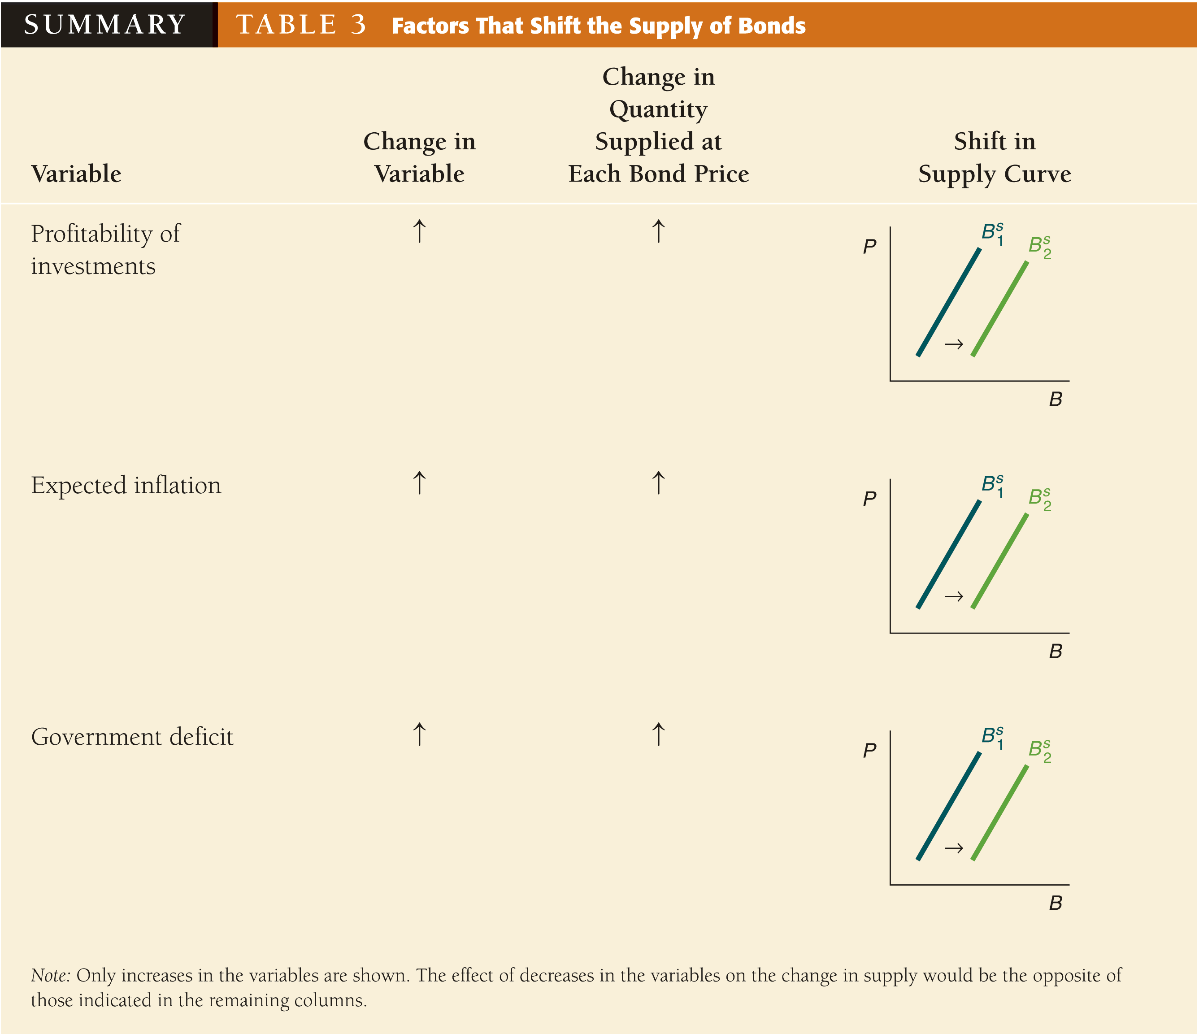

Slide 41
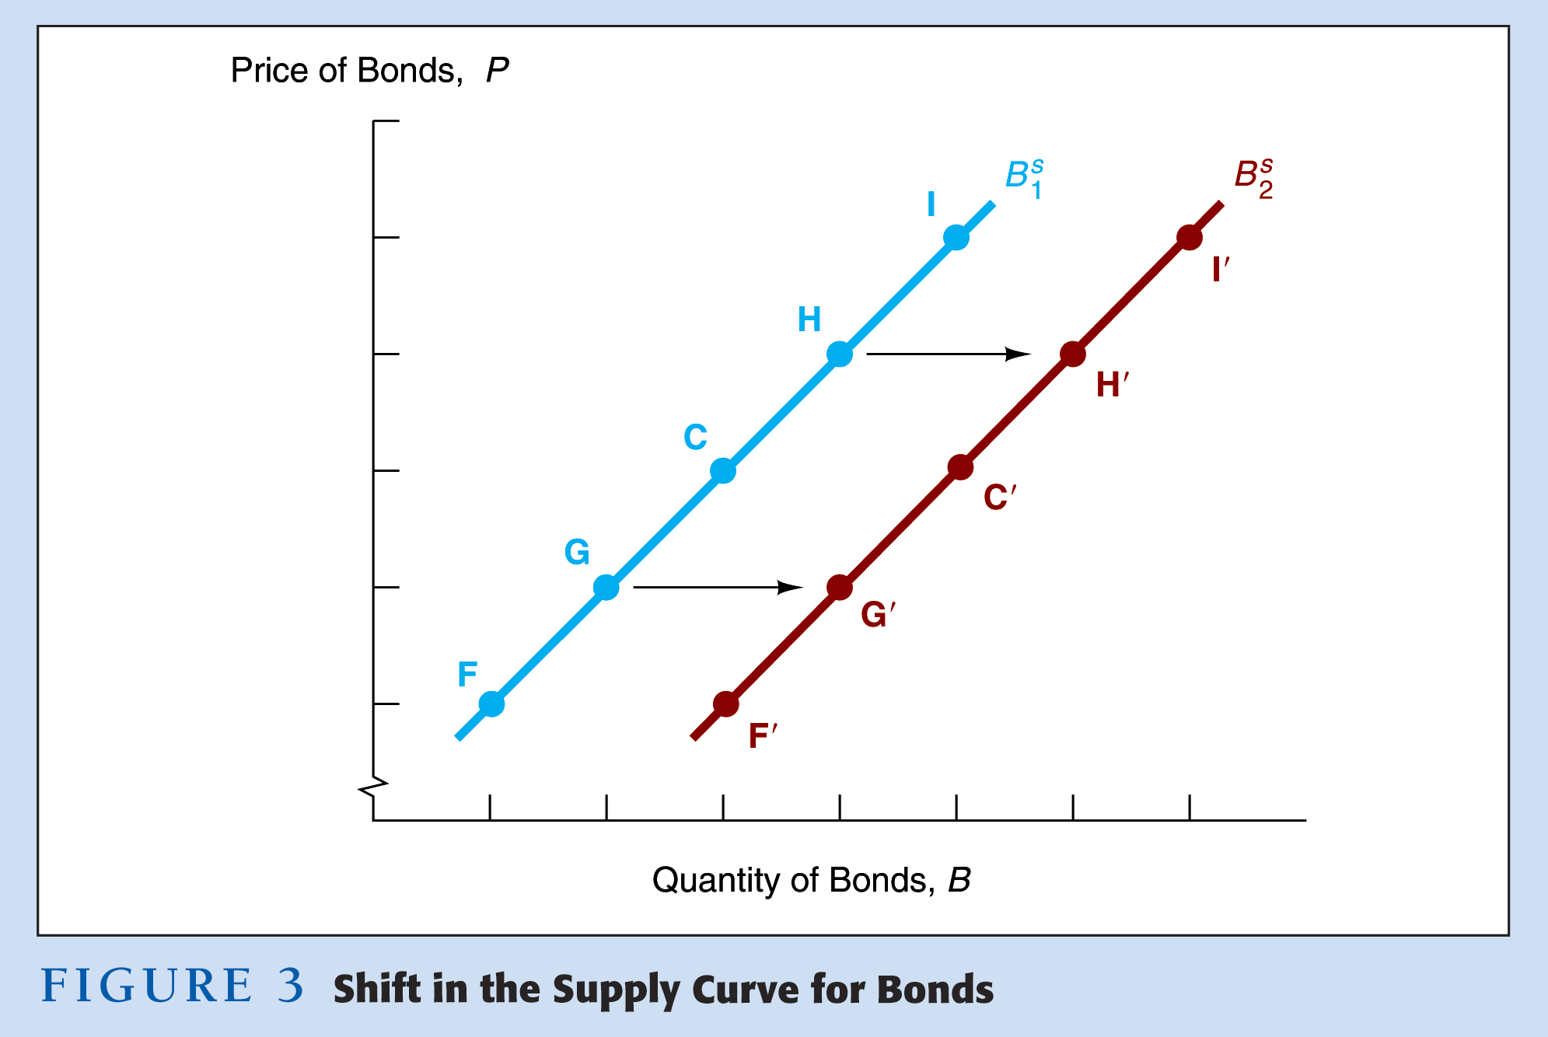
Shift in Supply
Notes:
1. Profitability of Investment Opportunities
Business cycle expansion, investment opportunities ⊥, B^{s} ^, B^{s} shifts out to right
2. Expected Inflation
πι^{e} ⊥, B^{s} ^, B^{s} shifts out to right
3. Government Activities
Deficits ⊥, B^{s} ^, B^{s} shifts out to right

Slide 42
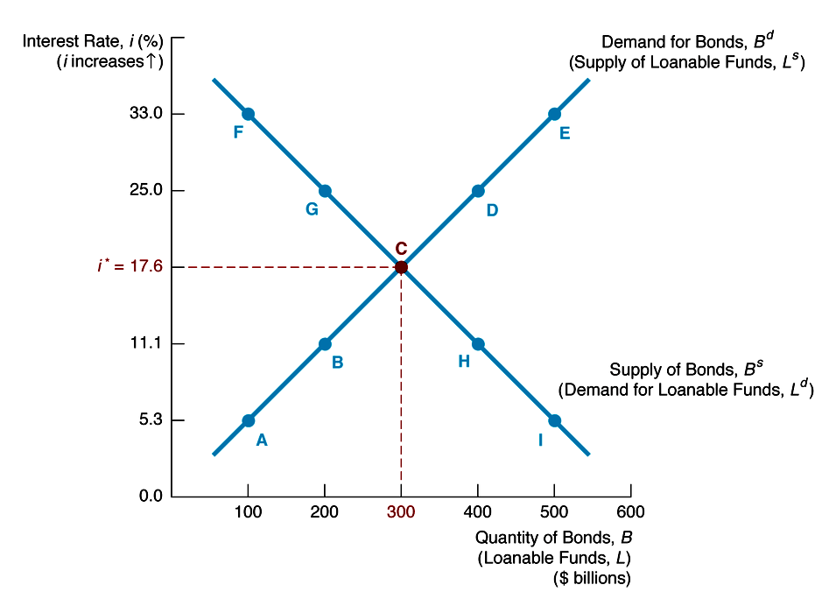
Loanable Funds Terminology
1. Demand for bonds = supply of loanable funds
2. Supply of bonds = demand for loanable funds
Notes:
A Brief Aside:
This formulation is from the other side of the asset. A bond is an asset which represents a debt obligation, the other side of which is the loan that the saver made to the bond seller.

Slide 43
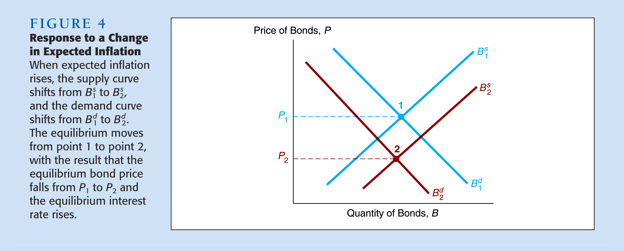
Fisher Effect
Notes:
If π^{e} ↑
1. Relative RET^{e} , B^{d} shifts in to left
2. B^{s} ↑, B^{s} shifts out to right
3. P ↓, i ↑

Slide 44
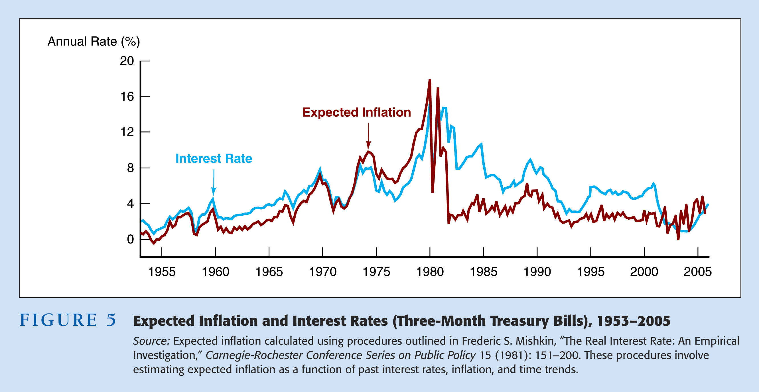
Fisher Effect

Slide 45
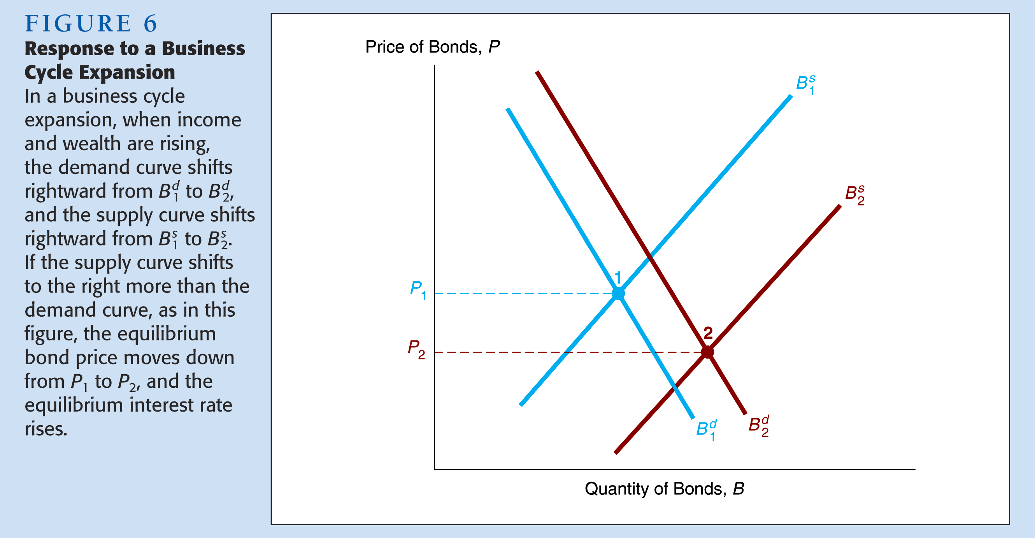
Business Cycle and Interest Rates

Slide 46
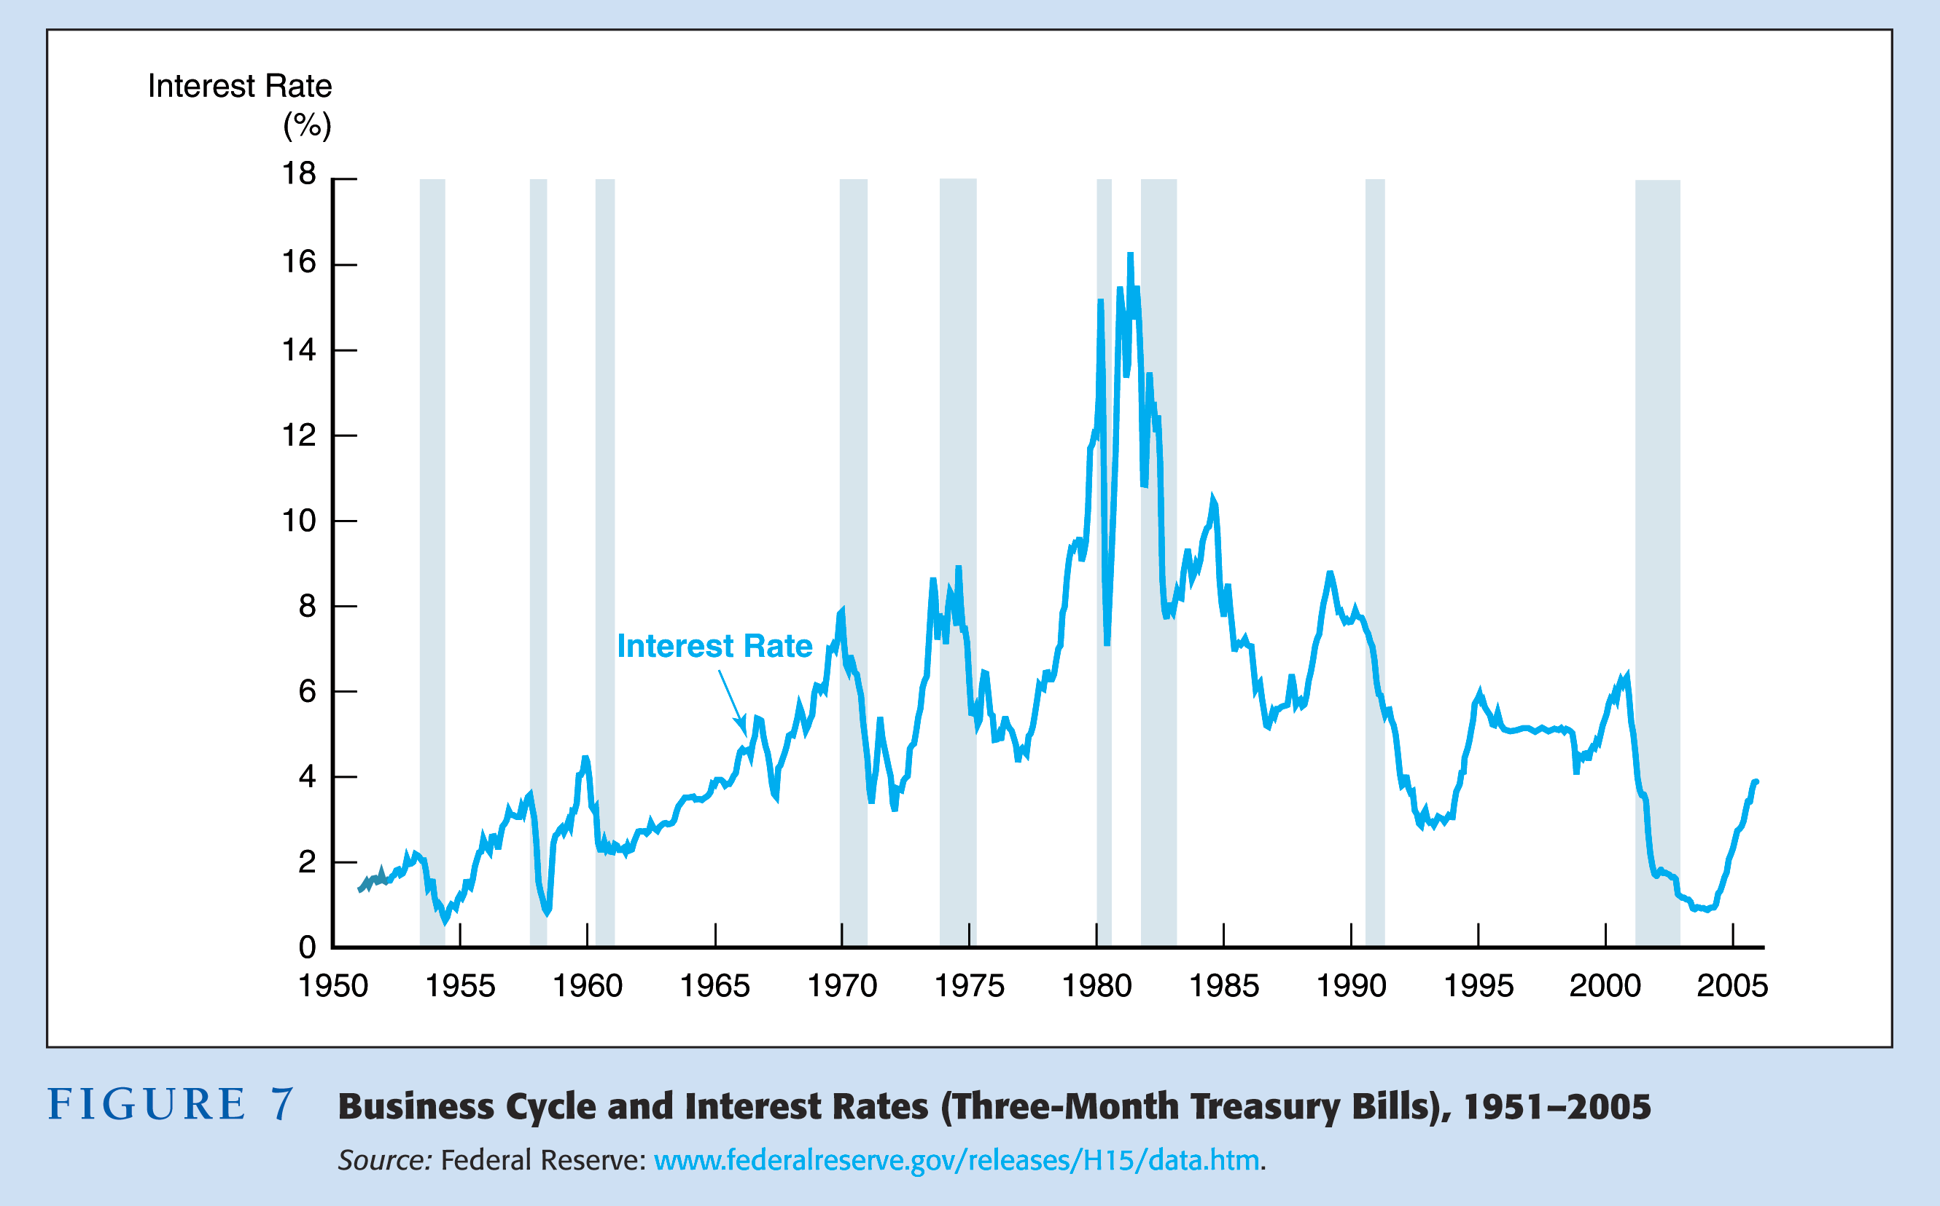
Business Cycle and Interest Rates

Slide 47
Practice Problems
What happens to the equilibrium bond price, and interest rate in the following scenarios (ceteris paribus)?
  Gold prices start to rise dramatically.
  The stock market becomes relatively more liquid.
  The stock market begins to fluctuate wildly.
  Real Estate prices fall sharply.
Notes:
Gold prices start to rise dramatically suggesting a future boom
Demand for gold rises as people move more money into the gold market therefore demand for bonds falls, resulting in lower prices and higher interest rates.
The stock market becomes relatively more liquid
Then the demand for stocks increases and the demand for bonds falls, resulting in the price of bonds falling and the interest rate rising.
The stock market begins to fluctuate wildly
This suggests the relative risk in the stock market rises thus reducing portfolio demand for stocks and increasing demand for Bonds, causing the price of bonds to rise and the interest rate to fall
Real Estate prices fall sharply.
This would lead to a reduction in wealth, and certainly a reallocation away from real estate towards bonds, therefore the demand for bonds rises, resulting in rising prices and falling interest rates.
Evidence of Portfolio choice:
http://stockcharts.com/charts/YieldCurve.html

Slide 48
Interest Rate Ceilings
Regulation Q (max interest rate paid on deposits)
Merchant of Venice (Shakespeare)
  Bassanio, Antonio, Shylock, Portia
Deuteronomy 23:19
  Thou shalt not lend upon interest to thy brother; interest of money, interest of victuals, interest of any thing that is lent upon interest…
Notes:
Interesting note, what once read as interest, now is translated to usury, which means an excessive amount of interest, above the legal limit.
http://bible.cc/deuteronomy/23-19.htm
http://www.shakespeare-literature.com/The_Merchant_of_Venice/0.html Act 1 Scene 3
Double standard of brothers in Christian law versus Jewish law.
Shylock, pound of flesh
Draw Supply and Demand for loanable funds with max interest rate of 0.

Slide 49
The Liquidity Preference Framework

Slide 50
Liquidity Preference Analysis
Derivation of Demand Curve
1. Keynes assumed money has i = 0
2. As i ↑, relative RET^{e} on money ↓ (equivalently, opportunity cost of money ↑) ⇒ M^{d} ↓
3. Demand curve for money has usual downward slope
Derivation of Supply curve
1. Assume that central bank controls M^{s} and it is a fixed amount
2. M^{s} curve is vertical line
Market Equilibrium
1. Occurs when M^{d} = M^{s}, at i* = 15%
2. If i = 25%, M^{s} > M^{d} (excess supply): Price of bonds ↑, i ↓ to i* = 15%
3. If i =5%, M^{d} > M^{s} (excess demand): Price of bonds ↓, i ↑ to
i* = 15%

Slide 51
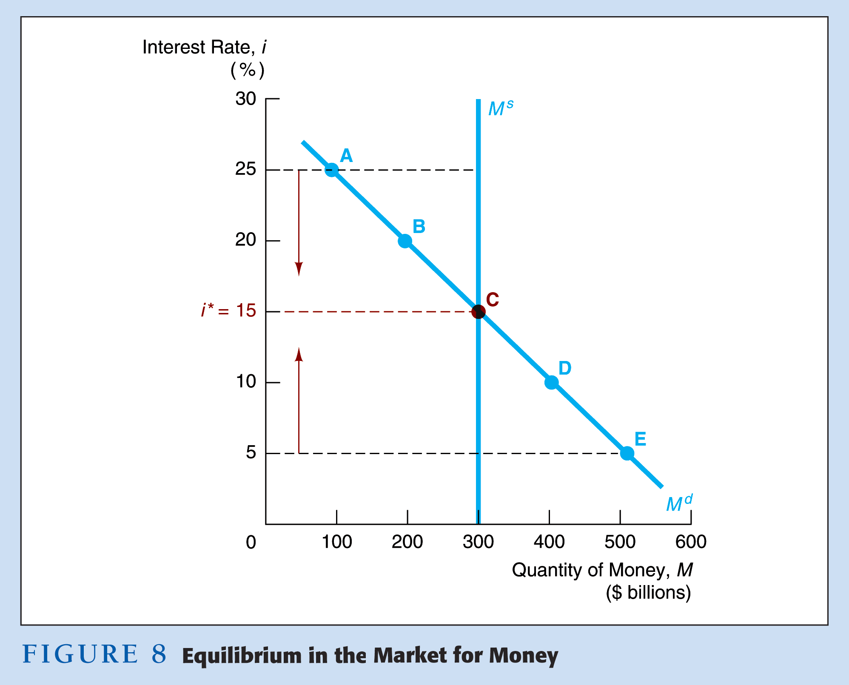

Slide 52
Shifts in the Demand for Money
Income Effect—a higher level of income causes the demand for money at each interest rate to increase and the demand curve to shift to the right
Price-Level Effect—a rise in the price level causes the demand for money at each interest rate to increase and the demand curve to shift to the right

Slide 53
Shifts in the Supply of Money
Assume that the supply of money is controlled by the central bank
An increase in the money supply engineered by the Federal Reserve
will shift the supply curve for money to the right

Slide 54
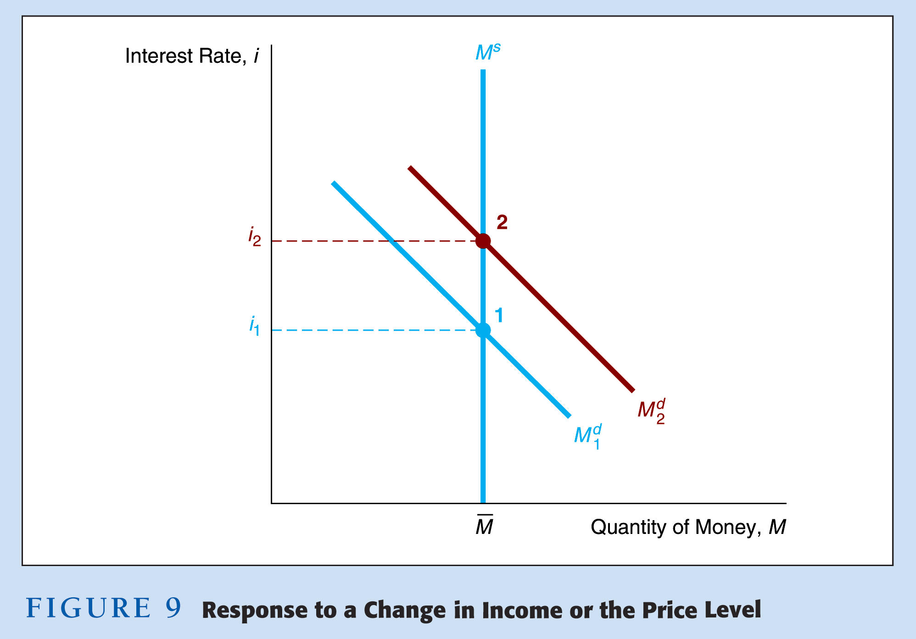

Slide 55
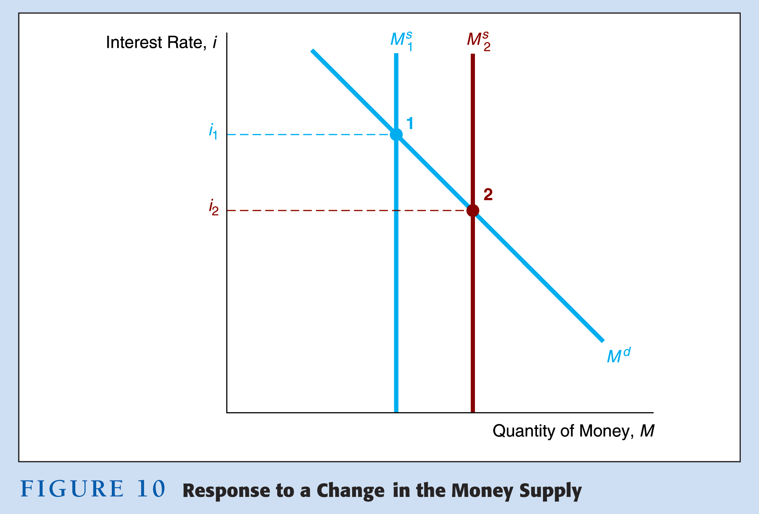

Slide 56
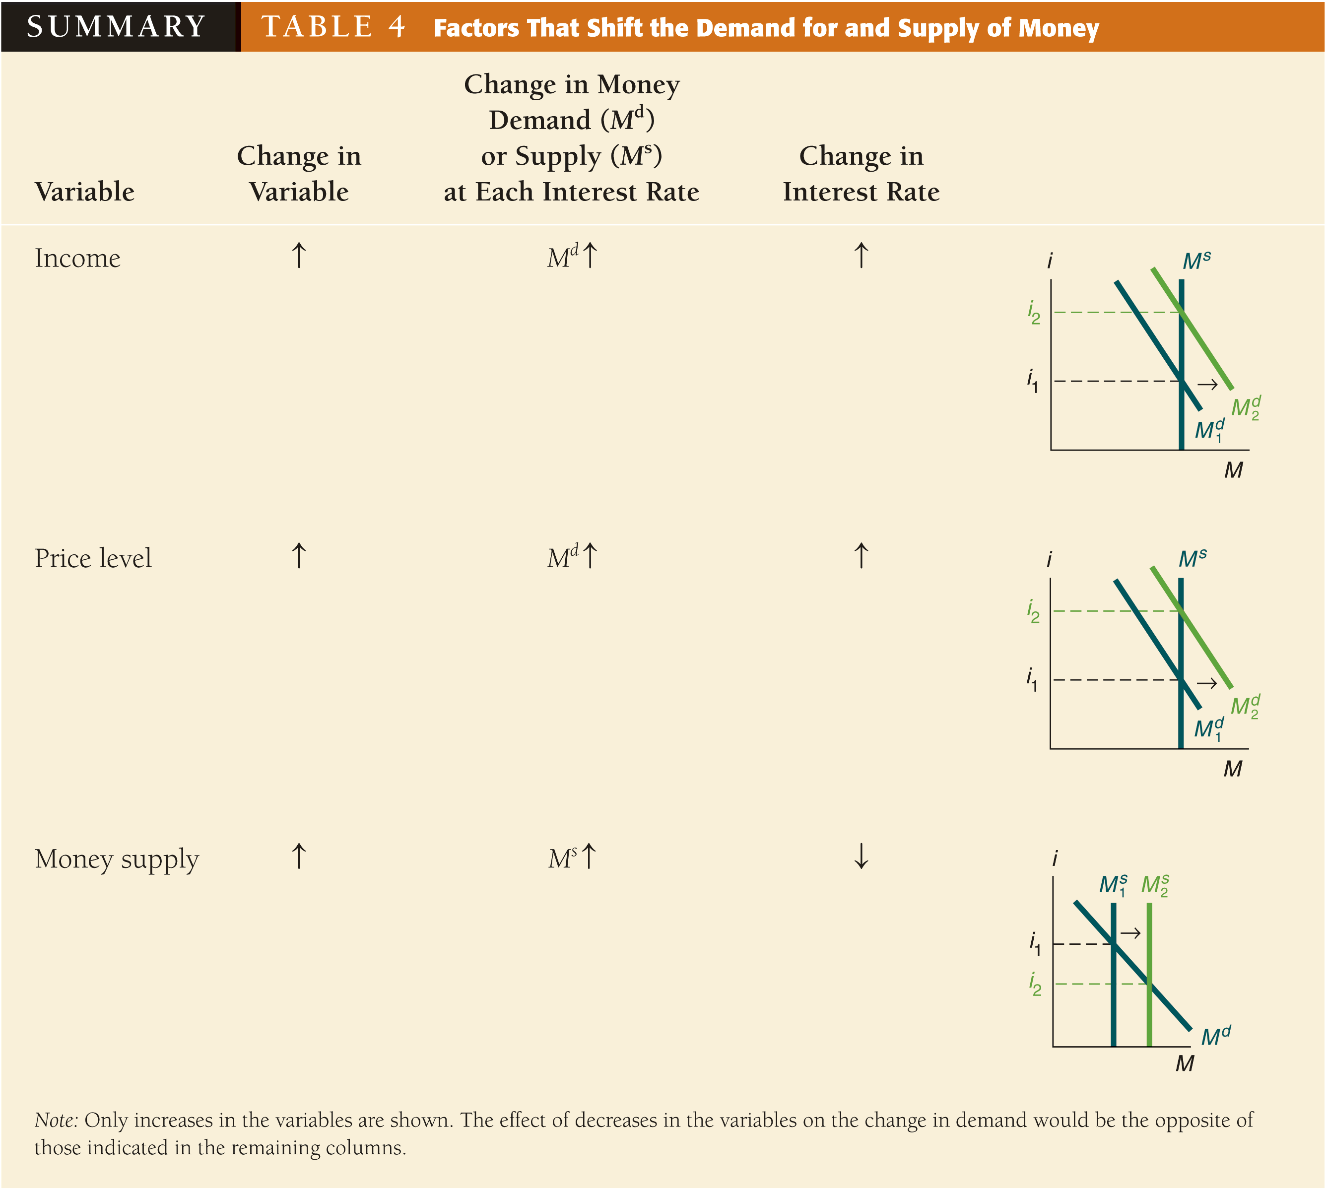

Slide 57
Everything Else Remaining Equal?
Liquidity preference framework leads to the conclusion that an increase in the money supply will lower interest rates—the liquidity effect.
Income effect finds interest rates rising because increasing the money supply is an expansionary influence on the economy.
Price-Level effect predicts an increase in the money supply leads to a rise in interest rates in response to the rise in the price level.
Expected-Inflation effect shows an increase in interest rates because an increase in the money supply may lead people to expect a higher price level in the future.

Slide 58
Money and Interest Rates
Effects of money on interest rates
1. Liquidity Effect
M^{s} ↑, M^{s} shifts right, i ↓
2. Income Effect
M^{s} ↑, Income ↑, M^{d} ↑, M^{d} shifts right, i ↑
3. Price Level Effect
M^{s} ↑, Price level ↑, M^{d} ↑, M^{d} shifts right, i ↑
4. Expected Inflation Effect
M^{s} ↑, π^{e} ↑, B^{d} ↓, B^{s} ↑, Fisher effect, i ↑
Effect of higher rate of money growth on interest rates is ambiguous
1. Because income, price level and expected inflation effects work in opposite direction of liquidity effect

Slide 59
Price-Level Effect and Expected-Inflation Effect
A one time increase in the money supply will cause prices to rise to a permanently higher level by the
end of the year. The interest rate will rise via the increased prices.
Price-level effect remains even after prices have stopped rising.
A rising price level will raise interest rates because people will expect inflation to be higher over the course of the year. When the price level stops rising, expectations of inflation will return to zero.
Expected-inflation effect persists only as long as the price level continues to rise.

Slide 60
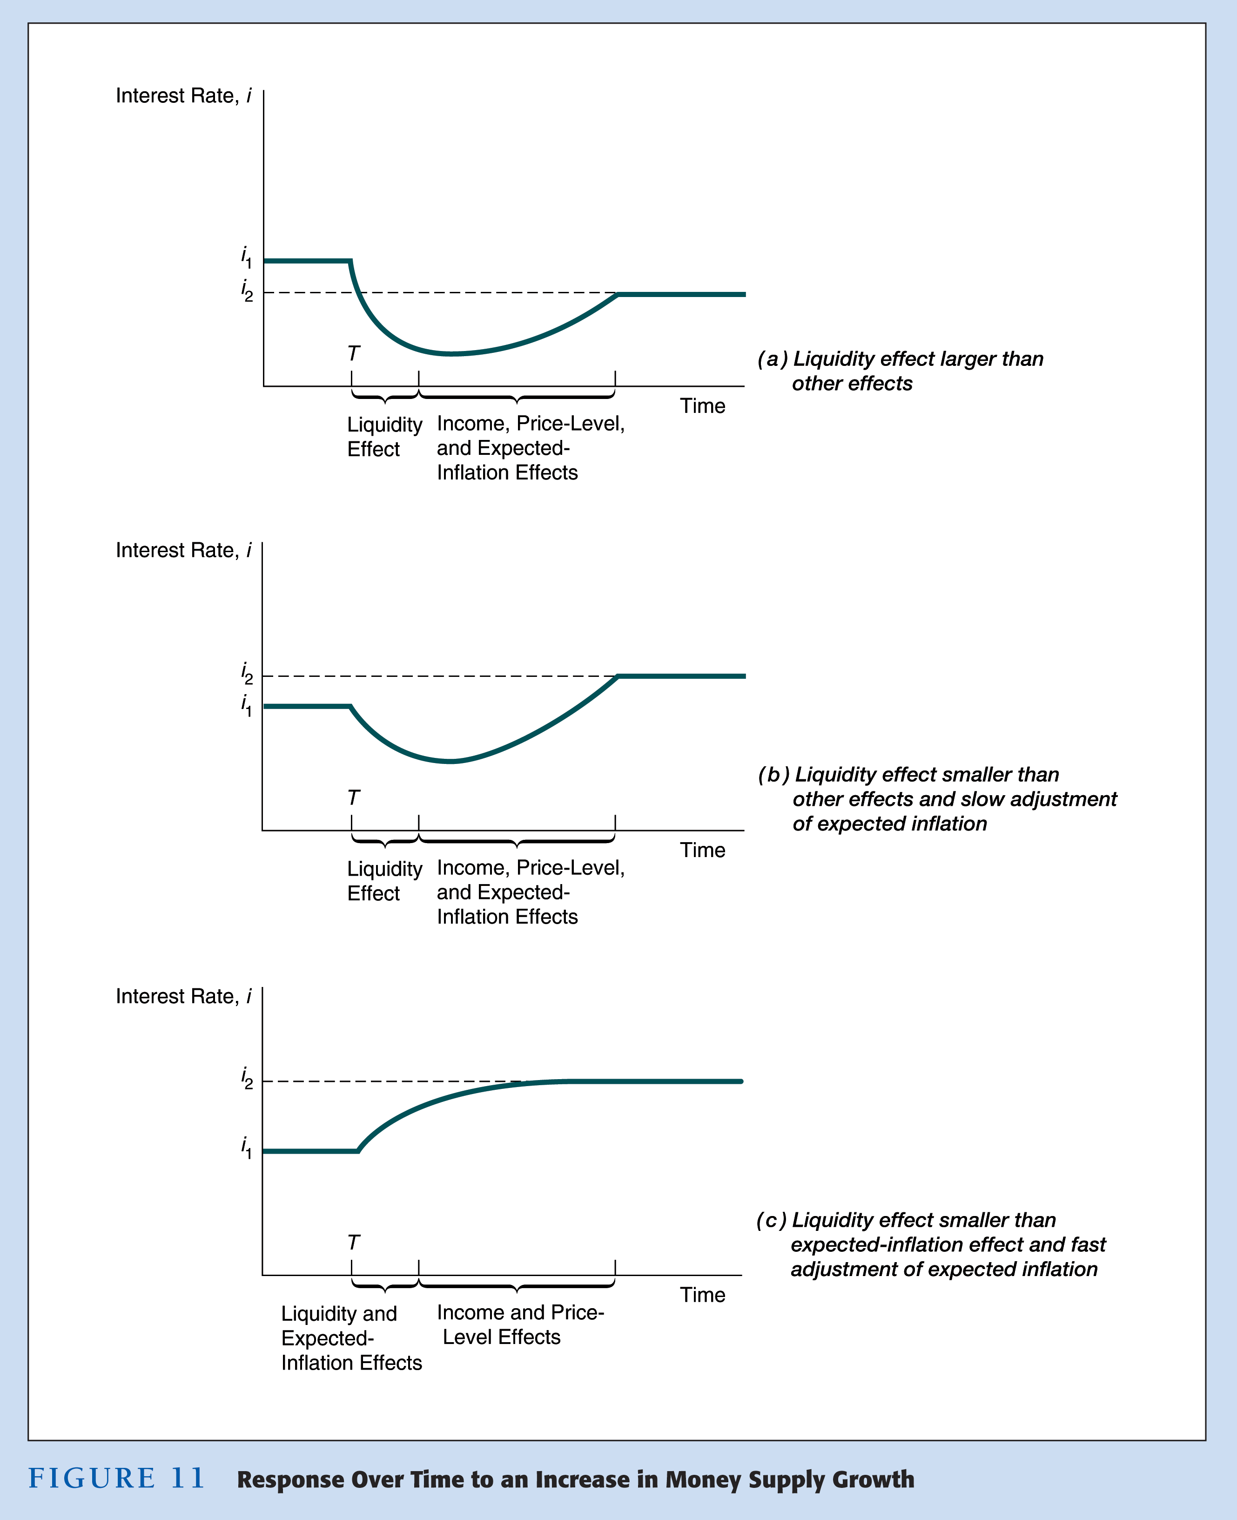

Slide 61
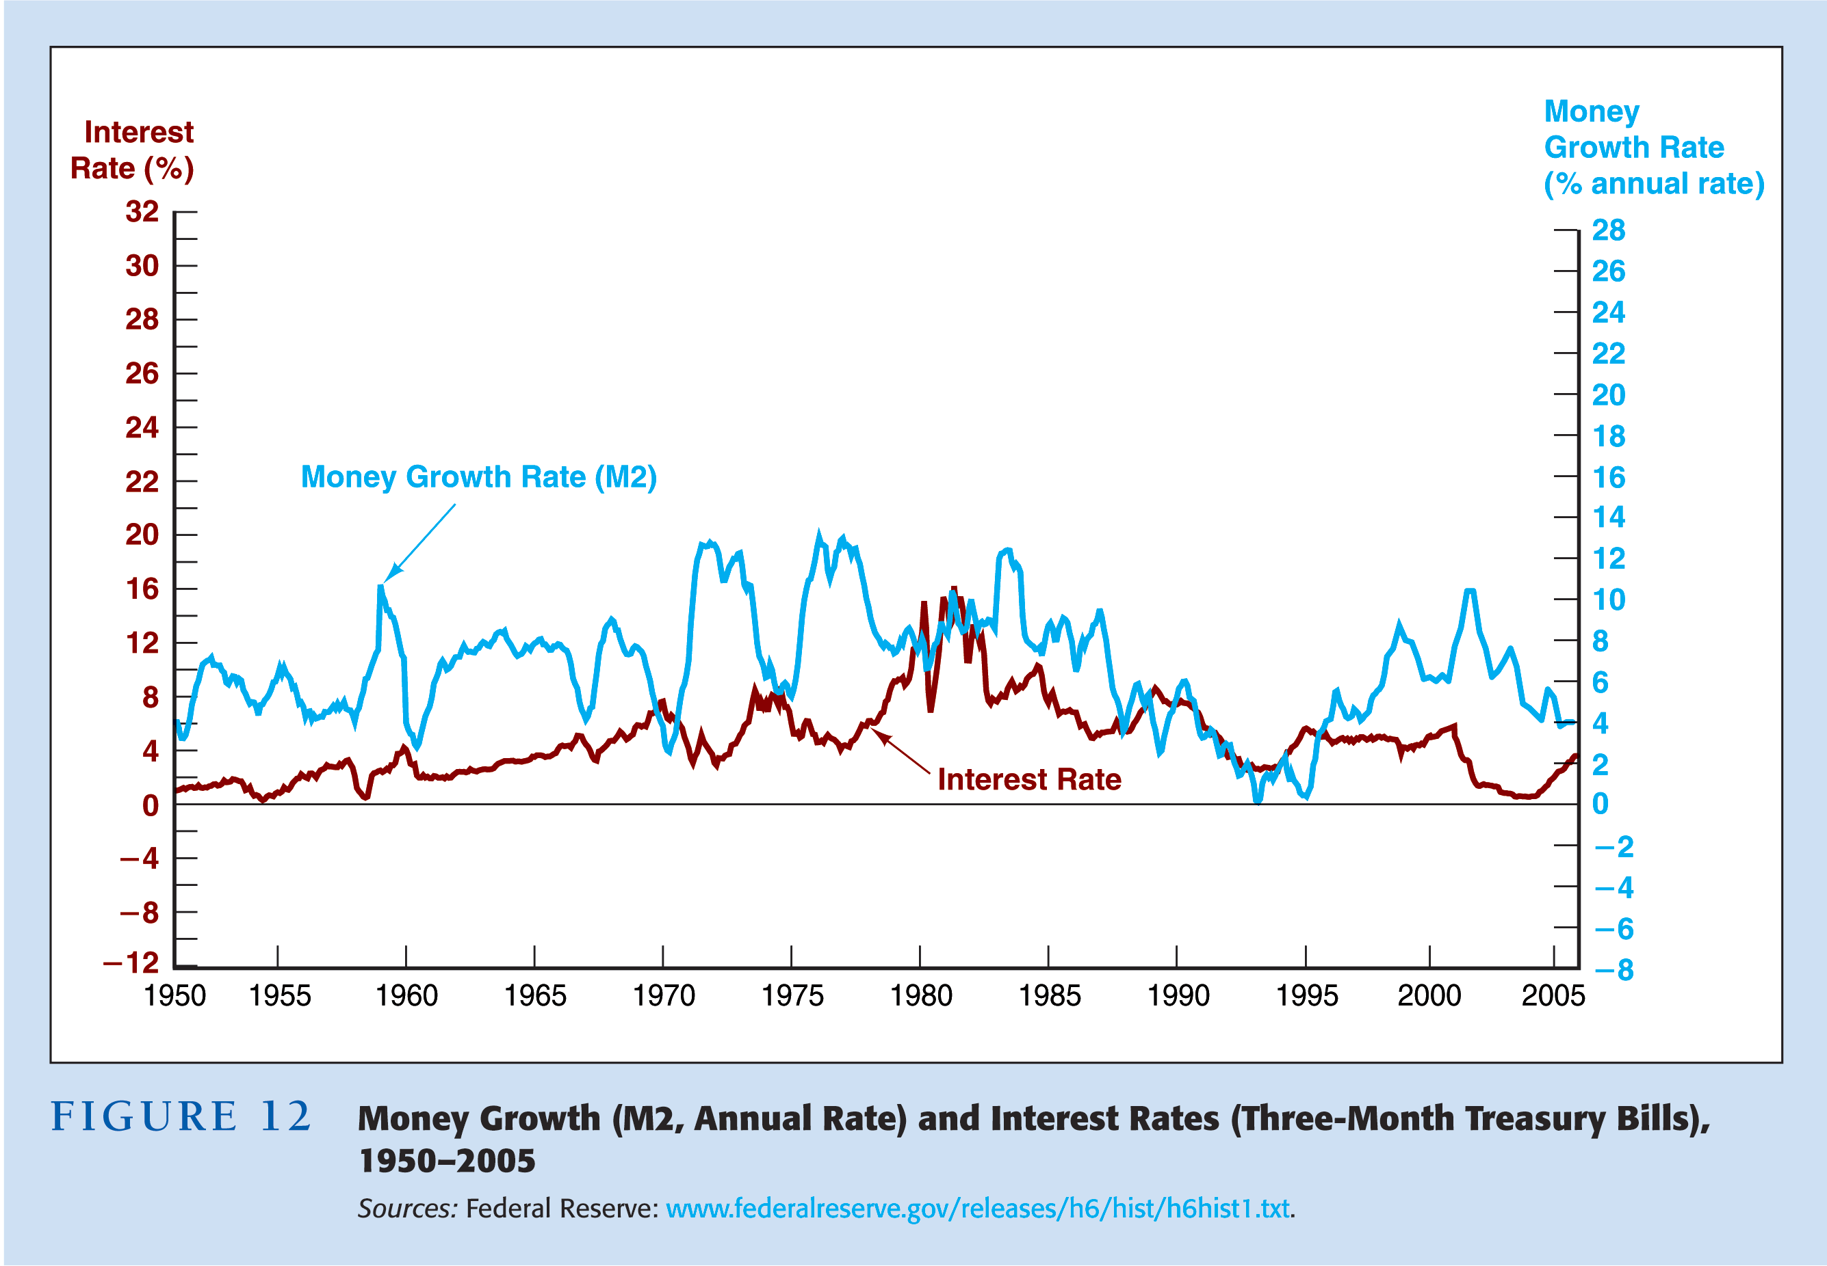

Slide 62
Relation of Liquidity Preference
Framework to Loanable Funds
Keynes’s Major Assumption
Two Categories of Assets in Wealth
Money
Bonds
1. Thus: M^{s} + B^{s} = Wealth
2. Budget Constraint: B^{d} + M^{d} = Wealth
3. Therefore: M^{s} + B^{s} = B^{d} + M^{d}
4. Subtracting M^{d} and B^{s} from both sides:
M^{s} – M^{d} = B^{d} – B^{s}
Money Market Equilibrium
5. Occurs when M^{d} = M^{s}
6. Then M^{d} – M^{s} = 0 which implies that B^{d} – B^{s} = 0, so that B^{d} = B^{s} and bond market is also in equilibrium

Slide 63
Relation of Liquidity Preference
Framework to Loanable Funds
1. Equating supply and demand for bonds as in loanable funds framework is equivalent to equating supply and demand for money as in liquidity preference framework
2. Two frameworks are closely linked, but differ in practice because liquidity preference assumes only two assets, money and bonds, and ignores effects on interest rates from changes in expected returns on real assets
Notes:
For a full treatment of the technical differences and inconsistencies between the two approaches in the short run. Read: Fields, T. W., & Hart, W. R. (2003). What We Should (Not) Teach Students About Interest Rate Determination. Journal of Economics and Finance Education, 2(2), 6-15.

Slide 64
The Risk and Term Structure of Interest Rates
Notes:
Risk versus term structure:
Risk: Why do bonds of similar maturity have different interest rates?
Term structure: Why do bonds with the same risk, from the same firm, but with different amounts of time until maturity differ in interest rates?

Slide 65
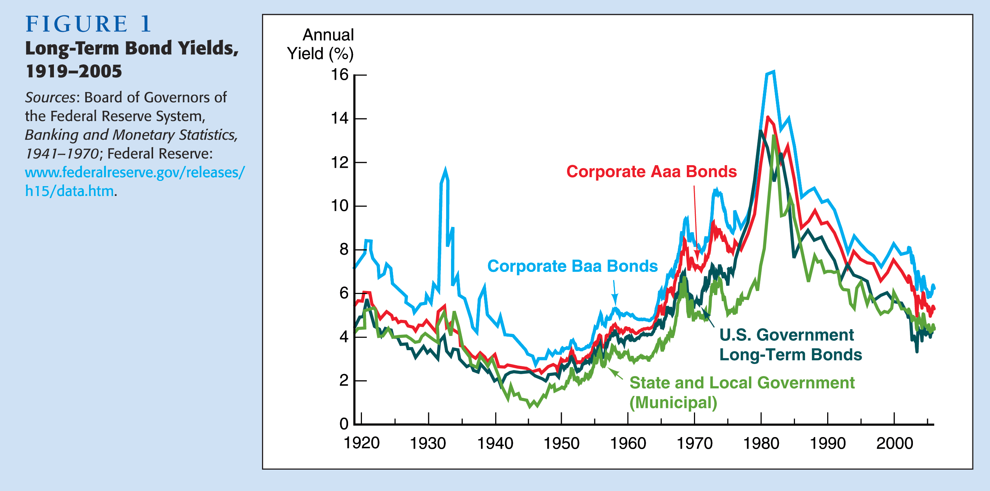
Risk Structure of Long-Term Bonds in the United States

Slide 66
Risk Structure of Interest Rates
Default risk—occurs when the issuer of the bond is unable or unwilling to make interest payments or pay off the face value
  U.S. T-bonds are considered default free
  Risk premium—the spread between the interest rates on bonds with default risk and the interest rates on T-bonds
Liquidity—the ease with which an asset can be converted into cash
Income tax considerations

Slide 67
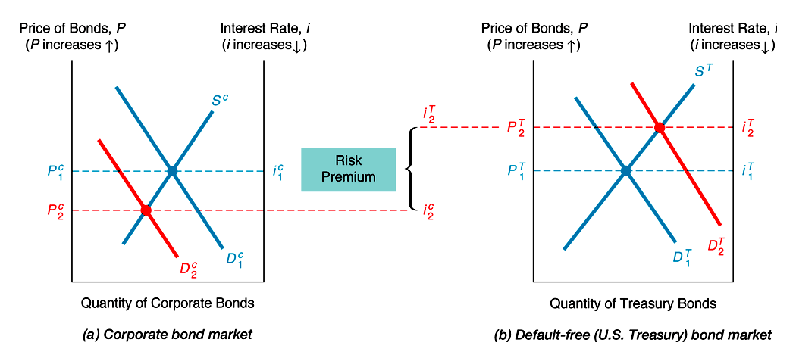
Increase in Default Risk on Corporate Bonds
Notes:
So the expected rate of return, the interest rate (assuming holding to maturity), must compensate the holder for the extra risk.
Corporate Bond Market
1. R^{e} on corporate bonds γοεσ δοων, D^{c} , D^{c} shifts left
2. Risk of corporate bonds υπ, D^{c} , D^{c} shifts left
3. P^{c} δοων, i^{c} ⊥
Treasury Bond Market
4. Relative R^{e} on Treasury bonds ⊥, D^{T ^}, D^{T} shifts right
5. Relative risk of Treasury bonds δοων, D^{T} ^, D^{T} shifts right
6. P^{T} ⊥, i^{T} down
Outcome:
Risk premium, i^{c} – i^{T}, rises

Slide 68
Analysis of Figure 2: Increase in
Default Risk on Corporate Bonds
Corporate Bond Market
1. R^{e} on corporate bonds ↓, D^{c} ↓, D^{c} shifts left
2. Risk of corporate bonds ↑, D^{c} ↓, D^{c} shifts left
3. P^{c} ↓, i^{c} ↑
Treasury Bond Market
4. Relative R^{e} on Treasury bonds ↑, D^{T} ↑, D^{T} shifts right
5. Relative risk of Treasury bonds ↓, D^{T} ↑, D^{T} shifts right
6. P^{T} ↑, i^{T} ↓
Outcome:
Risk premium, i^{c} – i^{T}, rises
Notes:
So the expected rate of return, the interest rate (assuming holding to maturity), must compensate the holder for the extra risk.

Slide 69

Bond Ratings
Notes:
Bonding ratings are measures of risk, or measures of the probability of default. How do they estimate probability of future default?

Slide 70
Corporate Bonds Become Less Liquid
Corporate Bond Market
1. Less liquid corporate bonds D^{c} ↓, D^{c} shifts left
2. P^{c} ↓, i^{c} ↑
Treasury Bond Market
1. Relatively more liquid Treasury bonds, D^{T} ↑, D^{T} shifts
right
2. P^{T} ↑, i^{T} ↓
Outcome:
Risk premium, i^{c} – i^{T}, rises
Risk premium reflects not only corporate bonds’ default risk, but also lower liquidity
Notes:
So “risk” premiums can vary for many reasons, like changing liquidity or changing perceptions of risk.

Slide 71
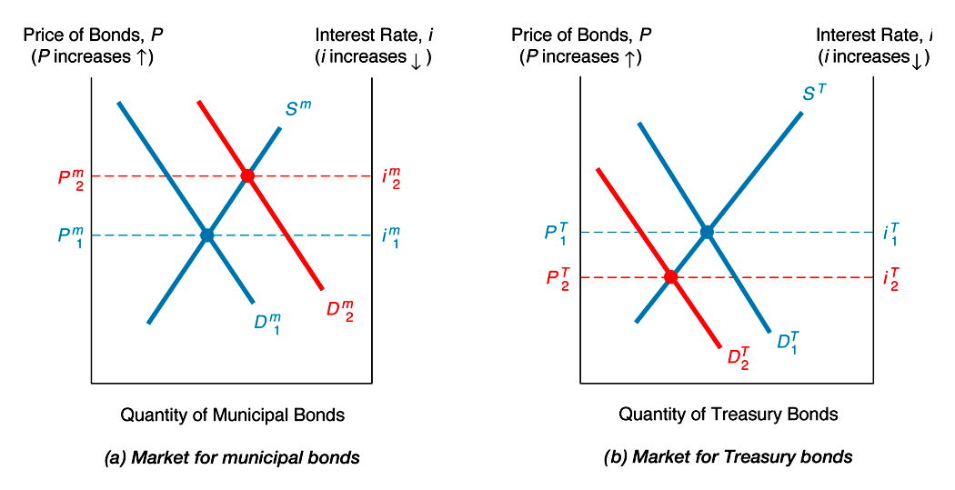
Tax Advantages of Municipal Bonds
Notes:
Explains why Muny’s have lower yields (interest rates) than other bonds, despite having positive default risk.

Slide 72
Analysis of Figure 3:
Tax Advantages of Municipal Bonds
Municipal Bond Market
1. Tax exemption raises relative RET^{e} on municipal bonds, D^{m} ↑, D^{m} shifts right
2. P^{m} ↑, i^{m} ↓
Treasury Bond Market
1. Relative RET^{e} on Treasury bonds ↓, D^{T} ↓, D^{T} shifts left
2. P^{T} ↓, i^{T} ↑
Outcome:
i^{m} < i^{T}

Slide 73
Term Structure Facts to be Explained
1. Interest rates for different maturities move together over time
2. Yield curves tend to have steep upward slope when short rates are low and downward slope when short rates are high
3. Yield curve is typically upward sloping
Three Theories of Term Structure
1. Expectations Theory
2. Segmented Markets Theory
3. Liquidity Premium (Preferred Habitat) Theory
  A. Expectations Theory explains 1 and 2, but not 3
  B. Segmented Markets explains 3, but not 1 and 2
  C. Solution: Combine features of both Expectations Theory and Segmented Markets Theory to get Liquidity Premium
  (Preferred Habitat) Theory and explain all facts

Slide 74
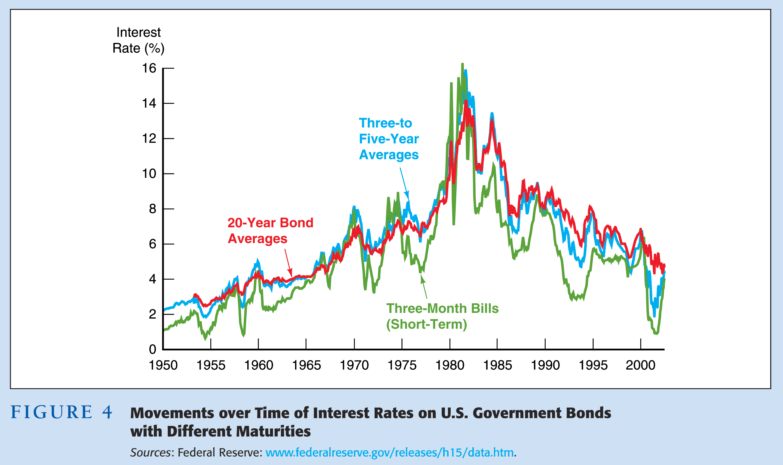
Interest Rates on Different Maturity Bonds Move Together

Slide 75
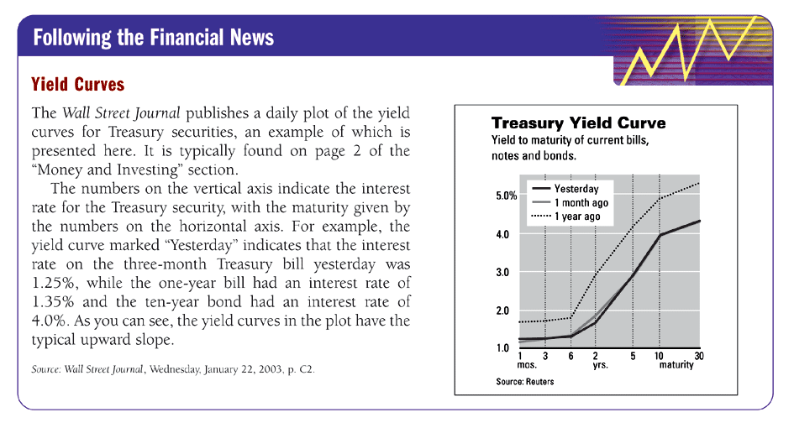
Yield Curves

Slide 76
Term Structure of Interest Rates
Bonds with identical risk, liquidity, and tax characteristics may have different interest rates because the time remaining to maturity is different
Yield curve—a plot of the yield on bonds with differing terms to maturity but the same risk, liquidity and tax considerations
  Upward-sloping  long-term rates are above
  short-term rates
  Flat  short- and long-term rates are the same
  Inverted  long-term rates are below short-term rates

Slide 77
Facts Theory of the Term Structure of Interest Rates Must Explain
Interest rates on bonds of different maturities move together over time
When short-term interest rates are low, yield curves are more likely to have an upward slope; when short-term rates are high, yield curves are more likely to slope downward and be inverted
Yield curves almost always
slope upward

Slide 78
Three Theories to Explain the Three Facts
Expectations theory explains the first two facts but not the third
Segmented markets theory explains fact three but not the first two
Liquidity premium theory combines the two theories to explain all three facts

Slide 79
Expectations Theory
The interest rate on a long-term bond will equal an average of the short-term interest rates that people expect to occur over the life of the long-term bond
Buyers of bonds do not prefer bonds of one maturity over another; they will not hold
any quantity of a bond if its expected return
is less than that of another bond with a different maturity
Bonds like these are said to be perfect substitutes

Slide 80
Expectations Theory—Example
Let the current rate on one-year bond be 6%.
You expect the interest rate on a one-year bond to be 8% next year.
Then the expected return for buying two one-year bonds averages (6% + 8%)/2 = 7%.
The interest rate on a two-year bond must be 7% for you to be willing to purchase it.

Slide 81
Expectations Theory—In General

Slide 82
Expectations Theory—In General (cont’d)

Slide 83
Expectations Theory—In General (cont’d)

Slide 84
Expectations Theory—In General (cont’d)

Slide 85
More Examples…
Here are the following 1 year expected interest rates for the next 5 years.
3%, 5%, 8%, 5%, 3%
What would you expect for the 1,2,3,4 and 5 year interest rates?
Notes:
What would you expect for the 1,2,3,4 and 5 year interest rates?
3%, 4%, 5.33%, 5.25%, 4.8%

Slide 86
Expectations Theory
Explains why the term structure of interest rates changes at different times
Explains why interest rates on bonds with different maturities move together over time (fact 1)
Explains why yield curves tend to slope up when short-term rates are low and slope down when short-term rates are high (fact 2)
Cannot explain why yield curves usually slope upward (fact 3)

Slide 87
Segmented Markets Theory
Bonds of different maturities are not substitutes at all
The interest rate for each bond with a different maturity is determined by the demand for and supply of that bond
Investors have preferences for bonds of one maturity over another
If investors have short desired holding periods and generally prefer bonds with shorter maturities that have less interest-rate risk, then this explains why yield curves usually slope upward (fact 3)

Slide 88
Liquidity Premium &
Preferred Habitat Theories
The interest rate on a long-term bond will equal an average of short-term interest rates expected to occur over the life of the long-term bond plus a liquidity premium that responds to supply and demand conditions for that bond
Bonds of different maturities are substitutes but not perfect substitutes

Slide 89
Liquidity Premium Theory

Slide 90
Numerical Example
1. One-year interest rate over the next five years:
5%, 6%, 7%, 8% and 9%
2. Investors’ preferences for holding short-term bonds, liquidity premiums for one to five-year bonds:
0%, 0.25%, 0.5%, 0.75% and 1.0%.
Interest rate on the two-year bond:
(5% + 6%)/2 + 0.25% = 5.75%
Interest rate on the five-year bond:
Interest rates on one to five-year bonds:
Comparing with those for the expectations theory, liquidity premium (preferred habitat) theories produce yield curves more steeply upward sloped
Notes:
1. One-year interest rate over the next five years:
5%, 6%, 7%, 8% and 9%
Investors’ preferences for holding short-term bonds, liquidity
premiums for one to five-year bonds:
0%, 0.25%, 0.5%, 0.75% and 1.0%.
Interest rate on the two-year bond:
(5% + 6%)/2 + 0.25% = 5.75%
Interest rate on the five-year bond:
(5% + 6% + 7% + 8% + 9%)/5 + 1.0% = 8%
Interest rates on one to five-year bonds:
5%, 5.75%, 6.5%, 7.25% and 8%.

Slide 91
Preferred Habitat Theory
Investors have a preference for bonds of one maturity over another
They will be willing to buy bonds of different maturities only if they earn a somewhat higher expected return
Investors are likely to prefer short-term bonds over longer-term bonds

Slide 92
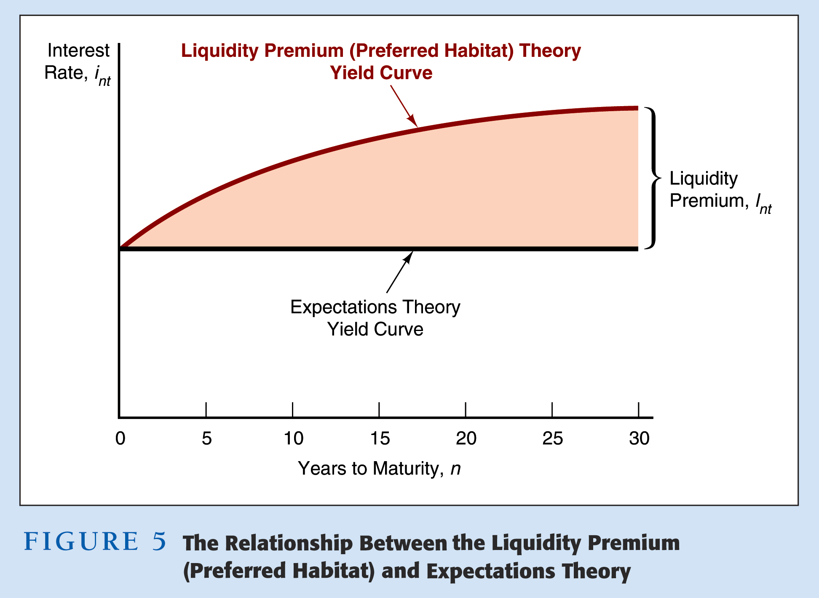

Slide 93
Liquidity Premium and Preferred Habitat Theories, Explanation of the Facts
Interest rates on different maturity bonds move together over time; explained by the first term in
the equation
Yield curves tend to slope upward when short-term rates are low and to be inverted when short-term rates are high; explained by the liquidity premium term in the first case and by a low expected average in the second case
Yield curves typically slope upward; explained
by a larger liquidity premium as the term to
maturity lengthens

Slide 94
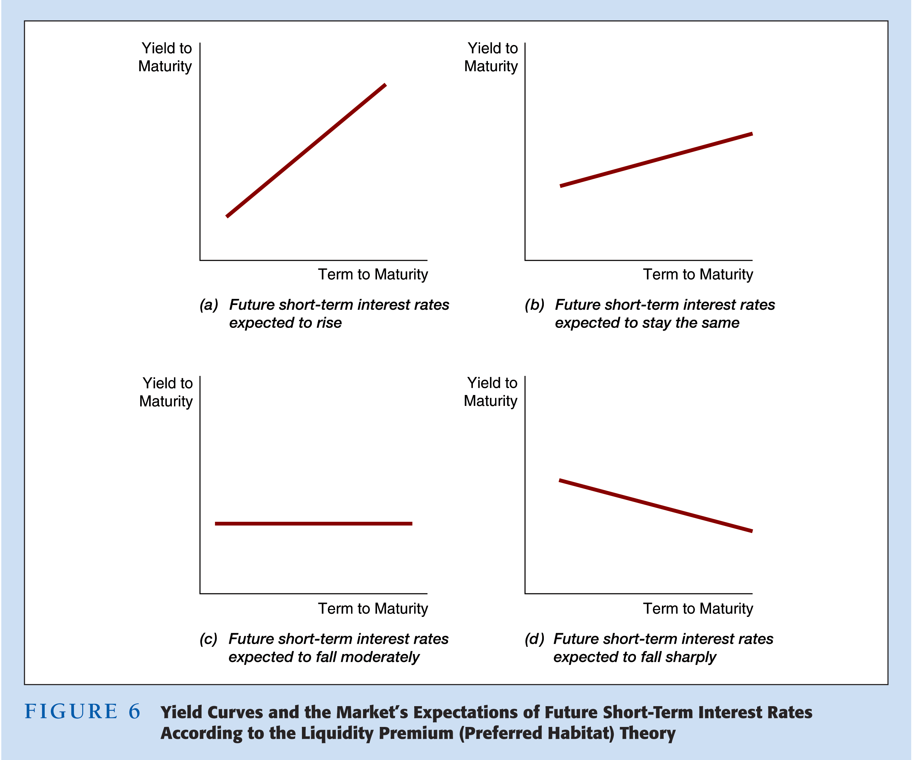
Market Predictions of Future Short Rates

Slide 95
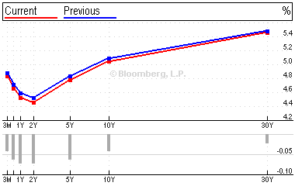
Spring 2001
Notes:
What are market expectations?
How have they changed from blue to red?
Notice the role the Fed plays as an anchor of short rates, how might this effected future short rates? Long rates? Remember the liquidity effect, price level effect, inflation expectations effect, and the income effect are all interacting here.

Slide 96
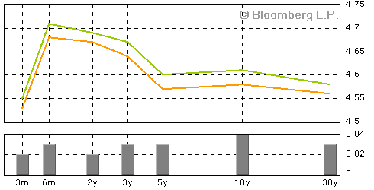
Spring 2005

Slide 97
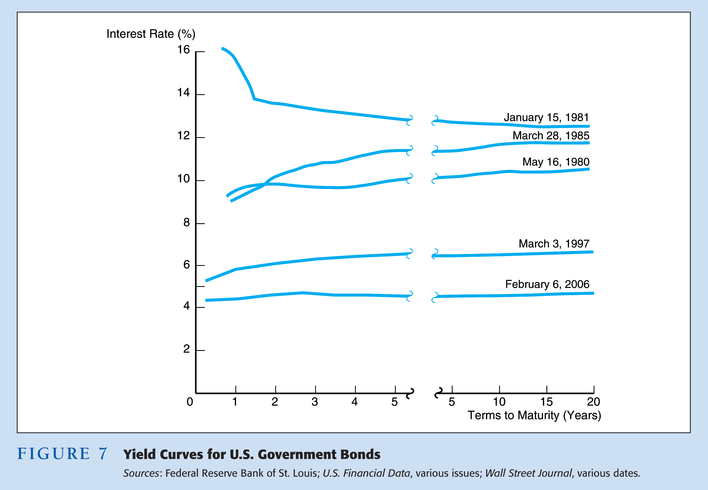
Interpreting Yield Curves 1980–2006

Slide 98
Dynamic Yield Curve
Yield curve changes plotted against DJIA
http://stockcharts.com/charts/YieldCurve.html
Yield curves since the late 70’s
http://fixedincome.fidelity.com/fi/FIHistoricalYield
Notes:
Here are a few web pages that help analyze the yield curve.

Slide 99
Appendix
Slides after this point will most likely not be covered in class. However they may contain useful definitions, or further elaborate on important concepts, particularly materials covered in the text book.
They may contain examples I’ve used in the past, or slides I just don’t want to delete as I may use them in the future.

Slide 100
Expectations Hypothesis
Key Assumption: Bonds of different maturities are perfect substitutes
Implication: RET^{e} on bonds of different maturities are equal
Investment strategies for two-period horizon
1. Buy $1 of one-year bond and when it matures buy another one-year bond
2. Buy $1 of two-year bond and hold it
Expected return from strategy 2
(1 + i_{2t})(1 + i_{2t}) – 1 1 + 2(i_{2t}) + (i_{2t})² – 1
=
1 1
Since (i_{2t})² is extremely small, expected return is approximately 2(i_{2t})

Slide 101
Expected Return from Strategy 1
(1 + i_{t})(1 + i^{e}_{t+1}) – 1 1 + i_{t} + i^{e}_{t+1} + i_{t}(i^{e}_{t+1}) – 1
=
1 1
Since i_{t}(i^{e}_{t+1}) is also extremely small, expected return is approximately
i_{t} + i^{e}_{t+1}
From implication above expected returns of two strategies are equal: Therefore
2(i_{2t}) = i_{t} + i^{e}_{t+1}
Solving for i_{2t}
i_{t} + i^{e}_{t+1}
i_{2t} =
2

Slide 102
Expected Return from Strategy 1
More generally for n-period bond:
i_{t} + i^{e}_{t+1} + i^{e}_{t+2} + ... + i^{e}_{t+(n–1)}
i_{nt} =
n
In words: Interest rate on long bond = average short rates expected to occur over life of long bond
Numerical example:
One-year expected interest rates over the next five years 5%, 6%, 7%, 8% and 9%:
Interest rate on two-year bond:
Interest rate for five-year bond:
Interest rate for one to five year bonds:
Notes:
Interest rate on two-year bond:
(5% + 6%)/2 = 5.5%
Interest rate for five-year bond:
(5% + 6% + 7% + 8% + 9%)/5 = 7%
Interest rate for one to five year bonds:
5%, 5.5%, 6%, 6.5% and 7%.

Slide 103
Expectations Hypothesis and Term Structure Facts
Explains why yield curve has different slopes:
1. When short rates expected to rise in future, average of future short rates = i_{nt} is above today’s short rate: therefore yield curve is upward sloping
2. When short rates expected to stay same in future, average of future short rates are same as today’s, and yield curve is flat
3. Only when short rates expected to fall will yield curve be downward sloping
Expectations Hypothesis explains Fact 1 that short and long rates move together
1. Short rate rises are persistent
2. If i_{t} ↑ today, i^{e}_{t+1}, i^{e}_{t+2} etc. ↑ ⇒ average of future rates ↑ ⇒ i_{nt} ↑
3. Therefore: i_{t} ↑ ⇒ i_{nt} ↑, i.e., short and long rates move together

Slide 104
Explains Fact 2 that yield curves tend to have steep slope when short rates are low and downward slope when short rates are high
1. When short rates are low, they are expected to rise to normal level, and long rate = average of future short rates will be well above today’s short rate: yield curve will have steep upward slope
2. When short rates are high, they will be expected to fall in future, and long rate will be below current short rate: yield curve will have downward slope
Doesn’t explain Fact 3 that yield curve usually has upward slope
Short rates as likely to fall in future as rise, so average of future short rates will not usually be higher than current short rate: therefore, yield curve will not usually slope upward

Slide 105
Segmented Markets Theory
Key Assumption: Bonds of different maturities are not substitutes at all
Implication: Markets are completely segmented: interest rate at each maturity determined separately
Explains Fact 3 that yield curve is usually upward sloping
People typically prefer short holding periods and thus have higher demand for short-term bonds, which have higher price and lower interest rates than long bonds
Does not explain Fact 1 or Fact 2 because assumes long and short rates determined independently

Slide 106
Liquidity Premium (Preferred Habitat) Theories
Key Assumption: Bonds of different maturities are substitutes, but are not perfect substitutes
Implication: Modifies Expectations Theory with features of Segmented Markets Theory
Investors prefer short rather than long bonds ⇒ must be paid positive liquidity (term) premium, l_{nt}, to hold long-term bonds
Results in following modification of Expectations Theory
i_{t} + i^{e}_{t+1} + i^{e}_{t+2} + ... + i^{e}_{t+(n–1)}
i_{nt} = + l_{nt}
n

Slide 107
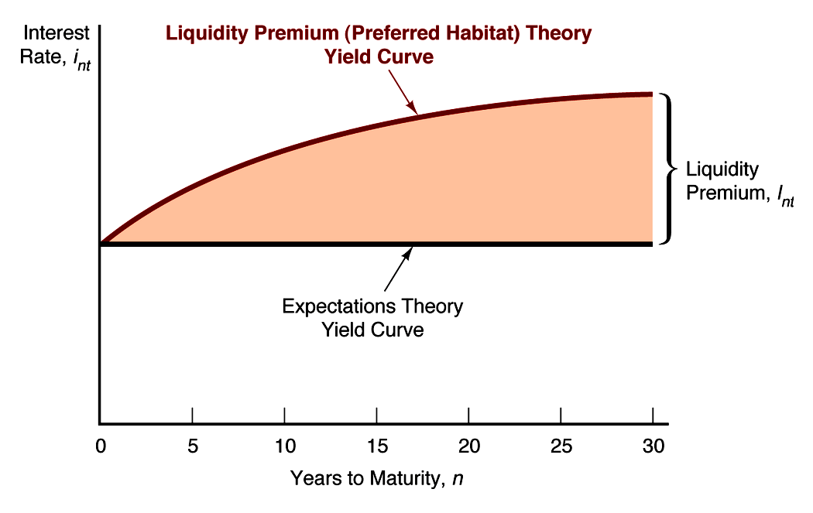
Relationship Between the Liquidity Premium (Preferred Habitat) and Expectations Theories

Slide 108
Liquidity Premium (Preferred Habitat) Theories: Term Structure Facts
Explains all 3 Facts
Explains Fact 3 of usual upward sloped yield curve by investors’ preferences for short-term bonds
Explains Fact 1 and Fact 2 using same explanations as expectations hypothesis because it has average of future short rates as determinant of long rate

Slide 109
Trading Experiment
Instructions
Assign type
Assign trading location

Slide 110
Trading Experiment
Questions for Discussion
What trades were you willing to make and why?
Did you have a particular trading strategy, and if so, what was it?
Was your strategy effective at maximizing your total points?

Slide 111
Trading Experiment
Did any item serve as a generally accepted medium of exchange in the experiment?
If so, what item was it, why were people willing to accept it, and how was the pattern of trades affected by the existence of a medium of exchange? What were the advantages having a generally accepted medium of exchange in this economy?
If not, why was there no generally accepted medium of exchange?
What would the effect on trading strategies have been if the storage costs of all the goods had been equal?

Slide 112
Trading Experiment
Can you think of any markets where some item other than currency serves as a generally accepted medium of exchange?
If so, what are the advantages and disadvantages of using this item instead of currency?
Notes:
Prison and cigarettes. Grade school playground and ??

Slide 113
So What Is Money?

Slide 114
Meaning and Function of Money
Economist’s Meaning of Money
1. Anything that is generally accepted in payment for goods and services
2. Not the same as wealth or income
Functions of Money
1. Medium of exchange
2. Unit of account
3. Store of value
Notes:
Medium of exchange – generally accepted for payment
Unit of account – it operates a a mechanism for pricing, eliminating the need for all the bilateral prices
Store of value – roughly keeps its value over time, therefore minimizing storage costs.

Slide 115
Evolution of Money
Commodities
Precious metals like gold and silver
Paper currency
Checks
Electronic means of payment: Fedwire, CHIPS, SWIFT, ACH
Electronic money: Debit cards, Stored-value cards, Electronic cash and checks

Slide 116
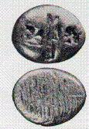
The First Money
700-637 BC Lydian King stamped electrum ingots with lions head (Western Turkey)
Previous to this they merely used items (grains, etc) to balance out the barter.

Slide 117
The First Money
640 BC Lydian King stamped electrum ingots with lions head
Many countries used different commodities as a medium of exchange
Roman Empire (to 476 AD), used coins extensively.
Dark ages 476 AD - 1250, money disappeared or fell out of favor in Europe, maintained in the Byzantine Empire
Notes:
Weatherford, J. M. (1997). The History of Money: From Sandstone to Cyberspace. New York: Crown Publishers.

Slide 118
The First Money
Aztecs used the cacao seeds. Largely to equalize a barter transaction.
Knights of Templar (1118 AD- 1314 AD) The first bankers. Managed money for the French Kings, the Pope, and Crusaders
Freed from the requirement of physically transporting the gold, or coin.
Goldsmiths story.
Notes:
Weatherford, J. M. (1997). The History of Money: From Sandstone to Cyberspace. New York: Crown Publishers.

Slide 119
Commodity Money
Criteria for commodity Money
Easily standardized
Widely accepted
Divisible
Easy to carry
Must not deteriorate
Examples: cigarettes, booze, gold, clams etc.
Notes:
Smelly African money…not easily accepted: http://mahalanobis.twoday.net/stories/489015/

Slide 120
Commodity Standard
Gold standard
Bimetallic standard
Coins
Full bodied currency
Fiat (freedom from commodity standard)
Problems and issues with commodity money:
Seigniorage (The difference between the m.v. of money and the cost of production)
Gresham’s Law- “Bad money chases out good money”

Slide 121
History of Paper Currency
First identified in 1st century AD China
Full bodied currency
  First bank note in Europe, 1661, backed by copper sheets weighing 500 lbs.
Fiat Currency
  The Dollar

Slide 122
Fun Facts about the Dollar
Ave life of $1 bill is 18 months, 9 years for a $100
490 notes in a lb. So 10 Million in 100’s weighs 204lbs.
½ of bills printed in a day are $1 denomination
http://www.wheresgeorge.com/
Notes:
Are you normal about money?

Slide 123
History of Money in US
Franklin “The Father of Paper Money”
  States issued currency
Continentals (1777-1781)
  “Not worth a continental”
Free Banking ( - 1866)
  States and banks issued their own currency
Greenbacks (Civil War)
Nationalization of Gold (1933)
The Collapse of the Bretton Woods System (1971)
Goodwin, Jason. 2003. Greenback : How the Dollar Changed the World. New York: Henry Holt.
  http://news.mpr.org/play/audio.php?media=/midmorning/2003/01/31_midmorn2
  Clips: Paper money 7:00; Metallists 14:45; Wizard of Oz 20:45; Dollar 49:00

Slide 124
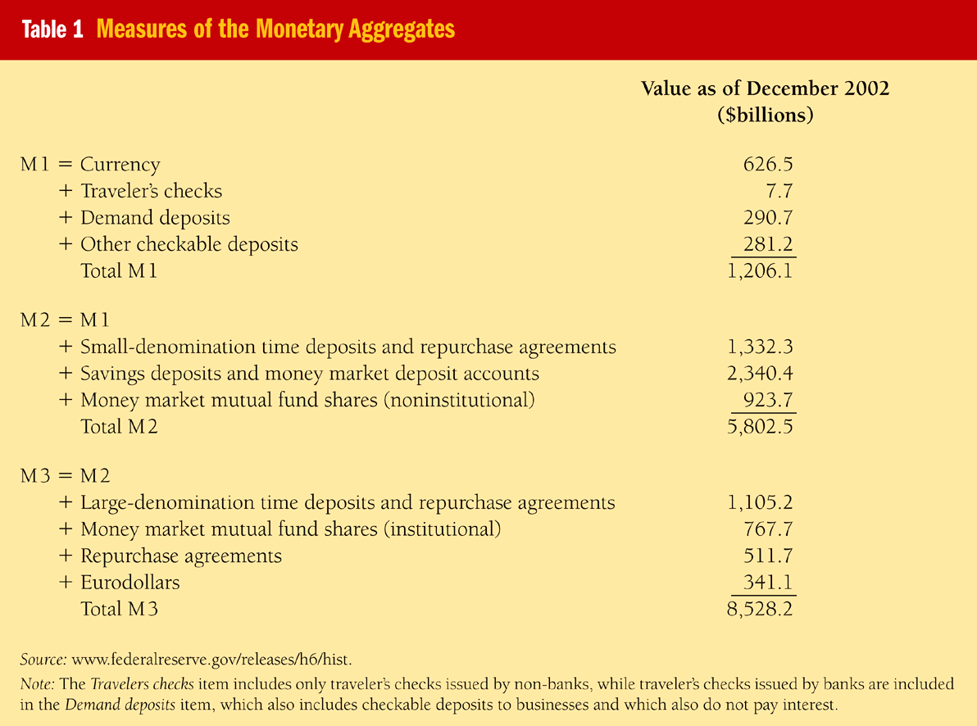
Federal Reserve’s Monetary Aggregates

Slide 125
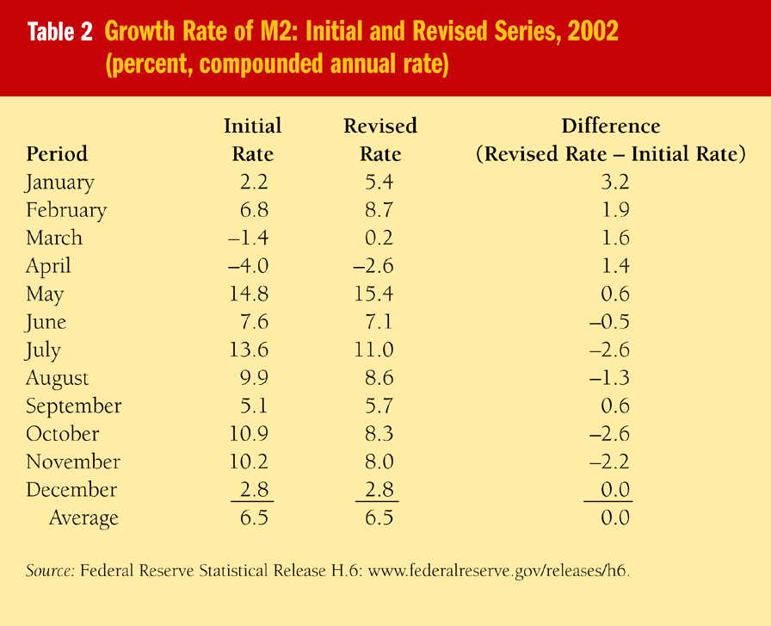
How Reliable are the M2 Money Data: Data Revisions

Slide 126
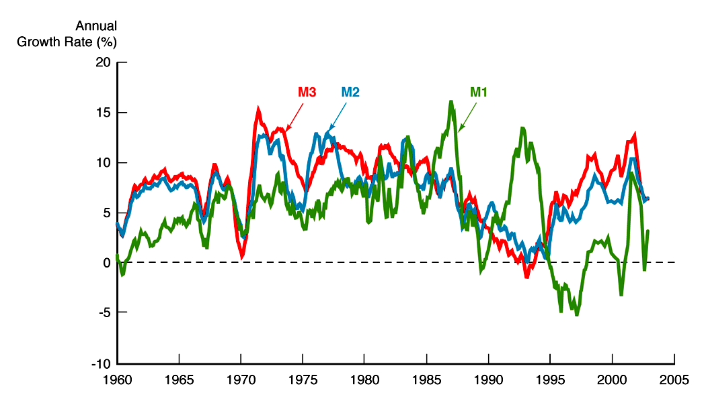
Growth Rates of Fed’s
Monetary Aggregates

Slide 127
The Economic Organization of a POW Camp
R.A. Radford Economica, 1945, 189-201
According to Radford, did cigarettes function well as money in the POW camp?
Was it important to their use as currency that cigarettes had intrinsic value?
Why would individuals re-roll their machine-rolled cigarettes?
What is the significance of the fact that a halving of Red Cross parcels changed prices?
What accounts for the fall in the value of the "bully mark"?
What happened to prices during an air raid? Why?
Notes:
Some non-money related questions from the article:
What, according to Radford, accounts for the development of an exchange system in a POW camp?
Can the development of the system be explained by the equality or lack of equality in the distribution of supplies?
Were prisoners generally unhappy with their particular allotment of supplies and thereby motivated to develop an exchange system?
Which force does Radford think was most important in accounting for the evolution of the exchange system?
In what sense does the "extent of the market" matter in the POW camp exchange system?
Why, according to Radford, were traders (middlemen) disliked?
Does Radford regard traders as social parasites?
In what sense did traders take advantage of pricing discrepancies?
Why did the British officers attempt to regulate prices in the POW camp?
In your view, did the POW exchange system produce a just distribution of goods? Would you have favored regulation of the exchange system? What sort?

Slide 128
The Economic Organization of a POW Camp
R.A. Radford Economica, 1945, 189-201
Important monetary ideas:
  Increase in cigarettes caused prices to rise (that is to say, the number of cigarettes it took to buy a particular item increased).
  Decrease in the number of cigarettes caused prices to fall.
  Demand for cigarettes other than as money affected their ability to function as money (non-monetary demand). It also affected the relationship between prices and the quantity of cigarettes
  Prices responded to expectations of changes in the number of cigarettes. Prisoners were forward looking, rational, and prices reflected those beliefs about the future.
Notes:
If the number of cigarette fell by half, one would expect prices to fall by half, but in fact they fell by more due to the non-monetary demand.

Slide 129
The Money Quote
"Lenin was certainly right. By a continuing process of inflation, governments can confiscate, secretly and unobserved, an important part of the wealth of their citizens. There is no subtler, no surer means of overturning the existing basis of society than to debauch the currency. The process engages all the hidden forces of economic law on the side of destruction, and does it in a manner which not one man in a million is able to diagnose.." - John Maynard Keynes, `The Economic Consequences of The Peace'
“Fiat money is the cause of inflation, and the amount which people lose in purchasing power is exactly the amount which was taken from them and transferred to their governments by this process.” – G. Edward Griffin, “The Creature from Jekyll Island”
Notes:
http://en.wikipedia.org/wiki/Fiat_currency

Slide 130
More Money Quotes
“A fiat monetary system allows power and influence to fall into the hands of those who control the creation of new money, and to those who get to use the money or credit early in its circulation. The insidious and eventual cost falls on unidentified victims who are usually oblivious to the cause of their plight. This system of legalized plunder (though not constitutional) allows one group to benefit at the expense of another. An actual transfer of wealth goes from the poor and the middle class to those in privileged financial positions.” — Congressman Ron Paul (R-TX), "Paper Money and Tyranny"
"It is well enough that people of the nation do not understand our banking and monetary system, for if they did, I believe there would be a revolution before tomorrow morning." — Henry Ford

Slide 131
Multiple Deposit Creation and the Money Supply Process

Slide 132
Four Players in the Money Supply Process
1. Central Bank: The Fed
2. Banks
3. Depositors
4. Borrowers from banks
Federal Reserve System
1. Conducts monetary policy
2. Clears checks
3. Regulates banks

Slide 133
The Fed’s Balance Sheet
Federal Reserve System
Assets
Liabilities
Government securities
Discount loans
Currency in circulation
Reserves
Monetary Base, MB = C + R

Slide 134
Control of the Monetary Base
Open Market Purchase from Bank
The Banking System The Fed
Assets Liabilities Assets Liabilities
Securities – $100 Securities + $100 Reserves + $100
Reserves + $100
Open Market Purchase from Public
Public The Fed
Assets Liabilities Assets Liabilities
Securities – $100 Securities + $100 Reserves + $100
Deposits + $100
Banking System
Assets Liabilities
Reserves Checkable Deposits
+ $100 + $100
Result: R ↑ $100, MB ↑ $100

Slide 135
If Person Cashes Check
Public The Fed
Assets Liabilities Assets Liabilities
Securities – $100 Securities + $100 Currency + $100
Currency + $100
Result: R unchanged, MB ↑ $100
Effect on MB certain, on R uncertain
Shifts From Deposits into Currency
Public The Fed
Assets Liabilities Assets Liabilities
Deposits – $100 Currency + $100
Currency + $100 Reserves – $100
Banking System
Assets Liabilities
Reserves – $100 Deposits – $100
Result: R ↓ $100, MB unchanged

Slide 136
Discount Loans
Banking System The Fed
Assets Liabilities Assets Liabilities
Reserves Discount Discount Reserves
+ $100 loan + $100 loan + $100 + $100
Result: R ↑ $100, MB ↑ $100
Conclusion: Fed has better ability to control MB than R

Slide 137
Deposit Creation: Single Bank
First National Bank
Assets Liabilities
Securities – $100
Reserves + $100
First National Bank
Assets Liabilities
Securities – $100 Deposits + $100
Reserves + $100
Loans + $100
First National Bank
Assets Liabilities
Securities – $100 Deposits + $100
Loans + $100

Slide 138
Deposit Creation: Banking System
Bank A
Assets Liabilities
Reserves + $100 Deposits + $100
Bank A
Assets Liabilities
Reserves + $10 Deposits + $100
Loans + $90
Bank B
Assets Liabilities
Reserves + $90 Deposits + $90
Bank B
Assets Liabilities
Reserves + $ 9 Deposits + $90
Loans + $81

Slide 139
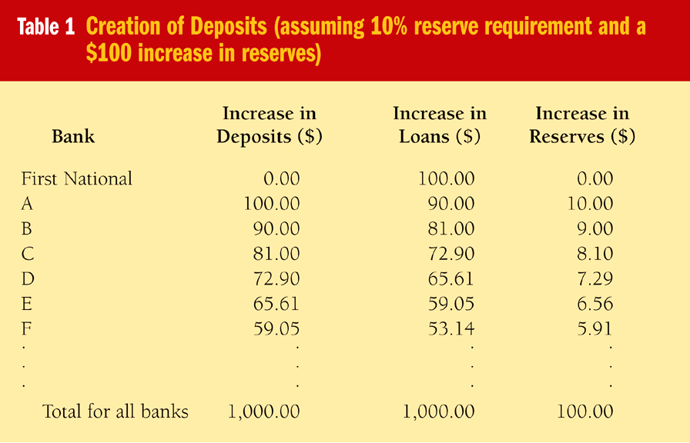
Deposit Creation

Slide 140
Deposit Creation
If Bank A buys securities with $90 check
Bank A
Assets Liabilities
Reserves + $10 Deposits + $100
Securities + $90
Seller deposits $90 at Bank B and process is same
Whether bank makes loans or buys securities, get same deposit expansion

Slide 141
Deposit Multiplier
Simple Deposit Multiplier
1
ΔD = × ΔR
r
Deriving the formula
R = RR = r × D
1
D = × R
r
1
ΔD = × ΔR
r

Slide 142
Deposit Creation:
Banking System as a Whole
Banking System
Assets Liabilities
Securities – $100 Deposits + $1000
Reserves + $100
Loans + $1000
Critique of Simple Model
Deposit creation stops if:
1. Proceeds from loan kept in cash
2. Bank holds excess reserves

Slide 143
The Monetary Base
1. MB = C + R = (Fed notes) + (bank deposits) + (Treasury currency) – (coin)
Asset = Liabilities of Fed balance sheet ⇒
2. (Fed notes) + (bank deposits) = (securities) + (discount loans) +
(gold and SDRs) + (coin) + (cash items in process of collection) + (other Fed assets) – (Treasury deposits) – (foreign and other deposits) – (deferred-availability cash items) – (other Fed liabs)
Float = (cash items in process of collection) – (deferred-availability cash items)
Substituting 2 into 1 and using definition of float:
MB = (securities) + (discount loans) + (gold and SDRs) + (float) + (other Fed assets) + (Treasury currency) – (Treasury deposits) – (foreign and other deposits) – (other Fed liabs)

Slide 144
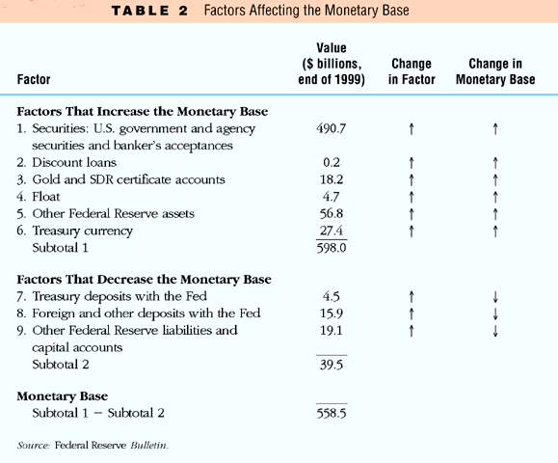
Summary: Factors that Affect the Monetary Base

Slide 145
Wizard of OZ
The Wizard of OZ as a monetary allegory
Rockoff, Hugh. 1990. "The "Wizard of Oz" as a Monetary Allegory." Journal of Political Economy, 98:4, pp. 739-60.
http://www.uno.edu/~coba/econ/projects/oz/
http://www.micheloud.com/FXM/MH/Crime/WWIZOZ.htm
http://www.ryerson.ca/~lovewell/oz.html

Slide 146
William Jennings Bryan
Bryan gave a very passionate speech and "brought the delegates to their feet howling in ecstasy with his cry toward the end: (Boller, p. 168)
“We have petitioned, and our petitions have been scorned; we have entreated, and our entreaties have been disregarded; we have begged, and they have mocked when our clamity came. We beg no longer; we entreat no more. We defy them ...! Having behind us the producing masses of this nation and the world, supported by the commercial interests, the laboring interests, and the toilers everywhere, we will answer their demand for a gold standard by saying to them: You shall not press down upon the brow of labor this crown of thorns, you shall not crucify mankind upon a cross of gold!”
http://www.americanpresidents.org/presidents/yearschedule.asp
http://www.americanpresidents.org/ram/amp082399g2.ram
At 24 minutes

Slide 147
Structure of Central Banks and the Federal Reserve System

Slide 148

First Bank of United States 1791-1811

Slide 149

Second Bank of United States 1816-1836

Slide 150
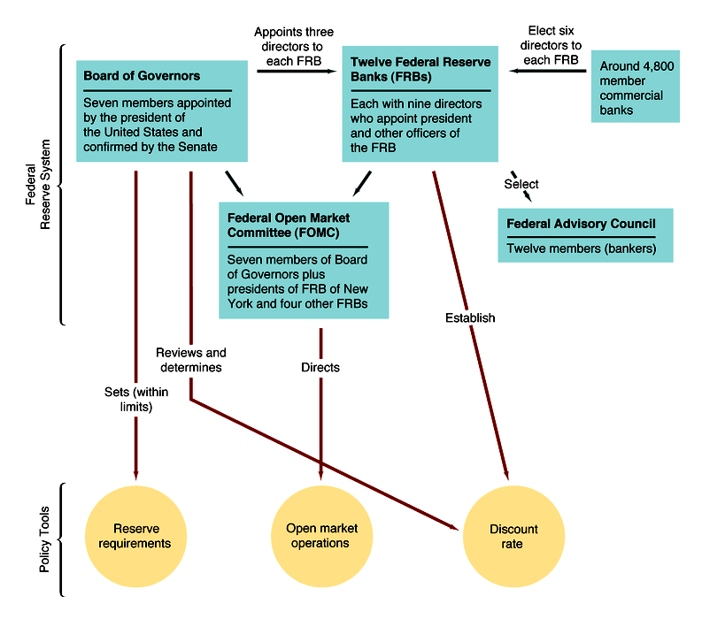
Formal Structure of the Fed
Notes:
Whats on paper

Slide 151

Federal Reserve Districts
Notes:
Note two district banks in Missouri.
Note the geographical breakdown of districts, more like historic population distribution.

Slide 152
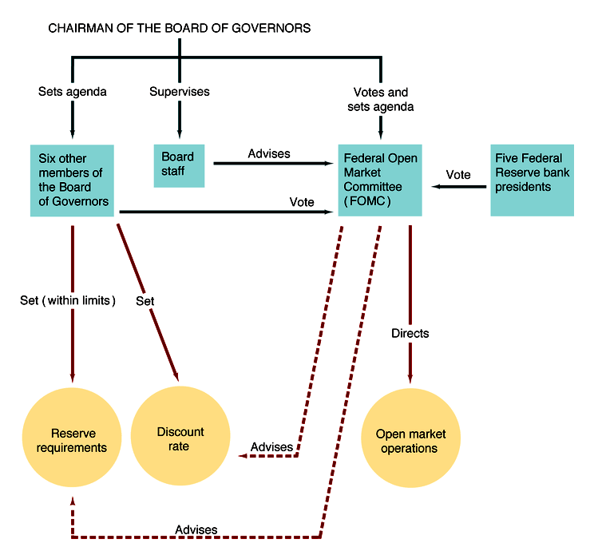
Informal Structure of the Fed
Notes:
What really happens

Slide 153
Central Bank Independence
Factors making Fed independent
1. Members of Board have long terms
2. Fed is financially independent: This is most important
Factors making Fed dependent
1. Congress can amend Fed legislation
2. President appoints Chairmen and Board members and can influence legislation
Overall: Fed is quite independent
Other Central Banks
1. Bank of England least independent: Govt. makes policy decisions
2. European Central Bank: most independent—price stability primary goal
3. Bank of Canada and Japan: fair degree of independence, but not all on paper
4. Trend to greater independence: New Zealand, European nations
Notes:
Instrument independence the ability of CB to set instruments and targets
Goal independence the ability of CB to choose and set goals

Slide 154
Explaining Central Bank Behavior
Theory of bureaucratic behavior
1. Is an example of principal-agent problem
2. Bureaucracy often acts in own interest
Implications for Central Banks:
1. Act to preserve independence
2. Try to avoid controversy: often plays games
3. Seek additional power over banks
Should Fed be Independent?
Case For:
1. Independent Fed likely has longer-run objectives, politicians don't: evidence is independence produces better policy outcomes throughout the whole
2. Avoids political business cycle
3. Less likely deficits will be inflationary
Case Against:
1. Fed may not be accountable
2. Hinders coordination of monetary and fiscal policy
3. Fed has often performed badly
Notes:
Dynamic inconsistency
http://nobelprize.org/economics/laureates/2004/prescott-interview.html

Slide 155
Central Bank Independence and
Macro Performance in 17 Countries

Slide 156
Tools of Monetary Policy

Slide 157
The Market for Reserves and the Fed Funds Rate
Demand Curve for Reserves
  1. R = RR + ER
  2. i ↓, opportunity cost of ER ↓, ER ↑
  3. Demand curve slopes down
Supply Curve for Reserves
  1. If i_{ff} is below i_{d}, then discount borrowing, R^{s} = R_{n} (non-borrowed reserves, controlled by OMO)
  2. Supply curve flat (infinitely elastic) at i_{d} because as i_{ff} starts to go above i_{d}, banks borrow more at i_{d}
Market Equilibrium
  R^{d} = R^{s} at i*_{ff}
Notes:
The focus is now on the Fed Funds rate as a short term target. The primary tool is open market operations. Since 1994 the Fed announces its target for the fed funds rate.
The fed switched to a penalty discount rate policy (where the discount rate is above the fed funds) in January of 2003.
http://www.frbsf.org/education/activities/drecon/2004/0409.html

Slide 158
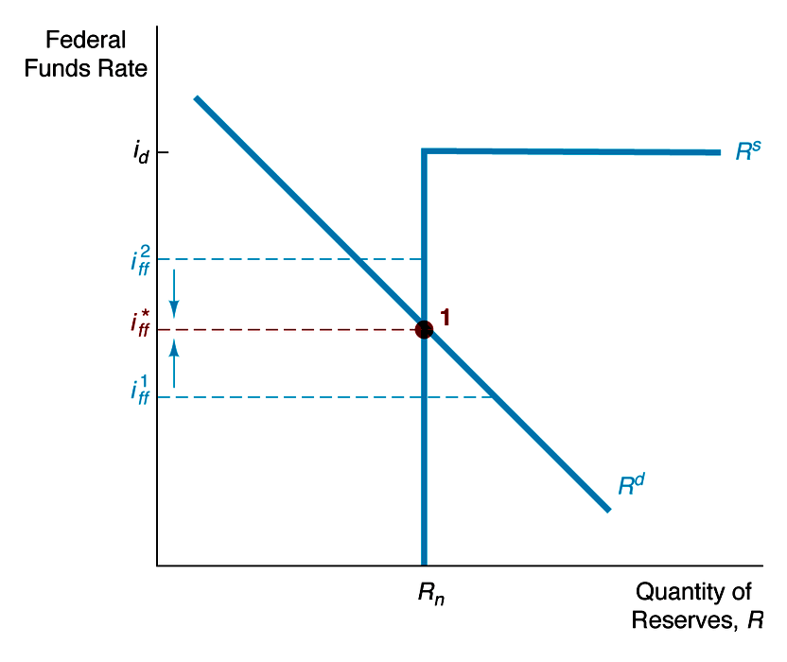
Supply and Demand for Reserves

Slide 159
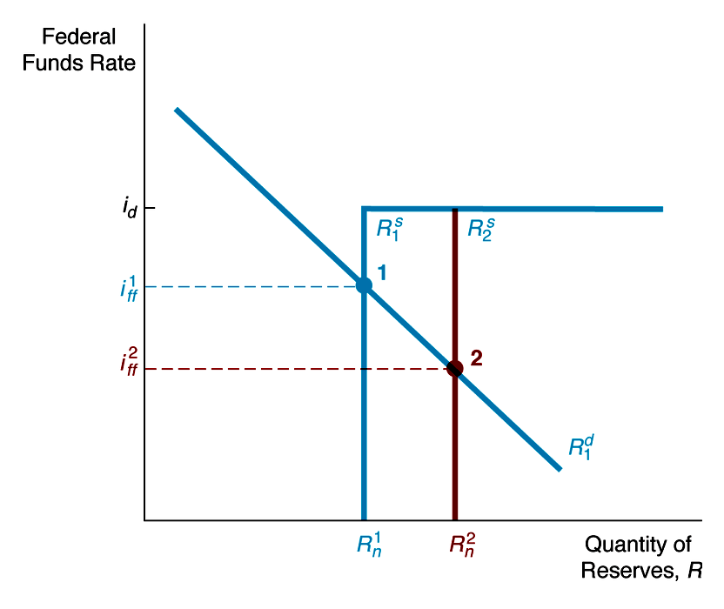
Response to Open Market Operations
Open Market Purchase
  Nonborrowed reserves, R^{n}, ↑ and shifts supply curve to right R^{s}₂: i ↓ to i²_{ff}

Slide 160
Open Market Operations
2 Types
  1. Dynamic:
  Meant to change MB
  2. Defensive:
  Meant to offset other factors affecting MB, typically uses repos
Advantages of Open Market Operations
  1. Fed has complete control
  2. Flexible and precise
  3. Easily reversed
  4. Implemented quickly

Slide 161
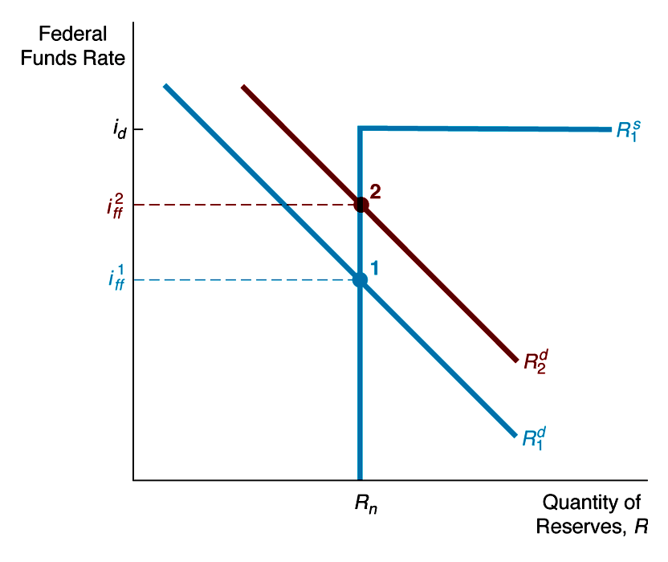
Response to Change in Required Reserves
Required reserve Requirement ↑
Demand for reserves ↑, R^{s} shifts right and i_{ff} ↑ to i²_{ff}

Slide 162
Reserve Requirements
Advantages
  1. Powerful effect
Disadvantages
  1. Small changes have very large effect on M^{s}
  2. Raising causes liquidity problems for banks
  3. Frequent changes cause uncertainty for banks
  4. Tax on banks
Proposed Reforms
  1. Abolish reserve requirements
  2. 100% reserve requirements (Milton Friedman)
    A. Advantage: complete control of M^{s}
    B. Disadvantage: Fed controls official M^{s} but not economically relevant M^{s}

Slide 163
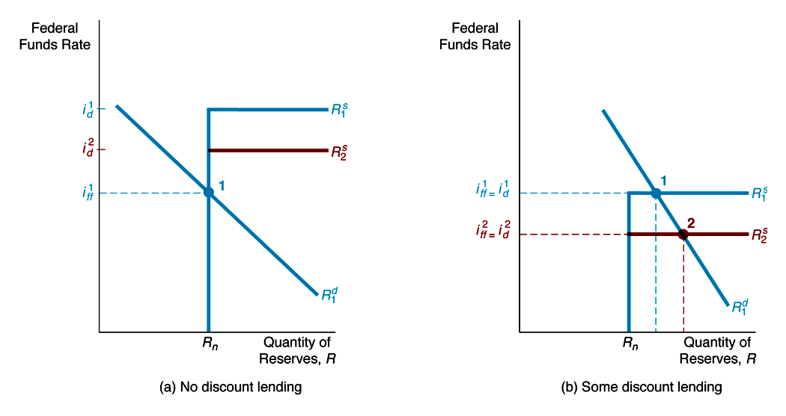
Response to a Change in the Discount Rate
(a) No discount lending Lower Discount Rate
Horizontal to section ↓ and supply curve just shortens, i_{ff} stays same
(b) Some discount lending
Lower Discount Rate
Horizontal section ↓, i_{ff} ↓ to i²_{ff} = i²_{d}

Slide 164
Discount Loans
3 Types
  1. Primary Credit
  2. Secondary Credit
  3. Seasonal Credit
Lender of Last Resort Function
  1. To prevent banking panics
  FDIC fund not big enough
  Example: Continental Illinois
  2. To prevent nonbank financial panics
  Examples: 1987 stock market crash and September 11 terrorist incident
Announcement Effect
  1. Problem: False signals

Slide 165
Discount Policy
Advantages
1. Lender of Last Resort Role
Disadvantages
1. Confusion interpreting discount rate changes
2. Fluctuations in discount loans cause unintended fluctuations in money supply
3. Not fully controlled by Fed
Proposed Reforms
1. Abolish discounting (Milton Friedman)
A. Eliminates fluctuations in M^{s}
B. However, lose lender of last resort role
2. Tie discount rate to market rate
A. i – i_{d} = constant, so less fluctuations of DL and M^{s}
B. Easier administration
C. No false announcement signals
Adopted Reforms
Penalty discount rate where Discount Rate>ff

Slide 166
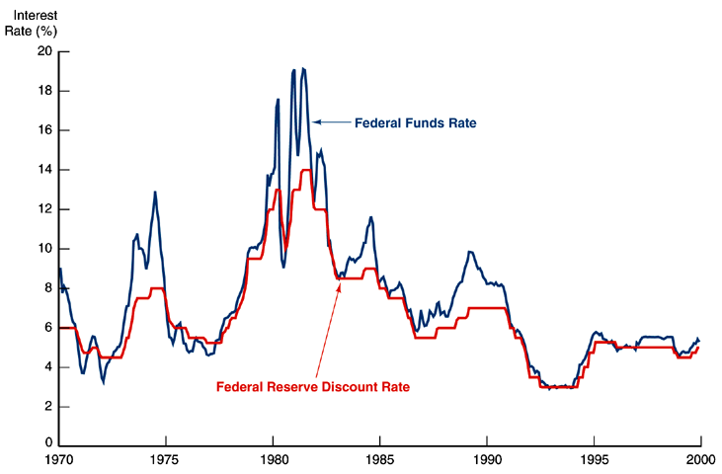
Market Interest Rates and the Discount Rate

Slide 167
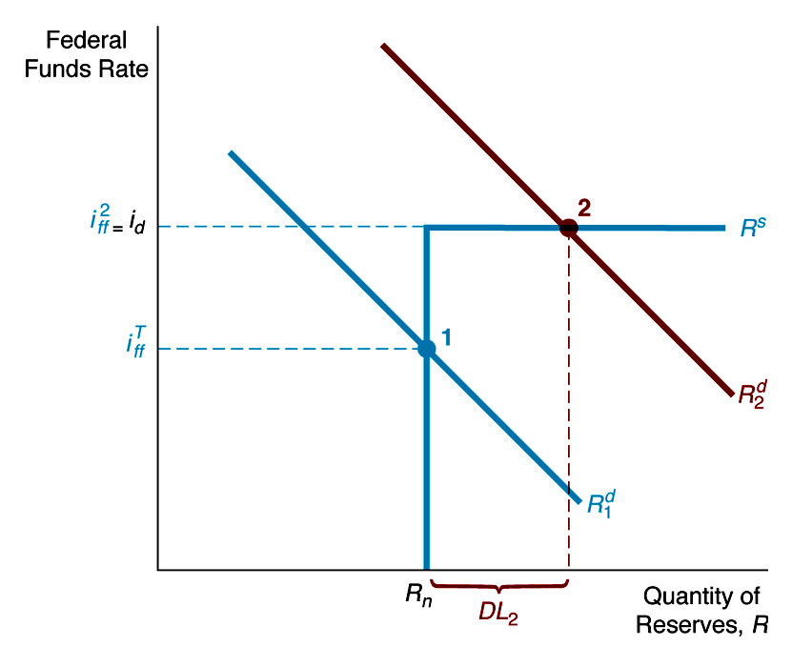
How Primary Credit Facility Puts Ceiling on i_{ff}
Rightward shift of R^{s} to R^{s}₂ moves equilibrium to point 2 where i²_{ff} = i_{d} and discount lending rises from zero to DL₂

Slide 168
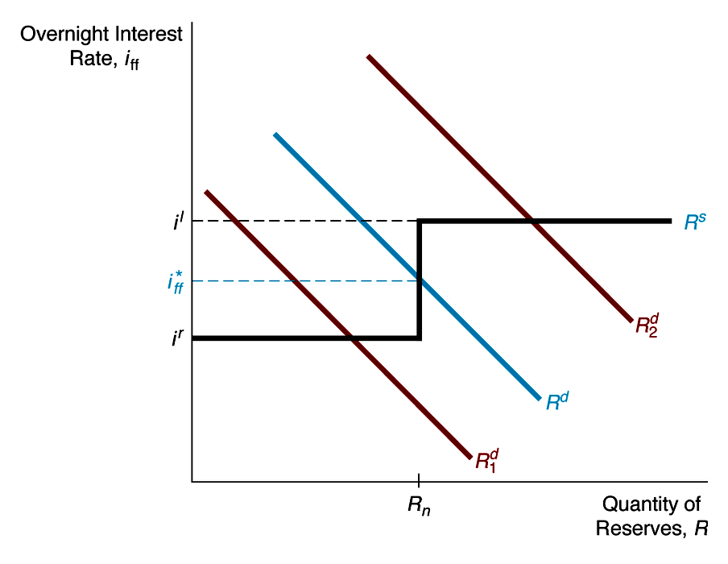
Channel/Corridor System for Setting Interest Rates in Other Countries
In the channel/corridor system standing facilities result in a step function supply curve, R^{s}. If demand curve shifts between R^{d}₁ and R^{d}₂, i_{ff} always remains between i^{r} and i^{l}
Notes:
Adopted by Canada, Australia, New Zealand all of which eliminate required reserves.
i l is the lombard rate, like the discount rate , generally 25 basis points above iff, and ir is the rate the CB pays on deposits generally 25 basis points below iff.

Slide 169
Conduct of Monetary Policy: Goals and Targets

Slide 170
Goals of Monetary Policy
Goals:
1. High Employment
2. Economic Growth
3. Price Stability
4. Interest Rate Stability
5. Financial Market Stability
6. Foreign Exchange Market Stability
Goals often in conflict
Notes:
The Fed recently discussed inflation targeting and how it might affect its choice of pursuing these goals.

Slide 171
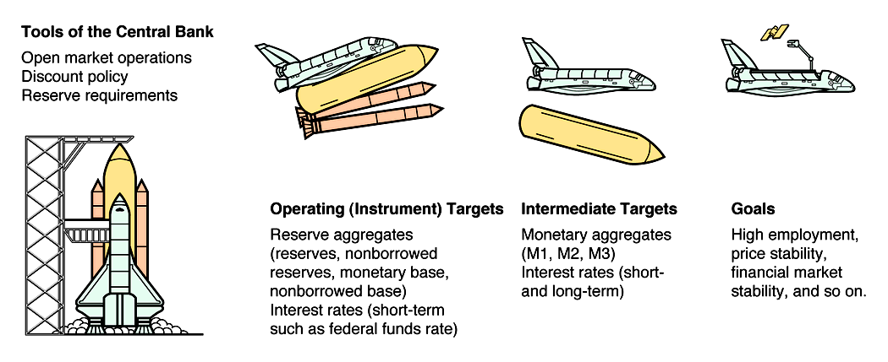
Central Bank Strategy

Slide 172

Money Supply Target
1. M ^{d} fluctuates between M ^{d'} and M ^{d''}
2. With M-target at M*, i fluctuates between i' and i''

Slide 173

Interest Rate Target
1. M ^{d} fluctuates between M ^{d'} and
M ^{d''}
2. To set i-target at i* M^{s} fluctuates between M' and M''

Slide 174
Criteria for Choosing Targets
Criteria for Intermediate Targets
1. Measurability
2. Controllability
3. Ability to predictably affect goals
Interest rates aren’t clearly better than M^{s} on criteria 1 and 2 because hard to measure and control real interest rates
Criteria for Operating Targets
Same criteria as above
Reserve aggregates and interest rates about equal on criteria 1 and 2. For 3, if intermediate target is M^{s}, then reserve aggregate is better

Slide 175
History of Fed Policy Procedures
Early Years: Discounting as Primary Tool
1. Real bills doctrine
2. Rise in discount rates in 1920: recession 1920–21
Discovery of Open Market Operations
1. Made discovery when purchased bonds to get income in 1920s
Great Depression
1. Failure to prevent bank failures
2. Result: sharp drop in M^{s}
Reserve Requirements as Tool
1. Banking Act of 1935
2. Required reserves ↑ in 1936, 1937 to reduce “idle” reserves:
Result: M^{s} ↓ and severe recession in 1937–38

Slide 176
Pegging of Interest Rates: 1942-51
1. To help finance war, T-bill at 3/8%, T-bond at 2 1/2%
2. Fed-Treasury Accord in March 1951
Money Market Conditions: 1950s and 60s
1. Interest Rates
A. Procyclical M
Y ↑ ⇒ i ↑ ⇒ MB ↑ ⇒ M ↑
π ↑ ⇒ π^{e} ↑ ⇒ i ↑ ⇒ MB ↑ ⇒ M ↑
Targeting Monetary Aggregates: 1970s
1. Fed funds rate as operating target with narrow band
2. Procyclical M

Slide 177
New Operating Procedures: 1979–82
1. Deemphasis on fed funds rate
2. Nonborrowed reserves operating target
3. Fed still using interest rates to affect economy and inflation
Deemphasis of Monetary Aggregates: 1982–Early 1990s
1. Borrowed reserves (DL) operating target
A. Procyclical M
Y ↑ ⇒ i ↑ ⇒ DL ↑ ⇒ MB ↑ ⇒ M ↑
Fed Funds Targeting Again: Early 1990s to the present
1. Fed funds target now announced
International Considerations
1. M ↑ in 1985 to lower exchange rate, M ↓ in 1987 to raise it
2. International policy coordination

Slide 178

Federal Funds Rate and Money
Growth Before and After October 1979

Slide 179
Taylor Rule, NAIRU and the Phillips Curve
Taylor Rule
  Fed funds rate target = inflation rate +
  equilibrium real fed funds rate +
  1/2 (inflation gap) +
  1/2 (output gap)
Phillips Curve Theory
  Change in inflation influenced by output relative to potential, and other factors
  When unemployment rate < NAIRU, inflation rises
  NAIRU thought to be 6%, but inflation falls with unemployment rate below 5%
  Phillips curve theory highly controversial

Slide 180

Taylor Rule and Fed Funds Rate

Slide 181

Taylor’s Rule

Slide 182
Taylor’s Rule in Early 2000’s
http://research.stlouisfed.org/publications/mt/page10.pdf

Slide 183
McCallum’s Monetary Base Rule
ΔMB*= ∏*+(10yr MA growth of Real GDP) - (4yr MA of Base velocity growth)
Where ∏*=0,1,2,3,4 percent

Slide 184

McCallum’s Rule

Slide 185
Appendix
Slides after this point will most likely not be covered in class. However they may contain useful definitions, or further elaborate on important concepts, particularly materials covered in the text book.
They may contain examples I’ve used in the past, or slides I just don’t want to delete as I may use them in the future.

Slide 186
E- Money
Closed stored value system
Open stored value system
Debit card system
Online vs. offline
Identified e-money vs anonymous e-money

