Slide 1
Attitudes & Job Satisfaction
3

Slide 2
What is the Difference Between Beliefs and Attitudes?
Beliefs: Cognitive statements without feeling
Attitude:

Slide 3
The “ABC” of Attitudes
Behaviors = actions
A________ = feeling
Stable
Attitude
Related Behaviors
Cognition = beliefs & evaluations
Moderating variables:
*Importance of the attitude
*Social pressure
*Correspondence (specificity)
between attitude and behavior
*Accessibility in memory
*Direct personal experience
Notes:
Asch line studies.

Slide 4
Important Attitudes: Involvement and Empowerment
Job Involvement:
Psychological Empowerment:
For definitions, please see your text…

Slide 5
Important Attitudes: Organizational Commitment
Organizational Commitment:
Identifying with a company and its goals, while wishing to maintain membership in the organization.
Three dimensions:
A_____________ – emotional attachment to organization
C___________ Commitment – economic value of staying
Normative Commitment – moral or ethical obligations

Slide 6
Important Attitudes: Job Satisfaction
Job Satisfaction:
A collection of feelings and beliefs that managers have about their current jobs.
Related to:
Job Involvement
Psychological Empowerment (see text for details)

Slide 7
Facets of Job Satisfaction
(measured by the Job Descriptive Index, JDI)
78
76
69
64
58
Percent Satisfied
20
Work Pay Promotion Supervision Co-Workers Overall
Itself
The JDI is a leading measure of job satisfaction. The Minnesota Job Satisfaction Questionnaire (not shown) and the “Faces” Scale (not shown) are two others.

Slide 8
Outcomes of Job Satisfaction
Job Performance
Organizational Citizenship Behavior
Customer Satisfaction
Absenteeism
For an entertaining student-made (10 min.) video about job satisfaction, see: https://www.youtube.com/watch?v=5BzBY3FaugY
Notes:
When employees are satisfied with their work, there are many positive outcomes in the workplace. However, the inverse is true as well, if employees are dissatisfied in their work, these same job outcomes will be negatively impacted.

Slide 9
Outcomes of Job Satisfaction
Turnover
Unionization
Workplace Deviance
Despite the overwhelming evidence of the impact of job satisfaction on the bottom line, most managers are either unconcerned about worker job satisfaction or they overestimate the level of worker job satisfaction.
Notes:
If a worker is satisfied in their job, they will remain in the job for a longer period of time than dissatisfied workers. However, as we have seen recently, workers are willing to stay in jobs where they are not satisfied because the job market is tight due to tough economic conditions.
Dissatisfied workers are more likely to cause problems in the workplace by stealing, absenteeism, limiting productivity, and other negative work outcomes.

Slide 10
Responses to Dissatisfaction:
Active
E_________:
Behavior with the intent of leaving the firm.
V_______:
Attempting to improve the workplace by complaining.
Destructive
Constructive
NEGLECT:
Allow conditions to get worse without telling managers; little concern for customers.
LOYALTY:
Waiting for conditions to improve.
Passive
See E X H I B I T 3–6
Notes:
When employees are dissatisfied with their jobs, they have four basic responses they can utilize. These options are divided into active and passive choices. The active options are exit and voice. If employees select to exit, they choose to leave or move in a direction of leaving the organization. In voice, the employees will work toward active and constructive attempts to improve conditions. The passive options are neglect and loyalty. Employees may choose to neglect their work and just allow conditions to worsen or they may choose to remain loyal to the organization and just wait for change.

Slide 11
Does Behavior Always Follow from Attitudes?
Leon Festinger –____________________________!
Cognitive D________________: Any incompatibility between two or more attitudes or between behavior and attitudes (See textbook, pp. 78 – 79)
Individuals seek to reduce this uncomfortable gap, or dissonance, to reach stability and consistency
How is Consistency is achieved?
Desire to reduce dissonance depends on:
Importance of elements
Degree of individual influence
Rewards involved in dissonance
For a short reading with a Ted^{x} video, see:
http://www.instructionaldesign.org/theories/cognitive-dissonance/
Notes:
Sometimes we observe people who will change what they say so it doesn’t contradict their behavior. When attitudes and behaviors don’t line up, individuals will experience cognitive dissonance. This incongruity is uncomfortable and individuals will seek to reduce the dissonance to find consistency.
People are willing to live with some discomfort but the degree to which this is true depends upon the importance of the elements, how much influences the individual has in the situation, and the rewards available.

Slide 12
Moods, & Emotions

Slide 13
A Broader View of Job Satisfaction
Traditional view:
Job Satisfaction is an attitude :
Cognitive & Evaluative
Stable
Newer view (“Affective Events Theory”):
Job Satisfaction has two parts:
Traditional Job Attitudes
____________________________
Notes:
Historically the study of organizational behavior has not given much attention to emotions. Emotions were typically seen as irrational so managers tended to work to make the workplace emotion-free.
Often managers viewed emotions as disruptive to the workplace and therefore a hindrance to productivity. However, when thinking about emotions, typically managers were focusing on negative emotions. Even though there are some negative emotions that could hinder productivity, there is no doubt that workers bring their emotions to the workplace. Therefore, any study in organizational behavior would not be complete without considering the roles of emotions in the workplace.

Slide 14
A Broader View of
Job Satisfaction
What are the differences between “Moods” and “Emotions?” (see ch. 4)
See E X H I B I T 4-1
Notes:
Affect is a generic term that covers a broad range of feelings people experience. This includes both emotions and moods. Emotions are intense feelings that are directed at someone or something. Moods are the feelings that tend to be less intense than emotions and that lack a contextual stimulus.

Slide 15
Basic Emotions:
While not universally accepted, there appear to be six basic emotions: (text, p. 106)
All other emotions are subsumed under these (some people include “contempt” as a 7th emotion). What do they look like? https://www.youtube.com/watch?v=embYkODkzcs (2 min.)
May be placed in a spectrum of emotion:
Happiness – surprise – fear – sadness – anger – disgust
For a distinction between “basic emotions” and situationally-determined “self-conscientious emotions” see: https://www.youtube.com/watch?v=MFOpa6qjDr0 (2 min).
Notes:
Not all psychologists agree; however, there do seem to be six basic emotions that emerge in studies: anger, fear, sadness, happiness, disgust, surprise. All other emotions fall under these six. Some psychologists even place these basic six on a spectrum of emotion.

Slide 16
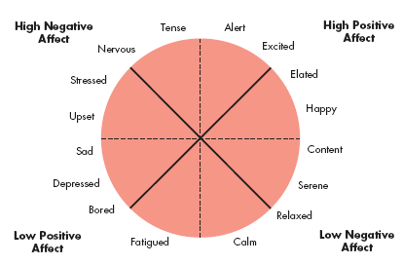
Moods:
General Mood states affect perceived reality.
Activated
Unpleasant
Pleasant
Deactivated
E X H I B I T 4-2
Notes:
Our basic moods carry positive and negative affects, they cannot be neutral. Emotions are grouped into general mood states. These states impact how employees perceive reality and thereby the moods can impact the work of employees.

Slide 17
Job Satisfaction Fluctuates Over Time, Based on Mood
See text…
For an entertaining 10 min. TEDx talk about, moods, perception, and happiness, see: https://www.ted.com/talks/shawn_achor_the_happy_secret_to_better_work

Slide 18
Emotional Labor: (See Text, Ch. 4)
What is Emotional Labor?
What is the difference between
Felt Emotions?
Displayed Emotions?
What is the difference between “surface acting” and “deep acting”?
____________________ Dissonance:
Employees are required to project one emotion while feeling another
Can be very stressful
Notes:
In many jobs there is an implied agreement on the types of emotions that should be expressed. For example, waitresses are supposed to be friendly and cheerful, whether they are currently feeling that emotion or not. When employees don’t feel the emotion they are required to express, they may experience emotional dissonance. This can lead to burnout and frustration with the job.
An employee’s actual emotions are their felt emotions and this is in contrast to the emotions that are required or deemed appropriate, which are called displayed emotions. There are two levels of displayed emotions that can be expressed. They are both appropriately called acting. Surface acting is when an employee displays the appropriate emotions even when they don’t feel those emotions. Deep acting is when the employee actually changes their internal feelings to match displayed rules; this level of acting can be very stressful.

Slide 19
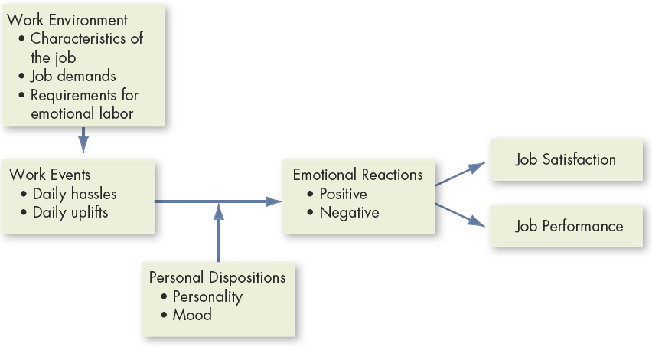
Affective Events Theory:
E X H I B I T may or may not be in your textbook…
Notes:
Affective Events Theory demonstrates that employees react emotionally to things that happen to them at work and this can influence their job performance and job satisfaction. The intensity of these responses will be based on emotion and mood.

Slide 20
What are the Implications of
Affective Events Theory?
An emotional reaction is actually the result of a series of emotional experiences triggered by a single work event
Current and past emotions affect job s__________________
Emotional fluctuations →variations in job p________________
Emotion-driven behaviors are typically brief and variable
Both negative and positive emotions can distract workers and reduce job performance
Emotions provide valuable insights about behavior
Emotions, and the minor events that cause them, should not be ignored at work; they accumulate
Notes:
Affective Events Theory (AET) has a number of implications. These implications are as follows:
When an employee has an emotional episode, it is actually the result of a series of emotional experiences that are triggered by a single event.
Your job satisfaction is impacted by current and past emotions.
As your emotions fluctuate over time, it will create variations in job performance.
Behaviors that are driven by emotions are typically brief and variable.
Both positive and negative emotions can distract workers and reduce job performance.
In summary, emotions do provide very valuable information and predict factors about behavior. In addition, it is important not to ignore minor events as they will accumulate over time.

Slide 21
Emotional Intelligence (EI):
Perceive Emotions: The ability to recognize emotions in oneself and others
Understanding Emotions: The ability to understand how emotions combine and progress
Facilitating Thought: The ability to use, and feel emotion as necessary to communicate ideas
Managing Emotions: The ability to modify feelings in oneself and others for personal understanding & growth
For sample questions on an EI test, see: http://www.businessinsider.com/forget-iq-take-yales-emotional-intelligence-test-2013-5
For a slightly different (7-dimension) model of EI and how it affects work and life, see: http://www.theeiinstitute.com/what-is-emotional-intelligence/ (11 min.)
Notes:
Emotional Intelligence (EI) is a growing area of study and is becoming increasingly important in the understanding of individual behavior. EI is pulling in one’s understanding of emotions and their impact on behavior. An individual who is emotionally intelligent will have a strong sense of self-awareness, recognizing your own emotions when experienced. They are also able to detect emotions in others. By understanding their own emotions and those of others, they can manage emotional cues and information to make decisions. Mayer et al. define EI as:
Perceive Emotions: The ability to perceive emotions in oneself and others as well as in objects, art, stories, music, and other stimuli
Facilitating Thought: The ability to generate, use, and feel emotion as necessary to communicate feelings or employ them in other cognitive processes
Understanding Emotions: The ability to understand emotional information, to understand how emotions combine and progress through relationship transitions, and to appreciate such emotional meanings
Managing Emotions: The ability to be open to feelings, and to modulate them in oneself and others so as to promote personal understanding and growth
EI plays a very important role in job performance; however, the jury is still out on the role EI plays in effectiveness in organizations.

Slide 22
Application of Emotions, Moods, & EI:
(See Text)
Selection:
Decision Making:
Negotiation:
Creativity:
Motivation:
Notes:
There are numerous applications of emotions and moods. These include selection of employees, decision making, creativity, motivation, and leadership.

Slide 23
Application of Emotions, Moods, & EI:
Customer Service:
Emotions affect service quality and customer relations.
Emotional C__________: “catching” emotions from others
Deviant Workplace Behaviors
Leadership:
Emotions affect whether workers receive & accept messages.
Leaders who are in a good mood, use humor, and praise employees increase positive moods in the workplace.
“People may forget what you said, but they will never forget how you made them feel” – John Maxwell
Notes:
Some additional applications of emotions and mood include negotiation, customer service, job attitudes, deviant workplace behaviors, and manager’s influence.

Slide 24
Summary:
Attitudes are stable judgments/ evaluations -- made up of affect, behaviors, and cognitions
Several types of attitudes affect organizational behavior.
Moods & Emotions are fleeting
Moods & Emotions influence both attitudes and behavior
Emotional Intelligence is a useful set of skills for being a manager.
Notes:
In summary, moods and emotions are important to the study of organizational behavior. Also, they are natural expressions and managers should not try to completely control the employees’ emotions, but they should be aware of the emotions and not ignore emotional indicators. This is because the more you understand the emotions of your employees, the better you will able to predict their behavior.

