Slide 1
Managing Organizational Structure

Slide 2
Overview: We will cover…
Several types of organizational structures:
Functional
Divisional
Matrix
Mechanistic vs. Organic type of structures
Factors influencing type of structure used
Strategy ▪Technology
Size ▪Environment

Slide 3
Grouping Jobs → Various Types of Organizational Structures
Functional Structure
An organizational structure composed of all the departments that an organization requires to produce its goods or services.
Examples: Finance, Marketing, Logistics, Production, Sales
Advantages?
Disadvantages?
For an optional 5 min. video about some disadvantages of Functional Structures, see https://insights.som.yale.edu/insights/can-you-work-without-silos
For a general description of Functional Structures, see the following optional 8 min. video:
https://www.youtube.com/watch?v=nf8Y2mZZ0nI

Slide 4
Divisional Structures
Divisional Structure
An organizational structure composed of separate business units within which are the functions that work together to produce a specific product for a specific customer
Divisions create smaller, manageable parts of a firm.
Divisions develop a business-level strategy to compete.
Divisions have marketing, finance, and other functions.
Functional managers report to divisional managers who then report to corporate management.

Slide 5
Types of Divisional Structures:
Product,
Geographic
Market

Slide 6
Types of Divisional Structures
P_____________ Structure
Customers are served by self-contained divisions that handle a specific type of product or service.
Allows functional managers to specialize in one product area
Division managers become experts in their area
Removes need for direct supervision of division by corporate managers
Divisional management improves the use of resources

Slide 7
Types of Divisional Structures
G_______________ Structure
Each region (or country) with customers with differing needs is served by a local self-contained division producing and/or selling products that best meet those needs.

Slide 8
Types of Divisional Structures
Market (Customer) Structure
Each kind of customer is served by a self-contained division
Example:
Business customers
Individual customers
Educational customers
Nonprofit customers
For optional videos reviewing divisional structures, see one or more of the following: https://www.youtube.com/watch?v=vSkBNv2pV8Q (3 min.)
https://www.youtube.com/watch?v=JbGLremIR3U (4 min.)

Slide 9
M______ Design Structure
An organizational structure that simultaneously groups people and resources by function and product.
Results in a complex network of superior-subordinate reporting relationships.
Advantage: The structure is very flexible and can respond rapidly to the need for change.
Disadvantage: Each employee has two bosses (functional manager and product manager) and possibly cannot satisfy both.

Slide 10
Matrix Structure (See Exhibit 15-5)
Want to learn more? You might enjoy these optional videos:
https://www.youtube.com/watch?v=lA-g2S1P2o4 (5 min.)
https://www.youtube.com/watch?v=iKArFiYfXWQ (9 min.)
https://www.youtube.com/watch?v=dT2tXv33lxQ (2 min.)

Slide 11
Dimensions of Organizational Structure
Complexity
Vertical: The number of different levels in the firm.
Horizontal: The number of different jobs at the same level.
Centralization of Authority
S______ of C___________: How many employees a manager supervises

Slide 12
Vertical Complexity: Tall and Flat Organizations
Tall structures have many levels of authority and narrow spans of control.
As hierarchy levels increase, communication gets difficult creating delays in implementing decisions.
Communications can also become garbled as it is repeated through the firm.
Flat structures have fewer levels and wide spans of control.
Structure results in quick communications but can lead to overworked managers.

Slide 13
Flat vs. Tall Organizations

Slide 14
Complex structures often require Integrating Mechanisms
Direct Contact: Two managers meet to discuss coordination
Liaison Role: Person has job of coordinating work between two depts.
Task Force/Cross-functional Team: People from multiple depts work together on temporary project.
Matrix Organization: Every person works for both functional dept and specific cross-functional projects.
Simple
Complex

Slide 15
Mechanistic vs. Organic Organizations (Burns & Stalker)
Characteristic | Mechanistic | Organic
Specialization | High | Low
Locus of Authority/ Centralization: | Top of Hierarchy | Middle of Hierarchy
Conflict resolution: | Rules, Supervisor | Informal Discussion
Communication: | Directions, Orders Feedback, Info. | Discussion; horizontal & diagonal info.
Primary loyalty: | To the organization | To the project & group
Status is based on: | Position in hierarchy | Expertise, competence
Formalization: | High | Low
Best type of environment | Stable environment | Changing environment
Notes:
Want to learn more?
Try this application exercise (if you have time; not required for the exam):
Go look at some articles about ZipCar. What type of organizational structure does it have? Is it closer to a Mechanistic or an Organic structure? Justify your position.
Supplemental video: https://www.youtube.com/watch?v=XfheAAlVBH0 (8 min.)

Slide 16
Max Weber’s Principles of Bureaucracy
Mechanistic Firms are often
Bureaucracies
Max Weber’s Principles of Bureaucracy:
Organization has a system of written rules and Standard Operating Procedures (SOPs) that specify how workers should behave in most situations.
Clear hierarchy of authority within the organization.
Personnel systems (e.g., hiring, performance appraisal, reward systems) are fair and equitable.
Clear system of task and role relationships between jobs. Workers understand how their job relates to other jobs in the organization.

Slide 17
Mechanistic Firms are often Bureaucracies (text, pp. 517-518)
Strengths
Weaknesses
Notes:
Bureaucracies have both strengths and weaknesses. They tend to offer economies of scale that are beneficial to the organization. This structure will minimize duplication of personnel and equipment through organization of jobs and departments. Communication will be strong and decision making is centralized. However, this type of structure is not without its weaknesses. In a bureaucratic environment, conflict often arises around organizational goals and unit goals, people can become obsessive about rules and regulations, and employees don’t always know how to deal with problems because employees are not empowered to make decisions.

Slide 18
Four Factors influence Organizational design choice
See Exhibit 15-10 & pp. 526-532 of your textbook…

Slide 19
Strategy, Size and Organizational Design
Strategy
Low-Cost (Cost minimizing) Strategy
Differentiation & Innovation Strategy
Size: Larger
organization
______________ Structure
______________ Structure
Mechanistic Structure
See Exhibit 15-8

Slide 20
Technology & Structure (Woodward)
Type of Technology | Best Type of Structure
Small Batch | Organic
Large Batch & Mass Production | Mechanistic
Continuous Process | Organic

Slide 21
Contingency Theory: Matching the firm’s structure with its environment
Environmental Characteristics | Highly Dynamic | Low in Dynamism
Highly Complex | Complex and Changing | Complex and Stable
Low in Complexity | Simple and Changing | Simple and Stable

Slide 22
Environment Affects Decision Making
Environments that are complex and changing (high dynamism and high complexity) create high levels of uncertainty among managers making decisions.
Scarcity also adds to the uncertainty.
Simple & Stable environments create low levels of uncertainty.
These, in turn, shape the ideal structure

Slide 23
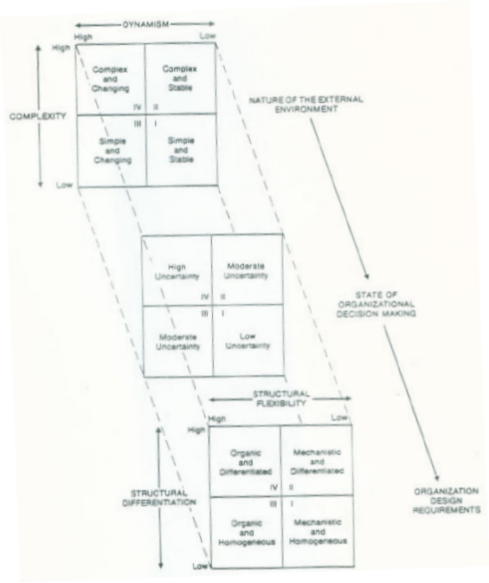
Dynamism
Contingency Theory
High
Low
High
Complex and Changing
Complex and
Stable
Nature of the External Environment
Complexity
Simple and Changing
Simple
and
Stable
*Complex, changing environments are best served by organic and highly differentiated (complex) organizational structures.
*Simple environments need mechanistic and homogeneous organizational structures
Low
High Uncertainty
Moderate Uncertainty
State of Organizational Decision Making
Moderate Uncertainty
Low Uncertainty
Structural Flexibility
High
Low
High
Organic
And
Differentiated
Mechanistic
And
Differentiated
Structural Differentiation
Organic
And
Homogeneous
Mechanistic
And
Homogeneous
Organizational Design Requirements
Low

Slide 24
New Design Options: “Boundaryless” (Team-based) Organization
Variation on Organic structure:
Self-managed, empowered work teams
Teams report to HQ; thus little “chain of command.” Flat hierarchy
Cross-hierarchical teams
360-degree feedback
Organized around processes, not functions, customers, or geography
Requires coordinating mechanisms
Examples: Semco, Oticon, Xerox

Slide 25
New Design Options: Virtual Organization
A small, core organization that outsources major business functions
Highly centralized with little departmentalization
Provides maximum flexibility while focusing on what the business does best.
Reduced control over parts of the business.
E X H I B I T 15-6
Notes:
Virtual organizations are developing as acceptable organizational structures. This structure offers a small core organization that outsources many of its major functions to competent suppliers. Virtual organizations are highly centralized with virtually no departmentalization to provide maximum flexibility, focusing on what the organization does best. This type of organization reduces control over some of the key parts of the business.

Slide 26
Summary
Managers must decide how to structure firms
Different theories help us understand different types of organization structures
Burns & Stalker’s “Mechanistic v. Organic” Model
Several factors influence type of structure:
Strategy
Size
Woodward’s Typology of Technologies
Environmental Contingencies
For slide-based reviews of these topics (from different textbooks and other universities; not always identical to MGT 308) see these optional videos:
https://slideplayer.com/slide/4255453/ (11 min.)
https://slideplayer.com/slide/9109889/ (11 min.; text outline provided.)
http://drisauraflores-busi-4940-businesspolicy.com/creating-effective-organizational-designs/

