Slide 1
Human Resource Management
For a simple overview case study (the Holden automotive company of Australia; a GM subsidiary) where HR is important, see the optional Murphy Library “films on demand” database video: http://fod.infobase.com.libweb.uwlax.edu/p_ViewVideo.aspx?xtid=35946&loid=40878&tScript=0# (HR Segment: 5 min.; entire video: 30 min.)

Slide 2
Learning Objectives
After studying the chapter, you should be able to:
List the major laws affecting Human Resource (HR) Management
Understand the functions of HR Management.
Explain why HR management gives an organization a competitive advantage.

Slide 3
The Legal Environment of HRM: Laws Impacting HR Managers
National Labor Relations Act & related “Labor & Employment Relations” laws
Occupational Safety & Health Act
Family & Medical Leave Act
Wage & Overtime Laws
Equal Employment Opportunity laws

Slide 4
Components of a Human Resource Management System
Interrelated Components:
Recruitment & Selection
Human Resource Development & Training
Performance Appraisal
Compensation & Benefits
Labor & Employment Relations

Slide 5
Human Resource Planning + Job Analysis = Staffing Needs
Human Resource Planning (HRP)
Managers predict their current and future needs for human resources.
HRP must be done prior to recruitment. It may lead to a decision to “Outsource” rather than hire.

Slide 6
Human Resource Planning
Demand forecasts
Estimates of the number and qualifications of employees the firm will need.
Supply forecasts
Estimates of the availability and qualifications of current workers and those in the labor market.
Want more information on Human Resource Planning? Then watch this optional slide-based video: https://www.youtube.com/watch?v=i1vekH53t2E (5 min.) [It has more detail than you need for MGT 308, but if you are eager to learn more, this is a good start…]

Slide 7
Job Analysis
Job Analysis: Identifying the tasks, & duties that make up a job and the knowledge, skills, and abilities needed to do the job.
What are some typical job analysis methods?

Slide 8
Job Descriptions & Job Specifications
Job Analysis typically leads to both a written
Job description
Job specification
What is the difference in these two documents?
For more about Job Analysis, Job Descriptions, and/or Job Specifications, see one of the following optional videos:
https://www.youtube.com/watch?v=51xgYK9PTKY (6 min.)
https://www.youtube.com/watch?v=G1-FJpPnSFY (5 min.)
https://www.youtube.com/watch?v=jsHC15xh43A (5 min.)
https://www.youtube.com/watch?v=Zr6cnQfDtjk (6 min.)
https://www.youtube.com/watch?v=D2_U_vsfr6I (8 min.) (also relates these to job design, which we covered in previous chapters)

Slide 9
Job Analysis forms a foundation…
Job Analysis
Job Specification → Selection
Training
Criterion Development
→
Performance Appraisal
Job Evaluation →Compensation

Slide 10
Recruitment & Selection
External Recruiting
Seeking outside the firm for people who have not worked at the firm previously.
Internal Recruiting
Seeking to fill open positions with
current employees from within the firm.
Benefits of internal recruiting?

Slide 11
Traditional Recruiting & Realistic Job Previews (text, pg. 589)
What is the difference?
What are the advantages of each?

Slide 12
Selection Tools (text, pp. 586 – 591)
Types of Selection Methods
Background Information / Application Blanks
Reference Checks
Paper-and-pencil (or Online) Employment Tests Cognitive Ability Tests Personality Tests Integrity Tests Situational Judgment Tests
Physical Ability Examinations
Work Sample / Performance Tests / Assessment Centers
Job Interviews Structured vs. Unstructured Interviews Individual vs. Panel / Group Interviews

Slide 13
The Selection Process
E X H I B I T 17-1
Notes:
As we saw in the previous chapter on culture, the decision about whom to hire is a very important one. The chart in this slide helps to outline a process by which to hire someone. There are three levels outlined – initial selection, substantive selection, and contingent selection – during each selection step, the applicant pool gets smaller and smaller and the criteria of moving to the next level gets more and more difficult. Let’s look at these steps in more detail.

Slide 14
Reliability and Validity
Selection tools must be reliable and valid.
Reliability is the degree to which the tool measures the same thing each time it is used.
Example: scores should be similar for the same person taking the same test over time.
Validity is the degree to which the test measures what it is supposed to measure
Example: how well a physical ability test predicts the job performance of a firefighter.

Slide 15
Training and Development
Training
Teaching organizational members how to perform current jobs and helping them to acquire the knowledge and skills they need to be effective performers.
Development
Building the knowledge and skills of organizational members to enable them to take on new duties and challenges.

Slide 16
Training and Development
Needs Assessment
An assessment of which employees need training or development and what type of skills or knowledge they need to acquire.

Slide 17
Training and Development
Training Methods:
Training (to improve performance in current job) |  |  |  | Development (to prepare for future jobs or careers)
Typical methods |  |  |  | Typical methods
On-the-job training and coaching | Hybrid approaches (includes both OTJ & classroom instruction) *Internship *Apprentice | Classroom instruction, Internet-based training, & computer-based training. |  | Formal Education | On-the-job training and coaching | Hybrid approaches (includes both OTJ & classroom instruction) *Internship *Apprentice | Classroom instruction, Internet-based training, & computer-based training.

Slide 18
Types of Training & Development Programs (text, pp. 591-593)
Basic _________ Skills
T_____________ Skills
I______________ Skills
P_____________ Skills
Health & Wellness
Civility Training
Business Ethics
Notes:
Once an employee is hired, it is important that they receive ongoing training and development while employed. Some different types of training programs include the following: Basic literacy skills training is a program that might be necessary because ½ of U.S. high school graduates do not have the basic skills necessary for work.
Technical skills training focuses on training for technical skills needed on the job.
Interpersonal skills training will help to enhance listening, communication, and teamwork.
Problem-solving skills training may help to sharpen the logic and reasoning capabilities of the workforce, which will assist in developing solid decision-making techniques.

Slide 19
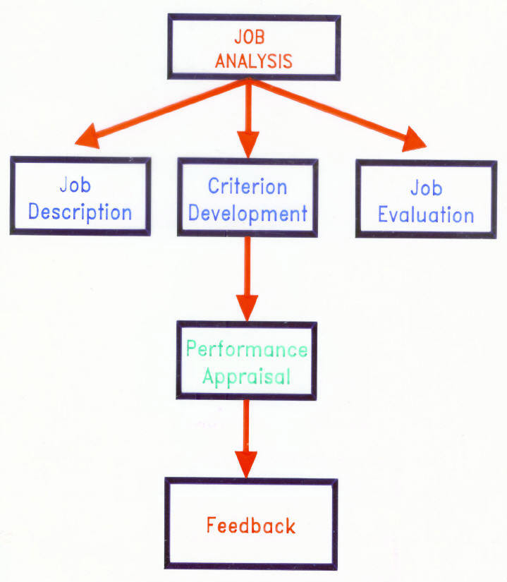
Performance Appraisal & Feedback
Note: Figure is not in Robbins and Judge textbook. Created by F. Ghouse for Prof. Ross.

Slide 20
Types of Criteria Used for Performance Appraisal
Global: There is one overall dimension of job performance.
Composite: Several dimensions of job performance are given weights and combined into an overall score.
Multiple: Criteria are independent and of interest in their own right; therefore, they are kept separate.

Slide 21
Performance Appraisal and Feedback
Performance Appraisal
The evaluation of employees’ job performance and contributions to their organization.
Performance Feedback
The process through which managers share performance appraisal information, give subordinates and opportunity to reflect on their own performance, and develop, with subordinates, plans for the future.

Slide 22
Performance Appraisal and Feedback (text, pp. 595-597)
What is the difference in the following?
Advantages / Disadvantages of each?
Trait Appraisals
Behavior Appraisals
Results/Outcomes appraisals

Slide 23
Performance Appraisal and Feedback
Objective appraisals
Assesses performance based on facts (e.g., sales)
Subjective appraisals
Assessments based on a manager’s perceptions of traits, behavior, or results.
G_________ rating scales are the most common method

Slide 24
Subjective Measures of Performance: Graphic Rating Scale (text, pp. 598-599)
What is a “Graphic Rating Scale?” What are its strengths and weaknesses?

Slide 25
Graphic Rating Scales are Prone to Rater Errors
Between-Person Rater Errors:
Leniency & Harshness Errors
Central Tendency
Contrast Effects
Within-Person Rater Errors:
First Impression (Primacy) & Recency Effects
Halo (vs. Horns)
Similar-to-me
Logical Category
For an animated optional video about some of these errors, see: https://www.youtube.com/watch?v=jCPaQuY-ejg (10 min.)

Slide 26
Methods to Combat Rater Error:
Between-Person (Between-Subject):
Rank Workers
Forced Distribution
Pair Comparison
Within-Person (Within-Subject):
Forced Choice Scale: Rater picks between two “good” statements; only one reflects good work.
Management by Objectives (MBO)
B___________ A_________ R_______ S________ (BARS)
Behavioral Observation Scale (BOS)

Slide 27
Subject Measures of Performance: Behaviorally Anchored Rating Scale
What are Behaviorally Anchored Rating Scale (“BARS)?”
What are the strengths and weaknesses of this approach?
What are Behavioral Observation Scales (“BOS”)?
What are the strengths and weaknesses of this approach?
For information about Graphic Rating Scales and BARS, see:
http://open.lib.umn.edu/humanresourcemanagement/chapter/11-2-appraisal-methods/
For a brief definition of Behavioral Observation Scales, see:
http://www.oxfordreference.com/view/10.1093/oi/authority.20110803095456852

Slide 28
Who Appraises Performance?
What are the advantages and disadvantages of self-appraisals?
What is the “360-degree evaluation & feedback” procedure?
Have you ever worked for a company that used 360-degree evaluations?
What are the strengths and weaknesses of this procedure?
See Exhibit 17-2 and accompanying text, pg. 597-598.

Slide 29
Effective Performance Feedback
Formal appraisals
An appraisal conducted at a set time during the year and based on performance dimensions that were specified in advance
Informal appraisals
An unscheduled appraisal of ongoing progress and areas for improvement
What are other methods identified by your textbook for improving performance evaluations?

Slide 30
Effective Feedback Tips
Be specific and focus on correctable _______. Provide a suggested improvement.
Focus on problem-solving and improvement, not criticism.
Express confidence in worker’s ability to improve.
Use both formal and informal feedback.
Treat subordinates with respect and praise achievements…
Set a timetable for agreed changes.
For a review ppt. lecture about performance appraisal (with far more detail than you need for MGT 308), watch this optional video: https://www.youtube.com/watch?v=iNvsTU__ANo (35 min.)

Slide 31
Pay and Benefits
Pay level
The relative position of an organization’s incentives in comparison with those of other firms in the same industry employing similar kinds of workers
Managers can decide to offer low, average or high relative wages.
High wages attract and retain high performers but raise costs; low wages can cause turnover and lack of motivation but provide lower costs.

Slide 32
Pay and Benefits
Pay Structure
The arrangement of jobs into categories based on their relative importance to the organization and its goals, level of skills, and other characteristics.

Slide 33
Pay and Benefits
Benefits
Legally required: social security, workers’ compensation
Voluntary: health insurance, retirement, day care
Cafeteria-style benefits plans allow employees to choose the best mix of benefits for them; can be hard to manage.

Slide 34
Work-Life Balance (text, Exhibit 17-4)
What are FIVE broad strategies for enhancing work-life balance for employees?
What are three specific approaches within each strategy?

Slide 35
Labor Relations
Labor Relations
The activities managers engage in to ensure they have effective working relationships with the labor unions that represent their employees interests.
Laws regulating areas of employment.
Fair Labor Standards Act (1938) prohibits child labor, sets a minimum wage and maximum working hours.
Equal Pay Act (1963) men and women doing equal work will get equal pay.
Work Place Safety (1970) OSHA mandates procedures for safe working conditions.

Slide 36
Unions
Represent worker’s interests to management in organizations.
The power that a manager has over an individual worker causes workers to join together in unions to try to prevent this.
Unions are permitted by the National Labor Relations Act (1935) which also created the NLRB to oversee the relationship between employers and unions.
Not all workers want unions. Union membership costs money in dues and workers might not want to strike.
Union membership is lower today than 40 years ago.

Slide 37
Unions
Collective bargaining
Negotiation between labor and management to resolve conflicts and disputes about issues such as working hours, wages, benefits, working conditions, and job security.
The process that unions and management go through to negotiate work agreements that are included in a contract which spells out agreed-upon terms such as the grievance procedure for resolving differences between the union and management over management’s administration of the contract.

Slide 38
The Leadership Role of HR (text, pp. 603-610)
How do/should Human Resource Managers show a leadership role in business organizations?

Slide 39
Summary
Managers must understand HR functions:
HR Planning & Job Analysis
Recruiting & Selection
Human Resource Development & Training
Performance Appraisal
Compensation & Benefits
Labor & Employment Relations
These functions should work together to
Minimize legal liability
Maximize a businesses’ effectiveness.
For an optional video (with case studies of Shell Oil and Intrepid Travel), reviewing the various functions of HR, see the following Murphy Library “Films on Demand” database film entitled, “Human Resources Function” (31 min.):
http://fod.infobase.com.libweb.uwlax.edu/p_ViewVideo.aspx?xtid=40230&tScript=0

